Slide 1

Pygame
Christopher Frost and David Nizzardo

Slide 2
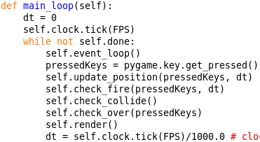
Mainloop
This is the loop that executes every frame
Every frame we:
Check if the players exited out of the game (self.event_loop())
Update the positions of players and hazards based on player inputs
Check if the players fired
Check collisions between players and hazards
Check if the game is over
Render the frame

Slide 3
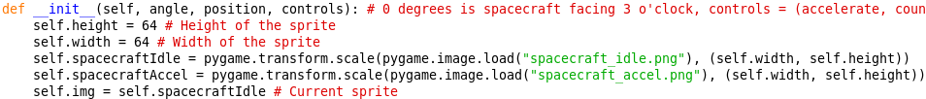

Rendering
Each class loads in an image and scales it down to a smaller size
Each class had a list called position that has its x and y coordinates
Eg. position = [100, 635]
To render an image, use the surface.blit() function
Parameters are the image, and the coordinates

Slide 4
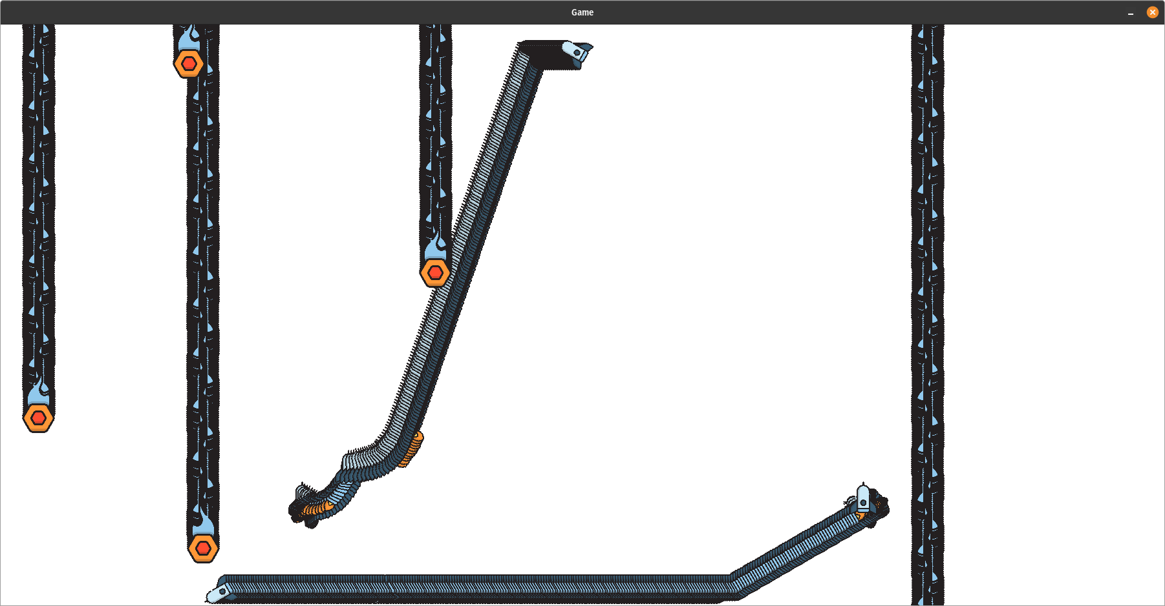
Rendering
surface.blit() only draws an image, it doesn’t erase the previous image
Solution: “Erase” the previous images by drawing the background at the beginning of each frame

Slide 5
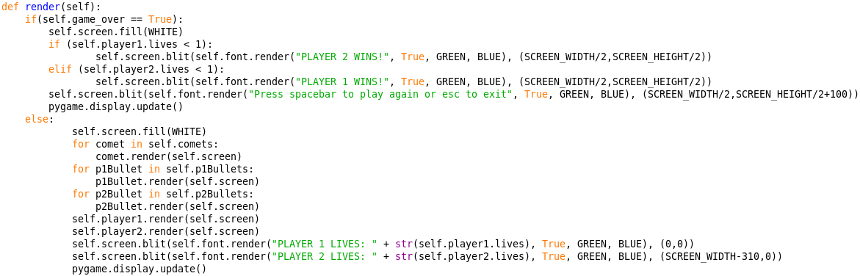
Rendering

Slide 6

Rendering
Some quirks
Position is the coordinates of the top left corner of the image, not the center
To put an image in the center:
position = [(SCREEN_WIDTH - self.width) / 2, (SCREEN_HEIGHT - self.height) / 2]
Top left corner of the screen is [0, 0] and bottom right corner is [SCREEN_WIDTH, SCREEN_HEIGHT]
x increases going to the right
y increases going down (not up)

Slide 7
Movement
Say we want an object moving to the right
Initialize:
self.velocity = [10, 0]
self.position = [0, 0]
Run every frame:
self.position[x] += self.velocity[x]
self.position[y] += self.velocity[y]
surface.blit(self.img, self.position)
Works, but there is one problem
The distance moved every second is dependent on the frame rate

Slide 8
Movement
At 5 fps:
Object moves at 10ppf * 5fps = 50 pixels a second
At 10 fps:
Object moves at 10ppf * 10fps = 100 pixels a second
How do we solve this?
Record the time that has passed since the last frame (dt)
Remember from the mainloop?

Slide 9
Movement
Object moving to the right with dt
Initialize:
self.velocity = [10, 0]
self.position = [0, 0]
Run every frame:
self.position[x] += self.velocity[x] * dt
self.position[y] += self.velocity[y] * dt
surface.blit(self.img, self.position)

Slide 10
Movement
At 5 fps:
dt = 0.2 seconds
10 * 0.2 = 2 pixels per frame
2ppf * 5fps = 10 pixels per second
At 10 fps:
dt = 0.1 seconds
10 * 0.1 = 1 pixel per frame
1ppf * 10fps = 10 pixels per second

Slide 11
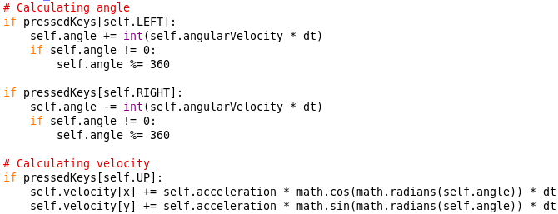
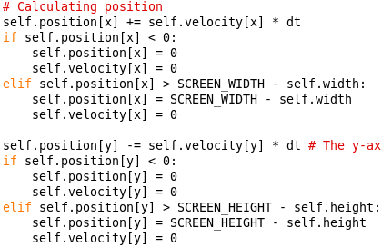
Movement: player.py

Slide 12
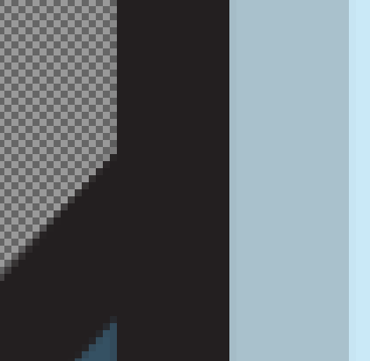
Collision Detection
First idea: Check if certain pixels of a sprite is overlapping with pixels of another sprite
Pro: Very accurate
Con: SLOW
Do we need pixel perfect collision?
No

Slide 13


Collision Detection
Second idea: Use the distance formula
spriteCenter = (self.position[x] + self.width, self.position[y] + self.height)
x = spriteCenter[x], y = spriteCenter[y]
d = math.sqrt(math.pow(x2 - x1, 2) + math.pow(y2 - y1, 2))
If d < THRESHOLD:
Better, but sqrt() is not exactly fast
d

Slide 14
Collision Detection
Third idea: Define a hitbox, and check if the edges of the hitbox is in the area covered by another hitbox
Hitbox is a rectangle, can be defined by two coordinates
Class Rect:
x1
y1
x2
y2
(x1, y1)
(x2, y2)

Slide 15
Collision Detection
xMatch = (rect2.x2 > rect1.x1 and rect2.x2 < rect1.x2) or
(rect2.x1 > rect1.x1 and rect2.x1 < rect1.x2)
yMatch = (rect2.y2 > rect1.y1 and rect2.y2 < rect1.y2) or
(rect2.y1 > rect1.y1 and rect2.y1 < rect1.y2)
xMatch and yMatch
Much faster to calculate, but not foolproof
rect2 must be the smaller object

Slide 16
Collision Detection
Another problem: If an object is too fast or the frame rate is too low, objects can “teleport” through each other
If the frame rate is too low, get faster hardware
For fast projectiles, define an collision area that lasts for a time t
If object is in that area, it is hit
Hitscan in shooter games
Frame n
Frame n+1

