Slide 1


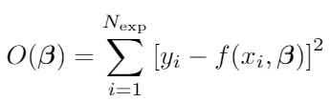


Experimental stress-strain response:
Simulated stress-strain response:
stress data
fitting parameter vector
strain data
strain data
rewrite
Objective function:
Optimal parameters:
Herrera-Solaz, V., J. LLorca, E. Dogan, I. Karaman, and J. Segurado. ‘An Inverse Optimization Strategy to Determine Single Crystal Mechanical Behavior from Polycrystal Tests: Application to AZ31 Mg Alloy’. International Journal of Plasticity 57 (1 June 2014): 1–15. https://doi.org/10.1016/j.ijplas.2014.02.001.

Slide 2

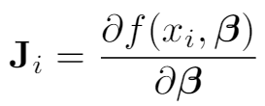
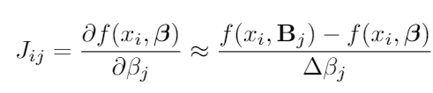







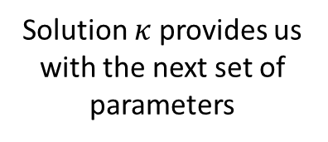
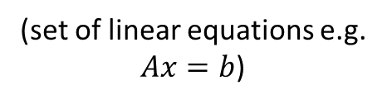
Consider effect of small perturbation of the parameter set:
(approximated through linearisation)
(we actually approximate $J$)
$i$^{th} row of Jacobian matrix:
Objective function now:
becomes
Set to zero derivative wrt $κ$:
(set of linear equations e.g.
$Ax=b$)
Scaler damping factor (we try three, and take solution with minimum error)
Solution $κ$ provides us with the next set of parameters

