Slide 1
MatFlow Introduction
2021.03.05

Slide 2

What is MatFlow?
Open-source Python Code for computational materials science
Runs on HPC system (CSF at Manchester)
Users specify some tasks to run in a workflow (YAML file)
Main output is a workflow HDF5 file
Results can be examined/plotted/analysed further locally using a locally installed copy of MatFlow
Aims are:
Making reproducibility and transparency require less effort (can cite the HDF5 file in your paper)
Connecting disparate software via extensions (proprietary and open-source)
Making comparisons easier (the same scientific objective can often be achieved in distinct ways)

Slide 3
MatFlow Installation
Installation on the UoM’s CSF
The “installation repository” on GitHub gives CSF installation instructions and contains all of our (LightForm’s) workflows: https://github.com/LightForm-group/UoM-CSF-matflow/
This repository is synchronised to the shared RDS space on the CSF: /mnt/eps01-rds/jf01-home01/shared/matflow
Installing Matflow (on UoM CSF): pip install --user matflow
Installing Matflow extensions (on UoM CSF): pip install --user matflow-damask
Installation adds some executables to your PATH, primarily: matflow and hpcflow
Test with: matflow validate
Getting help with MatFlow - LightForm Wiki (lightform-group.github.io)

Slide 4

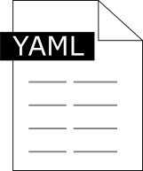




MatFlow Usage
Using MatFlow
MatFlow installation on a cluster
matflow go profile
MatFlow extensions
matflow-DAMASK
Profile
Schemas
Software
matflow-MTEX
workflow.hdf5
matflow-DefDAP
Profile file
Machine-agnostic
Task list
Resource options (e.g. num. cores)
MatFlow
matflow-formable
Auto-archiving
Cloud storage
Public data repositories (via DataLight)
Schemas file
Machine-agnostic
Defines available tasks
Defines commands to run
Links tasks to the extension packages
Software file
Machine-specific
Defines environment to be loaded
Defines software executable names
Further analysis
DOI

Slide 5
MatFlow Usage
Command line interface
Setting up
Validate schemas/extensions | matflow validate
Authorise Dropbox archive | matflow cloud-connect --provider dropbox
See list of available commands | matflow --help
See MatFlow version | matflow --version
Generating and running workflows
Set up a workflow | matflow make profile.yml
Set up and run a workflow | matflow go profile.yml
Create workflow directory
Profile
Modifying workflows
Kill a running workflow | matflow kill /workflow/directory

Slide 6
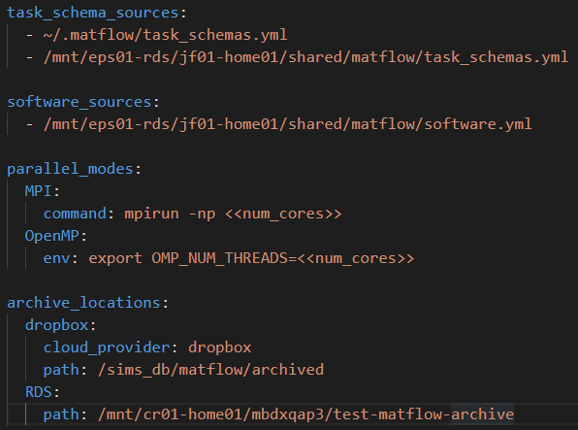
Configuration file
~/.matflow/config.yml
Where will MatFlow find schemas?
Where will MatFlow find software definitions?

Slide 7
Anatomy of a workflow
Workflows are two-dimensional
Workflow profiles are YAML files that contain (at least):
a name
a list of tasks
Elements
name: my_workflow
stats: false
run_options:
num_cores: 1
l: short
tasks:
- name: generate_microstructure_seeds
method: random
software: damask
base:
grid_size: [8, 8, 8]
sequences:
- name: num_grains
vals: [2, 4]
Task 1
Workflow progression
Task 2
Task 3

Slide 8
Anatomy of a task schema
In the task schemas file…
Inputs
Outputs
Commands
Input map: converts Matflow inputs into files that the software understands
Output map: converts files from software into Matflow outputs
- name: visualise_volume_element
inputs:
- volume_element
methods:
- name: VTK
outputs:
- __file__VTR_file
implementations:
- name: damask
input_map:
- inputs:
- volume_element
file: geom.geom
commands:
- command: geom_check
parameters: [geom.geom]
In the workflow tasks list…
- name: visualise_volume_element
method: VTK
software: damask
In this input map example, we want to visualise a volume element using the processing tools built in to DAMASK. To do this, we need to generate an input file that DAMASK expects – using an input map
In the matflow-damask extension package…
@input_mapper('geom.geom', 'visualise_volume_element', 'VTK')
def write_damask_geom(path, volume_element):
write_geom(volume_element, path)
See here for building a matflow extension

Slide 9
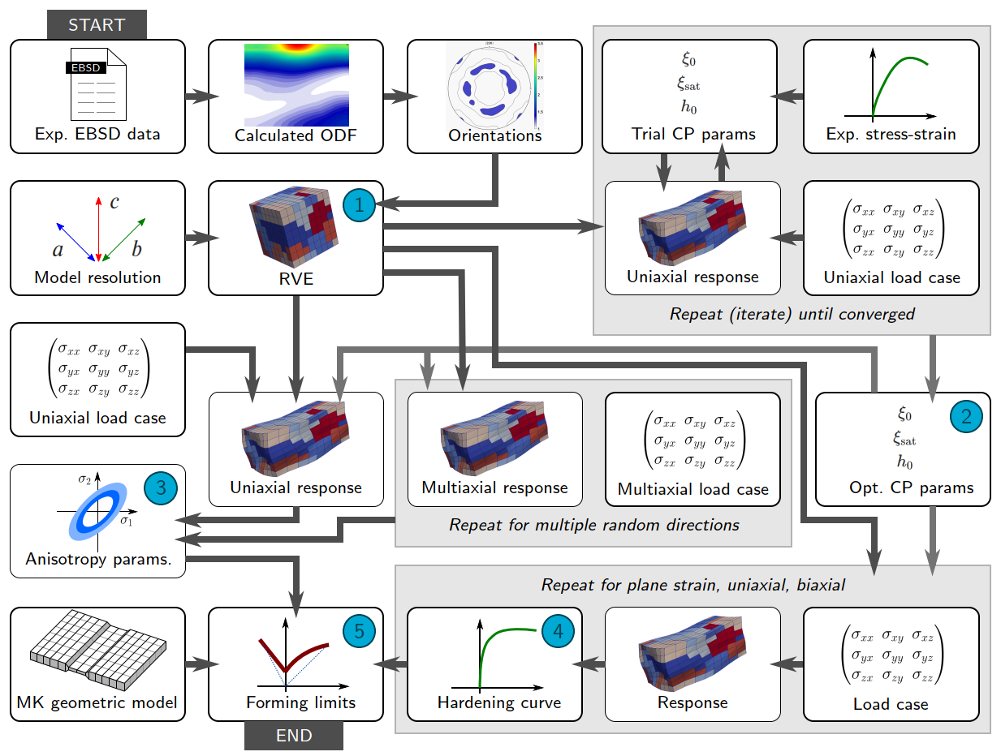
Example MatFlow data schematic

Slide 10
Getting started with MatFlow on the CSF
Running the example DAMASK workflow
The example DAMASK workflow can be found here on the installation repo, or here on the CSF: /mnt/eps01-rds/jf01-home01/shared/matflow/workflows/uniaxial_tensile_test_sim.yml
Some notes about this workflow can be found in the same directory, named: uniaxial_tensile_test_sim_README.md
If you are new to MatFlow, try running this workflow on the CSF!
You could also explore how we can use MatFlow within a Jupyter notebook to access the workflow data (click on the Binder link in the installation repository, or install MatFlow locally)
cd ~/scratch
cp /mnt/eps01-rds/jf01-home01/shared/matflow/workflows/uniaxial_tensile_test_sim.yml .
matflow go uniaxial_tensile_test_sim.yml

