Slide 1
MatFlow troubleshooting
01/12/2021

Slide 2


First steps
If you think there is a problem, run matflow validate to check for missing extensions/schemas
Missing/outdated extension
Solution: update packages by running /mnt/eps01-rds/jf01-home01/shared/matflow/update_matflow.sh

Slide 3
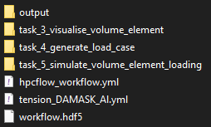
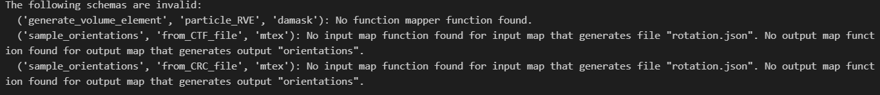
Some things that are not problems
Even though you may have six tasks, you may not end up with six task directories on Dropbox (some tasks don’t produce any “artifacts”)
When running matflow validate, the message “The following schemas are invalid: …” is not a problem, unless you want to use one of the listed tasks in your workflow!

Slide 4
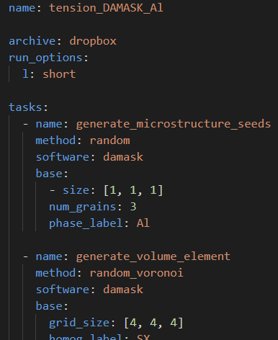
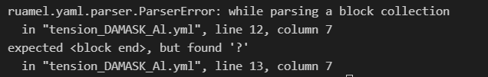
Bad YAML
Solution: copy and paste the workflow YAML into https://yamlvalidator.com/
If still having YAML issues: check for abnormal characters like weird quotation marks copied from other programs!
Try commenting out tasks until the workflow runs

Slide 5
Finding the problem
If you cannot load in Python, e.g., your volume_element_response parameter:
Look in the simulate_volume_element task directory for stdout.log and stderr.log, which are DAMASK’s output files.
Messages in stderr.log probably mean DAMASK found a problem with the input files
Now look at the log files in the output sub-directory of the workflow directory
If the simulation seemed to proceed fine, look at the output for jobs after the simulation task (including the processing task: e.g. if task 5 was the simulation: t5_pro.e3271371.1)
If the simulation failed because an input file was missing, start looking backwards in the output files e.g. starting from task 4 processing.

