Slide 1
Analysis of Complex Datasets. A case study with SkyServer
Lab course – Analysis of Complex Data Sets
Natalia Arzamasova, M.Sc.

Slide 2
Agenda for today
Introduction to the course topic and case study
Organizational details
Team forming ☺
Notes:
Themen heute
Zunächst Vorstellung des Themas

Slide 3
Course topic

Slide 4

Identifying User Interests within the Data Space
Study user interactions with a database
In particular,
What users are looking for?
How do they do so?
???
???
???
???
DB
???
???
???
Problem statement
Motivation
Foundation
Approach
Case study
Plan

Slide 5
Identifying User Interests within the Data Space
Which parts of the data space do many users have an interest in?
Database administrators
Users
Project management
Database improvement
Query recommendation
Is the database used as intended?
What are current hot spots of user interest?
Exploration of un-explored areas of the data space?
Performance optimization
Refactoring
Problem statement
Motivation
Foundation
Approach
Case study
Plan
Notes:
The outline is just an and has to be adjusted example (see https://sdqweb.ipd.kit.edu/wiki/Vortragshinweise) and copied to each slide manually. The current chapter should be in bold font. The distance of the words can be adjusted automatically by PowerPoint: select all words and arrows and then select “Anordnen -> Ausrichten -> Horizontal verteilen” (PowerPoint2007).

Slide 6
The main idea
Input data
Queries users run to a database consist of full information about their interests
We need a general method to find user interests by processing a query log
To do so we intend to define clusters of queries which look for similar data
DB (domains)
Query log
processing
Mine clusters of queries
results
Clusters of user interests
Motivation
Introduction
Foundation
Approach
Case study
Plan
Notes:
The outline is just an and has to be adjusted example (see https://sdqweb.ipd.kit.edu/wiki/Vortragshinweise) and copied to each slide manually. The current chapter should be in bold font. The distance of the words can be adjusted automatically by PowerPoint: select all words and arrows and then select “Anordnen -> Ausrichten -> Horizontal verteilen” (PowerPoint2007).

Slide 7
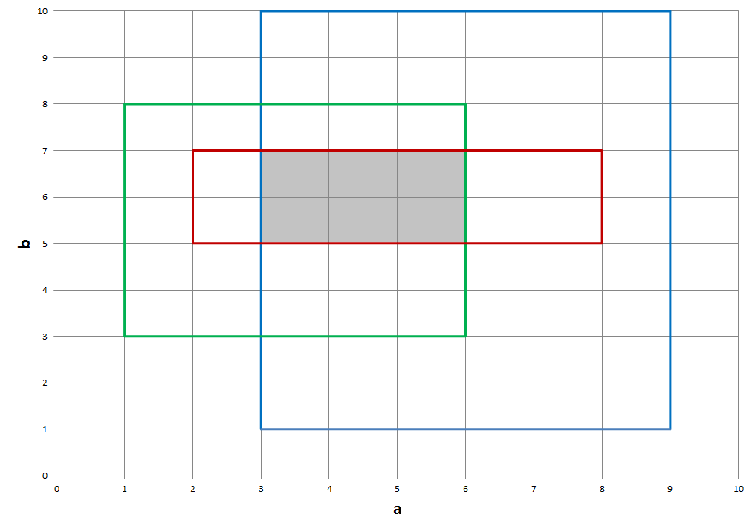


The trivial example
SELECT * FROM T
WHERE a BETWEEN 2 and 8 AND b BETWEEN 5 and 7
SELECT * FROM T
WHERE a BETWEEN 3 and 9 AND b BETWEEN 1 and 10
SELECT * FROM T
WHERE a BETWEEN 1 and 6 AND b BETWEEN 3 and 8
DB
(domains)
Query log
$$dom\left(a\right)=dom(b)=[0;10]$$
Mine clusters of queries
Clusters of user interests
Motivation
Introduction
Foundation
Approach
Case study
Plan
Notes:
The outline is just an and has to be adjusted example (see https://sdqweb.ipd.kit.edu/wiki/Vortragshinweise) and copied to each slide manually. The current chapter should be in bold font. The distance of the words can be adjusted automatically by PowerPoint: select all words and arrows and then select “Anordnen -> Ausrichten -> Horizontal verteilen” (PowerPoint2007).

Slide 8
The approach
Queries clustering
Query similarity
Distance
Basic definitions
Access Area
Domain, content, empty spaces
DB
(domains)
Query log
Mine clusters of queries
Clusters of user interests
Motivation
Problem statement
Foundation
Approach
Case study
Plan
Notes:
The outline is just an and has to be adjusted example (see https://sdqweb.ipd.kit.edu/wiki/Vortragshinweise) and copied to each slide manually. The current chapter should be in bold font. The distance of the words can be adjusted automatically by PowerPoint: select all words and arrows and then select “Anordnen -> Ausrichten -> Horizontal verteilen” (PowerPoint2007).

Slide 9



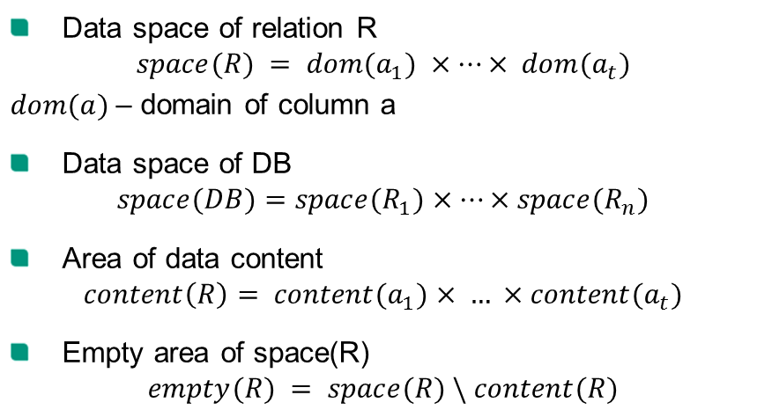




Definitions
Data space of relation R
$$space(R) = dom(a_{1}) ×…× dom(a_{t})$$
$dom(a)$– domain of column a
Data space of DB
$$space(DB)=space(R_{1})×…×space(R_{n})$$
Area of data content
$$content\left(R\right)= content(a_{1})× … ×content(a_{t})$$
Empty area of space(R)
$$empty(R) = space(R) \backslash content(R)$$
Queries clustering
Query similarity
Distance
Basic definitions
Access Area
Domain, content, empty spaces
$$b$$
$$content(R)$$
$$dom(b)$$
$$a$$
$$dom(a)$$
$$space(R)$$
$$empty(R)$$
Motivation
Introduction
Foundation
Approach
Case study
Plan

Slide 10

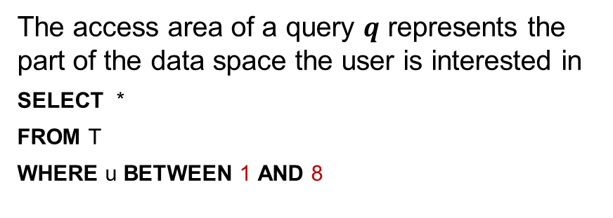



Access Area
The access area of a query $q$ represents the part of the data space the user is interested in
SELECT *
FROM T
WHERE u BETWEEN 1 AND 8
Queries clustering
Query similarity
Distance
Basic definitions
Access Area
Domain, content, empty spaces
$$access area$$
$$empty(u)$$
$$content(u)$$
$$space(u) = dom(u)$$
u
0
1
2
3
4
5
6
7
8
Motivation
Introduction
Foundation
Approach
Case study
Plan

Slide 11

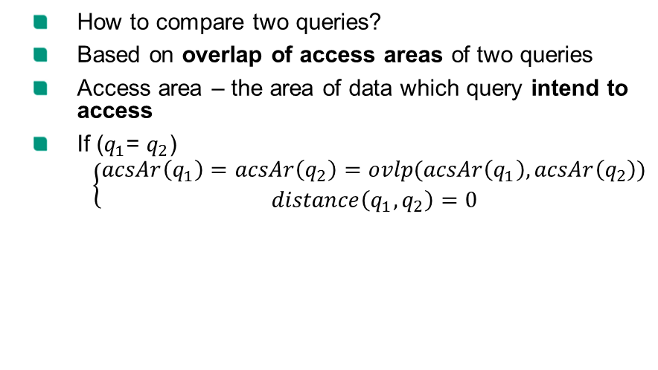


Similarity of two queries (distance)
How to compare two queries?
Based on overlap of access areas of two queries
Access area – the area of data which query intend to access
If ($q_{1}$= $q_{2}$)
$$\left\{\begin{aligned}acsAr\left(q_{1}\right)=acsAr\left(q_{2}\right)=ovlp(acsAr\left(q_{1}\right),acsAr\left(q_{2}\right)) \\ distance\left(q_{1},q_{2}\right)=0\end{aligned}\right.$$
Queries clustering
Query similarity
Distance
Basic definitions
Access Area
Domain, content, empty spaces
b
$$accAr(q_{2})$$
$$accAr(q_{1})$$
$$ovl(q_{1},q_{2})$$
a
Motivation
Introduction
Foundation
Approach
Case study
Plan

Slide 12
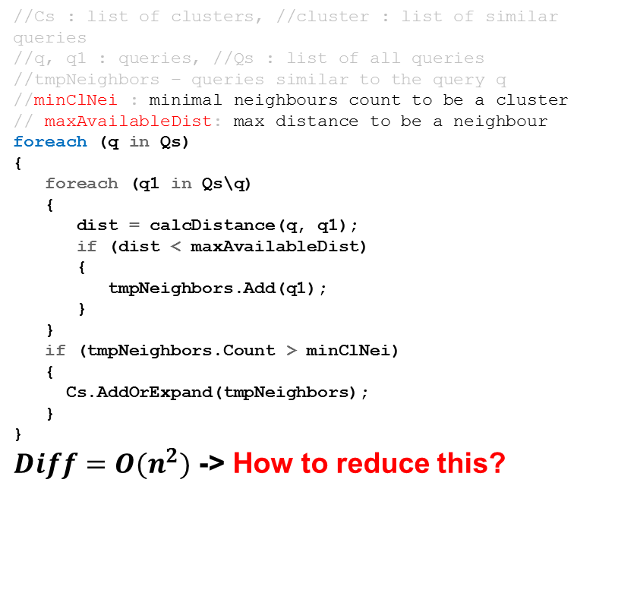
How to cluster queries?
//Cs : list of clusters, //cluster : list of similar queries
//q, q1 : queries, //Qs : list of all queries
//tmpNeighbors – queries similar to the query q
//minClNei : minimal neighbours count to be a cluster
// maxAvailableDist: max distance to be a neighbour
foreach (q in Qs)
{
foreach (q1 in Qs\q)
{
dist = calcDistance(q, q1);
if (dist < maxAvailableDist)
{
tmpNeighbors.Add(q1);
}
}
if (tmpNeighbors.Count > minClNei)
{
Cs.AddOrExpand(tmpNeighbors);
}
}
$Diff=O(n^{2})$ -> How to reduce this?
Queries clustering
Query similarity
Distance
Basic definitions
Access Area
Domain, content, empty spaces
Motivation
Introduction
Foundation
Approach
Case study
Plan
Notes:
The outline is just an and has to be adjusted example (see https://sdqweb.ipd.kit.edu/wiki/Vortragshinweise) and copied to each slide manually. The current chapter should be in bold font. The distance of the words can be adjusted automatically by PowerPoint: select all words and arrows and then select “Anordnen -> Ausrichten -> Horizontal verteilen” (PowerPoint2007).

Slide 13
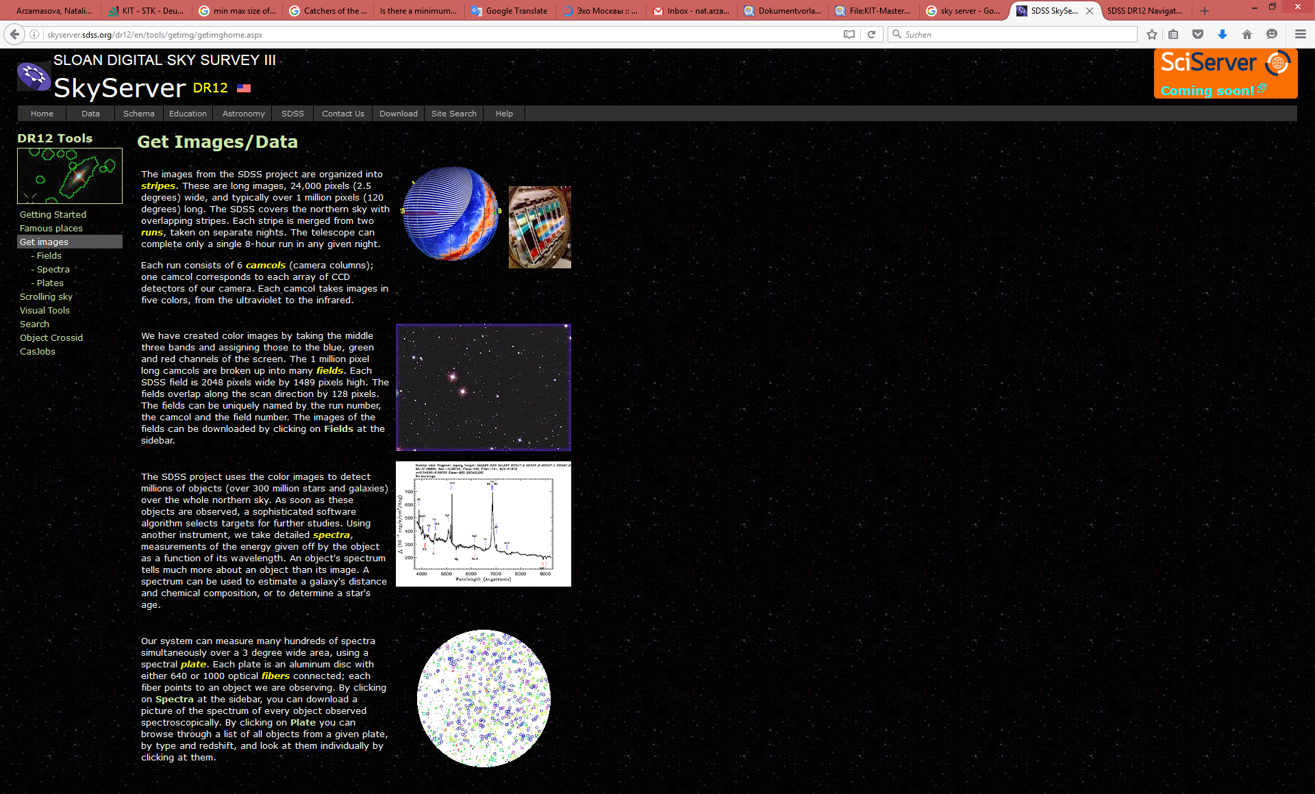
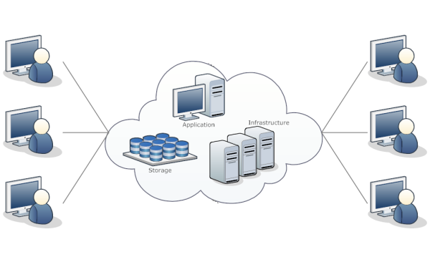
Case study
SkyServer http://skyserver.sdss.org/dr12/en/home.aspx
More specifically,
a lot of users (more than 47000 for the first 6 years)
no direct contact with DB provider (representative information sought)
most users are more or less capable of formulating queries expressing their information need correctly.
Motivation
Introduction
Foundation
Approach
Case study
Plan
Notes:
The outline is just an and has to be adjusted example (see https://sdqweb.ipd.kit.edu/wiki/Vortragshinweise) and copied to each slide manually. The current chapter should be in bold font. The distance of the words can be adjusted automatically by PowerPoint: select all words and arrows and then select “Anordnen -> Ausrichten -> Horizontal verteilen” (PowerPoint2007).

Slide 14
Literature
H. V. Nguyen et al. “Identifying User Interests within the Data Space – a Case Study with SkyServer”. In: EDBT. OpenProceedings.org, 2015, pp. 641–652.
http://dbis.ipd.kit.edu/download/IdentifyingUserInterests.pdf
Case study – SkyServer
http://skyserver.sdss.org/dr12/en/home.aspx
Motivation
Introduction
Foundation
Approach
Case study
Plan

Slide 15
The plan
Improve the quality of domain data
DB
(domains)
Query log
Preprocess the log
Mine clusters of queries
Improve the performance
Improve the quality of distance function
Clusters of user interests
Motivation
Introduction
Foundation
Approach
Case study
Plan

Slide 16
The schedule
Task 4
Tasks 2, 3
Improve the quality of domain data
DB
(domains)
Query log
Preprocess the log
Tasks 5
Tasks 5
Improve the performance
Mine clusters of queries
Improve the quality of distance function
Clusters of user interests
Task number | Task name | Submission deadline | Presentation date
0 | First start | 22.04.2016 | 25.04.2016
1 | Literature review | 6.05.2016 | 9.05.2016
2 | Preprocessing | 20.05.2016 | 23.05.2016
3 | Rewriting UDFs | 3.06.2016 | 6.06.2016
4 | Getting domains | 10.06.2016 | 13.06.2016
5 | Clustering and distance function | 8.07.2016 | 11.07.2016
6 | Final presentations | 15.07.2016 | 18.07.2016
Motivation
Introduction
Foundation
Approach
Case study
Plan

Slide 17
Organizational details

Slide 18
General information
Appointments
Mo, 9:45-11.15 in G50.34 301(in the beginning weekly, later on according to plan)
4 CP „Schein“ (no grade)
Consultation (Natalia Arzamasova, Room 362)
Thursdays 1.pm-3.pm
Team-Specific questions etc.
Tasks
6 Task + Final presentation
Published a week before working period starts
Submission until Fridays, 8:00 am (firm), in Ilia's system

Slide 19
Organization
Mandatory registration:
Registration from 18-22.04 in study portal
Otherwise new student form the waiting list is in
Requirements for passing the course:
Mandatory presence at all appointments (compulsory attendance)
Exception: Written excuse before (Mo: 9:00) to natalia.arzamasova@kit.edu (only once)
Submission and passing of all tasks requirement for final presentation
Submission before deadline
Getting at least 2/3 of the points for each Task
Final presentation

Slide 20
Ilias
All announcements, slides, and material provided in Ilias
Course: Analysis of Complex Data Sets
Ilias Discussion forum
Question of general interest (We see them as well)
No exchange of solutions
If required: Lab account per team (ask us)

Slide 21
Contact
Natalia Arzamasova, M.Sc.
Consultation: Th., 13:00-15:00, Room 362
natalia.arzamasova@kit.edu

Slide 22
Team Forming

