Slide 1
System Software Design
Quiz Generator Progress
202355505 강경민

Slide 2
Stuffs done so far
- ChatGPT API connection
- Quiz functionality
TODO
-Using DB to store the results
-Better prompt and customized settings
-Decoration

Slide 3
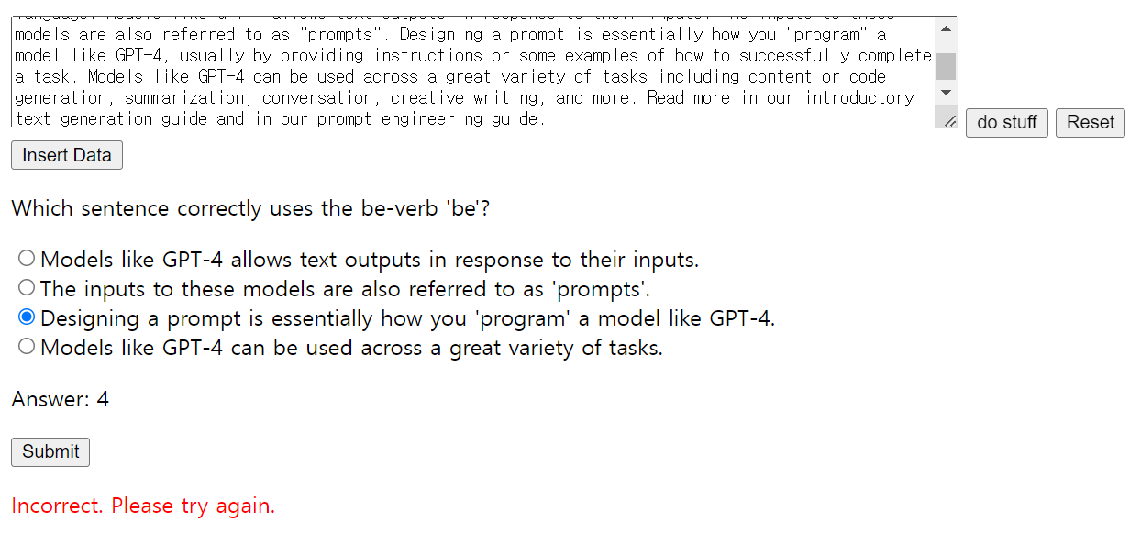
Website capablities
Can generate a quiz related to the english grammer (be-verb)
Shows result after taking a quiz

Slide 4
Things learnt so far
How to use webpack
async/await usage

Slide 5
TODO
- DB integration (sqlite3)
-Store and review the results
- :(
- Better user customization
-Specify the number of quizzes / topic
- Decoration
- Learn and apply a stylesheet

Slide 6
Thank you!

