Slide 1
System Software Design
Quiz Generator Progress
202355505 강경민

Slide 2
Stuffs done so far
- ChatGPT API connection
- Quiz functionality
- Using DB to store the results
TODO
-Better quiz customization
-Decoration
-Publishing

Slide 3
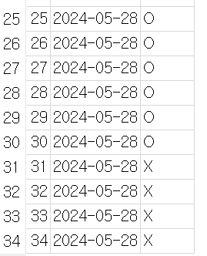
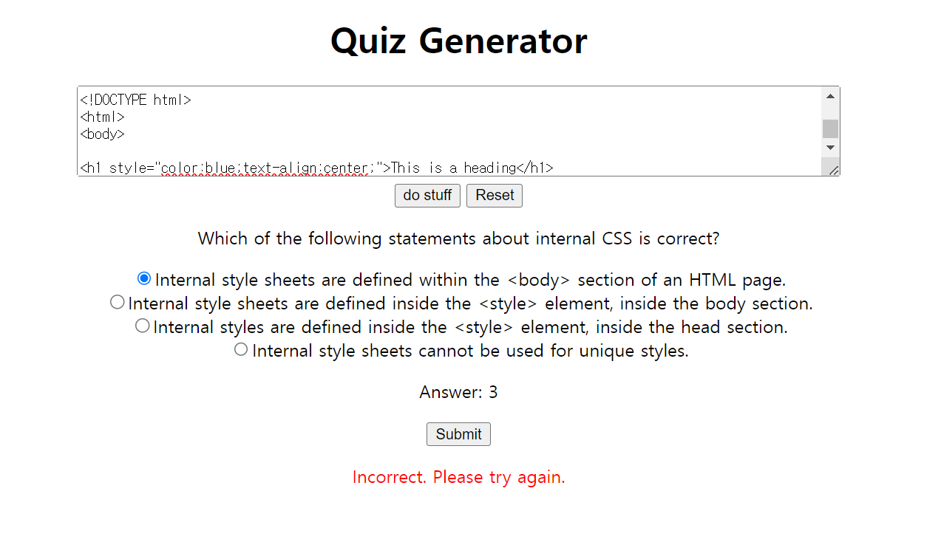
Website capablities
Can generate a quiz based on a context user provided
Shows a result after taking a quiz
Stores the result in a DB

Slide 4
Tools used
Basic languages
Javascript, CSS, HTML
Modules/Packages
Node.js, OpenAI, Webpack, Sqlite3, Express

Slide 5
Difficulties
ChatGPT API integration problem
__webpack_hmr not found
CORS

Slide 6
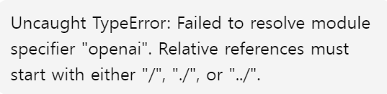

ChatGPT API Integration
API call runs well when it’s executed in cmd, but it doesn’t work on the browser
Node.js libraries not being supported by browser natively was the cause
Used webpack, to bundle the application and solve the problem

Slide 7
__webpack_hmr not found
When trying to integrate a sqlite3 DB into the application, the browser kept emitting error 404 Not Found
Mixed-server issue, using live server extension (from VSCode) and the express server at the same time caused the problem

Slide 8
CORS
After solving the __webpack_hmr problem, CORS error appeared
Added the webpack dev server, and configured proxy settings so a server would serve the files

Slide 9
TODO
- Better user customization
-Specify the number of quizzes / topic
- Review results
-Load the history from the DB
- Decoration
- Learn and apply a stylesheet
- Publish

Slide 10
Thank you!

