Slide 1
Introduction to GENie
A Project generator tool
By Miodrag Milanović – CppCon 2016

Slide 2
What is project generator ?
Tool that creates projects for you
It should be light weight and fast
Support portable features of various targets
Easy to learn
Extensible

Slide 3
What is GENie ?
GENie (pronounced as Jenny) is project generator tool. It automagically generates project from Lua script, making applying the same settings for multiple projects easy.
Initial version of GENie is fork of Premake 4.4 beta 5, and there is no intention to keep it compatible with it.
Made by :
Branimir Karadžić, Neil Richardson, Mike Popoloski,
Drew Solomon, Ted de Munnik, Miodrag Milanović, Brett Vickers, Bill Freist,
Terry Hendrix II, Ryan Juckett, Andrew Johnson, Johan Sköld, Alastair Murray,
Patrick Munns, Jan-Eric Duden, Phil Stevens, Stuart Carnie.

Slide 4
Why not Cmake ?
Too complicated syntax
To support some custom actions you need to be a expert or get one
It is easy to maintain but hell to do initial creation

Slide 5
Why GENie ?
Simple to use and learn
Easy extensible
Supported project generators:
FASTBuild (experimental)
GNU Makefile
Ninja (experimental)
Qbs / QtCreator (experimental)
Visual Studio 2008, 2010, 2012, 2013, 2015, 15
XCode

Slide 6
Who should use GENie ?
It is targeted to projects needing multiple types of project generated
People having trouble learning CMake or similar tools
People needing some very stranje custom build steps

Slide 7
Where can I get it ?
https://github.com/bkaradzic/GENie
Documentation at : https://github.com/bkaradzic/genie/blob/master/docs/scripting-reference.md#scripting-reference
Binaries :
Linux: https://github.com/bkaradzic/bx/raw/master/tools/bin/linux/genie
OSX: https://github.com/bkaradzic/bx/raw/master/tools/bin/darwin/genie
Windows: https://github.com/bkaradzic/bx/raw/master/tools/bin/windows/genie.exe

Slide 8
How to start ?
Create file named genie.lua in main or scripts subfolder of project
Open your favorite editor

Slide 9
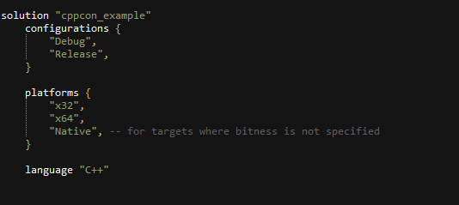
And start typing

Slide 10
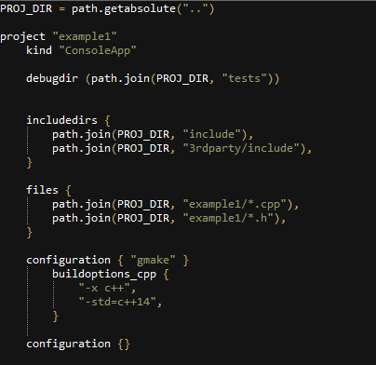
Define your project

Slide 11
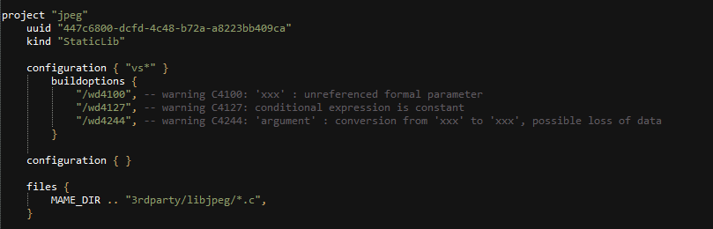
Libraries

Slide 12

Predefined toolchains
https://github.com/bkaradzic/bx/blob/master/scripts/toolchain.lua

Slide 13
How to generate project files
genie vs2015
genie xcode4
genie gmake
genie --gcc=android-arm gmake
genie --gcc=mingw-gcc gmake

Slide 14
Who use it ?
https://github.com/bkaradzic/bgfx bgfx - Cross-platform, graphics API agnostic, "Bring Your Own Engine/Framework" style rendering library.
https://github.com/Psybrus/Psybrus Psybrus Engine & Toolchain
https://github.com/dariomanesku/cmftstudio cmftStudio - cubemap filtering tool
https://github.com/mamedev/mame MAME - Multiple Arcade Machine Emulator
http://sol.gfxile.net/soloud SoLoud is an easy to use, free, portable c/c++ audio engine for games.
https://github.com/andr3wmac/Torque6 Torque 6 is an MIT licensed 3D engine loosely based on Torque2D. Being neither Torque2D or Torque3D it is the 6th derivative of the original Torque Engine.

Slide 15
Q & A
mmicko@gmail.com
https://github.com/bkaradzic/GENie/issues
https://twitter.com/micko_mame

