Slide 1
R for Medical Data Analysis
Screenshot Material

Slide 2
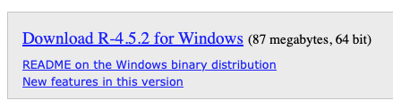
Download R for Windows

Slide 3
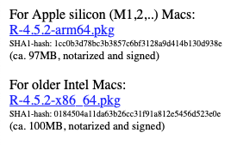
Download R for MacOS

Slide 4
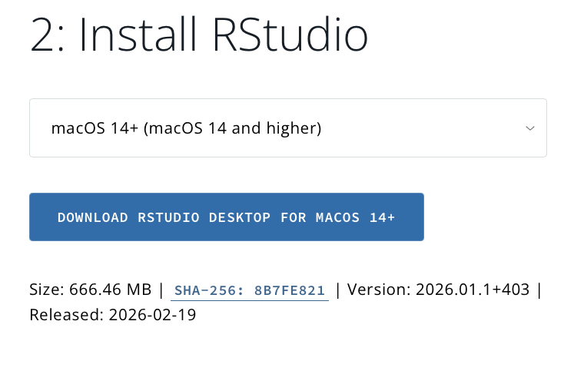
Install RStudio

Slide 5
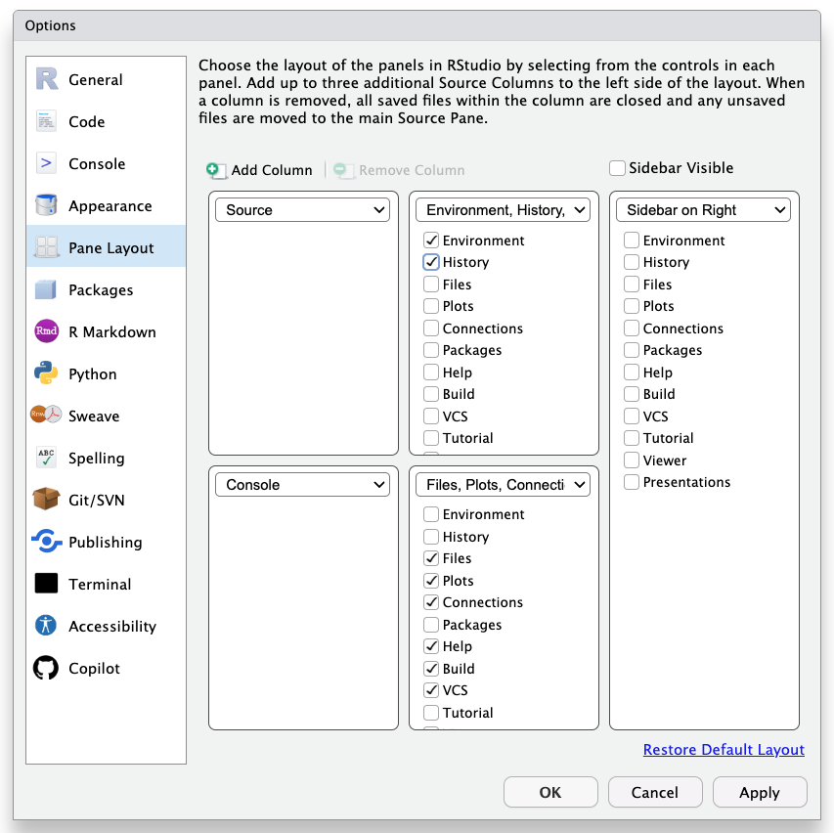
RStudio Pane Layout

Slide 6
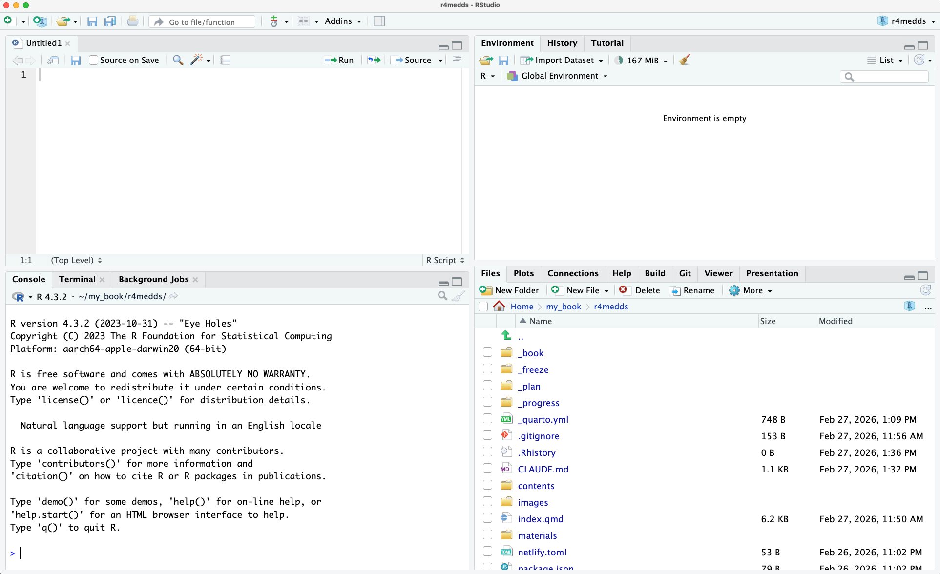
RStudio Panes

Slide 7
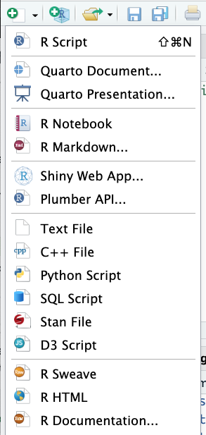
Files

