Slide 1
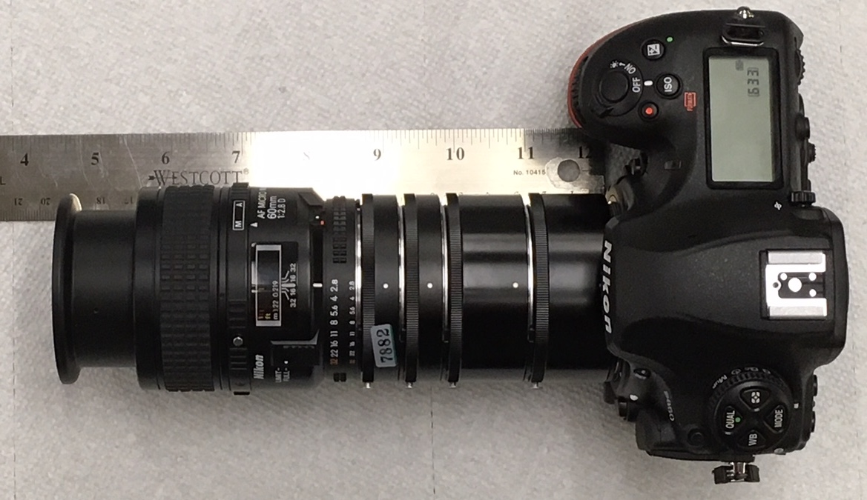
Lens diameters are in mm at indicated points. Lens overall length = 190 mm. Working distance = 44 mm
Magnification ratio = 2.75:1, Sensor area = 36 X 24 mm, 45.7 MP.
64.9. 53.5. 69.2. 71.8. 69.4. 63.1. 63.5

