Slide 1
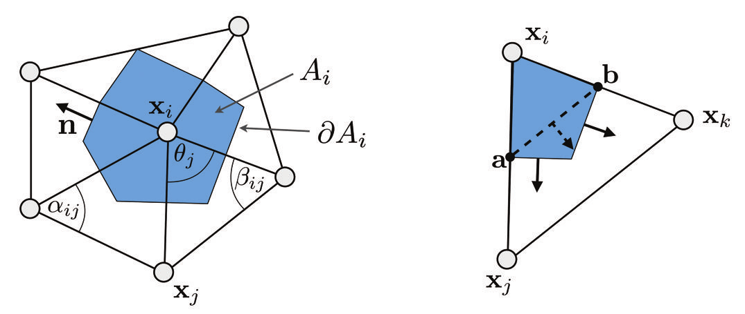

Slide 2
b
a
c

