Slide 1
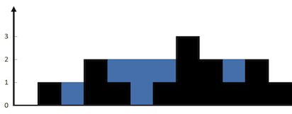
j
当|House[i]-heater[j]|>mid, j++
i

