Slide 1
Customer Complaint Monitoring
Evaluating Sentiment Analysis Models for Customer Complaint Detection
Software Development & Project Management for Data Science and AI​
​College of Computing, Khon Kaen University​
​
​
Presented by:
Yongjun Kim, Yonghun Kim, Yee Nwe Wynn​
​

Slide 2
Project Overview
• Background: Social media platforms allow customers to share experiences and complaints publicly. Manually monitoring feedback is time-consuming and delays responses to critical complaints.
• Our Solution: A machine learning-based sentiment analysis approach to automatically detect negative feedback.
• Project Goal: Evaluate different sentiment analysis models and determine which is most suitable for production deployment.

Slide 3
Proposed System Workflow
Customer Tweets
Sentiment Analysis
Negative Feedback Detection
Customer Support

Slide 4
Problem Statement
1. Large Volume of Feedback
Customers continuously post feedback on social media, making manual monitoring impossible at scale.
2. Identifying Complaints
Complaints contain informal language, sarcasm, emojis, and indirect expressions.
3. Model Differences
Different sentiment models perform inconsistently when detecting negative feedback.
Key Research Question:
Which sentiment analysis model can identify customer complaints most effectively while meeting our deployment criteria?

Slide 5
Project Objectives
Explore and preprocess the TweetEval sentiment benchmark dataset.
Evaluate baseline, production, and candidate sentiment analysis models.
Compare model performance using suitable evaluation metrics.
Analyze prediction errors and model behavior across data characteristics.
Track experiments and results using Weights & Biases (W&B).
Recommend the most suitable model based on predefined deployment criteria.

Slide 6
TweetEval Sentiment Dataset
Dataset Description
The project uses the English sentiment subset of TweetEval with its official training, validation, and test splits.
Split | Tweets | Negative | Neutral | Positive
Train | 45,615 | 15.55% | 45.32% | 39.13%
Validation | 2,000 | 15.60% | 43.45% | 40.95%
Test | 12,284 | 32.33% | 48.33% | 19.33%
Total | 59,899 | — | — | —
Key Observations
Neutral is the largest sentiment class across all splits.
The test set contains a higher proportion of negative tweets than the training set.

Slide 7
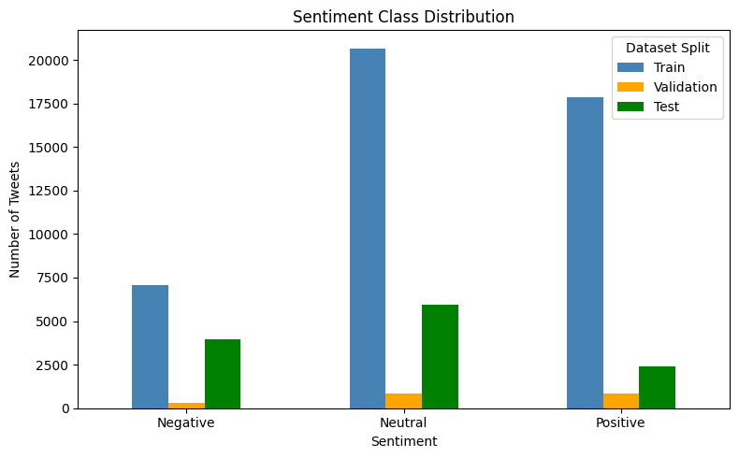
Exploratory Data Analysis (EDA)
Implications for Model Evaluation
Class Imbalance:
Models may perform better on majority classes.
Negative Recall:
Important for detecting customer complaints without missing negative tweets.
Macro F1:
Evaluates performance across all three sentiment classes equally.

Slide 8
Data Preparation and Preprocessing
Before model evaluation, we prepared the TweetEval dataset for sentiment classification.
Load TweetEval Dataset
Preprocessing Steps
Dataset Loading:
Load official TweetEval sentiment splits.
Text Preparation:
Prepare tweet text and sentiment labels.
Tokenization:
Convert text into model-compatible inputs.
Select Sentiment Task
Prepare Text and Labels
Tokenize Tweet Text
Model Input

Slide 9
Models Evaluated
Model | Role | Purpose
Twitter-RoBERTaEvaluation Goal | Baseline | Reference for performance comparison
GPT-2 Fine-tuned | Production | Existing model being evaluated
BERTweet | Candidate | Evaluate potential improvement
DistilBERT | Candidate | Evaluate potential improvement
Evaluation Goal
Compare the baseline, production, and candidate models to determine which model is most suitable for customer complaint monitoring.

Slide 10
Model Evaluation Pipeline
Load the official test split
Evaluation Scope
RoBERTa, BERTweet and DistilBERT: 12,284 tweets, three classes.
GPT-2: 6,347 tweets, negative and positive only.
Run each model and generate labels
Calculate quality and speed metrics
Compare results and inspect errors

Slide 11
Evaluation Metrics
Metric | What it measures
Negative precision | How many negative predictions are actually negative
Negative recall | How many actual negative tweets the model detects
Macro F1 | Balanced performance across the evaluated classes
Accuracy | The proportion of correct predictions
Inference speed | Average time per example during batch prediction
Project target: improve negative recall while maintaining at least 80% negative precision.

Slide 12
Model Comparison Results
Same test set: 12,284 tweets across three sentiment classes
Model | Accuracy | Macro F1 | Negative precision | Negative recall
RoBERTa | 72.18% | 0.7240 | 68.95% | 80.66%
GPT-2 | 53.60% | 0.5261 | 65.59% | 54.38%
BERTweet | 72.07% | 0.7207 | 70.76% | 79.38%
DistilBERT | 43.59% | 0.3935 | 53.16% | 78.42%
RoBERTa has the highest macro F1 and negative recall.
BERTweet improves precision but misses more negative tweets.

Slide 13
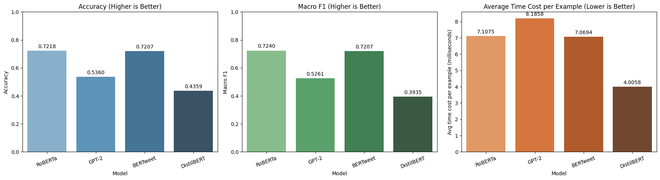
Visual Model Comparison
BERTweet’s precision gain comes with lower recall. Neither candidate meets the replacement target.

Slide 14
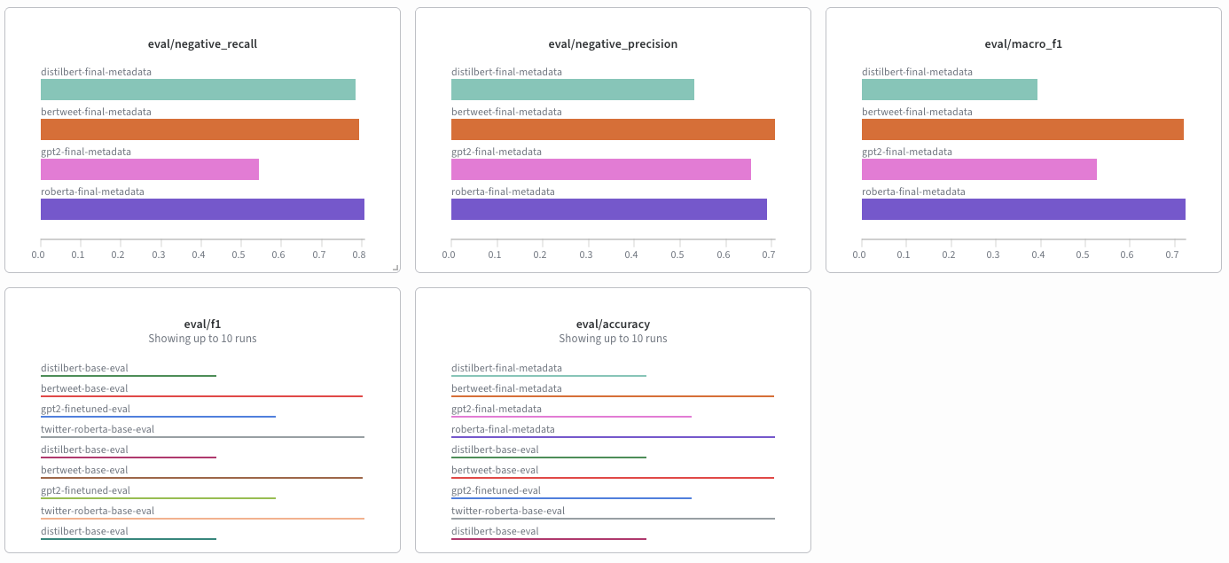
Experiment Tracking with Weights & Biases
W&B was used to track and visualize model results, making it easier to compare the performance of all four models.

Slide 15
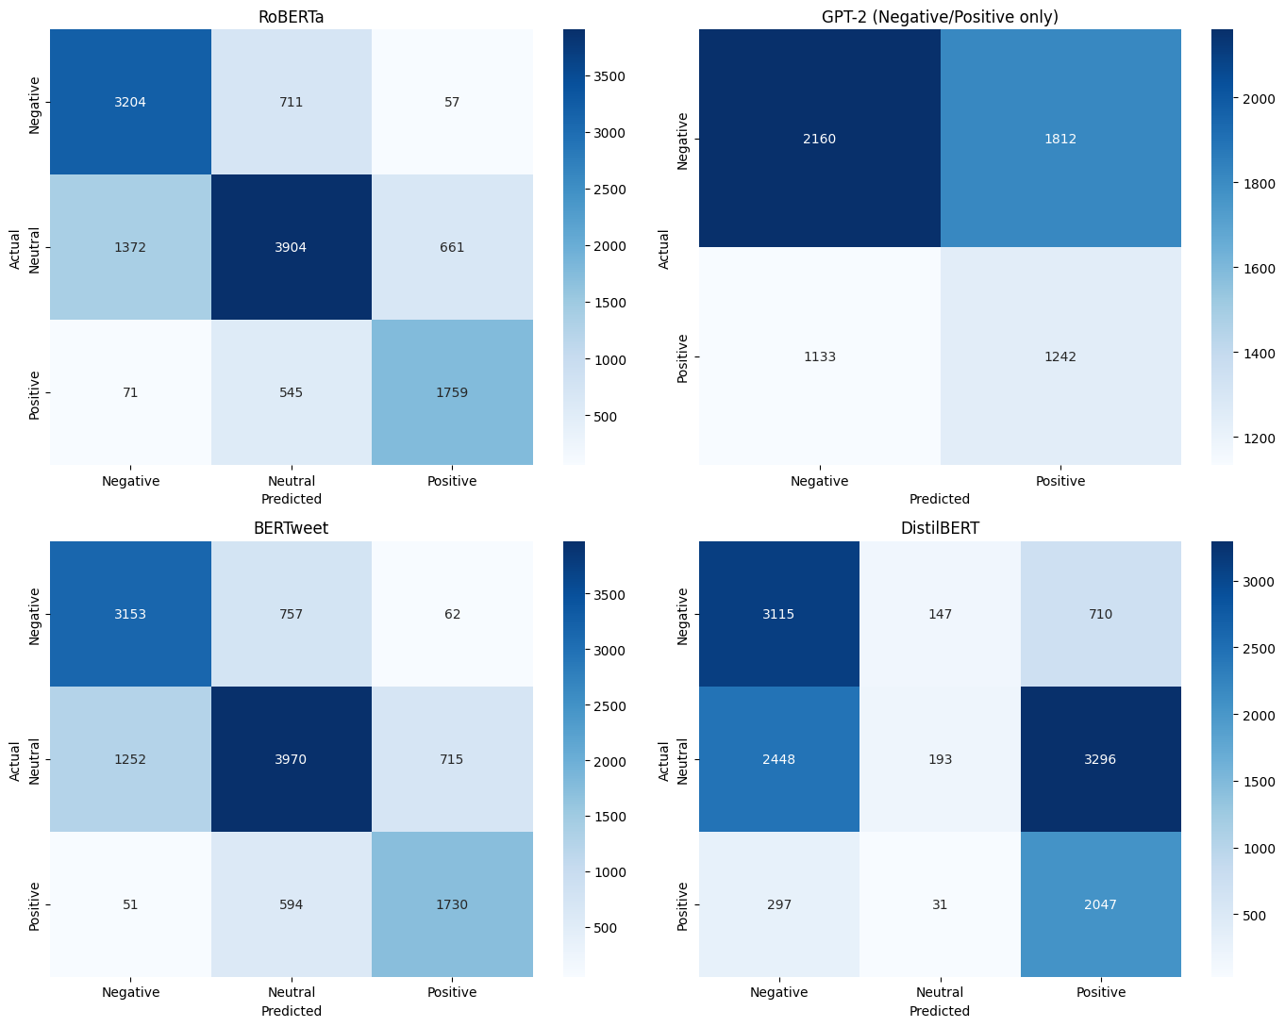
Confusion Matrices and Speed
Average prediction time
RoBERTa: 7.1075 ms
BERTweet: 7.0694 ms
DistilBERT: 4.0058 ms
GPT-2: 8.1858 ms
DistilBERT is faster in this run, but its neutral recall is only 3.25%.

Slide 16
Error Analysis
Example | Actual / predicted | Confidence
test_0 | Neutral / Negative | 80.47%
test_4 | Negative / Neutral | 41.64%
test_17 | Neutral / Negative | 82.69%
Some tweets may cause false alerts, while some complaints may be missed. These are possible explanations based on six errors we checked.
Even when the model is very confident, its prediction can still be wrong.

Slide 17
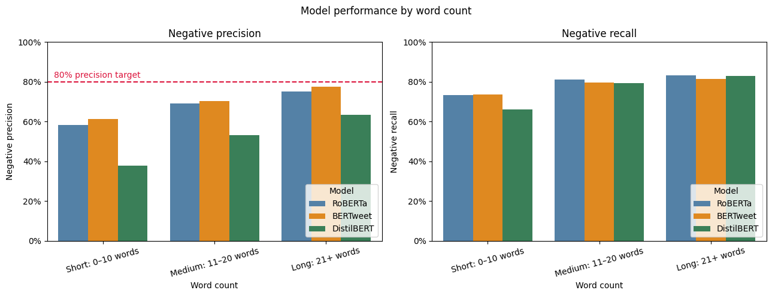
Metadata Analysis
None of the groups reached 80% negative precision. The groups contain different types of tweets, so we cannot be sure why their results are different.

Slide 18
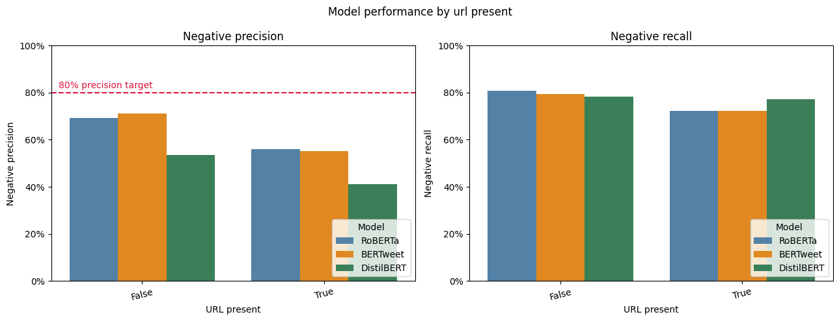
Model Performance by URL Presence
Model performance differs between tweets with and without URLs. This shows that URL presence may be related to prediction performance.

Slide 19
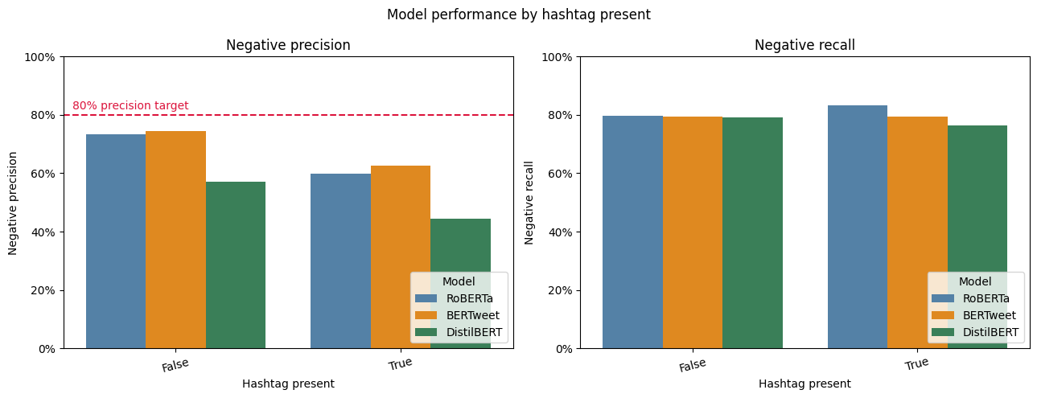
Model Performance by Hashtag Presence
Model performance differs between tweets with and without hashtags. However, we cannot conclude that hashtags cause these differences.

Slide 20
Deployment Recommendation
Keep Twitter RoBERTa for now
Neither candidate improves overall negative recall.
All three models remain below 80% negative precision.
BERTweet’s precision improvement comes at a recall cost.
Use negative predictions to prioritize human review.

Slide 21
Limitations and Future Work
Limitations
Models sometimes make incorrect sentiment predictions.
Indirect complaints and sarcasm are difficult to detect.
The project uses the TweetEval dataset, which may not represent all real customer complaints.
Only a small number of prediction errors were manually examined.
Future Work
Test the models on real customer complaints.
Improve detection of indirect complaints and sarcasm.
Analyze more prediction errors.
Monitor model performance before and after deployment.

Slide 22
Conclusion
RoBERTa remains the preferred model
It leads the three-class comparison in macro F1 and negative recall.
BERTweet offers a precision–recall trade-off. DistilBERT does not support replacement decision.
The target remains unmet. Human review and testing on real customer feedback are essential next steps.

Slide 23
Thank You!

