Slide 1

Another Day in Paradise Contacts
Logan Blair || James Eddy || Matthew Holden || Lauren Morris || Sebastian Scharager

Slide 2
Meet the Team
Lauren Morris- Project Manager/Documentation/Front End
Logan Blair - API
James Eddy - API
Matthew Holden - Database/Front End
Sebastian Scharager - Front End

Slide 3











Technologies
Hosting – GoDaddy, Digital Ocean
SSH – MobaXterm, Putty
Front end – Atom, Bootstrap
Communications – Discord, Github
Database – Putty, MySql
API testing – SwaggerHub, ARC,
Phpstorm
Gantt Chart – Excel

Slide 4
Things that went well
Things that did not go well
Looks professional and accessible
Good communication
We were able to overcome our inexperience
Did not start Front End early enough
Ended up switching to bootstrap halfway through
Struggled with PHP and the search function
Could have used the Gantt Chart and GitHub more

Slide 5
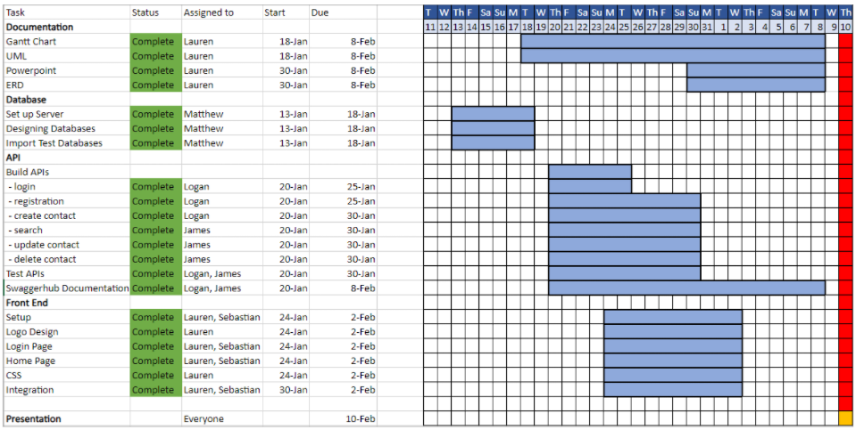
Gantt Chart

Slide 6
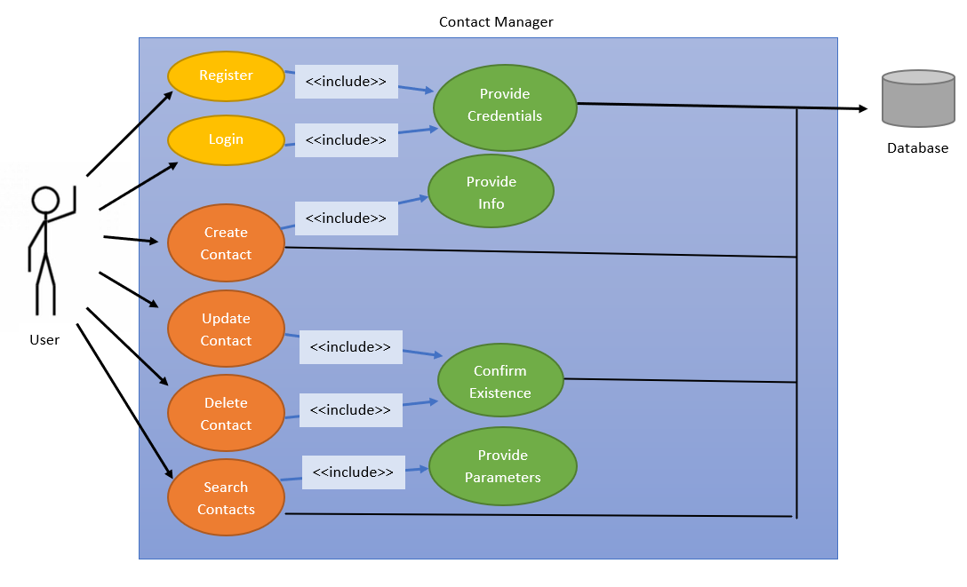
Use Case Diagram

Slide 7
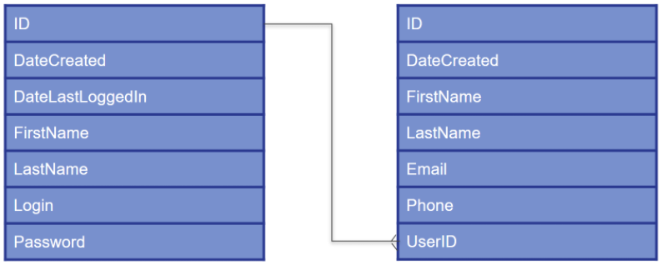
Entity Relationship Diagram (ERD)
Users
Contacts

Slide 8
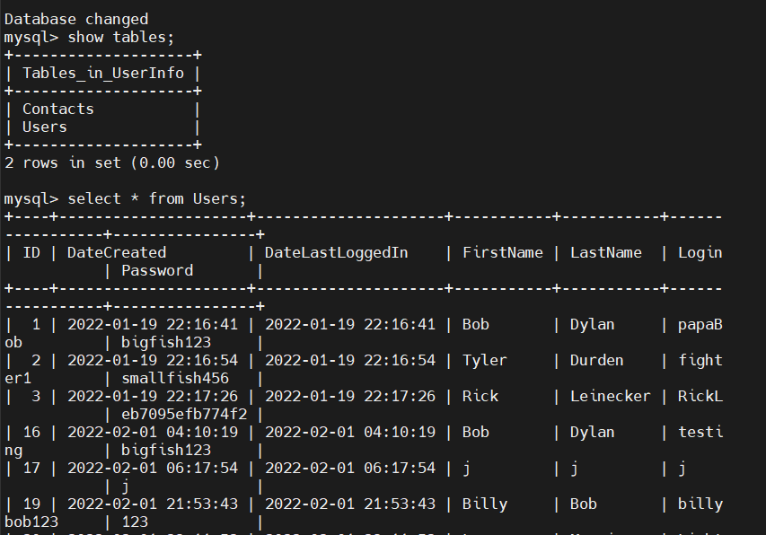
Database

Slide 9
API Documentation
Swaggerhub

Slide 10

Project Demonstration
Another Day in Paradise

Slide 11
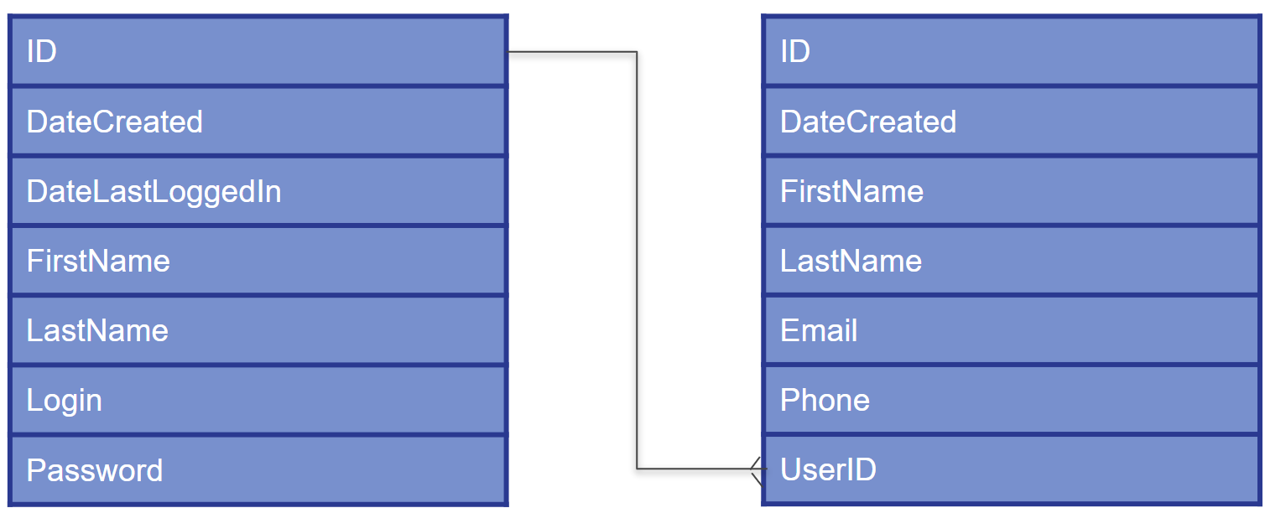
Questions

