Slide 1
Consensus Forecast:
We Will Muddle Through
Branch County Economic Development Forum
George Erickcek
W.E. Upjohn Institute for Employment Research
June 6, 2012

Slide 2
Lackluster conditions with few signs of strength
Employment– We need 150,000 jobs per month just to break even, and we are not getting them.
Consumers are not confident.
Housing is still in the basement.
Washington is at a stand still. Can the Fed do much more?
Europe is struggling, China is slowing down, and international uncertainty reigns.
We remain in unknown territory.

Slide 3
Is there any good news?
Manufacturing is holding strong.
Few, if any, forecasters are calling for a recessionary slowdown.
Inflation is still low, allowing the Fed some room to try new programs.

Slide 4
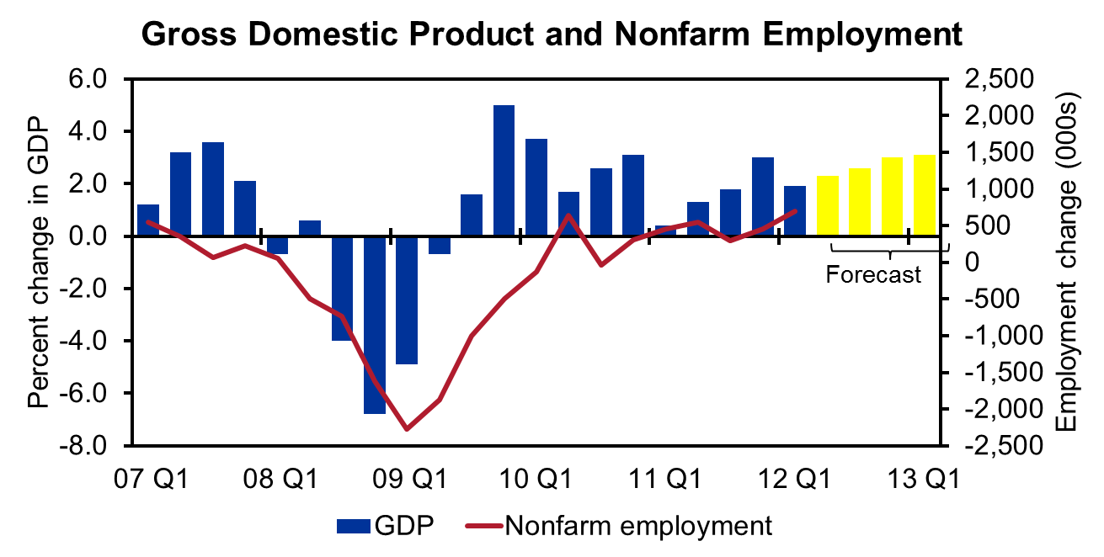
Nationwide, GDP grew at a 1.9% rate during the first quarter. And, the forecast is pretty boring.
The nation’s manufacturers continue to expand according to the ISM.
Source: BEA, University of Michigan RSQE forecast.

Slide 5
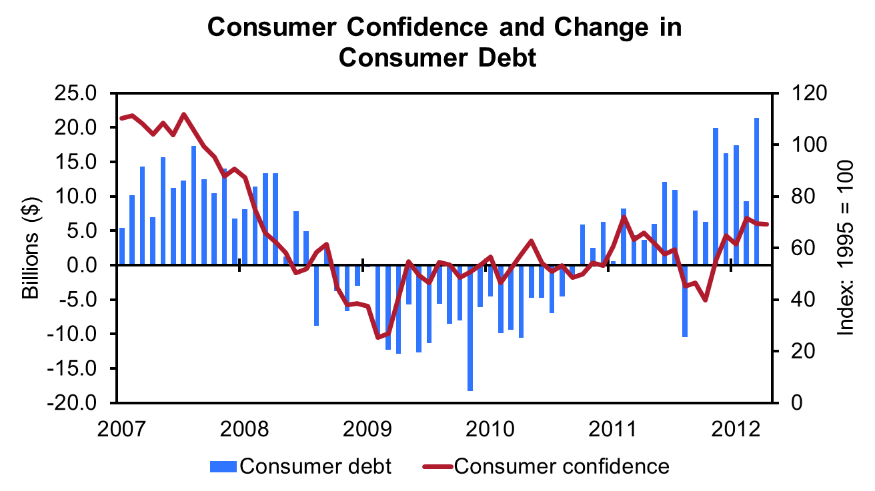
Consumers appear to be unhappily in debt.

Slide 6
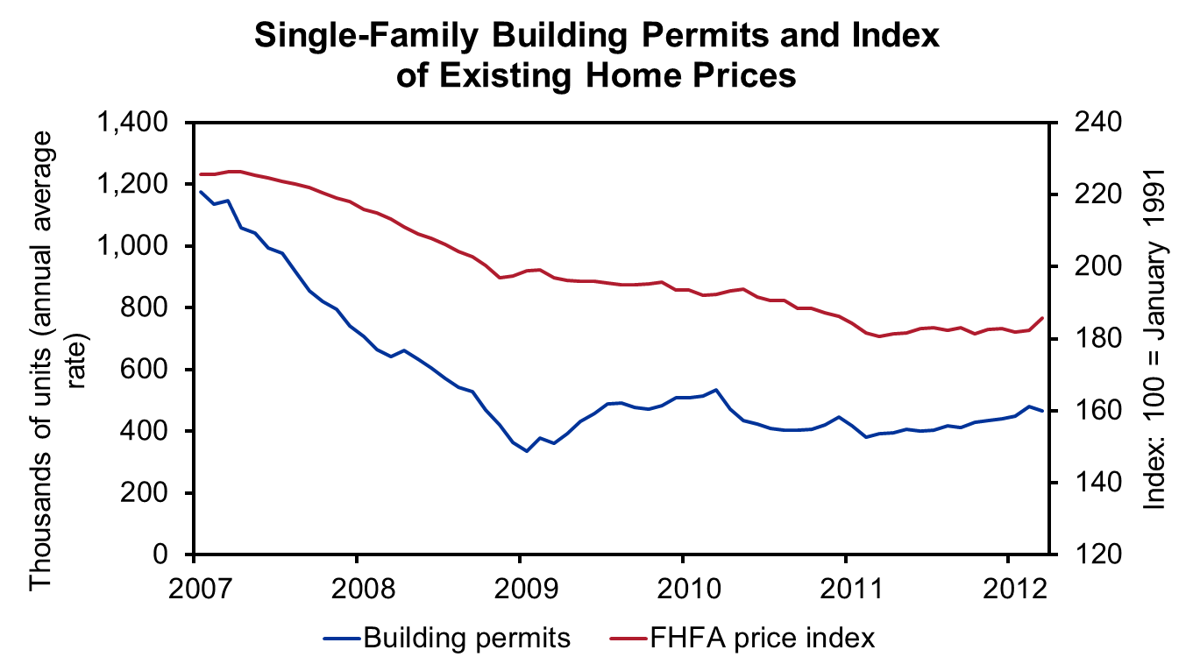
Good time to buy, but all homeowners have taken a hit

Slide 7
Why we are not in
Kansas anymore.
A greater percentage of the nation’s unemployed are long-term unemployed than ever before.
Banks are sitting on more money than ever before.
Corporate profits are breaking away from employment growth.
Income inequality continues to grow.

Slide 8
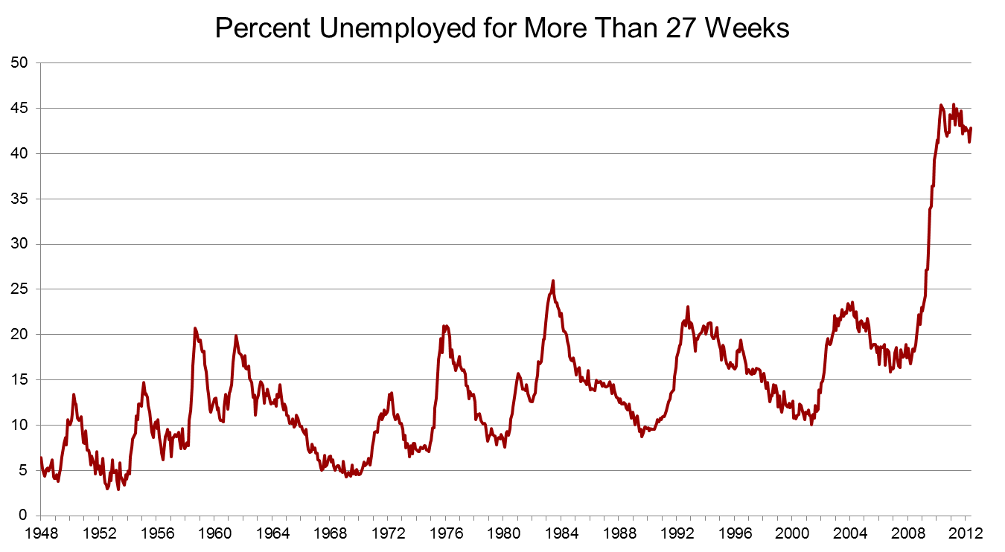
Being unemployed for more than 6 months is bad for your health.

Slide 9
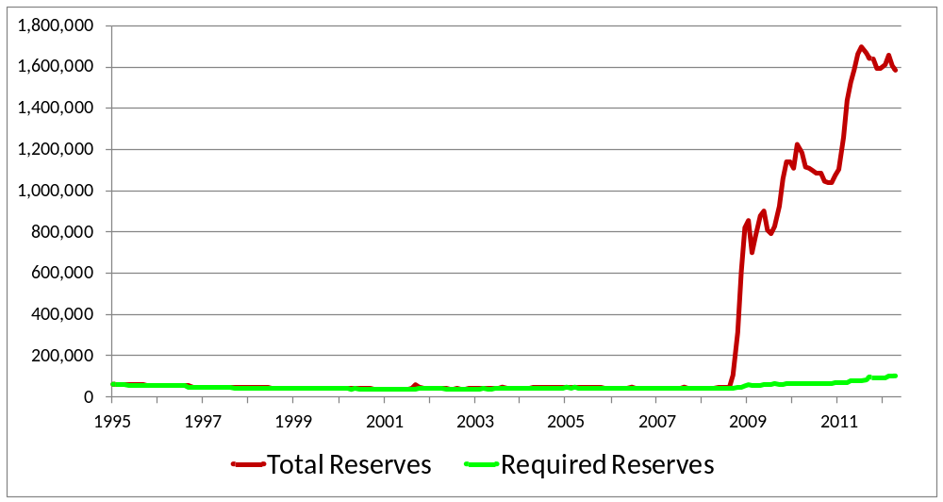
Credit: Banks are still holding more than a trillion dollars in excess reserves—but it is going down.
Total and Required Reserves at the Federal Reserve
Millions of Dollars
Source: Federal Reserve.

Slide 10
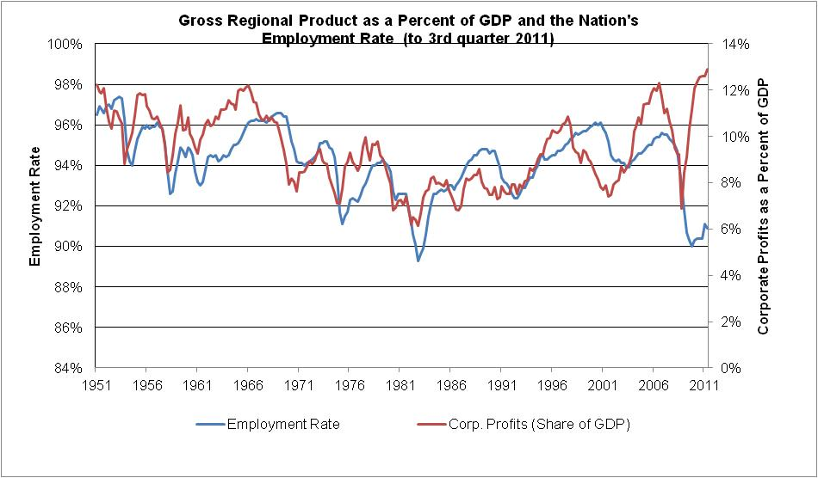
Corporations are making money
without hiring workers—a clear break
from past years.
Source: BEA and BLS.
Notes:
So the national setting calls for slow growth and a hopefully the end of a log jam on investments and leading. Still the world economy is still in turoil as well. It is a time of uncertainty and except for auto exogenous growth is not expected.

Slide 11
So why aren’t economists talking about a recession?
Interest rates MUST matter.
Manufacturing is still holding strong.
The economy, while sluggish, is not “out of balance.”
Are you ashamed of what you are driving?
No one wants to be the first to mention to the “r” word.

Slide 12
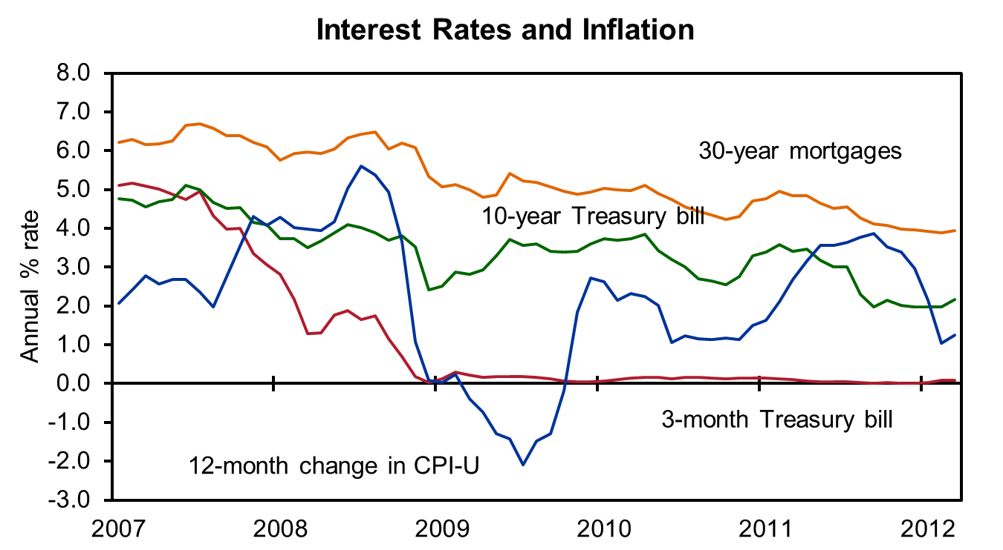
Good time to borrow and invest

Slide 13
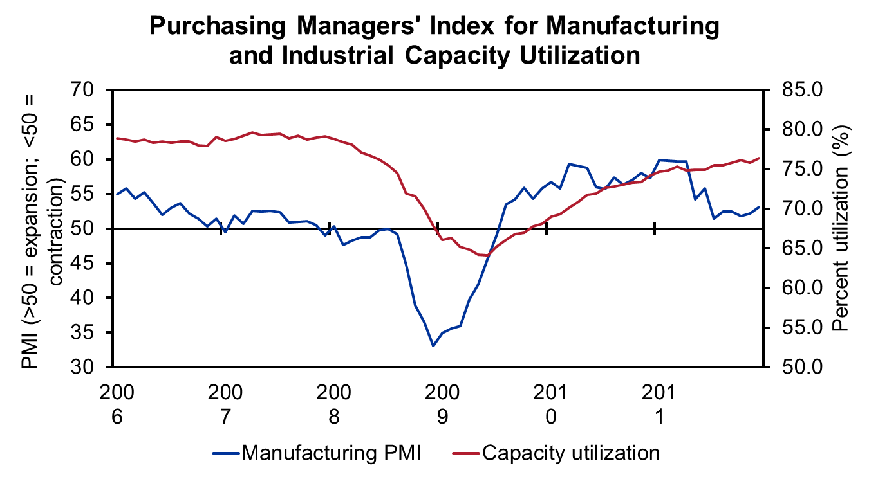
Manufacturing is still strong.

Slide 14
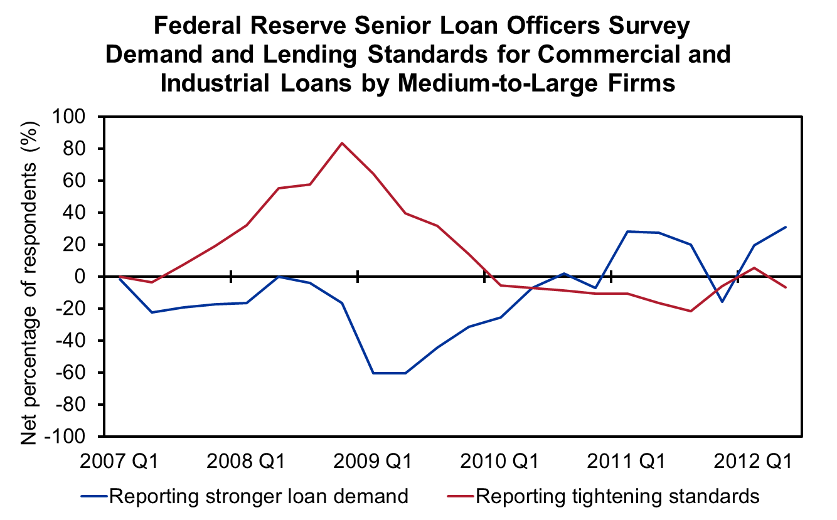
A glimpse of good news

Slide 15
What could go wrong or right?
Wrong:
  The Euro Zone Collapses.
    Exports and financial markets would be significantly impacted.
  Serious conflict in the Persian Gulf
    Oil prices would likely soar.
Right:
  Corporations invest in the U.S. due to changing cost structures.
  National banks start lending again.

Slide 16
Turning to Michigan
Employment continues to grow.
1q to 1q: 61370 total jobs created, up 1.6%
28,800 goods-producing jobs
Unemployment: 407,720—9.0% rate
U of M’s Forecast is positive.
4q to 4q
  54,300 additional jobs in 2012
  44,400 additional jobs in 2013
Notes:
Comerica Bank’s Michigan Economic Activity Index edged down one point in
June, to a level of 86. The June index level is 15 points, or 21 percent, above the cyclical index low of 71. Year-to-date, the index has averaged 88 points, three points above the average for all of 2010. “The Michigan index gave back the small gains it made over the first three months of the year, finishing the second quarter at the same level as 2010 year-end,” said Robert Dye, Chief Economist at Comerica Bank.
“Weak motor vehicle sales, and weak vehicle production in the wake of the Japan earthquake, along with weak growth in nonfarm payrolls, held the index down in June. A third quarter rebound in the state’s auto sector should provide lift to the index in coming months. However, downside risk to the broader U.S. economy and to the Euro-Zone economies remains elevated. The rapid decline in consumer confidence in
August is particularly threatening to the auto sector. The good news is that there is ample pent-up demand for new cars, which would be unleashed in the presence of moderate job creation, stable gasoline prices and low
interest rates.”

Slide 17
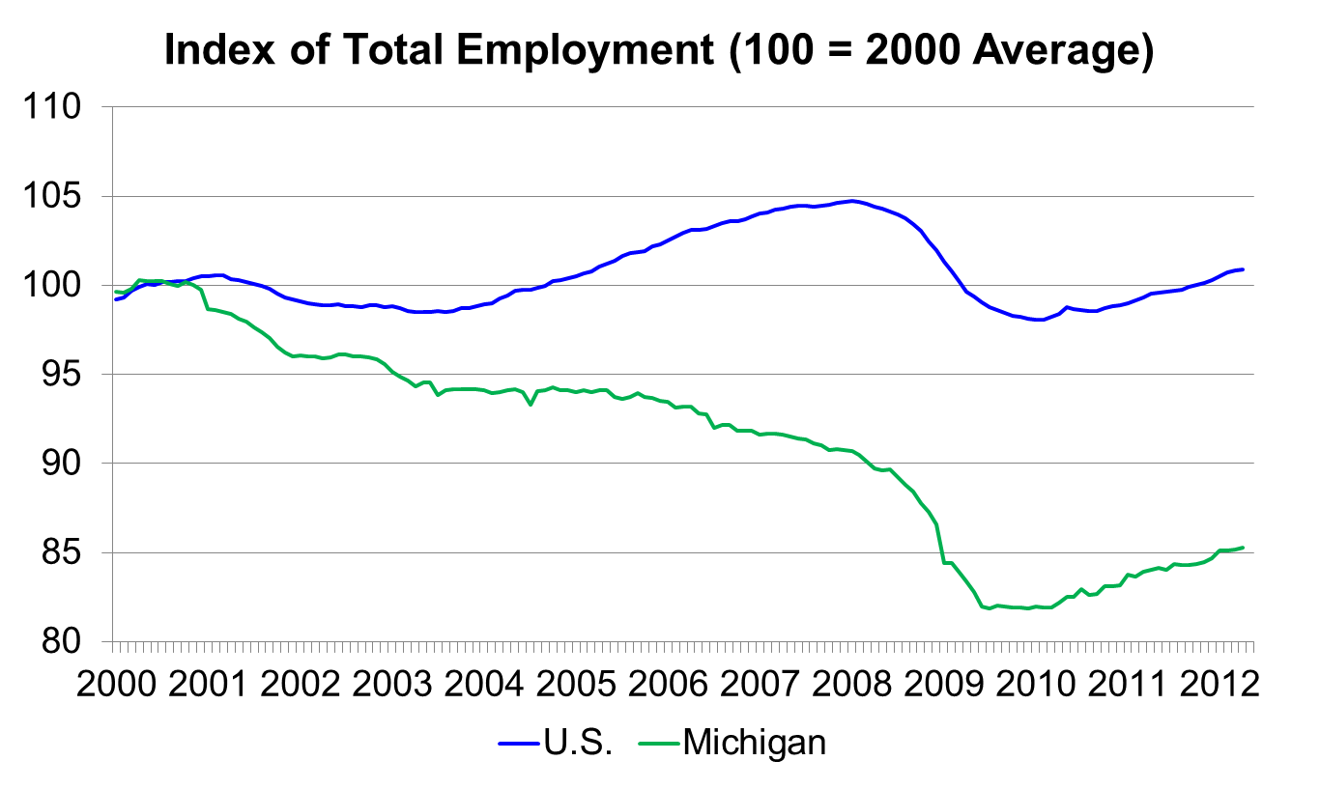
What are the chances that we will return to 2000 levels?
The state lost 740,000 jobs since 2000.
Since 2009, the state has gained 154,000 jobs; however, during the Great Recession, it lost 256,000.
Source: BLS and Upjohn Institute.

Slide 18
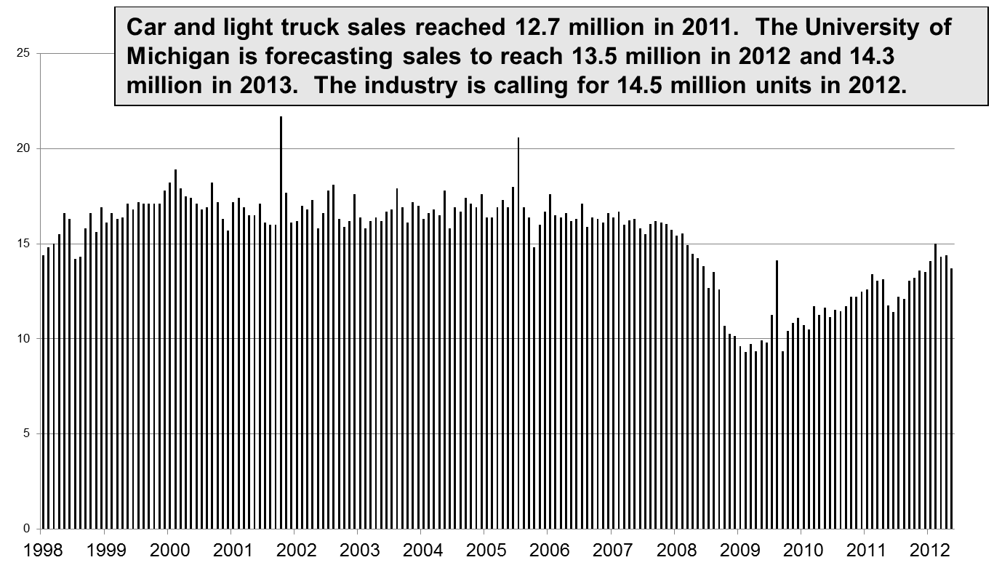
Auto deals are continuing to pick up.
Source: BEA.

Slide 19
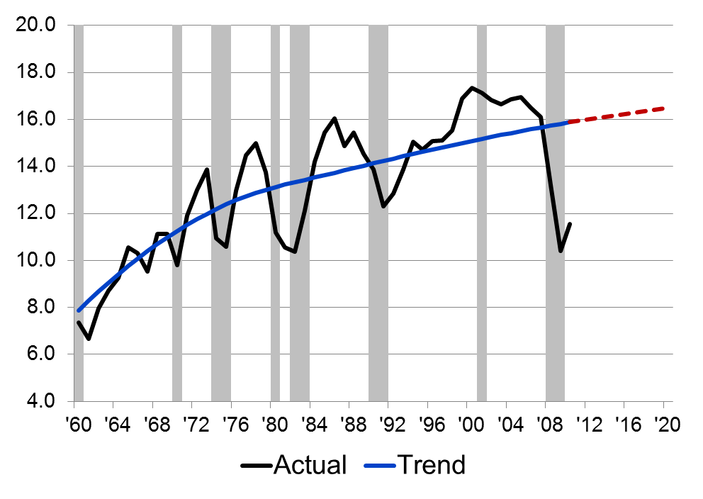
U.S. Light Vehicles Sales and Trend
Million of units
Automotive sales and production are highly volatile. Right now, sales and production are well below trend, presaging a significant and sustained rise in production and sales.
Source: Bill Testa, Chicago Federal Reserve.
Notes:
Create trend for all variables…..vehicles in op…
Scrappage rate trend…. Trend park…..vehicles per nf employee (driving age)
12/16/2011

Slide 20
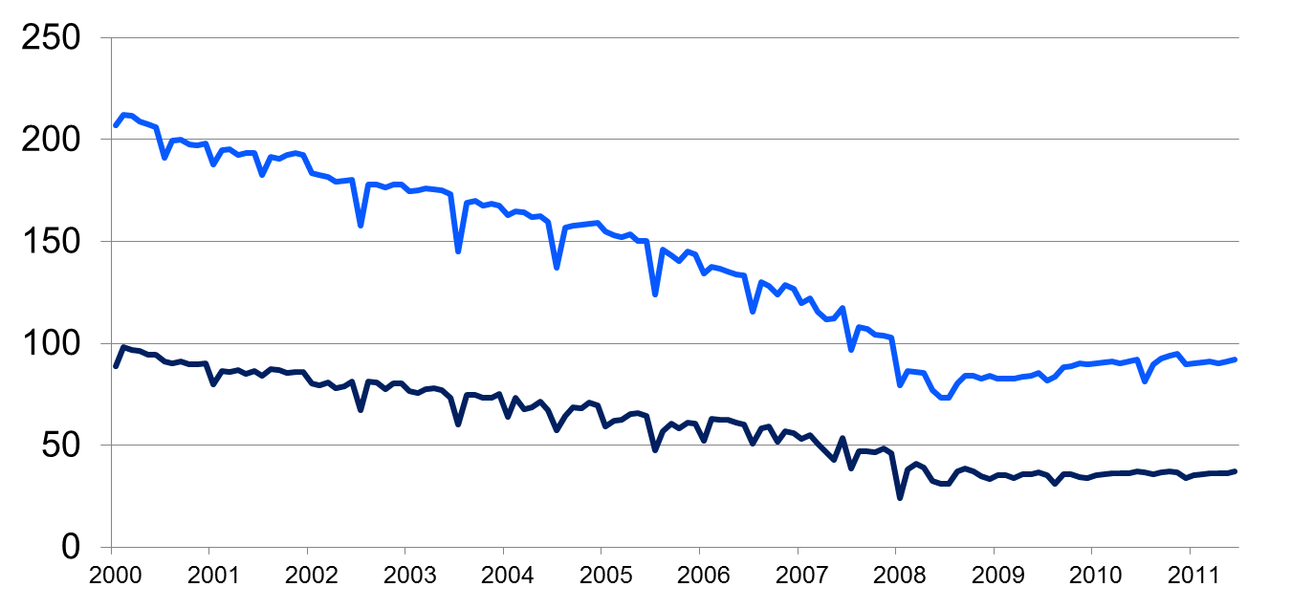
Employment in the state’s auto industry has clearly stabilized.
Employment in Thousands
Auto suppliers
Auto assembly
Source: BLS.

Slide 21
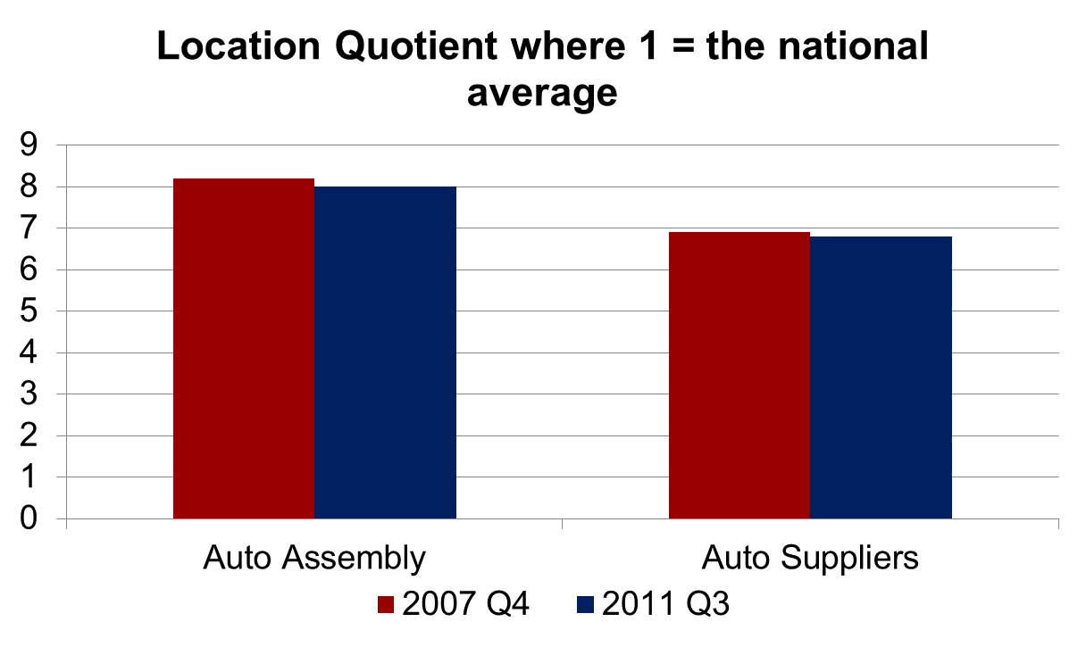
Is the state as auto dependent as before the recession? YES
Source: BLS CES.

Slide 22
Branch County
Employment is growing due to a strong manufacturing sector.
The unemployment rate is dropping.
Still
  Population is stagnant.
  The county must maintain its overall quality of life.

Slide 23
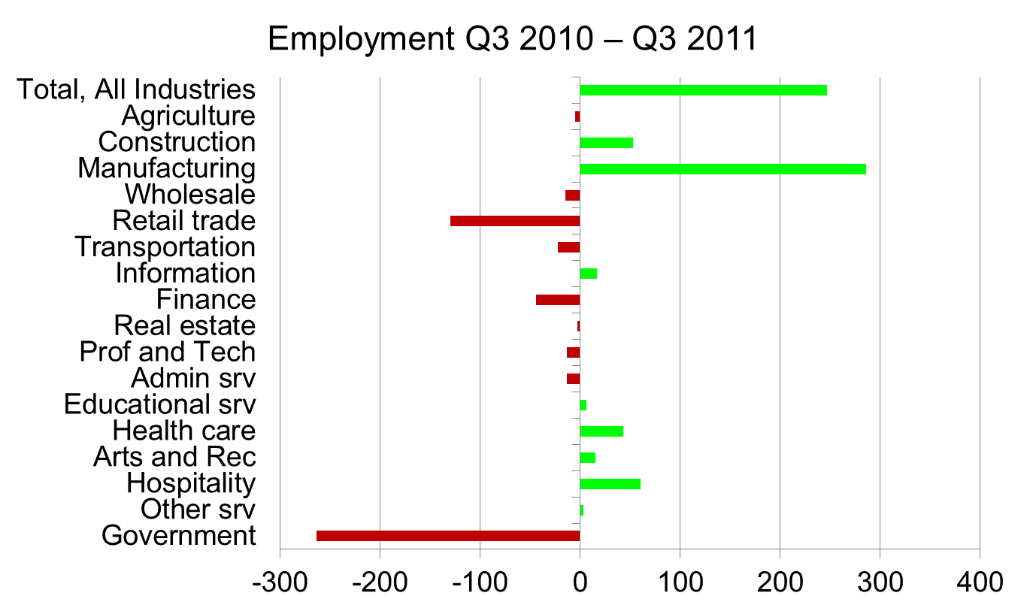
Manufacturing is powering employment growth.
Source: BLS ES-202.

Slide 24
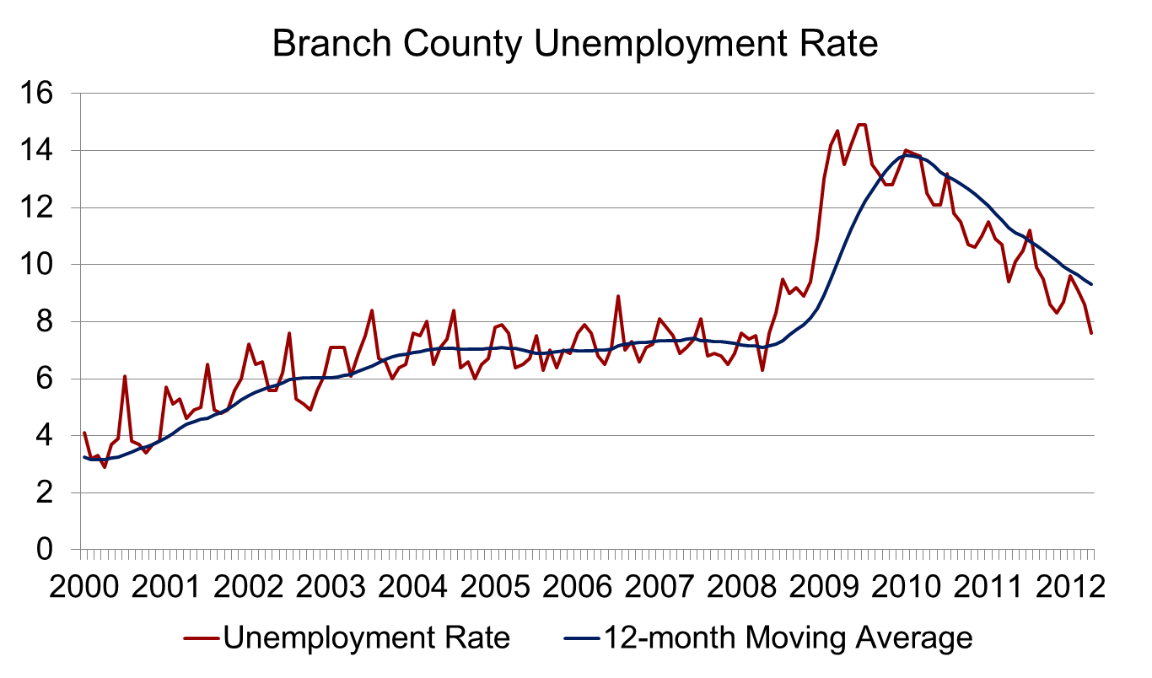
County unemployment is falling and is now below the nation’s.
Source: BLS LAUS.

Slide 25
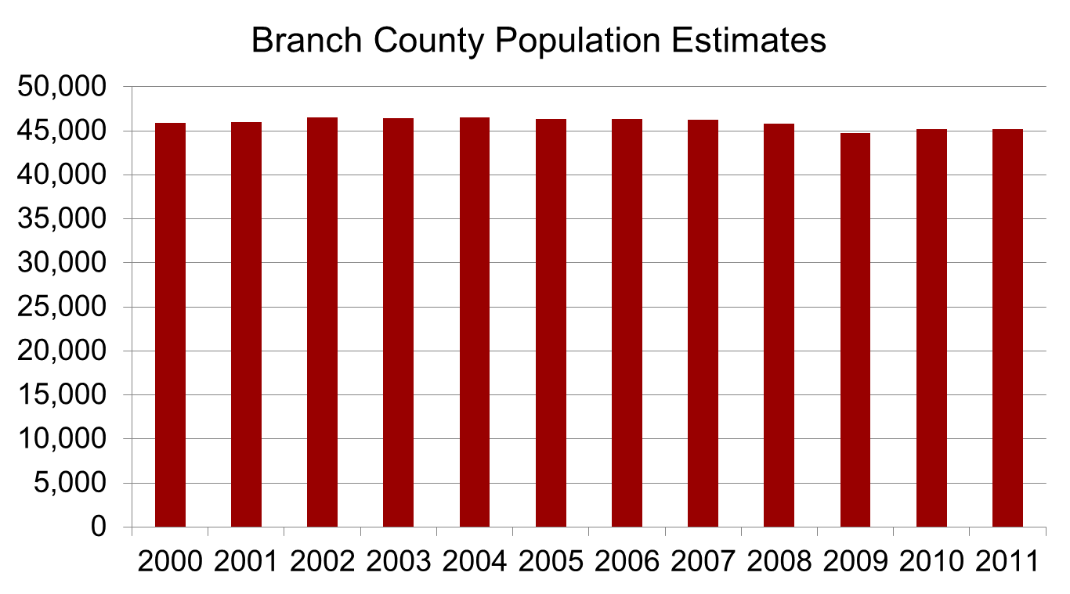
Population has remained steady.
Source: U.S. Census Annual Estimates.

Slide 26
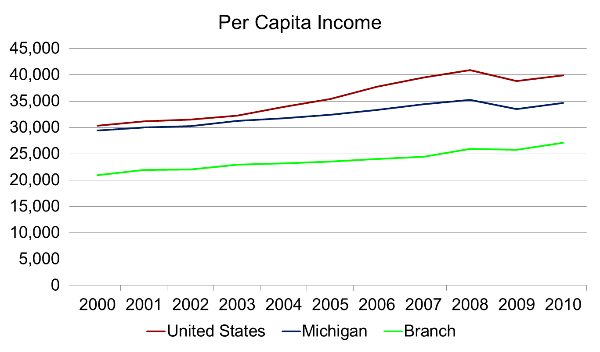
The county lags the state and the nation in per capita income.
Source: Bureau of Economic Analysis 2010.

Slide 27
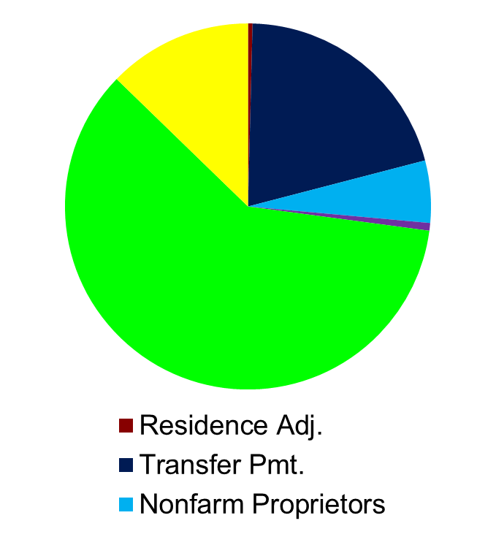
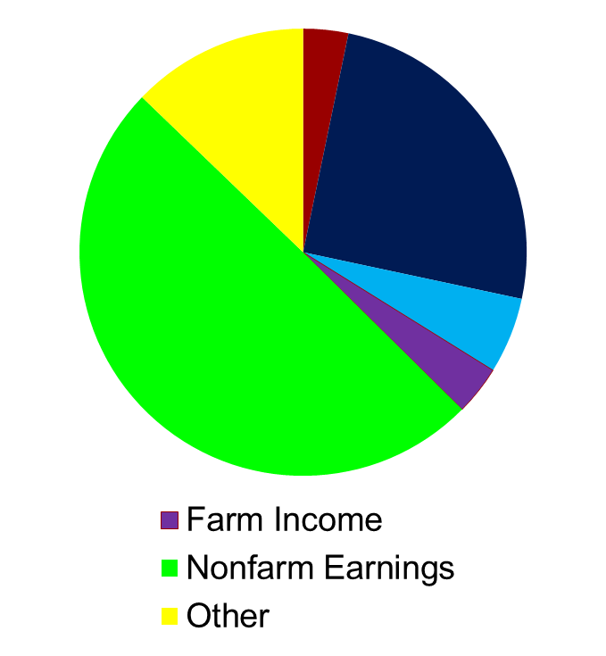
Earnings and transfer payments are the major component of the county’s income.
Income in Michigan
Income In Branch
Source: Bureau of Economic Analysis 2010.

Slide 28
Nearly 60 percent of the county’s population work outside the county.
County Employment
Employed Residents
Origin County | Employment (of 12,081) | Percent
Branch | 6,552 | 54.2
Hillsdale | 906 | 7.5
Calhoun | 798 | 6.6
St. Joseph | 629 | 5.2
Wayne | 273 | 2.3
All Other | 2,923 | 24.2
Destination County | Employment (of 15,962) | Percent
Branch | 6,552 | 41.8
Calhoun | 1,450 | 9.2
St. Joseph | 951 | 6.1
Steuben, IN | 798 | 5.1
Kalamazoo | 667 | 4.3
All Other | 6,274 | 33.7
Given high gas prices, what is keeping many residents from moving closer to where they work?
Source: Census On The Map 2010.

Slide 29
Farm income matters
Farm Earnings and Employment | Michigan | Branch
Farm Employment (% of total) | 63,667 (1.3) | 1,191 (5.9)
Farm Proprietors (% of proprietors) | 47,964 (4.4) | 990 (15.4)
Farm Earnings in millions (% of total) | $1,630 (0.5) | $29 (2.4)
Farm Proprietors Income in millions (% of proprietors) | $1,040 (4.6) | $21 (21.2)
Source: Bureau of Economic Analysis 2010.

Slide 30
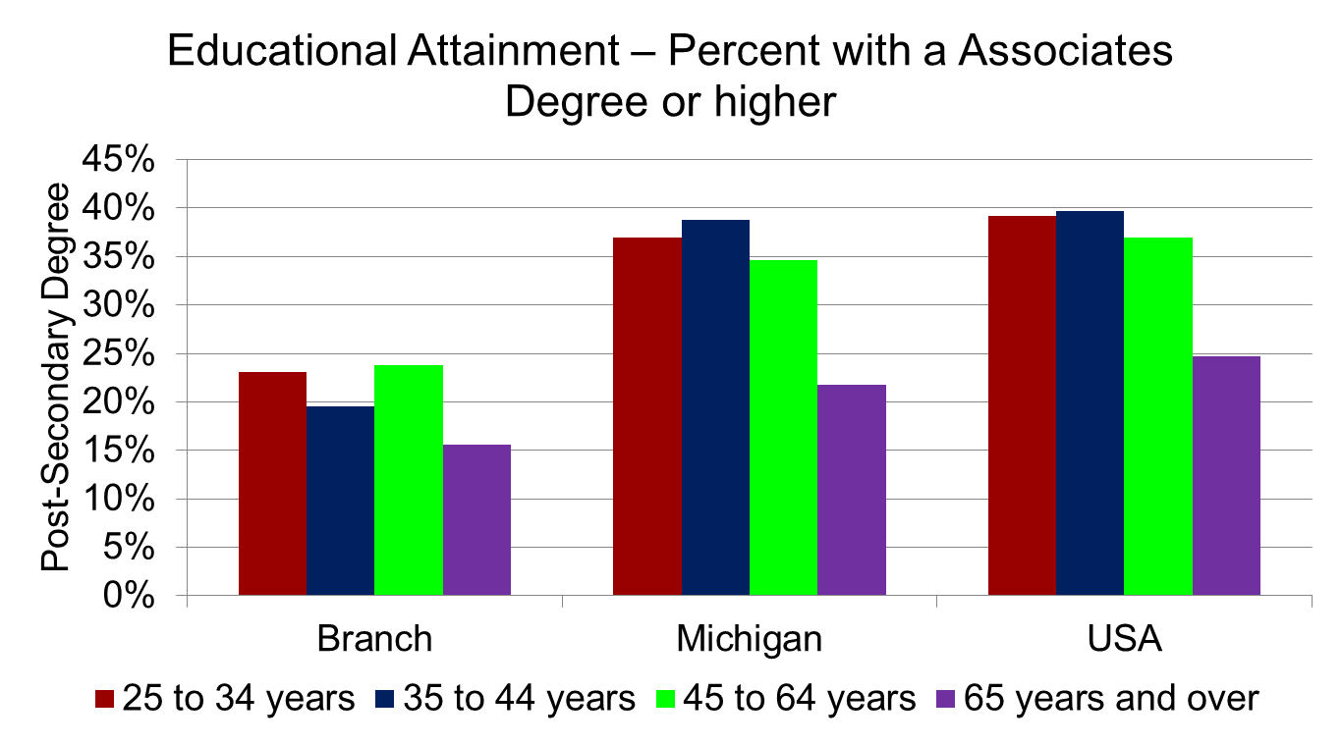
Educational attainment is lower than statewide but the trend is better.
Source: Census ACS 2008-2010 Average.

Slide 31
Conclusions and random thoughts
The outlook is cloudy; uncertainty is our biggest barrier.
Like the state, Branch County is being driven by the manufacturing recovery.
The importance of I-69 cannot be understated. According to Area Development 2011 Survey Annual CEO survey:
  Highway accessibility still ranks 1st.
  However, the availability of skilled labor is a very close second.

Slide 32
Consensus Forecast:
We Will Muddle Through
Branch County Economic Development Forum
George Erickcek
W.E. Upjohn Institute for Employment Research
June 6, 2012

