Slide 1
RNNs
By Marie

Slide 2

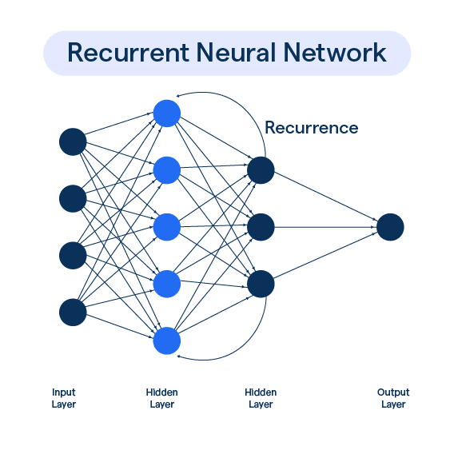
RNN in the most Basic Sense
A feed forward model type that can remember data from previous iteration. They are designed to handle sequential data by retaining information from previous steps.

Slide 3
What can RNNs be used for?
Predicting the weather
Language Processing +Specifically with translations and sentiment analysis
Video/image generation + music
Patient monitoring + watching for anomalies
Handle variable input sizes

Slide 4
This sounds like an LSTM
You are almost correct.
LSTMs are improved RNNs with logic gates and better long-term memory. LSTMs are better than RNNs in almost every way.
- We’ll be using RNNs to make next character predictors.

Slide 5
How do RNNs work?
RNNs work in time steps. Each time it reads a word in a sentence, some input x, it correlates it with some time t.
RNNs have a hidden state that ‘remembers’ previous inputs.
The ‘memory’ and new input are combined to make a more complex input that holds information from t_{n} and t_{n-1}.
Each RNN has three layers: Embedding, RNN layer, Decoding linear layer. ← All things eventually come back to a linear layer.

Slide 6
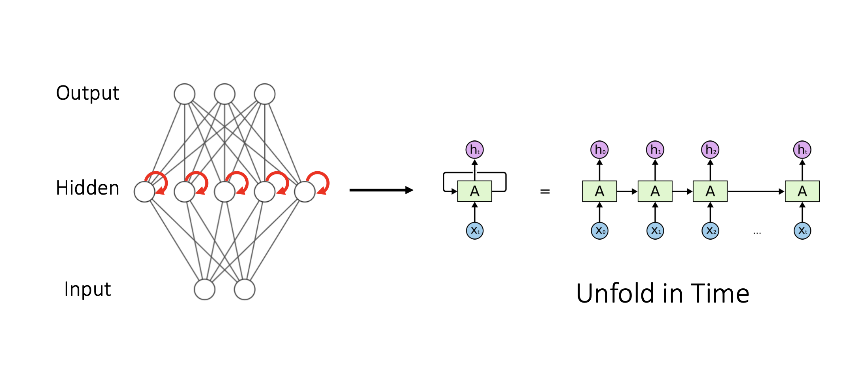
Basic RNN architecture

Slide 7
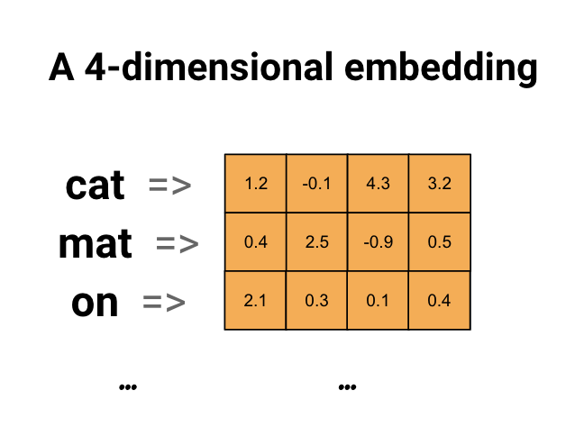
Embedding layer
Technical: transforms input tokens into dense vectors of fixed size, known as embeddings.
English: Assigns each new word/char/int a number so that the computer can recognize it.

Slide 8
self.embedding = torch.nn.Embedding(num_embeddings, embedding_dim)
Num_embeddings: How many unique tokens (words) you have
Embedding_dim: How big is each embedding vector (You choose).
This layer finds relationships between words by placing similar words closer together in the embedding space. Example Cat : Dog and Apple : Strawberry might be placed closed together.

Slide 9
self.rnn = torch.nn.RNN(input_size=input_size, hidden_size=hidden_size, num_layers=num_layers, nonlinearity= 'relu')
Input_size: Size of the embedding_dim from previous layer
Hidden_size: The size of the hidden state vector, which determines the capacity of the RNN to capture patterns in the data. (Basically, what a neuron does in CNN and linear regression)
Num_layers: How many RNNs layers you have. The more layers the longer it takes to train, and the more complex patterns captured, can lead to overfitting.
Nonlinearity: Activation function being used, if undeclared network will use tanh

Slide 10
Decoding Layer
你好世界
Technical: The decoder maps the hidden state output from the RNN to the desired output size, such as a set of class scores or predictions
English: The decoder layer turns the output of the RNN layer into something understood by humans.
Hello World

Slide 11
self.decoder = torch.nn.Linear(hidden_size, output_size)
Hidden_size: Same size as the hidden layer in the RNN (Ready to receive the ‘neurons’ passed from the previous layer)
Output_size: The number of possible classes ← vocabulary size (How many words can be mapped to)

