Slide 1
Intro to CNNS Convolutional neural Network
By: Marie

Slide 2

What a CNN does (Very Basics)
Looks at an image and does math on the pixels to give you a final value.

Slide 3
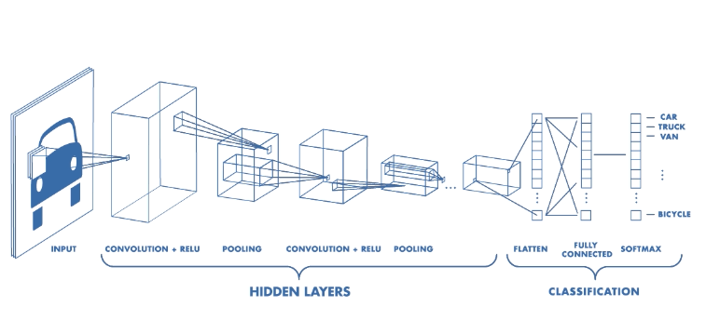
How CNNs work

Slide 4
Convolution Layers
self.cnn1 = torch.nn.Conv2d(in_channels=1, out_channels=64, kernel_size=3, stride=1, padding=1)
In channels: How many layers in an image gray scale = 1, RGB = 3, RGB alpha = 4
Out Channels: How many neurons will be passed into the next layer
Kernal size: How big is the moving square
Stride: How many pixels over the kernel moves each step
Padding: Extra pixels added to an image
This layer will multiply the pixel values by different weights. ⬅ Matrix Multiplication

Slide 5
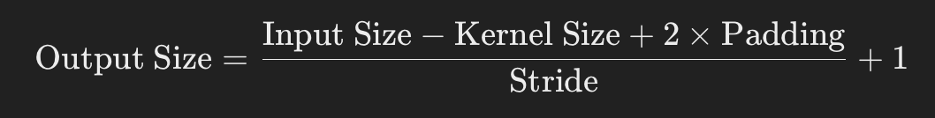
Calculating the image output size of convolutional layer
Output size is number of pixels, not number of neurons.

Slide 6
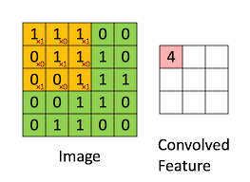

Slide 7
Max Pooling layers
self.maxPool1 = torch.nn.MaxPool2d(kernel_size=2) #Kernel is a square
Goes over the pixels with a kernel, the max number in each kernel set goes into the next layer.

Slide 8
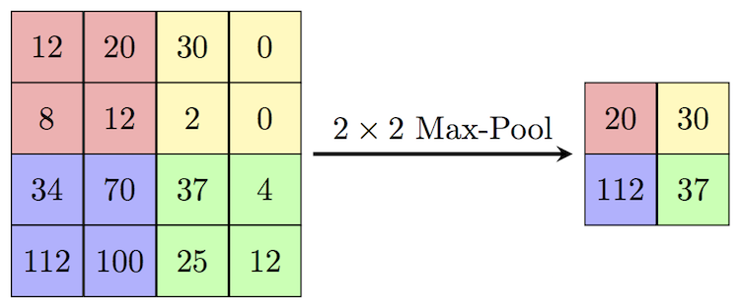

Slide 9
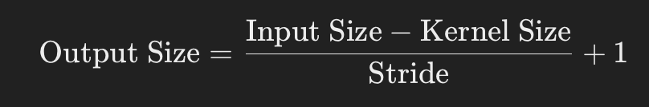
Max Pooling layer image size output

Slide 10
Flattening
out = out.view(-1, Neurons*Width*height) #This is where the previous equations mattered
Turns multi dimensional images into a single layer which can be looked at by fully connected layers

Slide 11
Fully connected
Basic linear layers with fun activation functions (Mostly Relu)
self.linear3 = torch.nn.Linear(512, 256)
out = torch.nn.functional.relu(self.linear3(out))

Slide 12
Classification function
Final layer with a softmax or sigmoid activation function:
Binary classification: Output = 1, sigmoid activation, (Single value)
Multi-classification: Output = #of classes, softmax activation, (Array of values)

Slide 13
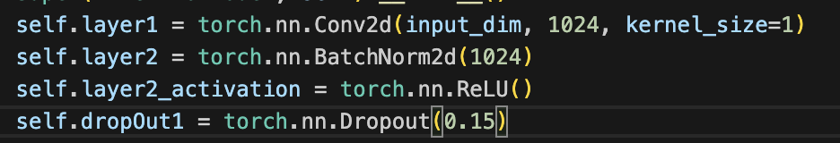
Extras: BatchNorm and Dropout

