Slide 1
Intro to Machine Learning and linear regression
By Marie

Slide 2
What Is AI vs. Machine Learning
AI suggests a machine mimicking human intelligence.
Machine learning is the algorithms a computer follows and uses to learn pattern to complete a certain task.
Machine learning is far more specific and task oriented.
AI is far more general and can include machine learning.
This club will focus on machine learning and its algorithms.

Slide 3
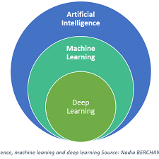


Linear Regression is here

Slide 4
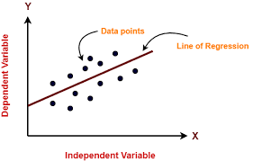
Linear Regression in the simplest terms:

Slide 5
What is needed for a linear regression model (Pytorch)
According to Marie

Slide 6
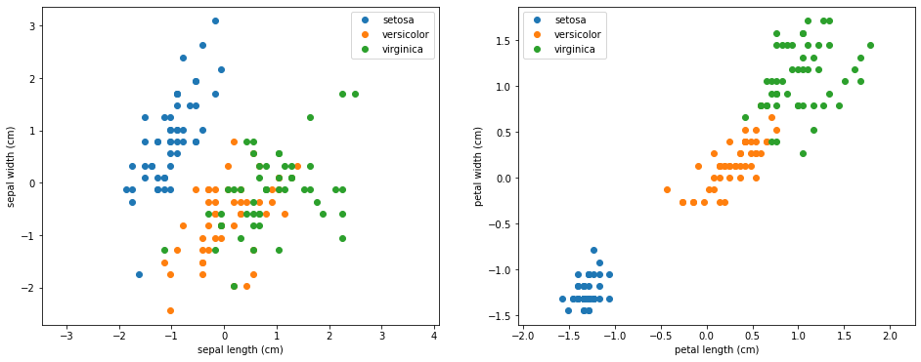


Linear data or data with linear correlation

Slide 7
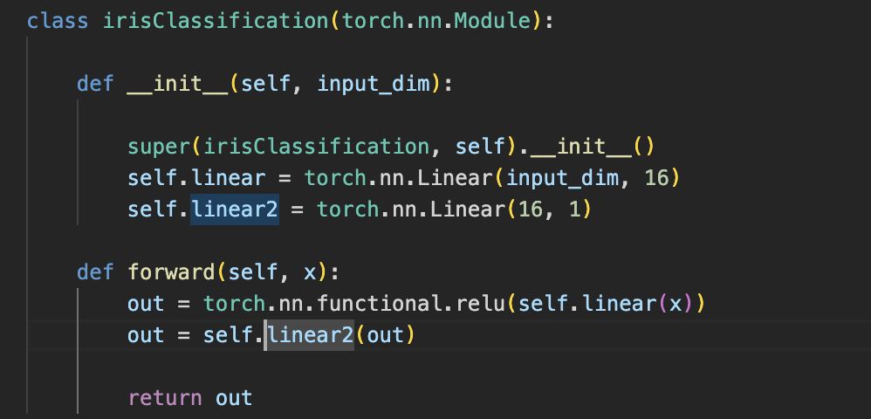
A model

Slide 8
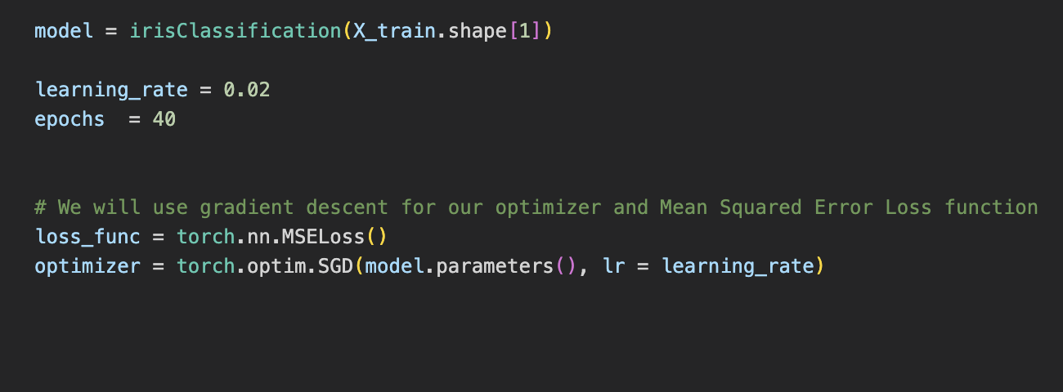
Hyper parameters

Slide 9
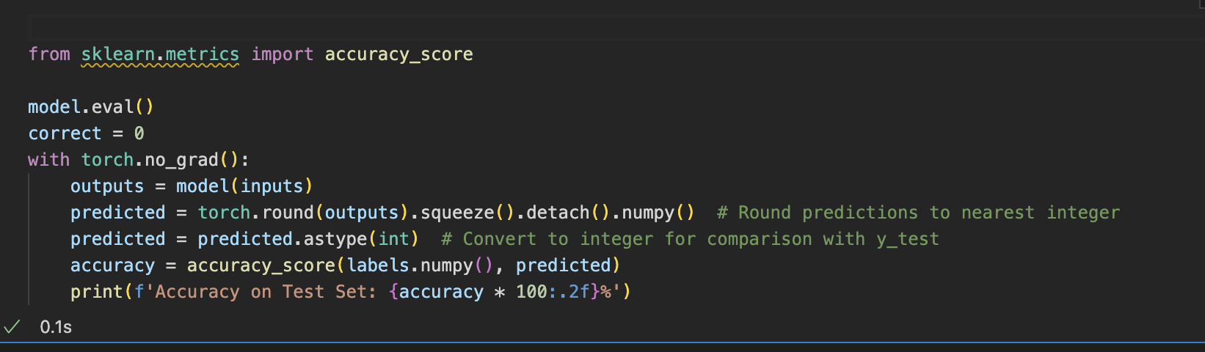
A way to track error and get results

Slide 10
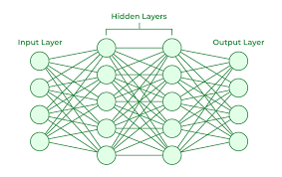
Breaking down a model Layers and Feed Forward (Ignore RNN)

Slide 11
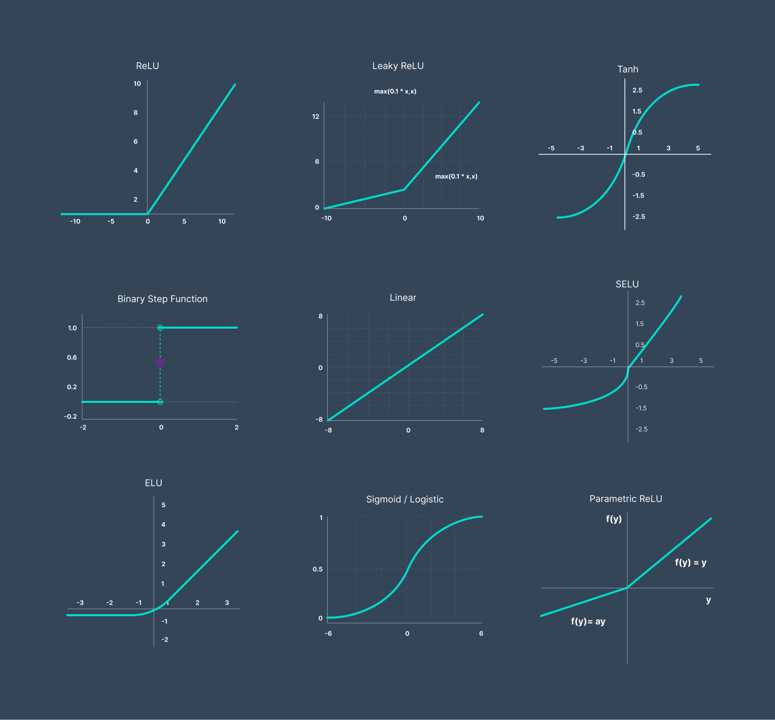
Activation functions: Calculations done on data to try and find patterns

Slide 12
Hyper Parameters
Learning Rate: How far your optimizer jumps forward. Should be small, unless limited epochs
Epochs: How many times your model looks over the data, finds more complex patterns each time (hopefully)
Loss Function: How you define model success (MSE is most common)
Optimizer: Updates weights and biases after an epoch, used with learning rate. <3 ADAM, although it can depend on model.

Slide 13
There is a coding doc in teams that has parts of the model you need to fill in. The goal in the next x minutes is to make a >90% accuracy in under 80 epochs by changing around hyper parameters and model layers. The basics have been put in for you. This will change as the club progresses.

