Slide 1
Algorithm and Complexity (CSC 405)
By
Prof. A. S. Sodiya

Slide 2
Content
Introduction to Algorithm and Complexity
Types of Algorithm
Algorithm Methodologies

Slide 3
1.0 Introduction to Algorithm
Definitions:
An algorithm is any well-defined computational procedure that takes some value, or set of values, as input and produces some value, or set of values, as output.
An algorithm is thus a sequence of computational steps that transform the
input into the output.
An algorithm can also be seen as a computational logic
We can also view an algorithm as a tool for solving a well-specified computational problem.
An algorithm describes a specific computational procedure for achieving that input/output relationship
An algorithm is a finite set of instructions that, if followed, accomplishes a
particular task.

Slide 4
Introduction to Algorithm….
All algorithms must satisfy the following criteria:
(1) Input. There are zero or more quantities that are externally supplied.
(2) Output. At least one quantity is produced.
(3) Definiteness. Each instruction is clear and unambiguous.
(4) Finiteness. If we trace out the instructions of an algorithm, then for all cases, the
algorithm terminates after a finite number of steps.
(5) Effectiveness. Every instruction must be basic enough to be carried out

Slide 5
Introduction to Algorithm
Computational complexity is the study of the cost of solving interesting problems.
It is the measure of the amount of resources needed in solving problems.
The major resources usually considered are:-
Time
Space
Algorithm analysis = Analysis of the resources usage of given algorithms
Targets:
Make resources usage to be of polynomial order
Make that polynomial as small as possible
Avoid:
Exponential order
ie. Polynomial is good, while exponential is bad

Slide 6
Introduction to Algorithm (contd….)
For example, we might need to sort a sequence of numbers in ascending order. This problem arises frequently in practice and provides fertile ground for introducing many standard design techniques and analysis tools. Here is how we formally define the sorting problem:
Input: A sequence of n numbers (a₁1 a₂, ….. a_{n})
Output: A permutation (reordering) (a’₁1 a’₂, ….. a’_{n}) i of the input sequence such
that a’₁ ≤ a’₂ ≤ ….. a’_{n} 1
For example, given the input sequence {31; 41; 59; 26; 41; 58}, a sorting algorithm
returns as output the sequence {26; 31; 41; 41; 58; 59}. Such an input sequence is
called an instance of the sorting problem. In general, an instance of a problem
consists of the input (satisfying whatever constraints are imposed in the problem
statement) needed to compute a solution to the problem.

Slide 7
Introduction to Algorithm (contd….)
The major goal of this course is to develop techniques for developing efficient algorithms.
Why efficient algorithms?
Efficient algorithms lead to efficient program
Efficient programs sell better
Efficient programs make better use of hardware
Programmers who write efficient programs are more marketable than those who don’t
Factors influencing program efficiency
Problem being solved
Programming languages
Compiler
Computer hardware
Programmer ability
Programmer effectiveness
Algorithm

Slide 8
2.0 Types of Algorithm
General Types of Algorithms
Category A: Deterministic vs. Randomized
One important (and exclusive) distinction one can make is, whether the algorithm is deterministic or randomized.
Deterministic algorithms produce on a given input the same results following the same computation steps. Randomized algorithms throw coins during execution. Hence either the order of execution or the result of the algorithm might be different for each run on the same input.
There are subclasses for randomized algorithms. Monte Carlo type algorithms and Las Vegas type algorithms.
A Las Vegas algorithm will always produce the same result on a given input. Randomization will only affect the order of the internal executions.
In the case of Monte Carlo algorithms, the result may might change, even be wrong. However, a Monte Carlo algorithm will produce the correct result with a certain probability.

Slide 9
A. Deterministic vs. Randomized
So of course the question arises: What are randomized algorithms good for? The computation might change depending on coin throws. Monte Carlo algorithms do not even have to produce the correct result.
Why would that be desirable?
The answer is two fold:
Randomized algorithms usually have the effect of perturbing the input. Or put it differently, the input looks random, which makes bad cases very seldom.
Randomized algorithms are often conceptually very easy to implement. At the same time they are in run time often superior to their deterministic counterparts.

Slide 10
Types of Algorithm (Contd…)
Category B: Offline vs. Online
Another important (and exclusive) distinction one can make is, whether the algorithm is offline or online.
Online algorithms are algorithms that do not know their input at the beginning. It is given to them online, whereas Offline algorithms know their input beforehand.
What seems like a minor detail has profound effects on the design of algorithms and on their analysis.
Online algorithms are usually analyzed by using the concept of competitiveness, that is the worst case factor they take longer compared to the best algorithm with complete information.
Most Online Algorithm are generic.
Offline:- Fixed data
Online:- Real time or dynamic data

Slide 11
Types of Algorithm (Contd…)
Examples of Offline vs. Online
Develop an to sort the data below in ascending order:-
34, 12, 134, 65, 986, 193, 304, 5, 566, 499, 777, 725, 300, 675, 99, 444, 845, 431, 955, 288

Slide 12
Types of Algorithm (Contd…)
Examples of Offline vs. Online
Develop an to sort the data below in ascending order:-
34, 12, 134, 65, 986, 193, 304, 5, 566, 499, 777, 725, 300, 675, 99, 444, 845, 431, 955, 288
Algorithm 1: Sort_offline_data
Input: A(LL)
Output: B(I)
LL <-- 1
Do While LL <= 20
Input A(LL)
LL <-- LL + 1
Enddo
Temp <-- A(1)
LL <-- 2
I <-- 1
Do While I <= 20
Temp = A(I)
J <-- I + 1
Do While J <= 20
If Temp > A(J)
Temp = A(I)
A(I) = A(J)
A(J) = Temp
Endif
J <-- J + 1
Enddo
I <-- I + 1
Enddo
End
Stop

Slide 13
Types of Algorithm (Contd…)
Example
2. Develop an algorithm to sort any integer of size n in ascending order:-

Slide 14
C. Exact vs approximate
Exact algorithms aim at computing the actual or optimal solution.
They are often quite expensive in terms of run time or memory, and hence sometimes difficult or not possible for large input.
They usually havean optimization goal in mind, e.g. compute the real results, shortest path, the alignment or minimal distance
Approximation algorithms aim at solving an optimization problem that runs in polynomial time in the length of the input and outputs a solution that is guaranteed to be close to the optimal solution.
Given an optimization problem P, an algorithm A is said to be an approximation algorithm for P, if for any given instance I, it returns an approximate solution, that is a feasible solution
The goal of an approximation algorithm is to come as close as possible to the optimum value in a reasonable amount of time which is at most polynomial time.

Slide 15
C. Exact vs approximate ……
Exact algorithms are designed in such a way that it is guaranteed that they will find the optimal solution in a finite amount of time
In computer science and operations research, approximation algorithms are efficient algorithms that find approximate solutions to NP-hard optimization problems with provable guarantees on the distance of the returned solution to the optimal one.
Approximation algorithms
Guaranteed to run in polynomial time.
2. Guaranteed to get a solution which is close to the optimal solution (a.k.a near optimal).
3. Obstacle : need to prove a solution’s value is close to optimum value, without even knowing what the optimum value is !
Exercise 1:
Can approximate algorithms be better than exact algorithm? Justify your answer and give instances

Slide 16
D. Heuristic and Operational
Heuristic algorithms try to reach the optimal solution without giving a guarantee that they always do.
A good heuristics is almost always near or at the optimal value.
Heuristics
1. Develop intuitive algorithms.
2. Guaranteed to run in polynomial time.
3. No guarantees on quality of solution.

Slide 17
E. Metaheuristic
A metaheuristic algorithm is used to define heuristic methods applicable to a wide set of different problems.
A metaheuristic algorithm can be seen as a general purpose heuristic method toward promising regions of the search space containing high-quality solutions.
A metaheuristic is a general algorithmic framework which can be applied to different optimization problems with relatively few modifications to make them adapted to a specific problem.
Exercise 2:
Differentiate between heuristic and metaheuristic

Slide 18
E. Metaheuristic…..
The metaheuristics are from now on regularly employed in all the sectors of engineering,
Examples of metaheuristics algorithms:
The evolutionary algorithms
The tabu search method
The ant colony optimization
The simulated annealing method
Etc.

Slide 19
F. Combinatorial Algorithm
Combinatorial algorithms are computational procedures which are designed to help solve combinatorial problems. Combinatorial problems are problems involving arrangements of elements from a finite set and selections from a finite set. These problems can be divided into three basic types: (1) enumeration problems, (2) existence problems, and (3) optimization problems.

Slide 20
F. Combinatorial Algorithms…
In enumeration problems, the goal is either to find how many arrangements there are satisfying the given properties or to produce a list of arrangements satisfying the given properties.
In existence problems, the goal is to decide whether or not an arrangement exists satisfying the given properties.
In optimization problems the goal is to find where a given function of several variables takes on an extreme value (maximum or minimum) over a given finite domain. Graph theoretic algorithms are included in the above definition of combinatorial algorithms.
Exercise 3:
Design an algorithm to compute ^{n}C_{p}

Slide 21
F. Combinatorial Algorithms…
Solution to Exercise 3

Slide 22
G. Operational Algorithms
Operational algorithms aim at executing establish procedure or expert knowledge.
They are algorithms which do not aim at optimizing an objective function.
They chain a series of computational operations guided by expert knowledge but not in conjunction with a specific objective function.
They are usually used to implement organisational’ processes

Slide 23
3.0 Algorithm Design Methodologies
Major algorithmic paradigms are:-
Simple recursive algorithms
Backtracking algorithms
Divide-and-conquer algorithms
Dynamic programming algorithms
Greedy algorithms
Branch-and-bound algorithms
Brute force algorithms
and others....

Slide 24
A. Simple Recursive Algorithms
A simple recursive algorithm
Solves the base cases directly
Recurs with a simpler subproblem
Does some extra work to convert the solution to the simpler subproblem into a solution to the given
problem
Examples are:
To count the number of elements in a list:
– If the list is empty, return zero; otherwise,
– Step past the first element, and count the remaining elements in the list
– Add one to the result
To test if a value occurs in a list:
– If the list is empty, return false; otherwise,
– If the first thing in the list is the given value, return true; otherwise
– Step past the first element, and test whether the value occurs in the remainder of the list

Slide 25
B. Backtracking Algorithm
A simple recursive algorithm
A backtracking algorithm is based on a depth-first recursive search. It
Tests to see if a solution has been found, and if so, returns it; otherwise
For each choice that can be made at this point,
– Make that choice
– Recur
– If the recursion returns a solution, return it
If no choices remain, return failure
For example, color a map with no more than four colors:
colour(Country n)
– If all countries have been colored (n > number of countries) return success; otherwise,
– For each colour c of four colours,
Color country n with colour c
recursively color country n + 1
If successful, return success
Return failure

Slide 26
B. Backtracking Algorithm
A backtracking algorithm is based on a depth-first recursive search.
Backtracking is an algorithm for capturing some or all solutions to given computational issues, especially for constraint satisfaction issues. The algorithm can only be used for problems which can accept the concept of a “partial candidate solution” and allows a quick test to see if the candidate solution can be a complete solution.
Backtracking is considered an important technique to solve constraint satisfaction issues and puzzles.
It
Tests to see if a solution has been found, and if so, returns it; otherwise
For each choice that can be made at this point,
– Make that choice
– Recur
– If the recursion returns a solution, return it
If no choices remain, return failure
For example, colour a map with no more than four colours:
colour(Country n)
– If all countries have been colored (n > number of countries) return success; otherwise,
– For each colour c of four colours,
Colour country n with colour c
recursively color country n + 1
If successful, return success
Return failure

Slide 27
B. Backtracking Algorithm
Backtracking helps in solving an overall issue by finding a solution to the first sub-problem and then recursively attempting to resolve other sub-problems based on the solution of the first issue.
If the current issue cannot be resolved, the step is backtracked and the next possible solution is applied to previous steps, and then proceeds further. In fact, one of the key things in backtracking is recursion.

Slide 28
B. Backtracking Algorithm….
Backtracking Methodology
View picking a solution as a sequence of choices
For each choice, consider every option recursively
Return the best solution found

Slide 29
B. Backtracking Algorithm….
Pick a starting point.
while(Problem is not solved)
For each path from the starting point.
check if selected path is safe, if yes select it
and make recursive call to rest of the problem
If recursive calls returns true,
then return true.
else
undo the current move and return false.
End For
If none of the move works out, return false, NO SOLUTON.

Slide 30
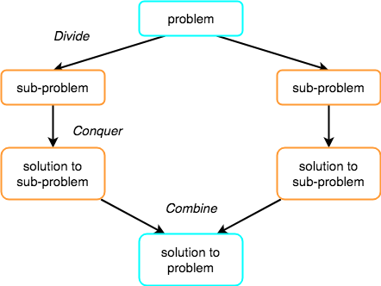
B. Divide-and-conquer algorithms
The concept of Divide and Conquer involves three steps:
Divide the problem into multiple small problems.
Conquer the subproblems by solving them. The idea is to break down the problem into atomic subproblems, where they are actually solved.
Combine the solutions of the subproblems to find the solution of the actual problem.

Slide 31
B. Divide-and-conquer algorithms
A divide-and-conquer algorithm consists of two parts:-
Divide the problem into smaller subproblems of the same type and solve these subproblems recursively
Combine the solutions to the subproblems into a solution to the original problem
Traditionally, an algorithm is only called divide-and-conquer if it contains two or more recursive calls.
Two examples:
Quicksort:
– Partition the array into two parts, and quicksort each of the parts
– No additional work is required to combine the two sorted parts
Mergesort:
– Cut the array in half, and mergesort each half
– Combine the two sorted arrays into a single sorted array by merging them

Slide 32
Quick Sort
Divide: The array A[p . . r] is partitioned (rearranged) into two nonempty subarrays A[p . . q] and A[q + 1 . . r] such that each element of A[p . . q] is less than or equal to each element of A[q + 1 . . r]. The index q is computed as part of this partitioning procedure.
Conquer: The two subarrays A[p . . q] and A[q + 1 . . r] are sorted by recursive calls to quicksort.
Combine: Since the subarrays are sorted in place, no work is needed to combine them: the entire array A[p . . r] is now sorted.
The following procedure implements quicksort.
QUICKSORT(A,p,r)
1 if p < r
2 then q PARTITION(A,p,r)
3 QUICKSORT(A,p,q)
4 QUICKSORT(A,q + 1,r)
To sort an entire array A, the initial call is QUICKSORT(A, 1, length[A]).

Slide 33
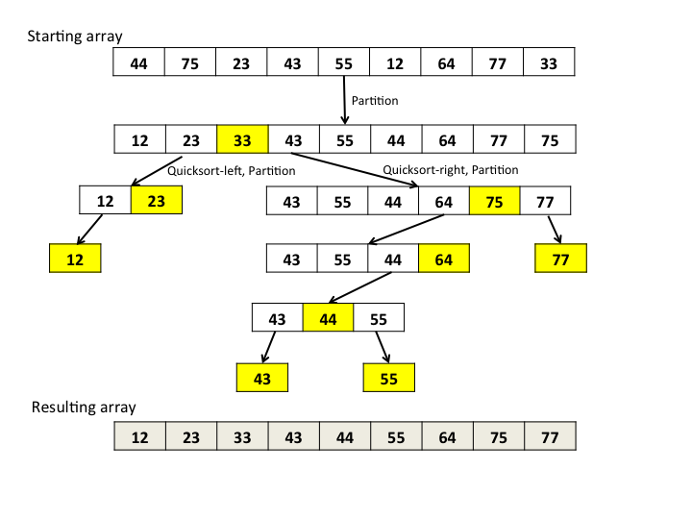
Quick Sort example….

Slide 34
Quick Sort
Partitioning the array
The key to the algorithm is the PARTITION procedure, which rearranges the subarray A[p . . r] in place.
PARTITION(A,p,r)
1 x A[p]
2 i p - 1
3 j r + 1
4 while TRUE
5 do repeat j j - 1
6 until A[j] x
7 repeat i i + 1
8 until A[i] x
9 if i < j
10 then exchange A[i] A[j]
11 else return j

Slide 35
Quick Sort
Exercises
1. Illustrate the operation of PARTITION on the array A = 13, 19, 9, 5, 12, 8, 7, 4, 11, 2, 6, 21.
2. What value of q does PARTITION return when all elements in the array A[p . . r] have the same value?
3. Give a brief argument that the running time of PARTITION on a subarray of size n is (n).
4. How would you modify QUICKSORT to sort in nonincreasing order?

Slide 36
Merge Sort
Merge sort uses a divide-and-conquer approach:
1) Divide the array repeatedly into two halves
2) Stop dividing when there is single element left. By
fact, single element is already sorted.
3) Merges two already sorted sub arrays into one.
Pseudo Code:
a) Input: Array A[1…N], indices p, q, r (p ≤ q <r).
A[p…r] is the array to be divided
A[p] is the beginning element and A[r] is the ending element
Output: Array A[p…r] in ascending order

Slide 37
Merge Sort
Merge sort uses a divide-and-conquer approach:
1) Divide the array repeatedly into two halves
2) Stop dividing when there is single element left. By
fact, single element is already sorted.
3) Merges two already sorted sub arrays into one.
Pseudo Code:
a) Input: Array A[1…N], indices p, q, r (p ≤ q <r).
A[p…r] is the array to be divided
A[p] is the beginning element and A[r] is the ending element
Output: Array A[p…r] in ascending order

Slide 38
Merge Sort
The merge sort algorithm closely follows the divide-and-conquer paradigm. Intuitively, it operates as follows.
Divide: Divide the n-element sequence to be sorted into two subsequences of n/2 elements each.
Conquer: Sort the two subsequences recursively using merge sort.
Combine: Merge the two sorted subsequences to produce the sorted answer.

Slide 39
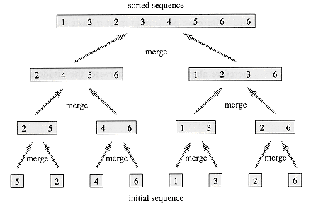
Merge Sort

Slide 40
Merge Sort Algorithm
MERGE-SORT(A,p,q,r)
1 if p <r
2 then q ← (r + p)/2
3 MERGE-SORT(A, p, q )
4 MERGE-SORT(A,q+1,r)
5 MERGE(A, p, q, r)

Slide 41
Merge Sort Algorithm
Algorithm 1: MergeSort(A)
n ← length(A);
if n ≤ 1 then
return A;
L ← MergeSort(A[1 : n/2]);
R ← MergeSort(A[n/2 + 1 : n]);
return Merge(L, R);

Slide 42
Merge Sort Algorithm
Algorithm 2: Merge(L, R)
m ← length(L) + length(R);
S ← empty array of size m;
i ← 1; j ← 1;
for k = 1 → m do
if L(i) < R(j) then
S(k) ← L(i);
i ← i + 1;
else
S(k) ← R(j);
j ← j + 1;
return S;
Intuitively, Merg

Slide 43
Dynamic Programming Algorithm
Dynamic programming algorithms
A dynamic programming algorithm remembers past results and uses them to find new results. Dynamic programming
is generally used for optimization problems in which:
Multiple solutions exist, need to find the best one
Requires optimal substructure and overlapping subproblem
Optimal substructure: Optimal solution contains optimal solutions to subproblems
Overlapping subproblems: Solutions to subproblems can be stored and reused in a bottom-up fashion
This differs from Divide-and-Conquer, where subproblems generally need not overlap.

Slide 44
Dynamic Programming Algorithm….
There are many examples in bioinformatics. For example:
Compute an optimal pairwise alignment
– Optimal substructure: the alignment of two prefixes contains solutions for the optimal alignments of smaller prefixes.
– Overlapping subproblems: The solution for the optimal alignment of two prefixes can be constructed
using the stored solutions of the alignment of three subproblems (in the linear gap model).
Compute a Viterbi path in an HMM
– Optimal substructure: the Viterbi path for an input prefix ending in a state of an HMM contains shorter
Viterbi paths for smaller parts of the input and other HMM states.
– Overlapping subproblems: The solution for the Viterbi path for an input prefix ending in a state of an
HMM can be constructed using the stored solutions of Viterbi paths for a shorter input prefix and all
HMM states.

Slide 45
Greedy Algorithm
A greedy algorithm sometimes works well for optimization problems. A greedy algorithm works in phases.
At each phase:
You take the best you can get right now, without regard for future consequences
You hope that by choosing a local optimum at each step, you will end up at a global optimum
This strategy actually often works quite well and for some class of problems it always yields an optimal solution.
Do you know a simple graph problem which is solved greedily to optimality?

Slide 46
Branch-and-Bound Algorithm
Exercises
1. Illustrate the operation of merge sort on the array A = 3, 41, 52, 26, 38, 57, 9, 49.
2. Write pseudocode for MERGE(A,p,q,r).

Slide 47
Greedy Algorithm….
A greedy algorithm sometimes works well for optimization problems. A greedy algorithm works in phases.
At each phase:
You take the best you can get right now, without regard for future consequences
You hope that by choosing a local optimum at each step, you will end up at a global optimum
This strategy actually often works quite well and for some class of problems it always yields an optimal solution.
Do you know a simple graph problem which is solved greedily to optimality?

Slide 49
Analysis of Algorithms
• Issues:
Correctness
Time Efficiency
Space Efficiency
Optimality
• Approaches:
Theoretical Analysis
Empirical Analysis

Slide 50
Analysis of Algorithms - Issues
Issues:
Correctness – Does it work as advertised?
Time Efficiency – Are time requirements minimized?
Space Efficiency – Are space requirements minimized?
Optimality – Do we have the best balance between minimizing time and space?
Theoretical

Slide 51
Theoretical Analysis Of Time Efficiency
Time efficiency is analyzed by determining the number of repetitions of the basic operation as a
function of input size
Basic operation: the operation that contributes most towards the running time of the algorithm
T(n) = C_{op} * C(n)
Where,
T(n) = Running Time
C_{op} = Execution Time For Basic Operation
C(n) = Number Of Times Basic Operation Is Executed

Slide 52
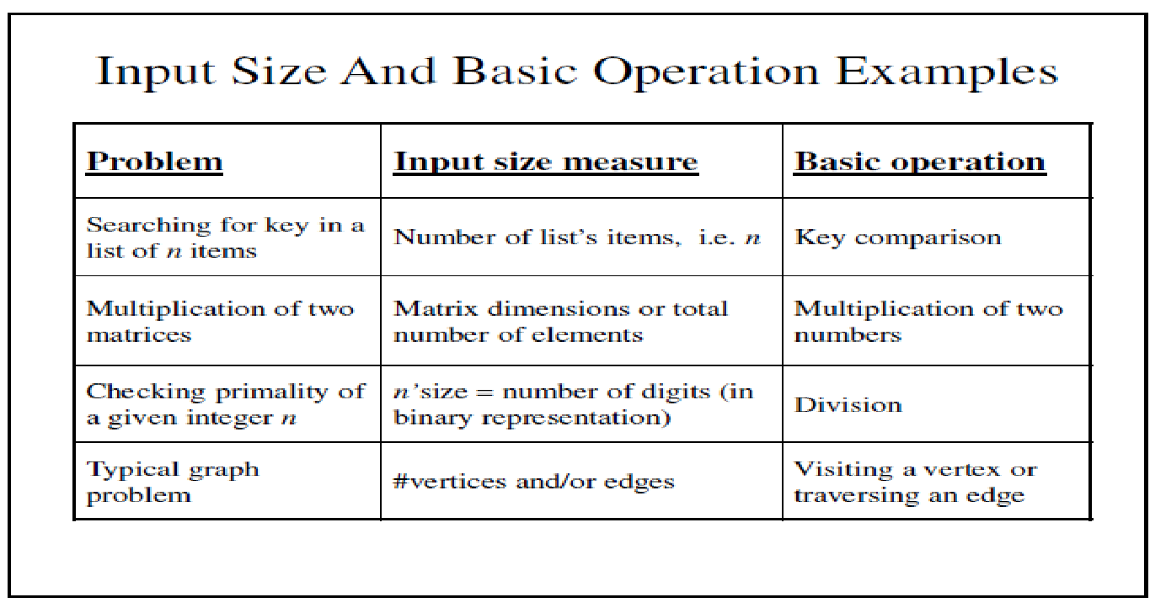
Theoretical Analysis Of Time Efficiency
Time efficiency is analyzed by determining the number of repetitions of the basic operation as a
function of input size
Basic operation: the operation that contributes most towards the running time of the algorithm
T(n) = C_{op} * C(n)
Where,
T(n) = Running Time
C_{op} = Execution Time For Basic Operation
C(n) = Number Of Times Basic Operation Is Executed

Slide 53
Empirical Analysis Of Time Efficiency
• Select a specific (typical) sample of inputs
• Use physical unit of time (e.g., milliseconds)
or
• Count actual number of basic operation’s
executions
• Analyze the empirical data

Slide 54
Best-Case, Average-Case, Worst-Case
• For some algorithms efficiency depends on
form of input:
– Worst case: C_{worst}(n) – maximum over inputs of
size n
– Best case: C_{best}(n) – minimum over inputs of
size n
– Average case: C_{avg}(n) – “average” over inputs of
size n

Slide 55
Average-Case
• Average case: C_{avg}(n) – “average” over inputs
of size n
Number of times the basic operation will be executed on typical input NOT the average of worst and best case
Expected number of basic operations considered as a random variable under some assumption about the probability distribution of all possible inputs

Slide 56
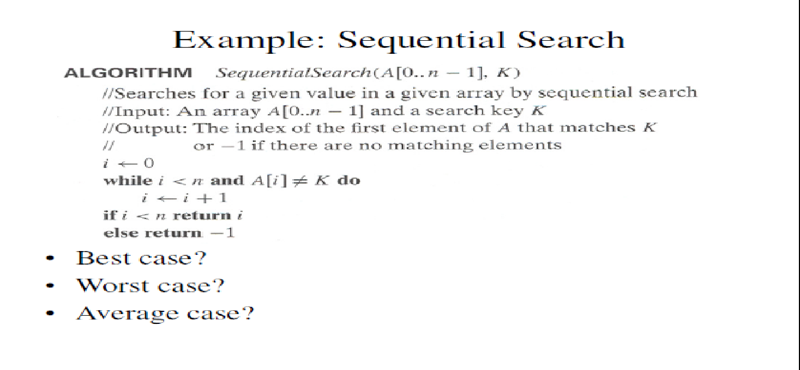
Average-Case

Slide 57
Best-Case

Slide 58
Average-Case

Slide 59
Order of Growth
Most important: Order of growth within a constant multiple as n
Example:
– How much faster will algorithm run on computer that is twice as fast?
– How much longer does it take to solve problem of double input size?

Slide 60
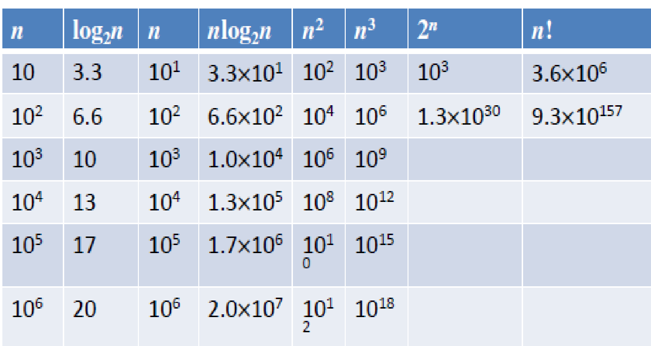
Some values of important function

Slide 61
Some values of important function

Slide 62
Some values of important function Order of Growth… The first thing is what constitutes a `primitive` operation. Most analysis of code is done in random access machine model, under which all arithmetic, comparison, assignment, logical operations fall.
The order of growth for a piece of code solving a particular problem is generally expressed as a polynomial, which represents the number of `primitive` operations required to be done expressed as a function of the input size.

Slide 63
Some values of important function Now if you sum up all the primitive operations' cost you get C = c1 + n*c2 + 2*c3*n + c4 = (c1+c4) + n*(c2+c3) = C1+n*C2
Consider this peace of code for calculating the factorial of a number:
function factorial(n): fact = 1 for i in range(0 to n-1) fact = fact * i return fact
C = θ(n)

Slide 64
Some values of important function Now if you sum up all the primitive operations' cost you get C = c1 + n*c2 + 2*c3*n + c4 = (c1+c4) + n*(c2+c3) = C1+n*C2
Consider this peace of code for calculating the factorial of a number:
function factorial(n): fact = 1 for i in range(0 to n-1) fact = fact * i return fact
C = θ(n)

Slide 65
Polynomial Order of Algorithms
P - Problems that can be solved in polynomial time.
P- Polynomial time solving . Problems which can be solved in polynomial time, which take time like O(n), O(n2), O(n3). Eg: finding maximum element in an array or to check whether a string is palindrome or not. so there are many problems which can be solved in polynomial time.
NP - Problems that can be verified in polynomial time.
Therefore, Every P problem is also a NP as every P problem can also be verified in polynomial time, but viceversa is not true because every NP problem cannot be solved in polynomial time.
NP- Non deterministic Polynomial time solving. Problem which can't be solved in polynomial time like TSP( travelling salesman problem) or An easy example of this is subset sum: given a set of numbers, does there exist a subset whose sum is zero?.
but NP problems are checkable in polynomial time means that given a solution of a problem , we can check that whether the solution is correct or not in polynomial time.

Slide 66
NP-Hard and NP Complete Problems
P - Problems that can be solved in polynomial time.
NP - Problems that can be verified in polynomial time.
Therefore, Every P problem is also a NP as every P problem can also be verified in polynomial time, but viceversa is not true because every NP problem cannot be solved in polynomial time.
Now here are our problems depicted in using a venn diagram,

Slide 67
Reducibility
Take two problems A and B both are NP problems.
Reducibility- If we can convert one instance of a problem A into problem B (NP problem) then it means that A is reducible to B.
NP-hard-- Now suppose we found that A is reducible to B, then it means that B is at least as hard as A.
NP-Complete -- The group of problems which are both in NP and NP-hard are known as NP-Complete problem.
Now suppose we have a NP-Complete problem R and it is reducible to Q then Q is at least as hard as R and since R is an NP-hard problem. therefore Q will also be at least NP-hard , it may be NP-complete also.

Slide 68
Reducibility
NP-hard-- Now suppose we found that A is reducible to B, then it means that B is at least as hard as A.
NP-Complete -- The group of problems which are both in NP and NP-hard are known as NP-Complete problem.
Now suppose we have a NP-Complete problem R and it is reducible to Q then Q is at least as hard as R and since R is an NP-hard problem. therefore Q will also be at least NP-hard , it may be NP-complete also.

Slide 69
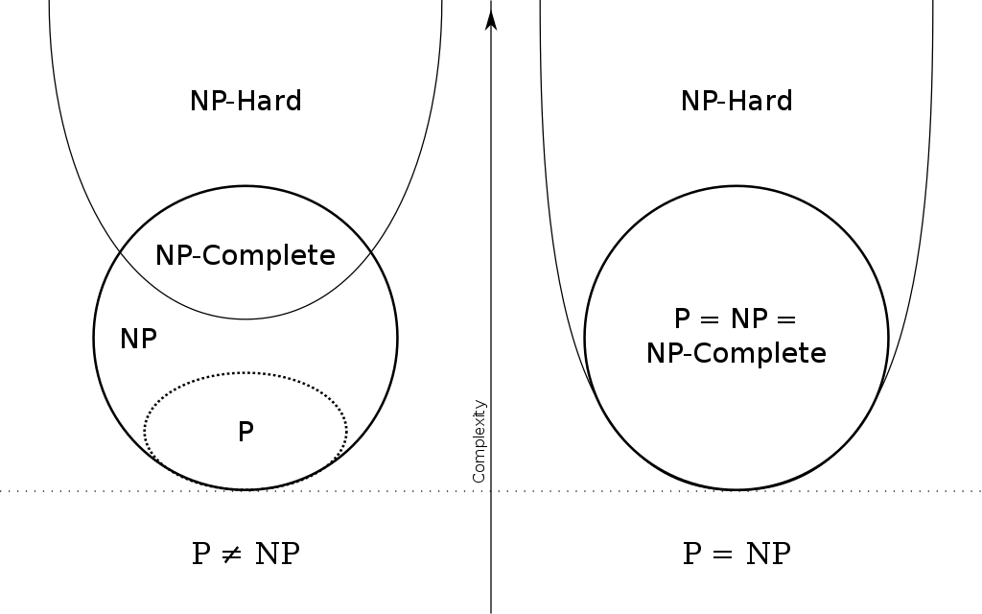

Slide 70
Reducibility
Take two problems A and B both are NP problems.
Reducibility- If we can convert one instance of a problem A into problem B (NP problem) then it means that A is reducible to B.
NP-hard-- Now suppose we found that A is reducible to B, then it means that B is at least as hard as A.
NP-Complete -- The group of problems which are both in NP and NP-hard are known as NP-Complete problem.
Now suppose we have a NP-Complete problem R and it is reducible to Q then Q is at least as hard as R and since R is an NP-hard problem. therefore Q will also be at least NP-hard , it may be NP-complete also.

Slide 71
Polynomial Order of Algorithms
Backtracking helps in solving an overall issue by finding a solution to the first sub-problem and then recursively attempting to resolve other sub-problems based on the solution of the first issue.
If the current issue cannot be resolved, the step is backtracked and the next possible solution is applied to previous steps, and then proceeds further. In fact, one of the key things in backtracking is recursion.

