Slide 1
Secure Data Hiding in Image Using Steganography
CAPSTONE PROJECT
Presented By:
Student Name : A.Liharika
College Name & Department :Methodist College of Engineering and Technology ,CSE dept.

Slide 2
OUTLINE
Problem Statement
Technology used
Unique features
End users
Result
Git-hub Link

Slide 3
This project successfully demonstrates a secure data-hiding mechanism using steganography.
By embedding encrypted messages within images, we ensure data confidentiality while maintaining image quality.
Future improvements include AI-based steganalysis resistance and mobile app implementation.
problem statement:

Slide 4
With the increase in digital communication, securing sensitive information is crucial.
Steganography offers a way to embed hidden messages inside images, making data transfer secure without raising suspicion.
This project focuses on Least Significant Bit (LSB) steganography to achieve secure data hiding.

Slide 5
tECHNOLOGY USED:
Libraries:
Pillow (PIL): For handling image processing and manipulation.
NumPy: For efficient array and pixel data processing.
PyCryptodome: For AES encryption and secure data handling.
Base64: For encoding encrypted data before embedding.
Platforms:
Google Colab: Cloud-based execution for running the project without installation.
Python 3: Core programming language used for implementation.

Slide 6
Advanced LSB steganography with optional encryption
Works seamlessly on Google Colab
Supports multiple file formats (PNG, JPEG, BMP)
Randomized pixel selection for enhanced security
Can hide text, images, and files
Unique features:

Slide 7
Cybersecurity professionals
Digital forensics researchers
Secure messaging applications
Law enforcement agencies
end users:

Slide 8
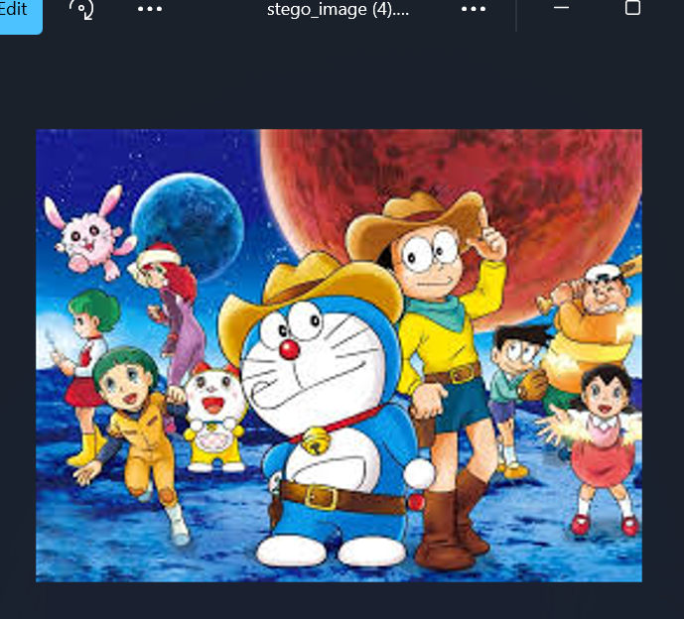
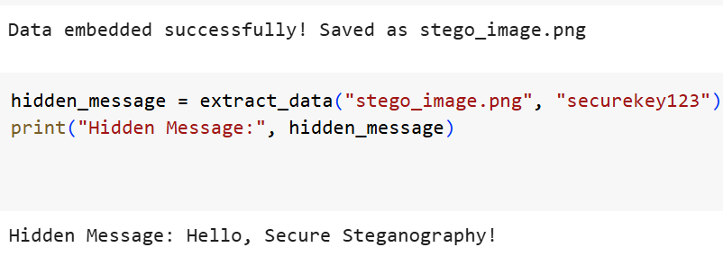
OUTPUTS:

Slide 9
GITHUB REPOSITORY LINK:
https://github.com/Liharika03/Steganography

Slide 10
THANK YOU

