Slide 1

Internal
TECHNOLOGY PLATFORM
Leave Management System
Executive Overview

Slide 2




The Problem — How Leave Is Managed Today
Excel & Paper-Based
No Approval Trail
Leave tracked in spreadsheets — easy to lose, hard to update, no real-time visibility
Approvals done by email or verbally — no record of who approved, when, or why
Balance Errors
Staffing Surprises
Manual calculations lead to wrong balances — employees take more or less than entitled
Managers don't know who's off until the day — no team planning or capacity control
No Reporting
Year-End Chaos
HR spends hours compiling leave data for reports — no dashboard, no trends
Carry forward and entitlement reset done manually — errors and disputes every January
These problems cost HR time, create disputes, and increase risk for the company.

Slide 3






The Solution — Leave Management System
Apply Leave Online
Automatic Approval Chain
Employees request leave from any device — choose type, dates, reason, and submit in minutes
Requests go to the right supervisor automatically — up to 5 levels, with full audit trail
Email Approve / Reject
Team Calendar & Planning
Supervisors approve or reject directly from email with one click — no login required
See who's on leave, check staffing capacity, prevent overbooking — all in one view
Reports & Export
Year-End Automation
Generate leave reports instantly — export to Excel or CSV for HR records and audits
Carry forward, burn expired leave, and generate next year's entitlements — one click
One system replaces Excel, email, and paper — saving HR time and reducing errors.

Slide 4
What Can It Do? — 28 Features
Employee (10)
Supervisor (7)
1. Apply Leave
11. Leave Approval
2. Leave Balance
12. Withdrawal Approval
3. Leave History
13. Replacement Approval
4. My Leave Entitlement
14. Subordinate Leave Entry
5. Leave Calendar
15. Subordinate Leave Adjustment
6. Cancel / Withdraw Leave
16. Team Calendar
7. Replacement Leave
17. Daily Leave View
8. Who's On Leave
Admin / HR (8)
9. My Approval Chain
10. Public Holiday
18. Leave Type Configuration
19. Leave Entitlement
System-Wide (3)
20. Years of Service Rules
26. Email Notifications
21. Approval Chain Setup
22. Capacity Settings
27. One-Click Email Approval
23. Admin Settings
28. Real-Time Alerts
24. Leave Report & Export
25. Year-End Closing

Slide 5
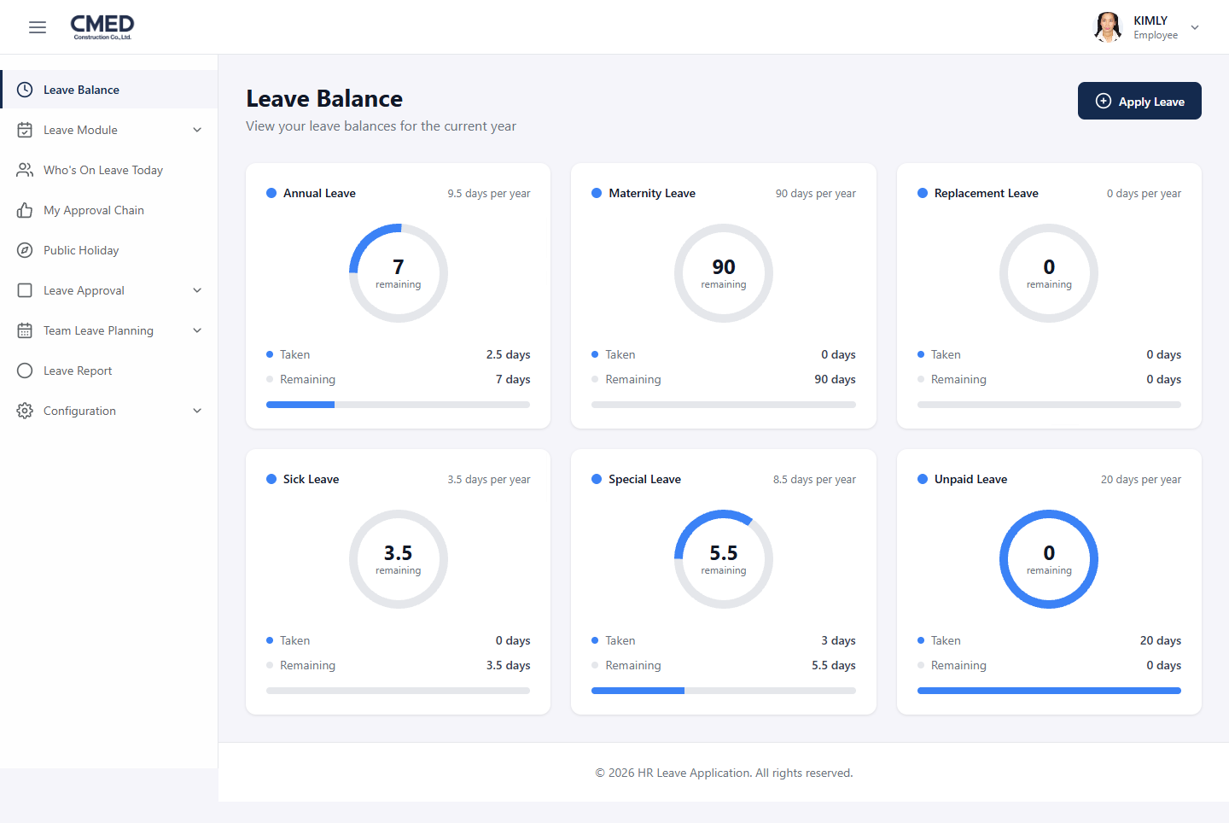
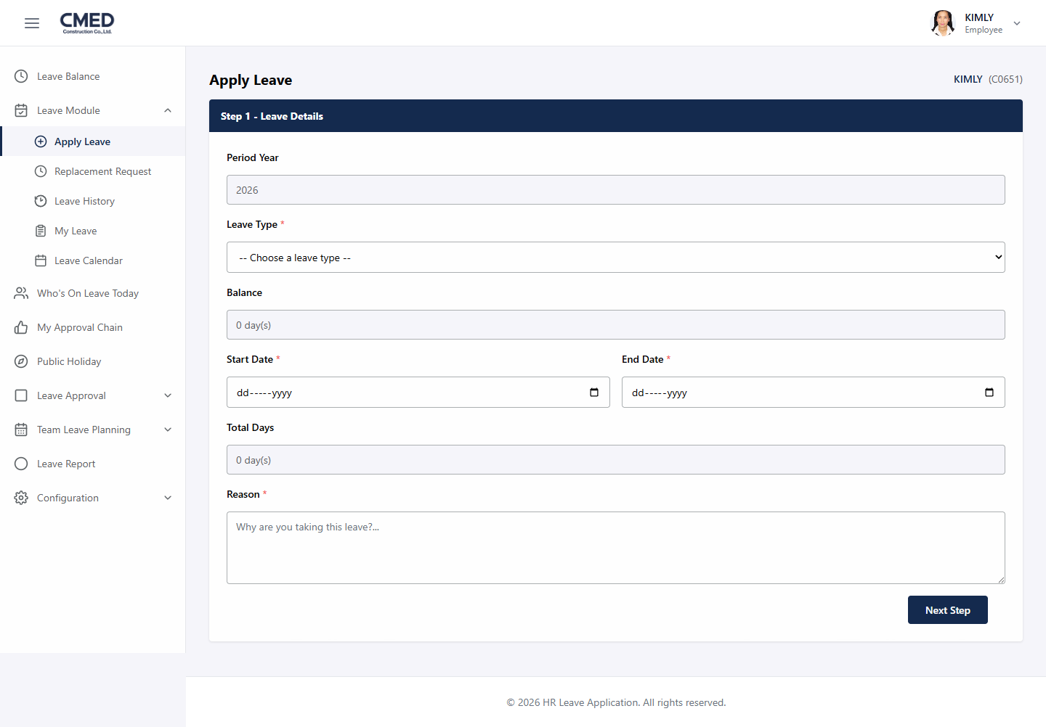
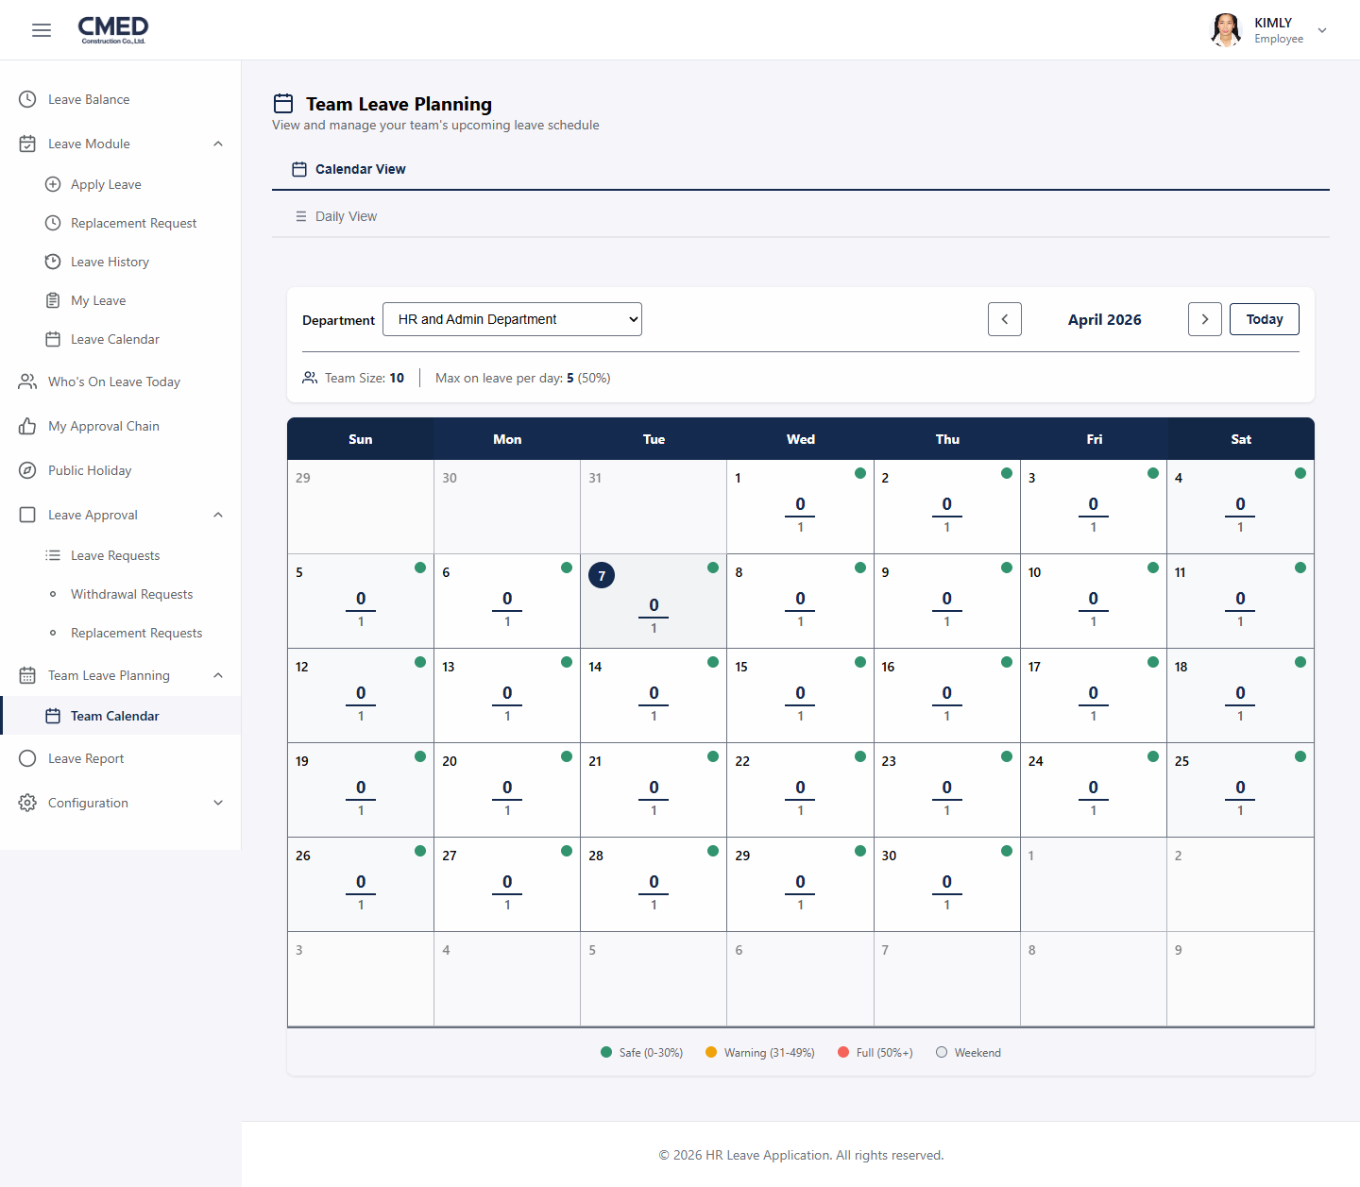
How It Looks
A modern, professional interface employees already find easy to use.
Leave Balance Dashboard
Apply for Leave
Team Leave Planning
Key Highlights
Works on any device — desktop, tablet, or phone browser
CMED branding and login integrated with company authentication
All employee data synced automatically from OrgChart — no manual entry
Color-coded calendar shows team capacity at a glance (Green / Yellow / Red)

Slide 6
Business Impact
Before (Manual Process)
After (This System)
✗ Leave tracked in Excel files
✓ Real-time digital dashboard
✗ Approval by email / verbal
✓ Automatic multi-level approval chain
✗ HR calculates balances manually
✓ System calculates automatically
✗ No visibility on team availability
✓ Team calendar with capacity alerts
✗ Reports take hours to compile
✓ One-click export to Excel / CSV
✗ Year-end takes days of manual work
✓ Year-end closing in one click
✗ No audit trail for approvals
✓ Full history with timestamps
✗ Errors cause disputes with staff
✓ Accurate, transparent, trusted
Save HR time · Eliminate errors · Full transparency · Happy employees

Slide 7
Internal
Thank You
Leave Management System — Ready for Review
Questions & Feedback Welcome

