Slide 1
Python Coding for Creating Glyphs
Jinta Zheng
zhenjint@oregonstate.edu
Office Hours: Thursday 3:00PM-5:00PM
Zoom Link: https://oregonstate.zoom.us/j/4537081606?pwd=cUVEZ0VFd3FQSEl2b0Nob0ZXeTRndz09

Slide 2
Outline
Download python and install
https://code.visualstudio.com/docs/python/python-tutorial
Environment setup
Design
Execute

Slide 3
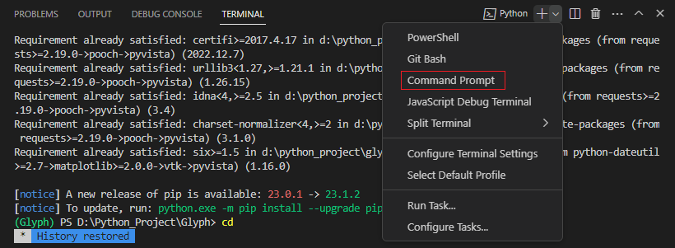
Environmental setup
Code example:
Github: https://github.com/jintazheng/InfoVisExample.git
Canvas: canvas/files/softwaretools/python
Requirement:
Visual studio code
Powershell->cmd
Python 64-bit, version > 3.10
https://www.python.org/downloads/

Slide 4
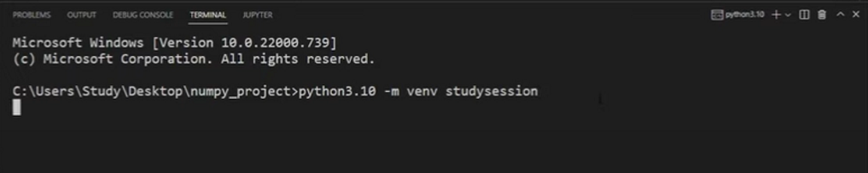
Environmental setup
Phython3.10 –m venv studysession

Slide 5
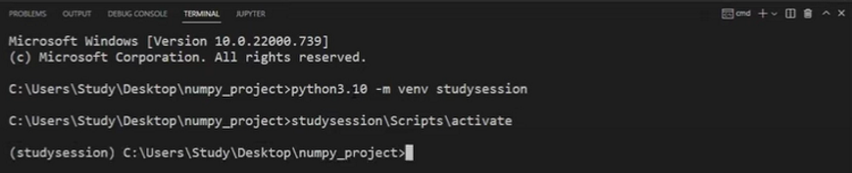
Environmental setup
…>studysession\Scripts\activate

Slide 6
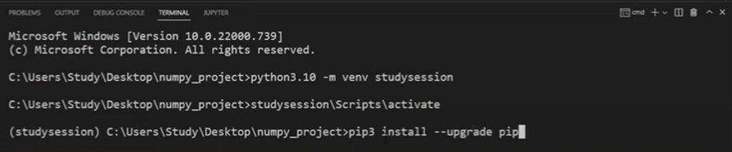
Environmental setup
> pip3 install – upgrade pip

Slide 7
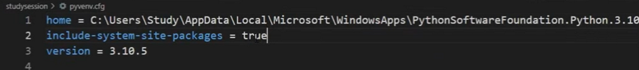
Environmental setup
Include-system-site-packages = true

Slide 8
Environmental setup
>pip install numpy
>pip install pyvista

Slide 9
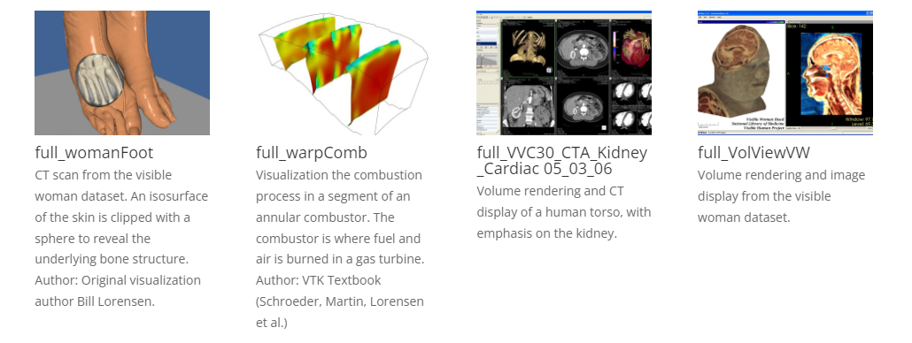
VTK(Visualization Toolkit)
Notes:
The Visualization Toolkit, or VTK, is an open-source, cross-platform software system for 3D computer graphics, image processing, and visualization. It was initially developed in 1993 and has become widely used in both research and industry. VTK is written in C++ and offers interfaces for Python

Slide 10
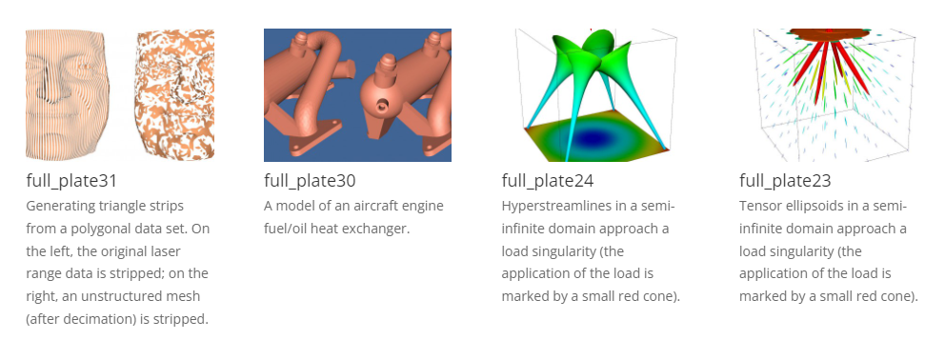
VTK
Notes:
VTK provides various tools and functionalities, such as algorithms for filtering, geometric transformations, modeling, rendering, and interaction. It supports a wide variety of visualization techniques, including scalar, vector, and tensor field visualization, as well as volume rendering and advanced algorithms like isosurface extraction and streamline generation.

Slide 11
Environmental setup
PyVista
Python-based library
https://docs.pyvista.org/index.html

Slide 12
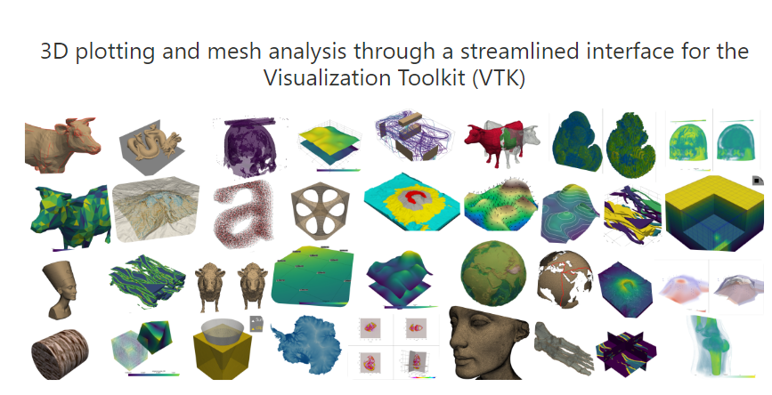
Environmental setup
PyVista

Slide 13
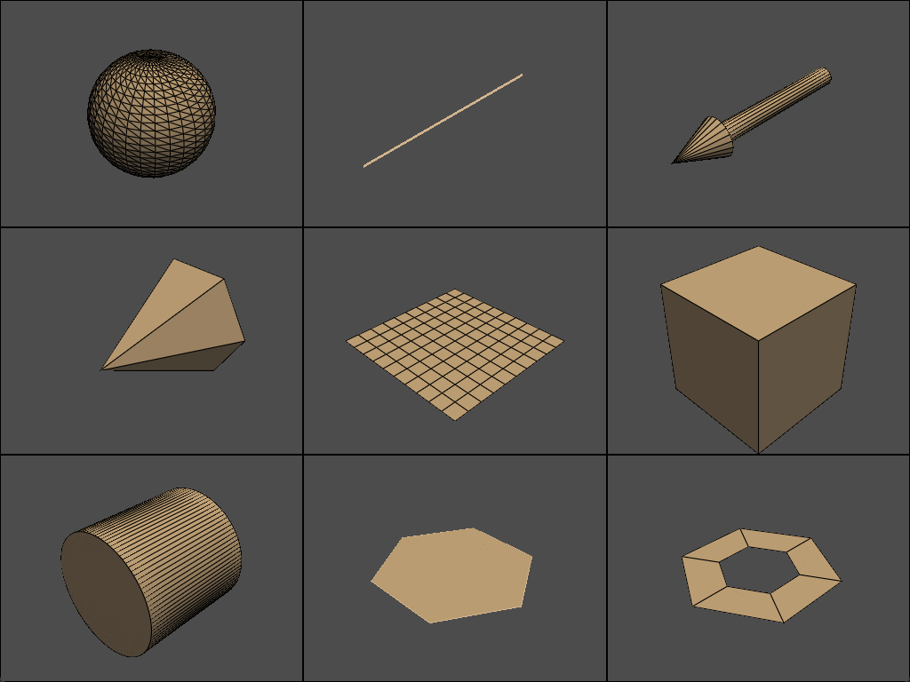
Draw primitives
def Sphere(
radius=0.5,
center=(0, 0, 0),
direction=(0, 0, 1),
theta_resolution=30,
phi_resolution=30,
start_theta=0,
end_theta=360,
start_phi=0,
end_phi=180,
)
Notes:
Pri mi tives
Pa ra meters
Corn
Cone
Height
Width
default

Slide 14
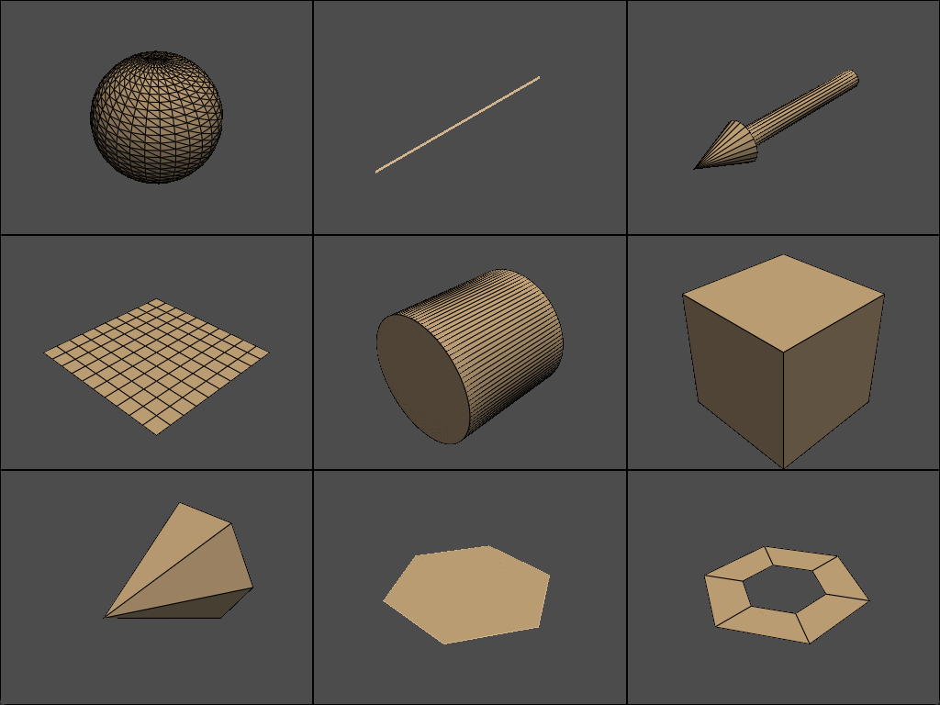
Draw primitives
def Line(
pointa=(-0.5, 0.0, 0.0),
pointb=(0.5, 0.0, 0.0),
resolution=1
)

Slide 15
Draw primitives
def Arrow(
start=(0.0, 0.0, 0.0),
direction=(1.0, 0.0, 0.0),
tip_length=0.25,
tip_radius=0.1,
tip_resolution=20,
shaft_radius=0.05,
shaft_resolution=20,
scale=None,
)

Slide 16
Draw primitives
def Cone(
center=(0.0, 0.0, 0.0),
direction=(1.0, 0.0, 0.0),
height=1.0,
radius=None,
capping=True,
angle=None,
resolution=6,
)

Slide 17
Draw primitives
def Plane(
center=(0, 0, 0),
direction=(0, 0, 1),
i_size=1,
j_size=1,
i_resolution=10,
j_resolution=10
)

Slide 18
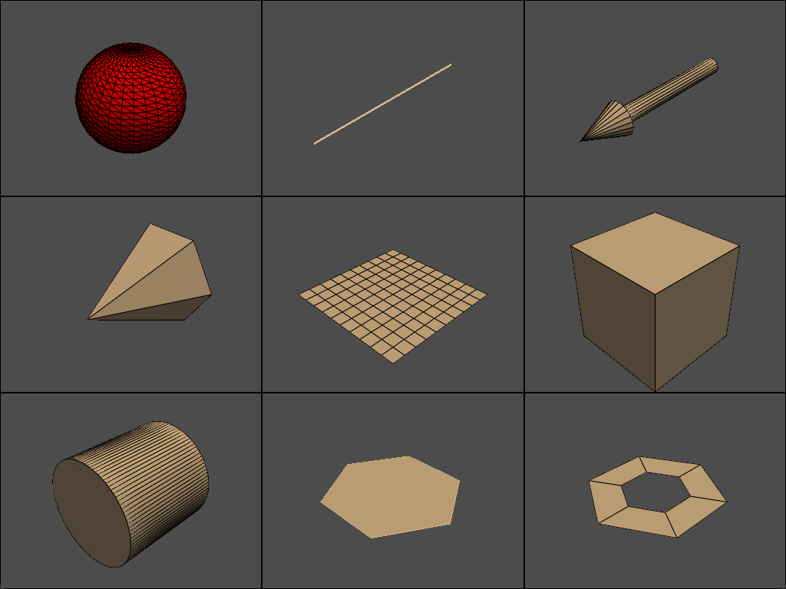
Draw primitives
Add colors
p.add_mesh(sphere, color="tan", show_edges=True)
def add_mesh(
self,
mesh,
color=None,
style=None,
scalars=None,
clim=None,
show_edges=None,
…)

Slide 19
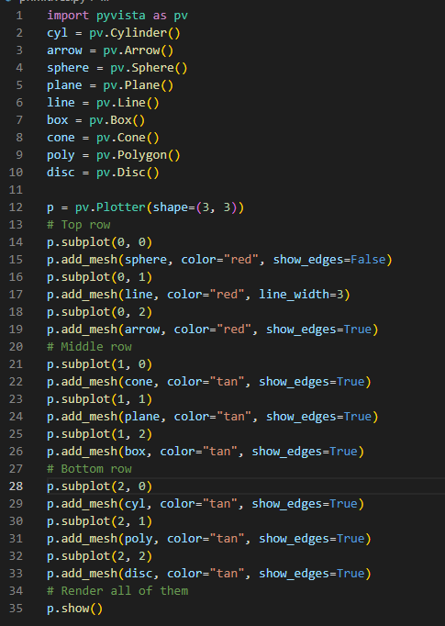

Slide 20
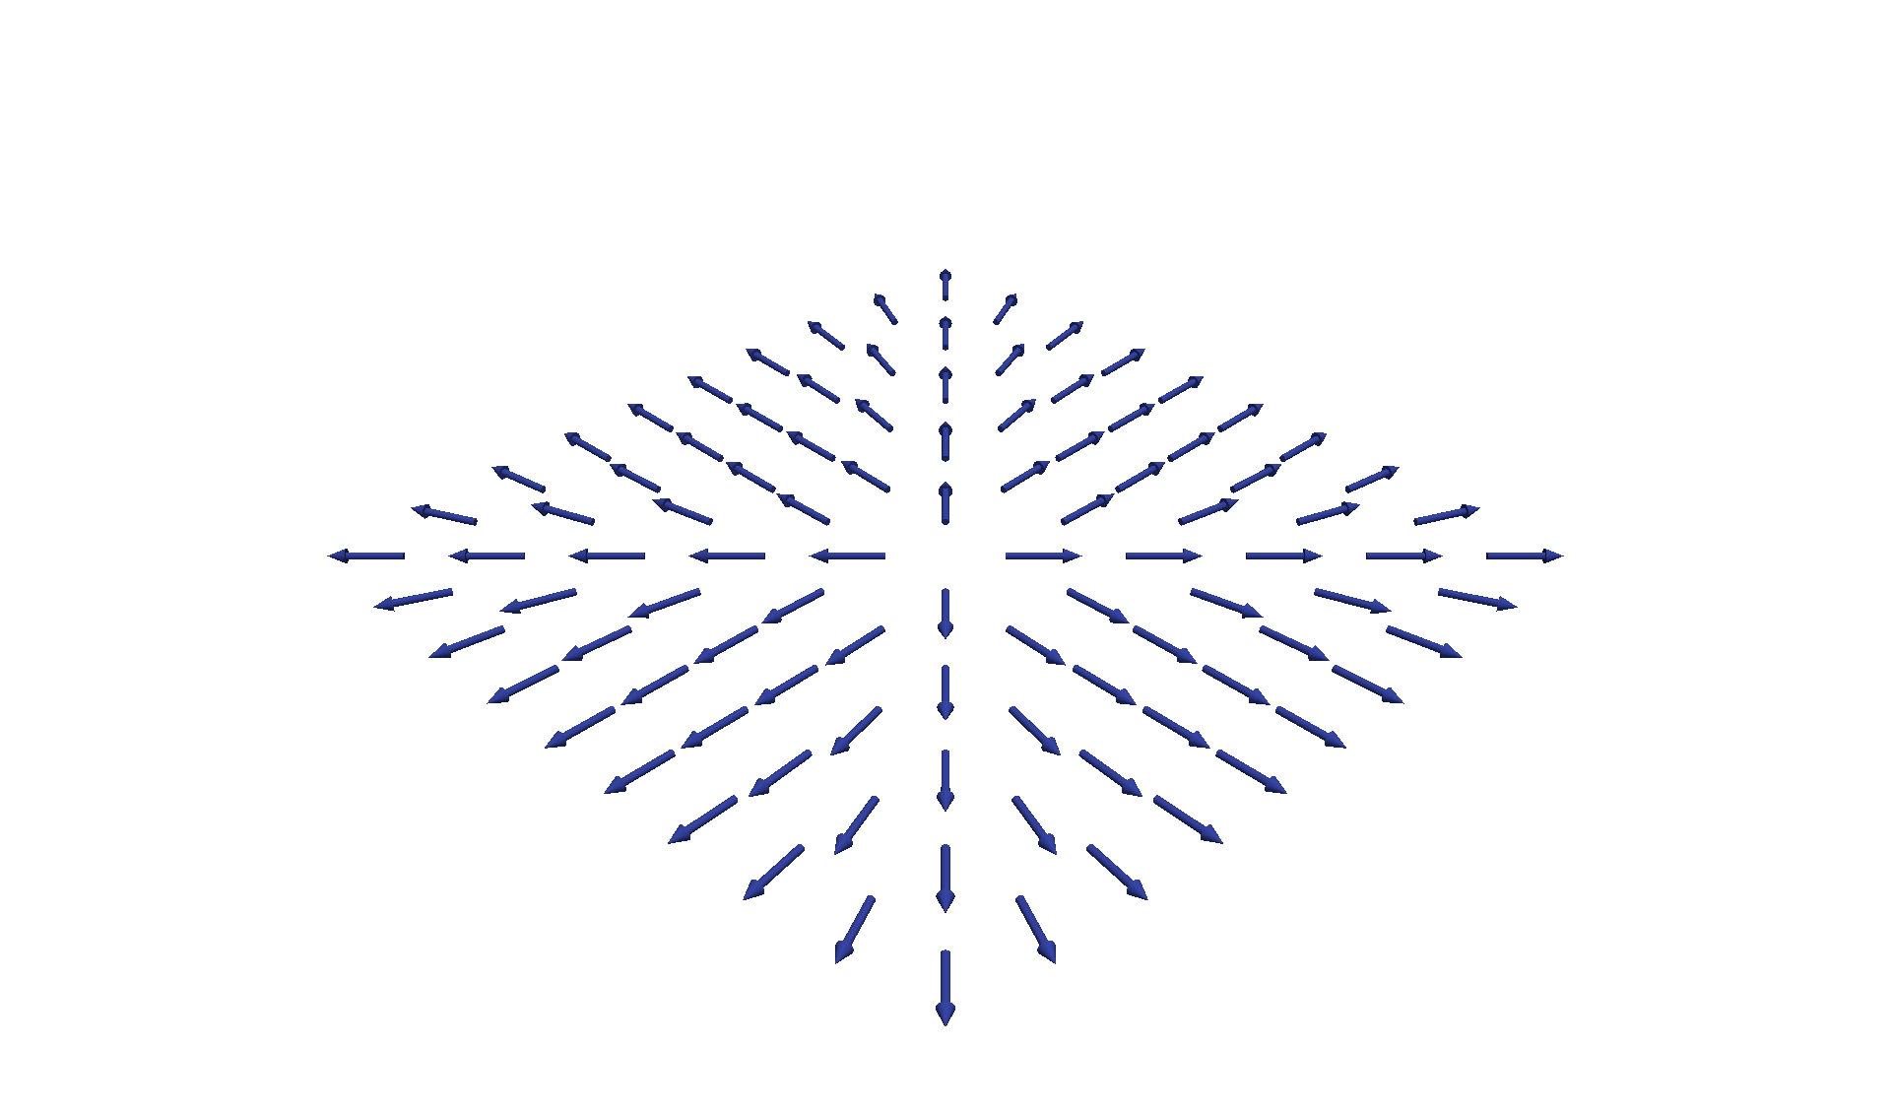
Draw a 2D vector field
Vector field is the parent structure
Each grid point has a vector (direction)
Step 1:
Make 2D grid
Step 2:
Vary the vector

Slide 21
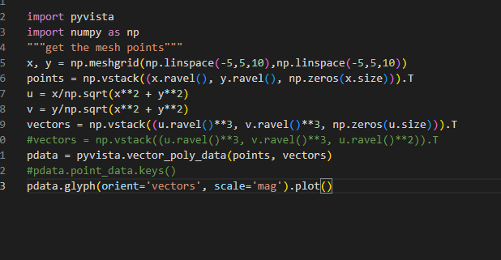

Slide 22
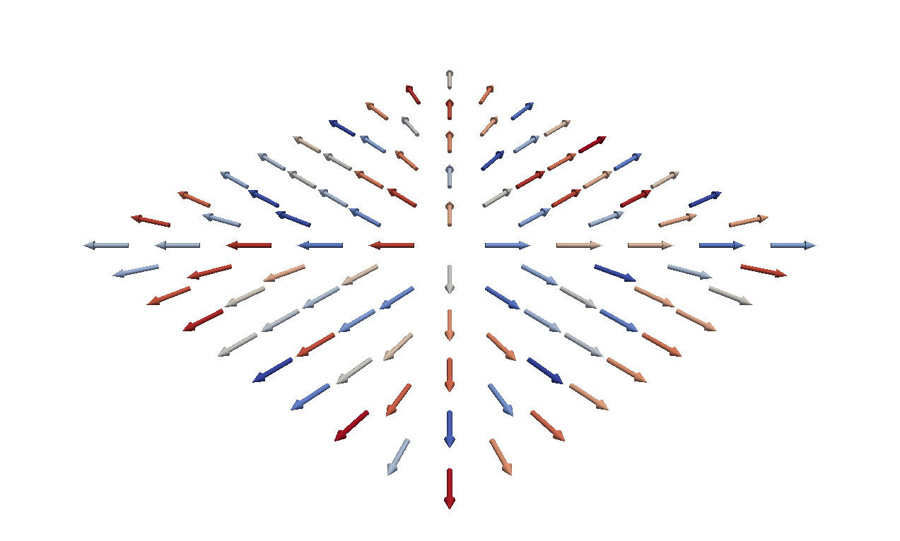
Draw a 2D vector field
Each grid point has a vector (direction + magnitude)
Step 1:
Make 2D grid
Step 2:
Vary the vector
Step 3:
Vary the magnitude

Slide 23
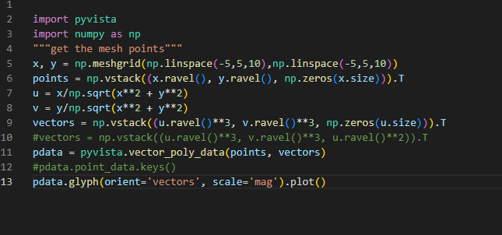

Slide 24
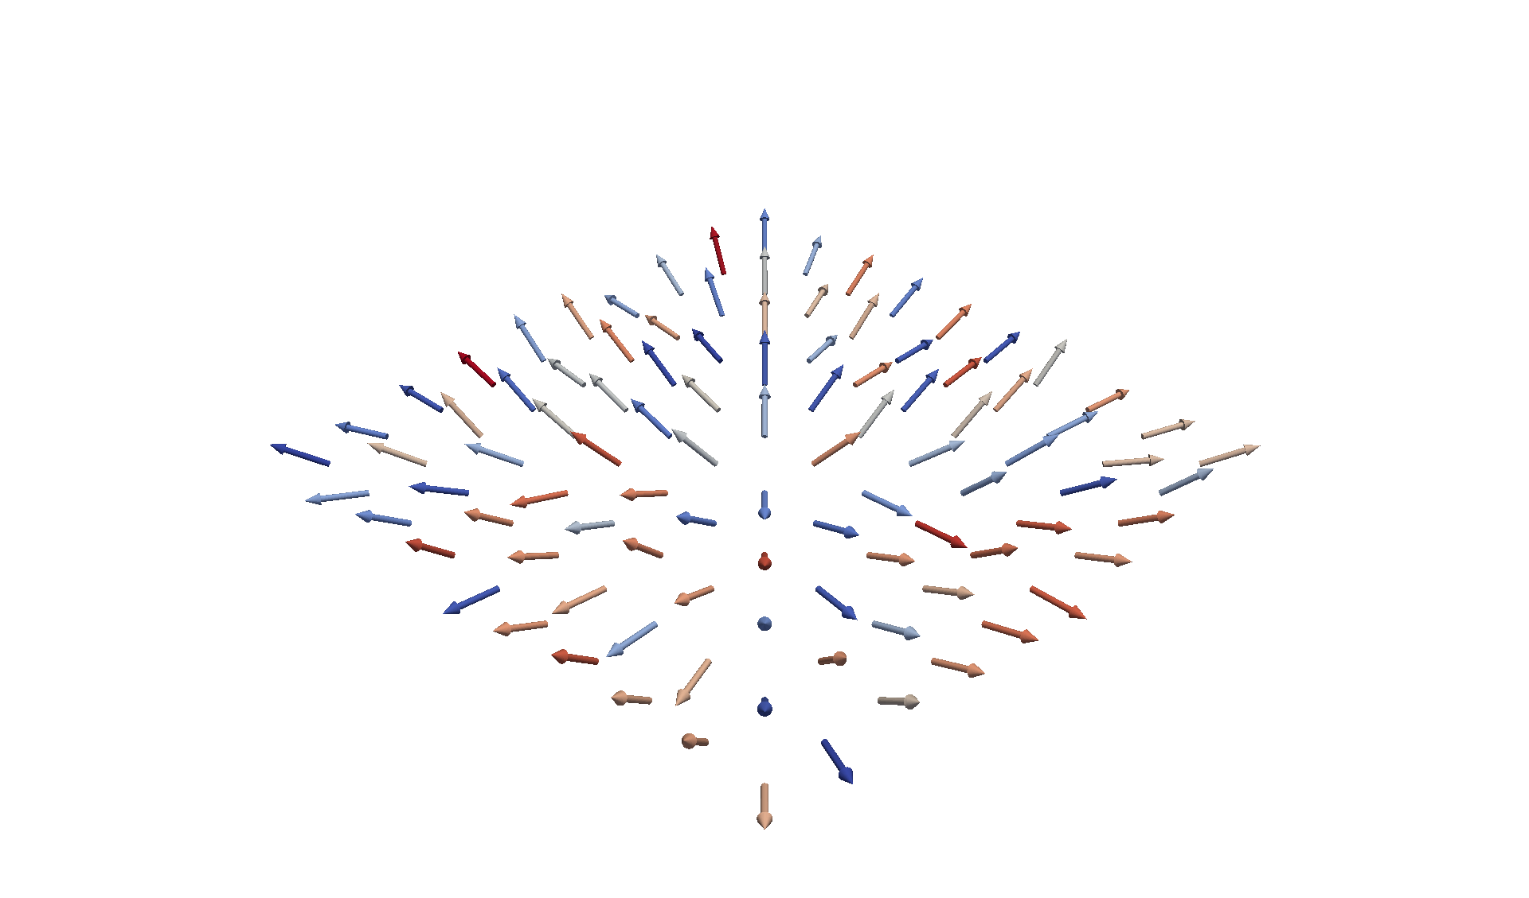
Draw a 2D vector field
Each grid point has a vector (direction + magnitude) + parameter1
Step 1:
Make 2D grid
Step 2:
Vary the vector
Step 3:
Vary the magnitude
Step 4:
Vary the parameter1

Slide 25
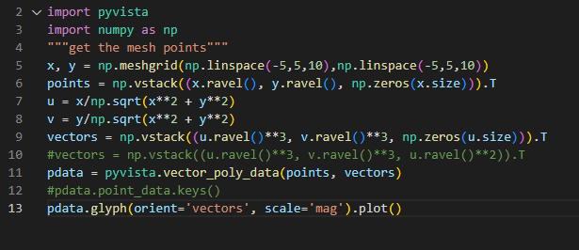

Slide 26
Draw a 2D vector field
How to represent more information ?
Each grid point has a vector
Direction
Magnitude
Parameter1
Parameter2
Uncertainty

Slide 27
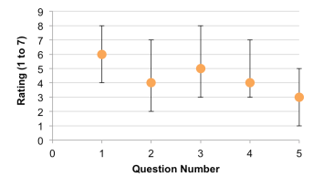
Uncertainty in data visualization
https://whereistheevidence.wordpress.com/articles/statistics/error-bars-a-way-to-visualize-uncertainty/
Notes:
Uncertainty in data visualization refers to the presence of unknown or imprecise information in the data being visualized.
This can arise due to various factors, such as measurement errors, sampling errors, missing data, or inherent variability in the data.
In data visualization, uncertainty can manifest in different ways, such as:
Error bars: These are graphical representations of the variability or uncertainty in the data points. Error bars can be used to indicate the range of possible values that the true value might fall within.

Slide 28
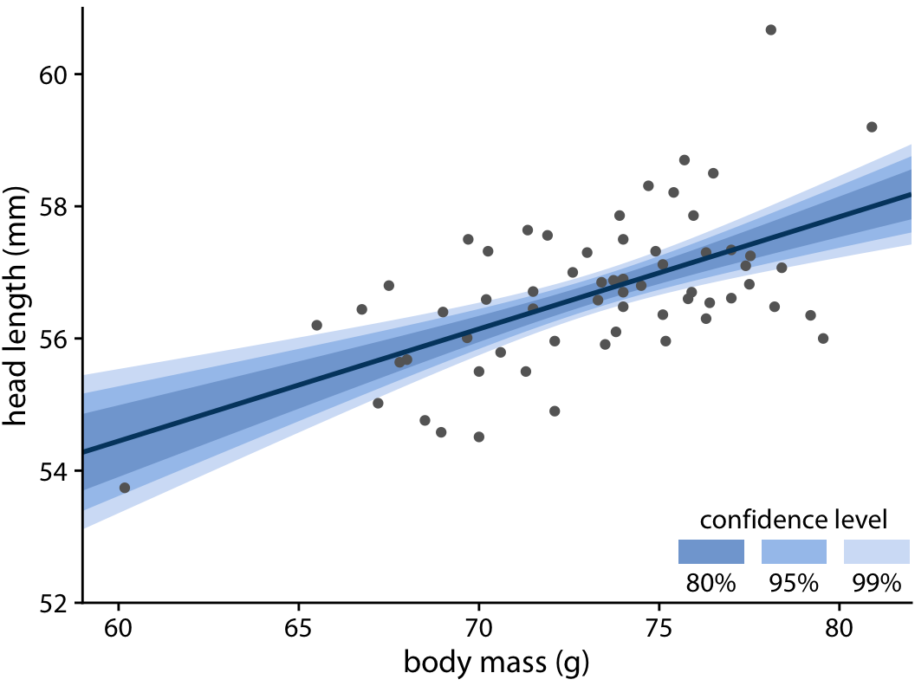
Uncertainty in data visualization
https://clauswilke.com/dataviz/visualizing-uncertainty.html
Notes:
Confidence intervals: These are statistical measures that provide a range of values within which a population parameter is likely to lie. Confidence intervals can be represented graphically using error bars or shading.

Slide 29

Uncertainty in data visualization
Notes:
Obscurity: The more uncertain an estimate is, the more difficult it is to see, becoming less visually prominent compared to more certain estimates. You can achieve this effect a number of ways, such as with transparency, color scale, or blurriness.

Slide 30
Draw a 2D vector field
How to represent more information ?
Each grid point has a vector
Direction
Magnitude
Parameter1
Parameter2

Slide 31
Attachment and alignment
Direction
Angle of arrow

Slide 32
Attachment and alignment
Magnitude
Color of arrow

Slide 33
Attachment and alignment
Parameter1
Length of arrow

Slide 34
Attachment and alignment
Parameter2
Length of rectangle

Slide 35
Use different combination

Slide 36
Design a new glyph
Combine the primitives that we have
Arrow
Sphere
Plane
Line
Box
Cone
Polygon
Disk
Cylinder

Slide 37
Design your own glyph !
Combine the primitives that we have
Arrow
Sphere
Plane
Line
Box
Cone
Polygon
Disk
Cylinder

Slide 38
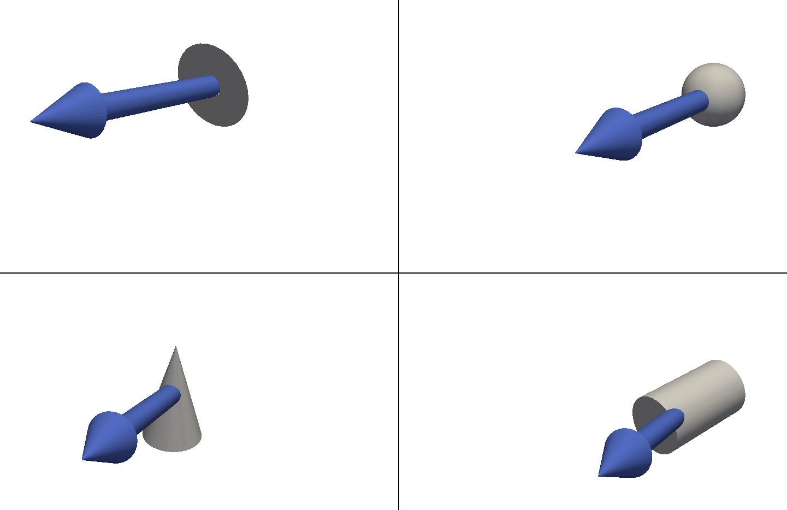
Apply glyphs to 2D vector field
Glyph
Data
+

Slide 39
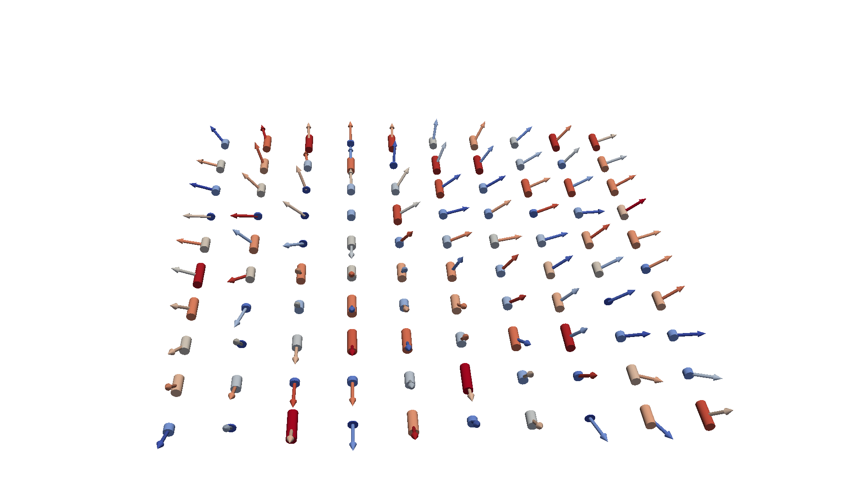
Apply glyphs to 2D vector field

Slide 40
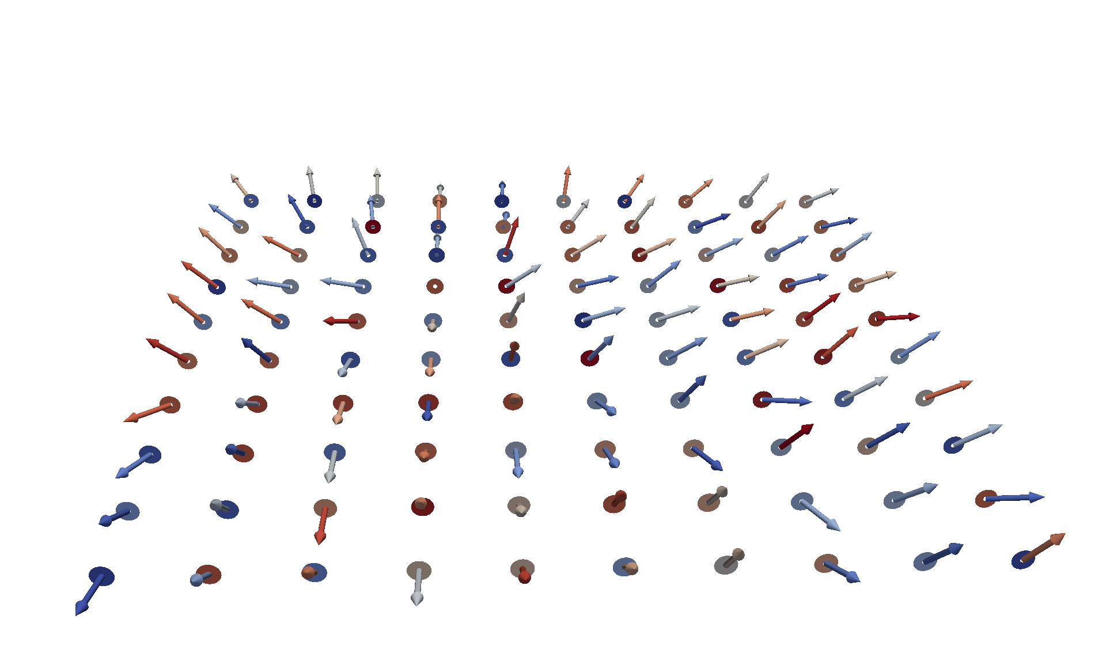
Apply glyphs to 2D vector field

Slide 41
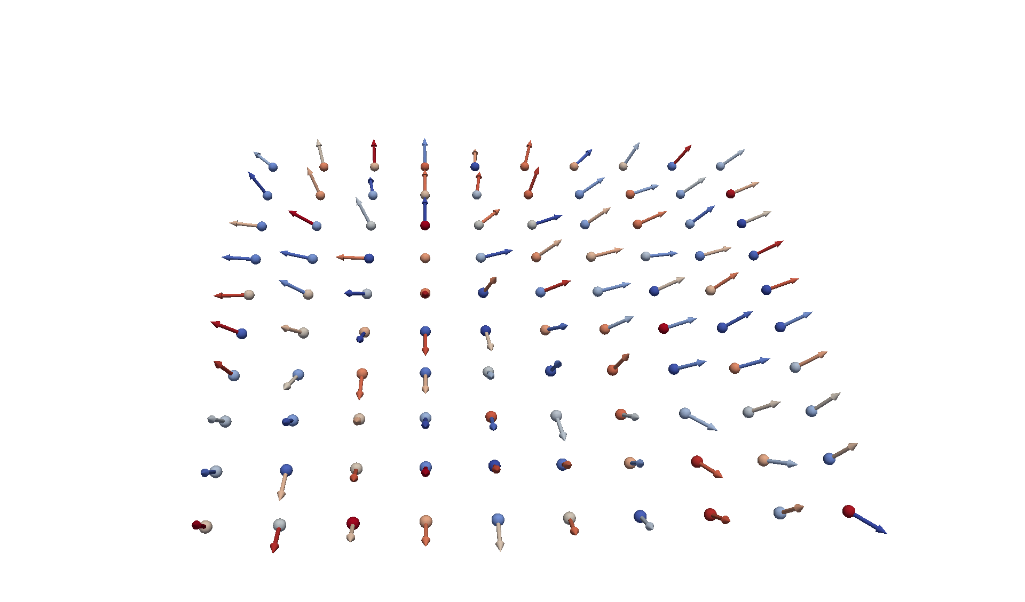
Apply glyphs to 2D vector field

Slide 42
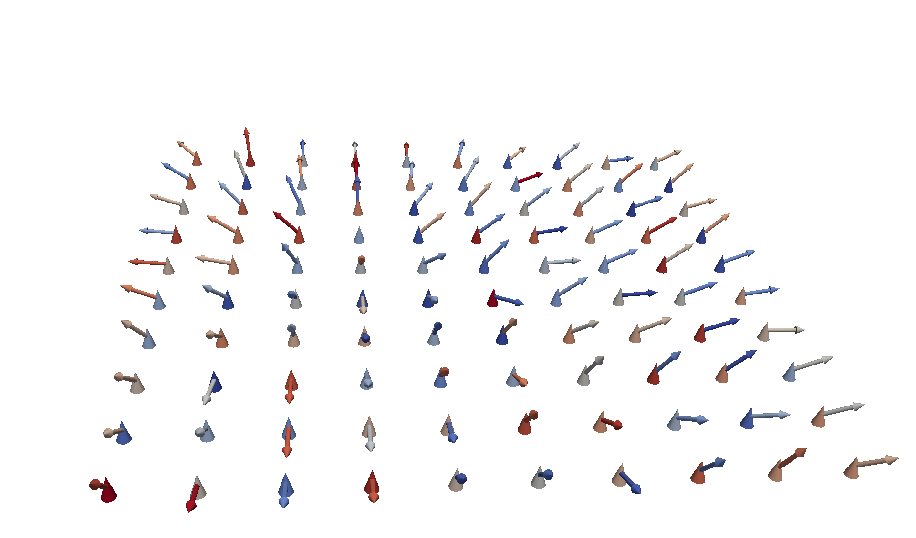
Apply glyphs to 2D vector field

Slide 43
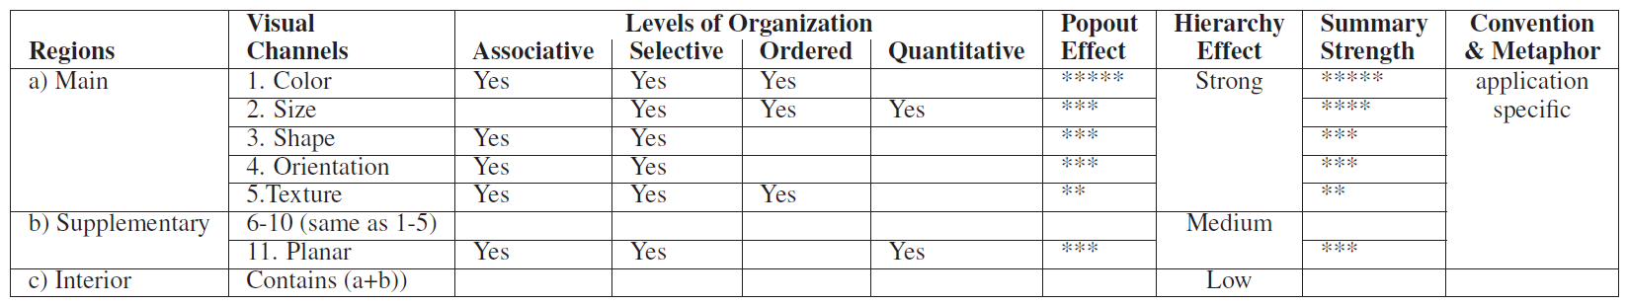

Slide 48
Thank you

