Slide 1
Topic Modeling Lihua Pei (Neo)
Analysis Donald Trump Twitters (@readDonaldTrump)

Slide 2
Data Describe
1. 2009/5/20 - 2017/4/20
2. 32826 Twitters
The mean length of twitters is 109.69 words.

Slide 3
Preprocessing (Data Cleaning)
1. Remove the special elements of twitters: “https” (link), “RT”(retweet), “@” , “#” (hashtag), “&”(&amp) --- regular expression.
2. Normalization: .lower()
3. Tokenization: split()
4. Stop Word: NLTK—stop words
5. Stemming and Lemmatization: PorterSteemer().stem()

Slide 4
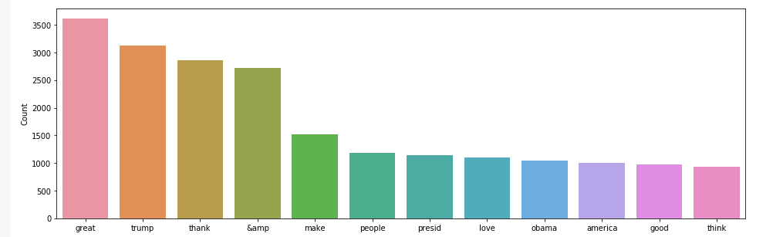
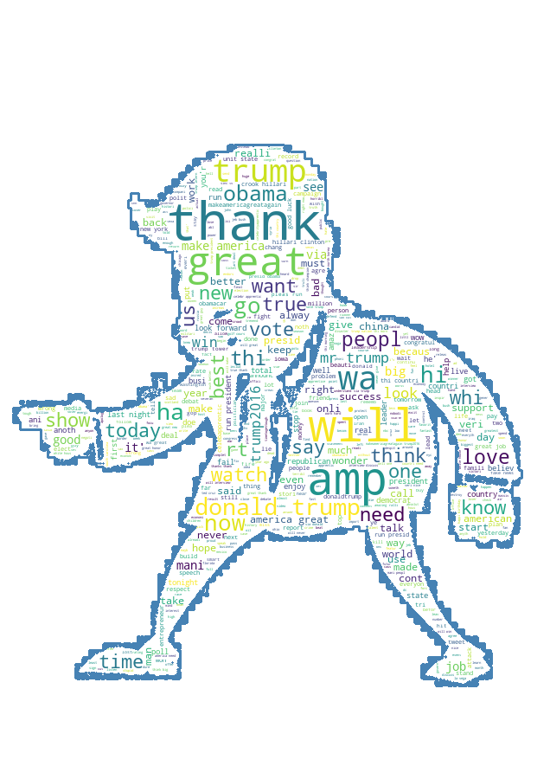

Basic Analysis bag of words BOW

Slide 5
Unsupervised Learning Using LSI and LDA
Analysis Donald Trump Twitters (@readDonaldTrump)

Slide 6
1. LSI (Latent Semantic Indexing):
(LSI) is an indexing and retrieval method that uses a mathematical technique called singular value decomposition (SVD) to identify patterns in the relationships between the terms and concepts contained in an unstructured collection of text.
gensim
2. LDA (Latent Dirichlet Allocation)
(LDA) Latent Dirichlet allocation is a generative statistical model that allows sets of observations to be explained by unobserved groups that explain why some parts of the data are similar.

Slide 7
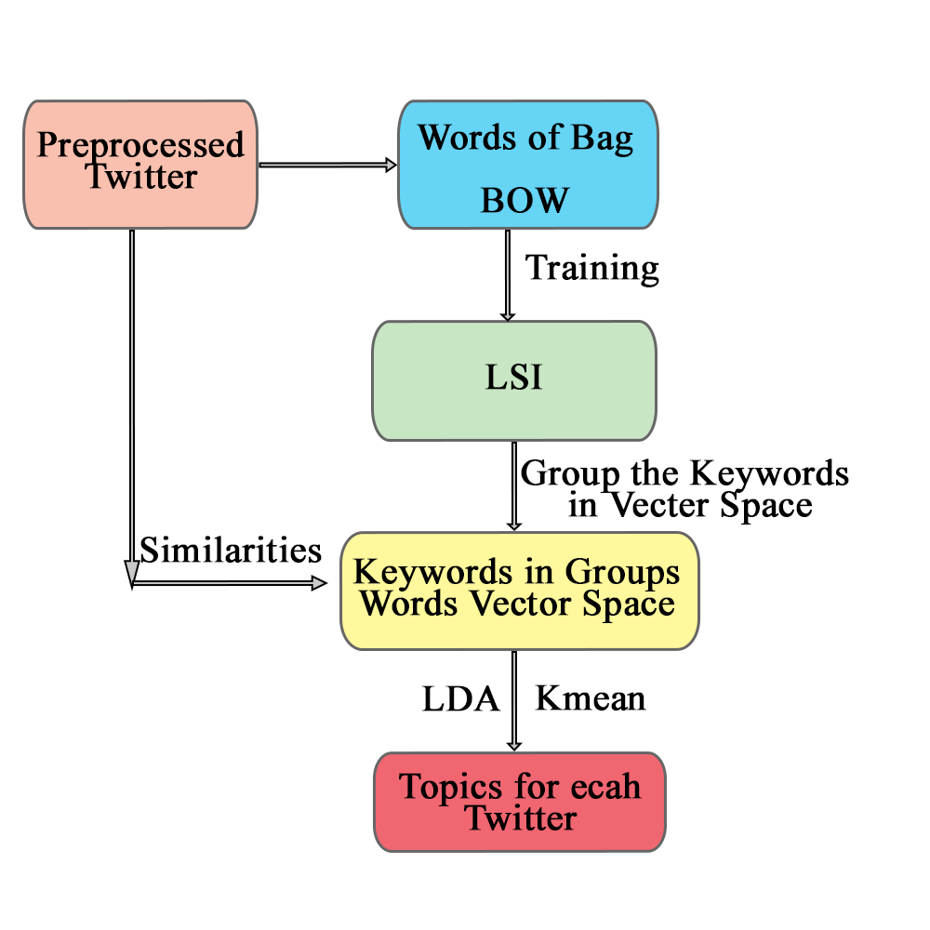
Processing

Slide 8
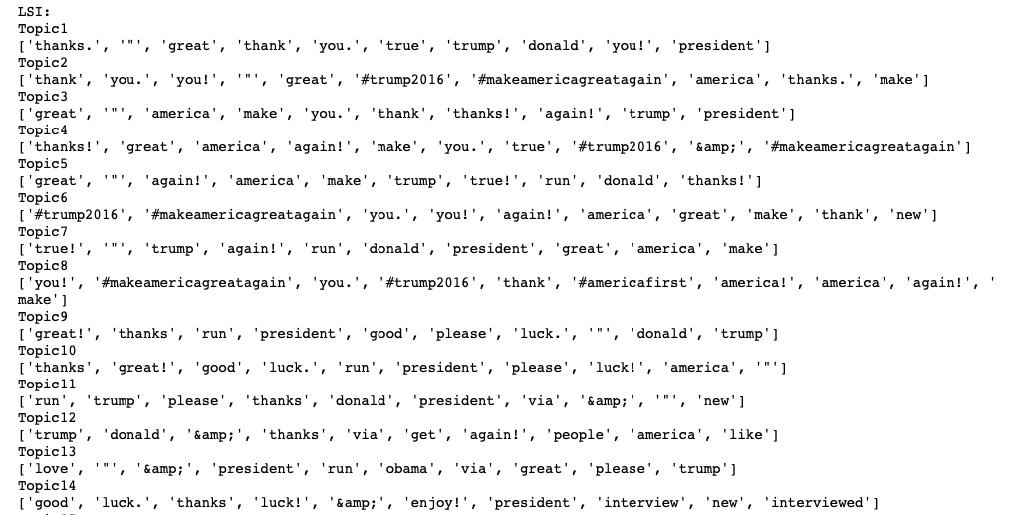
Grouped Keywords

Slide 9
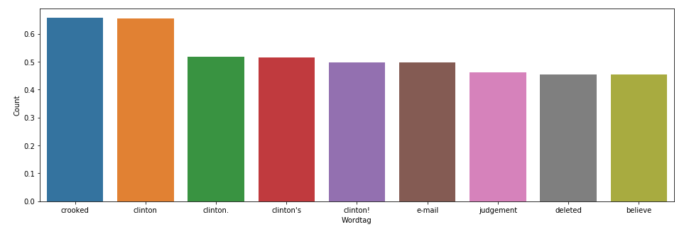
Word Embedding
The most similar words to [‘hillary’]
1. crooked - 0.65804
2. Clinton – 0.6548
3. e-mail – 0.4972

Slide 10
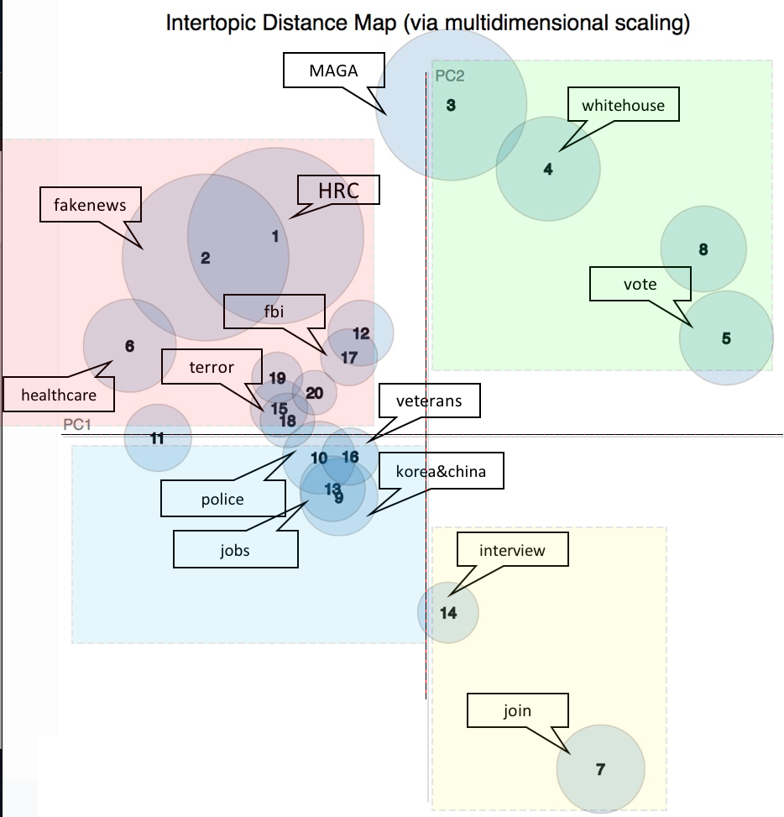
Inter-topic Distance

Slide 11
Thank You ! Lihua Pei (Neo)
Analysis Donald Trump Twitters (@readDonaldTrump)

