Slide 1
药衡智析 · 从成本异常到可核查行动
制药成本分析、证据引用与 Word / PDF 报告
本轮三个核心场景：3/3 组报告文件已核验
本地模拟 RPA 送达：3/3；不等于整改完成
真人专业归因、可读性与版式评审仍待完成
药衡智析 · 运行证据与验收边界 / 1
Notes:
{
"run_id": "delivery_20260919_final",
"revision": "04011c2a595a5d9f8efdd8de92bd5fd1dfcd8830"
}

Slide 2
三场景结果 · 先看数值，再核对证据
S1 · 银黄口服液 · 2026-05
单位成本：11.21 元/盒
S2 · 板蓝根颗粒 · 2026-05
单位成本：7.47 元/盒
S3 · 六味地黄胶囊 · 2026-03
单位成本：17.02 元/盒
药衡智析 · 运行证据与验收边界 / 2
Notes:
{
"source": "本轮绑定分析快照；缺失数据不补零"
}

Slide 3
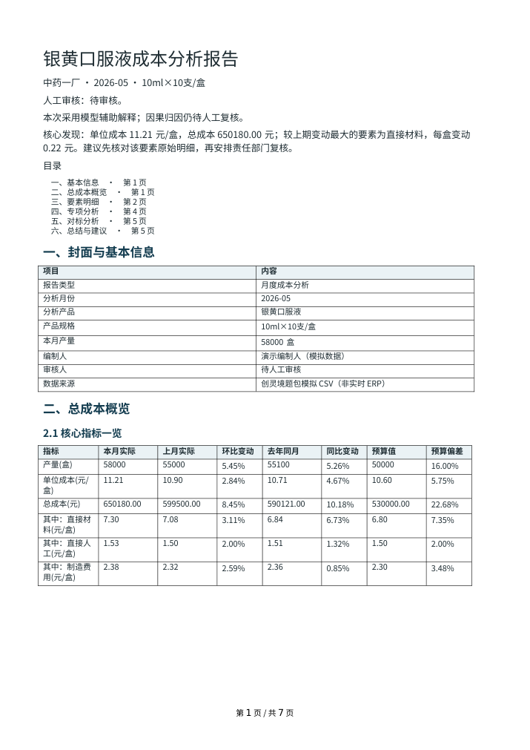
S1 · 银黄口服液
中药一厂 · 2026-05
总成本：650180 元
单位成本：11.21 元/盒
环比：2.844 %
报告：Word 已核验 / PDF 已核验
模型解释：deepseek-flash，身份已核验
专业原因、可读性及 0—5 分评分：待真人署名
药衡智析 · 运行证据与验收边界 / 3
Notes:
{
"scenario": "S1",
"binding": {
"id": "S1",
"job_id": "e6b7b2f514654b219ab9a164e9022e47",
"attempt_id": "2b260558de0d42e495a7cea235702b41",
"status": "DEGRADED",
"docx": "PASS",
"pdf": "PASS",
"error": null,
"snapshot_id": "3a4f905e080e0eb729af4ffa31d9ee31475b5737760bffb68e7a9143a14de9ae",
"artifacts": {
"docx": {
"artifact_id": "e6b7b2f514654b219ab9a164e9022e47-docx",
"sha256": "d02c71b20b3879e34446aa51122ab70cabcdb72c14db5e72dd921faa2de8b70c",
"bytes": 145684
},
"pdf": {
"artifact_id": "e6b7b2f514654b219ab9a164e9022e47-pdf",
"sha256": "89198651a897b31362e8defbdeda221cd787cc11ff504217d95b58e214bfd0ef",
"bytes": 495002
}
}
},
"snapshot": "/tmp/yaoheng-final-reports/S1/job_result.json",
"reports": {
"docx": "/tmp/yaoheng-final-reports/S1/report.docx",
"pdf": "/tmp/yaoheng-final-reports/S1/report.pdf"
},
"model_evidence": {
"id": "S1",
"job_id": "e6b7b2f514654b219ab9a164e9022e47",
"attempt_id": "2b260558de0d42e495a7cea235702b41",
"snapshot_id": "3a4f905e080e0eb729af4ffa31d9ee31475b5737760bffb68e7a9143a14de9ae",
"artifacts": {
"docx": {
"artifact_id": "e6b7b2f514654b219ab9a164e9022e47-docx",
"sha256": "d02c71b20b3879e34446aa51122ab70cabcdb72c14db5e72dd921faa2de8b70c",
"bytes": 145684
},
"pdf": {
"artifact_id": "e6b7b2f514654b219ab9a164e9022e47-pdf",
"sha256": "89198651a897b31362e8defbdeda221cd787cc11ff504217d95b58e214bfd0ef",
"bytes": 495002
}
},
"status": "PASS",
"generation_mode": "llm",
"model_live": true,
"identity": {
"status": "VERIFIED",
"requested": "deepseek-flash",
"returned": [
"deepseek-flash"
],
"reason": "全部调用响应model经核验一致"
},
"usage": {
"prompt_tokens": 21184,
"completion_tokens": 748,
"total_tokens": 21932,
"calls": 1
},
"alert_coverage": {},
"failures": []
}
}

Slide 4

S2 · 板蓝根颗粒
中药一厂 · 2026-05
总成本：761940 元
单位成本：7.47 元/盒
环比：3.1768 %
报告：Word 已核验 / PDF 已核验
模型解释：deepseek-flash，身份已核验
专业原因、可读性及 0—5 分评分：待真人署名
药衡智析 · 运行证据与验收边界 / 4
Notes:
{
"scenario": "S2",
"binding": {
"id": "S2",
"job_id": "4093d2051205465a84e131b01034abf8",
"attempt_id": "2b260558de0d42e495a7cea235702b41",
"status": "DEGRADED",
"docx": "PASS",
"pdf": "PASS",
"error": null,
"snapshot_id": "4eda1ee3a4878a9548f67f6e4bc25ca8f37084b162ffc21dac43c072186b6fa8",
"artifacts": {
"docx": {
"artifact_id": "4093d2051205465a84e131b01034abf8-docx",
"sha256": "051f0dc7bc4eac11d0d44eb83d1dcbbac63f121cd7aede2f8fb322316ba65115",
"bytes": 148186
},
"pdf": {
"artifact_id": "4093d2051205465a84e131b01034abf8-pdf",
"sha256": "d2a8f412c4af99b9c1ba53bf9e6d374a494e867ffc978b46c5f0f8ce2f74eba7",
"bytes": 489091
}
}
},
"snapshot": "/tmp/yaoheng-final-reports/S2/job_result.json",
"reports": {
"docx": "/tmp/yaoheng-final-reports/S2/report.docx",
"pdf": "/tmp/yaoheng-final-reports/S2/report.pdf"
},
"model_evidence": {
"id": "S2",
"job_id": "4093d2051205465a84e131b01034abf8",
"attempt_id": "2b260558de0d42e495a7cea235702b41",
"snapshot_id": "4eda1ee3a4878a9548f67f6e4bc25ca8f37084b162ffc21dac43c072186b6fa8",
"artifacts": {
"docx": {
"artifact_id": "4093d2051205465a84e131b01034abf8-docx",
"sha256": "051f0dc7bc4eac11d0d44eb83d1dcbbac63f121cd7aede2f8fb322316ba65115",
"bytes": 148186
},
"pdf": {
"artifact_id": "4093d2051205465a84e131b01034abf8-pdf",
"sha256": "d2a8f412c4af99b9c1ba53bf9e6d374a494e867ffc978b46c5f0f8ce2f74eba7",
"bytes": 489091
}
},
"status": "PASS",
"generation_mode": "llm",
"model_live": true,
"identity": {
"status": "VERIFIED",
"requested": "deepseek-flash",
"returned": [
"deepseek-flash"
],
"reason": "全部调用响应model经核验一致"
},
"usage": {
"prompt_tokens": 20136,
"completion_tokens": 842,
"total_tokens": 20978,
"calls": 1
},
"alert_coverage": {},
"failures": []
}
}

Slide 5
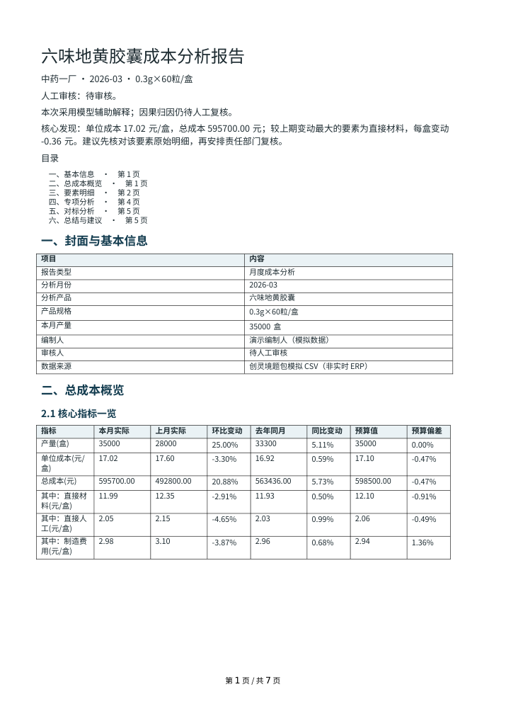
S3 · 六味地黄胶囊
中药一厂 · 2026-03
总成本：595700 元
单位成本：17.02 元/盒
环比：-3.2955 %
报告：Word 已核验 / PDF 已核验
模型解释：deepseek-flash，身份已核验
专业原因、可读性及 0—5 分评分：待真人署名
药衡智析 · 运行证据与验收边界 / 5
Notes:
{
"scenario": "S3",
"binding": {
"id": "S3",
"job_id": "8e668ea2d65f4cbaba44b75d013055ae",
"attempt_id": "2b260558de0d42e495a7cea235702b41",
"status": "DEGRADED",
"docx": "PASS",
"pdf": "PASS",
"error": null,
"snapshot_id": "ad3f7bf69b7b7268209ea6aff74c841f7fe083bbedcf0ba33f3f7fe423dce291",
"artifacts": {
"docx": {
"artifact_id": "8e668ea2d65f4cbaba44b75d013055ae-docx",
"sha256": "95f6a94be59c771481700fe941e620f1eda34a47b6e106b40979ca701f4132f0",
"bytes": 148879
},
"pdf": {
"artifact_id": "8e668ea2d65f4cbaba44b75d013055ae-pdf",
"sha256": "71e2dd65268cd5466135a8a12905107a7772d62e39dba4a2cbeb6e0fa6610073",
"bytes": 535685
}
}
},
"snapshot": "/tmp/yaoheng-final-reports/S3/job_result.json",
"reports": {
"docx": "/tmp/yaoheng-final-reports/S3/report.docx",
"pdf": "/tmp/yaoheng-final-reports/S3/report.pdf"
},
"model_evidence": {
"id": "S3",
"job_id": "8e668ea2d65f4cbaba44b75d013055ae",
"attempt_id": "2b260558de0d42e495a7cea235702b41",
"snapshot_id": "ad3f7bf69b7b7268209ea6aff74c841f7fe083bbedcf0ba33f3f7fe423dce291",
"artifacts": {
"docx": {
"artifact_id": "8e668ea2d65f4cbaba44b75d013055ae-docx",
"sha256": "95f6a94be59c771481700fe941e620f1eda34a47b6e106b40979ca701f4132f0",
"bytes": 148879
},
"pdf": {
"artifact_id": "8e668ea2d65f4cbaba44b75d013055ae-pdf",
"sha256": "71e2dd65268cd5466135a8a12905107a7772d62e39dba4a2cbeb6e0fa6610073",
"bytes": 535685
}
},
"status": "PASS",
"generation_mode": "llm",
"model_live": true,
"identity": {
"status": "VERIFIED",
"requested": "deepseek-flash",
"returned": [
"deepseek-flash"
],
"reason": "全部调用响应model经核验一致"
},
"usage": {
"prompt_tokens": 26605,
"completion_tokens": 1218,
"total_tokens": 27823,
"calls": 1
},
"alert_coverage": {
"alert-ae6cfac6295472537aa5": {
"covered": true,
"element_key": "materials",
"basis": "total"
},
"alert-a3392a1012a3bdbfd2a9": {
"covered": true,
"element_key": "labor",
"basis": "total"
},
"alert-918366df38ec19897ded": {
"covered": true,
"element_key": "overhead",
"basis": "total"
}
},
"failures": []
}
}

Slide 6
指标证据能重算，缺证结论有边界
金额使用 Decimal；产量独立去重，不随成本明细累加
季度单位成本 = Σ成本 / Σ可比产量，不能直接平均月单价
机械合成反例：材料 15 对 30 元/件 → (15−30)/30 = −50%
差额、差异率、贡献度分别保存分子、分母与双方来源
环比、同比、预算和跨厂分别核对期间；缺失和零分母保留无定义
药衡智析 · 运行证据与验收边界 / 6
Notes:
{
"tests": "tests/test_industry.py",
"scope": "独立合成反例，不是比赛原始数据或行业基准"
}

Slide 7
任务闭环 · 确认载荷与送达回执逐项核对
报告发现 → 编辑负责人 / 行动 → 用户确认 → 幂等 outbox
本轮核心场景本地模拟送达：3/3；其他场景见技术附件
自动演示只访问回环地址，并在确认前核验服务端模拟模式
同一任务编号但行动或收件人不同，不承认送达
查询超时保留此前已证实的送达证据；真人责任确认待本人填写
药衡智析 · 运行证据与验收边界 / 7
Notes:
{
"rpa_receipts": [
{
"id": "S1",
"job_id": "e6b7b2f514654b219ab9a164e9022e47",
"attempt_id": "2b260558de0d42e495a7cea235702b41",
"snapshot_id": "3a4f905e080e0eb729af4ffa31d9ee31475b5737760bffb68e7a9143a14de9ae",
"artifacts": {
"docx": {
"artifact_id": "e6b7b2f514654b219ab9a164e9022e47-docx",
"sha256": "d02c71b20b3879e34446aa51122ab70cabcdb72c14db5e72dd921faa2de8b70c",
"bytes": 145684
},
"pdf": {
"artifact_id": "e6b7b2f514654b219ab9a164e9022e47-pdf",
"sha256": "89198651a897b31362e8defbdeda221cd787cc11ff504217d95b58e214bfd0ef",
"bytes": 495002
}
},
"status": "PASS",
"action_id": "YH-0cf26ba9fda3c9d1229c636d",
"confirmed_payload_hash": "c36c900fa6c151743936124855a6c5ee7c2a2ada78ad5e7e19d1e389bc8a5fb3",
"receipt_sha256": "d0bb6fa294274cbc228f115bfe3542788889ad98d7bc09c51efddd35de298ad4",
"notification": "SIMULATED_SENT",
"human_acknowledgement": "NOT_ENTERED"
},
{
"id": "S2",
"job_id": "4093d2051205465a84e131b01034abf8",
"attempt_id": "2b260558de0d42e495a7cea235702b41",
"snapshot_id": "4eda1ee3a4878a9548f67f6e4bc25ca8f37084b162ffc21dac43c072186b6fa8",
"artifacts": {
"docx": {
"artifact_id": "4093d2051205465a84e131b01034abf8-docx",
"sha256": "051f0dc7bc4eac11d0d44eb83d1dcbbac63f121cd7aede2f8fb322316ba65115",
"bytes": 148186
},
"pdf": {
"artifact_id": "4093d2051205465a84e131b01034abf8-pdf",
"sha256": "d2a8f412c4af99b9c1ba53bf9e6d374a494e867ffc978b46c5f0f8ce2f74eba7",
"bytes": 489091
}
},
"status": "PASS",
"action_id": "YH-aa4dd092dd5d44dcdcc8efa8",
"confirmed_payload_hash": "e89a51ede508aaf516dd80dbee0054c4536684132eedf6138c7ecb039bc91722",
"receipt_sha256": "aceec86d2bd12af869a835aebd5dcced2c40c5800cbc46f3bb10f3690d3821d3",
"notification": "SIMULATED_SENT",
"human_acknowledgement": "NOT_ENTERED"
},
{
"id": "S3",
"job_id": "8e668ea2d65f4cbaba44b75d013055ae",
"attempt_id": "2b260558de0d42e495a7cea235702b41",
"snapshot_id": "ad3f7bf69b7b7268209ea6aff74c841f7fe083bbedcf0ba33f3f7fe423dce291",
"artifacts": {
"docx": {
"artifact_id": "8e668ea2d65f4cbaba44b75d013055ae-docx",
"sha256": "95f6a94be59c771481700fe941e620f1eda34a47b6e106b40979ca701f4132f0",
"bytes": 148879
},
"pdf": {
"artifact_id": "8e668ea2d65f4cbaba44b75d013055ae-pdf",
"sha256": "71e2dd65268cd5466135a8a12905107a7772d62e39dba4a2cbeb6e0fa6610073",
"bytes": 535685
}
},
"status": "PASS",
"action_id": "YH-6ea906b76bab142a97cf2a2a",
"confirmed_payload_hash": "ca1e4103b96d2bd8d7f7d6164d57fbdced44cbe759318ad50ca0a44dad6b2b88",
"receipt_sha256": "efddd0943185567f6145dde4729e2557b150a284c174fe02a4fb19937d2eaad8",
"notification": "SIMULATED_SENT",
"human_acknowledgement": "NOT_ENTERED"
}
],
"notice": "演示自动确认不冒充真人确认或真实微信发送"
}

Slide 8
加分原型 · 用小规模对照说明实际能力
图谱：只扩展 BM25 词项；向量与重排仍使用原问题，可关闭
固定三个合成问题：关闭召回 2/3，开启 3/3，产品范围不串用
该开发样本不证明普遍增益；多模型实调以本轮身份回执为准
预测反例：10 / 20 / 30 → 下期 40；末次值基线为 30
常量不漂移；缺月拒绝连续外推；波动范围未经覆盖率验证
药衡智析 · 运行证据与验收边界 / 8
Notes:
{
"tests": [
"tests/test_purpose_retrieval.py::test_fixed_graph_toggle_comparison_uses_same_scope_and_no_model",
"tests/test_forecasting.py"
],
"forecast": "样本内一步误差非独立留出检验；不宣称专业预测已验收"
}

Slide 9
行业迁移 · 共用核心，保留专属边界
机械参考包：3600 元 / 120 件 = 30 元/件；单位机时 0.5 小时/件
化工参考包：2400 元 / 200 kg = 12 元/kg；单位能耗 3 kWh/kg
制药、机械、化工双产品合成回归核对数值、单位与来源隔离
上述数字是独立合成假设，不是行业基准或全制造业适配证明
下一步由行业队友核对实际数据、政策、知识及联副产品 / 在制品口径
药衡智析 · 运行证据与验收边界 / 9
Notes:
{
"tests": "tests/test_industry.py",
"architecture": "现有模块化单体与受信行业包，无任意代码插件"
}

Slide 10
交付与待评 · 自动化证据和真人判断分开
三场景 Word / PDF：3/3；本地模拟送达：3/3
打开交付目录中的 S1、S2、S3 报告，与数字和引用来源逐项核对
真人分别填写专业归因、可读性和版式意见，再署名评分
模型、检索、数值、浏览器与 RPA 的结果分别保存在技术附件
缺少真人评分时保留待评状态，不宣称比赛整体验收或获奖水平
药衡智析 · 运行证据与验收边界 / 10
Notes:
{
"run_id": "delivery_20260919_final",
"human_review": "PENDING",
"competition_ready": false
}

