Slide 1

HSVmode:HSV
Progress Report
Name: Liu Zhaolin
Date: 19/07/2026

Slide 2
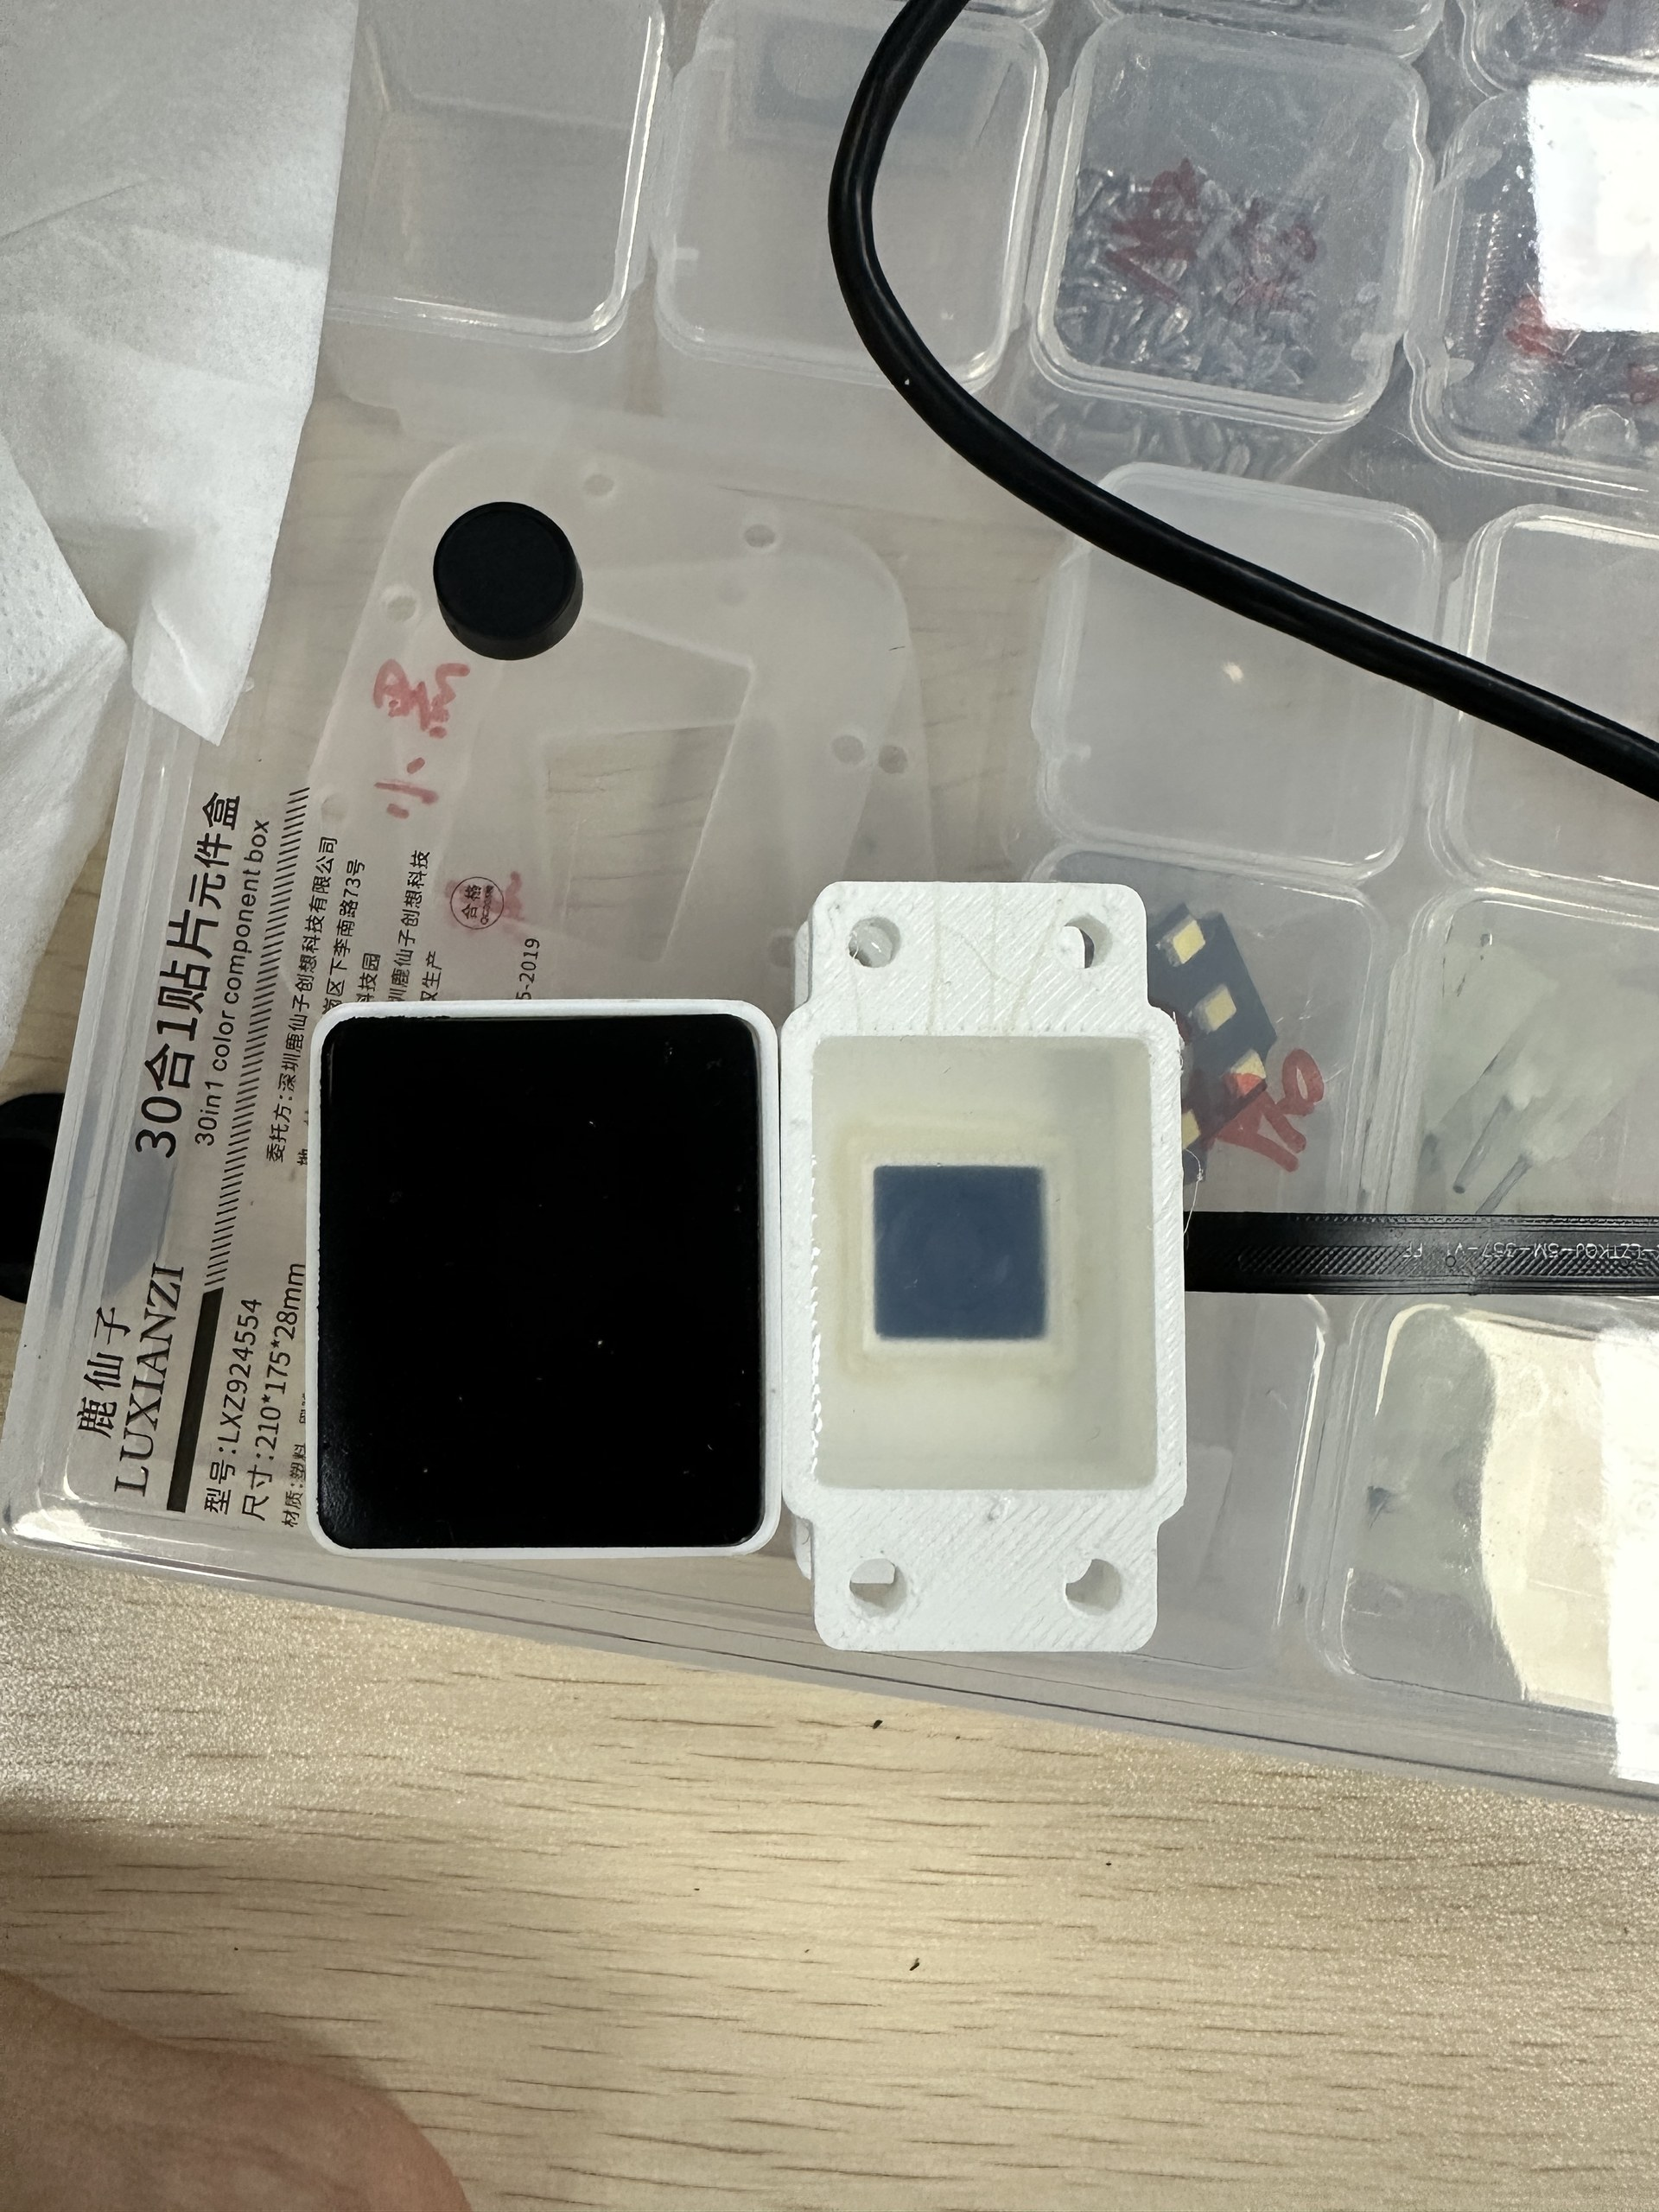
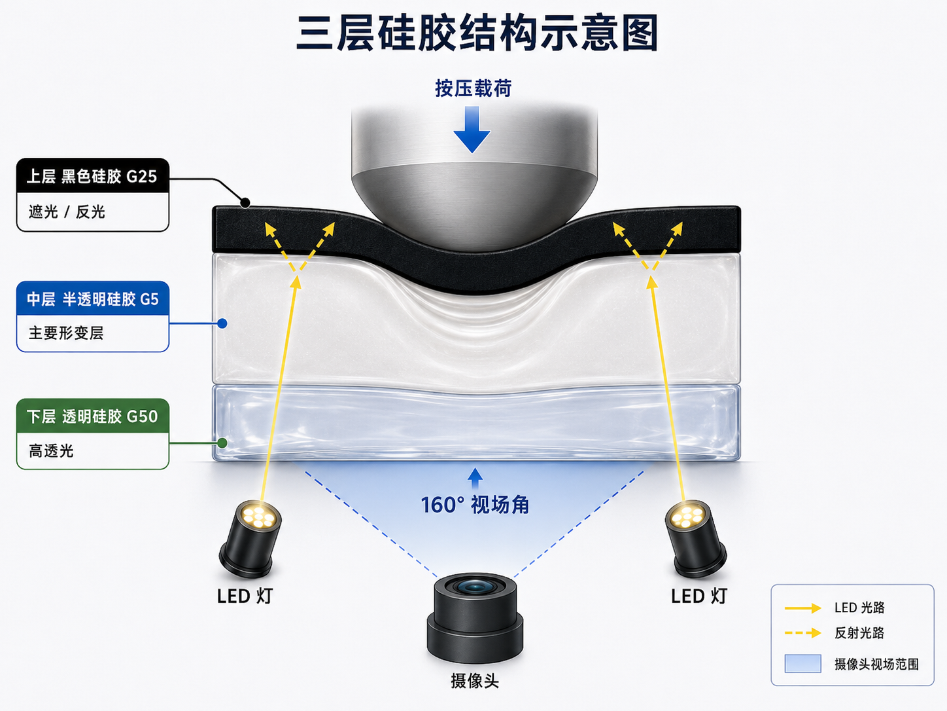
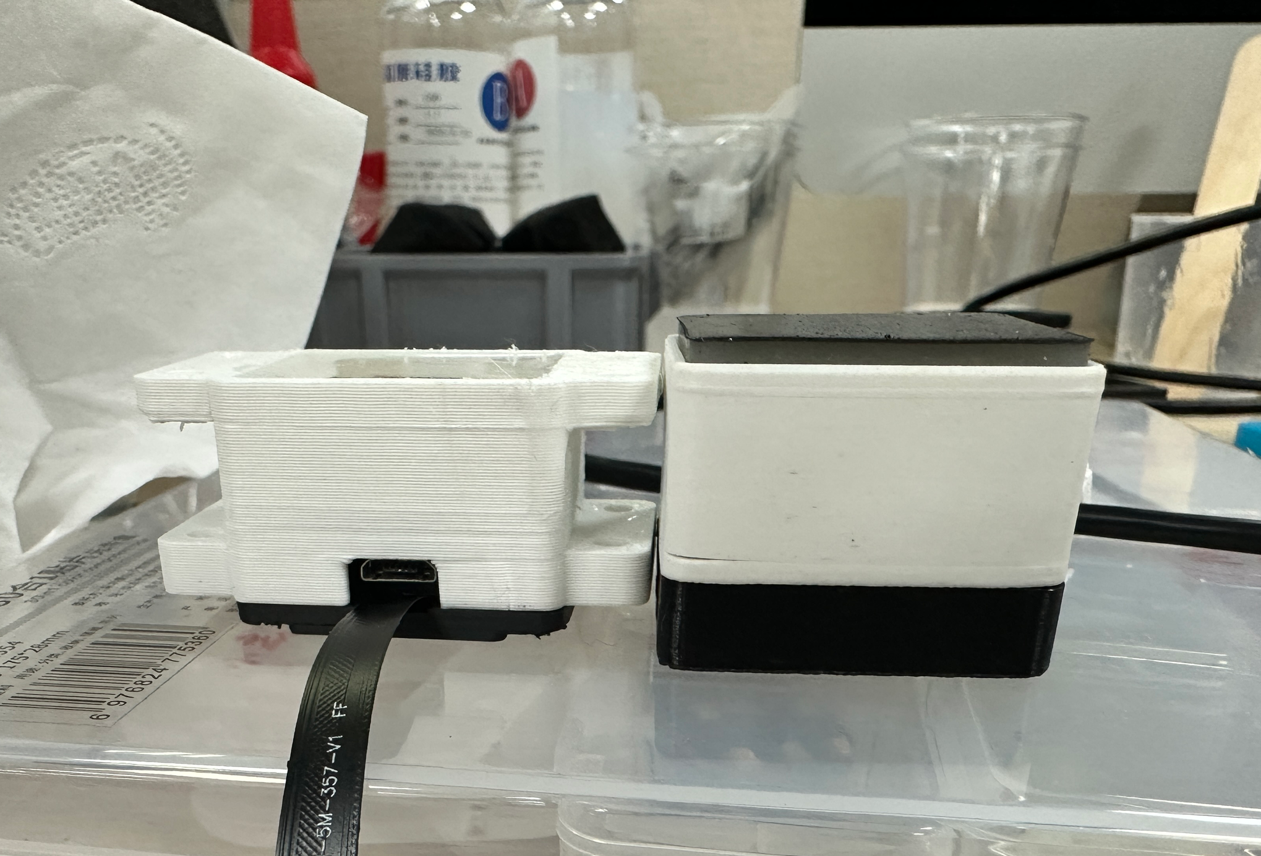
1.1 Hardware Setup of the Newly Designed Sensor
A completely new design was adopted to minimize the size of the tactile sensor while maximizing its measurement accuracy.

Slide 3
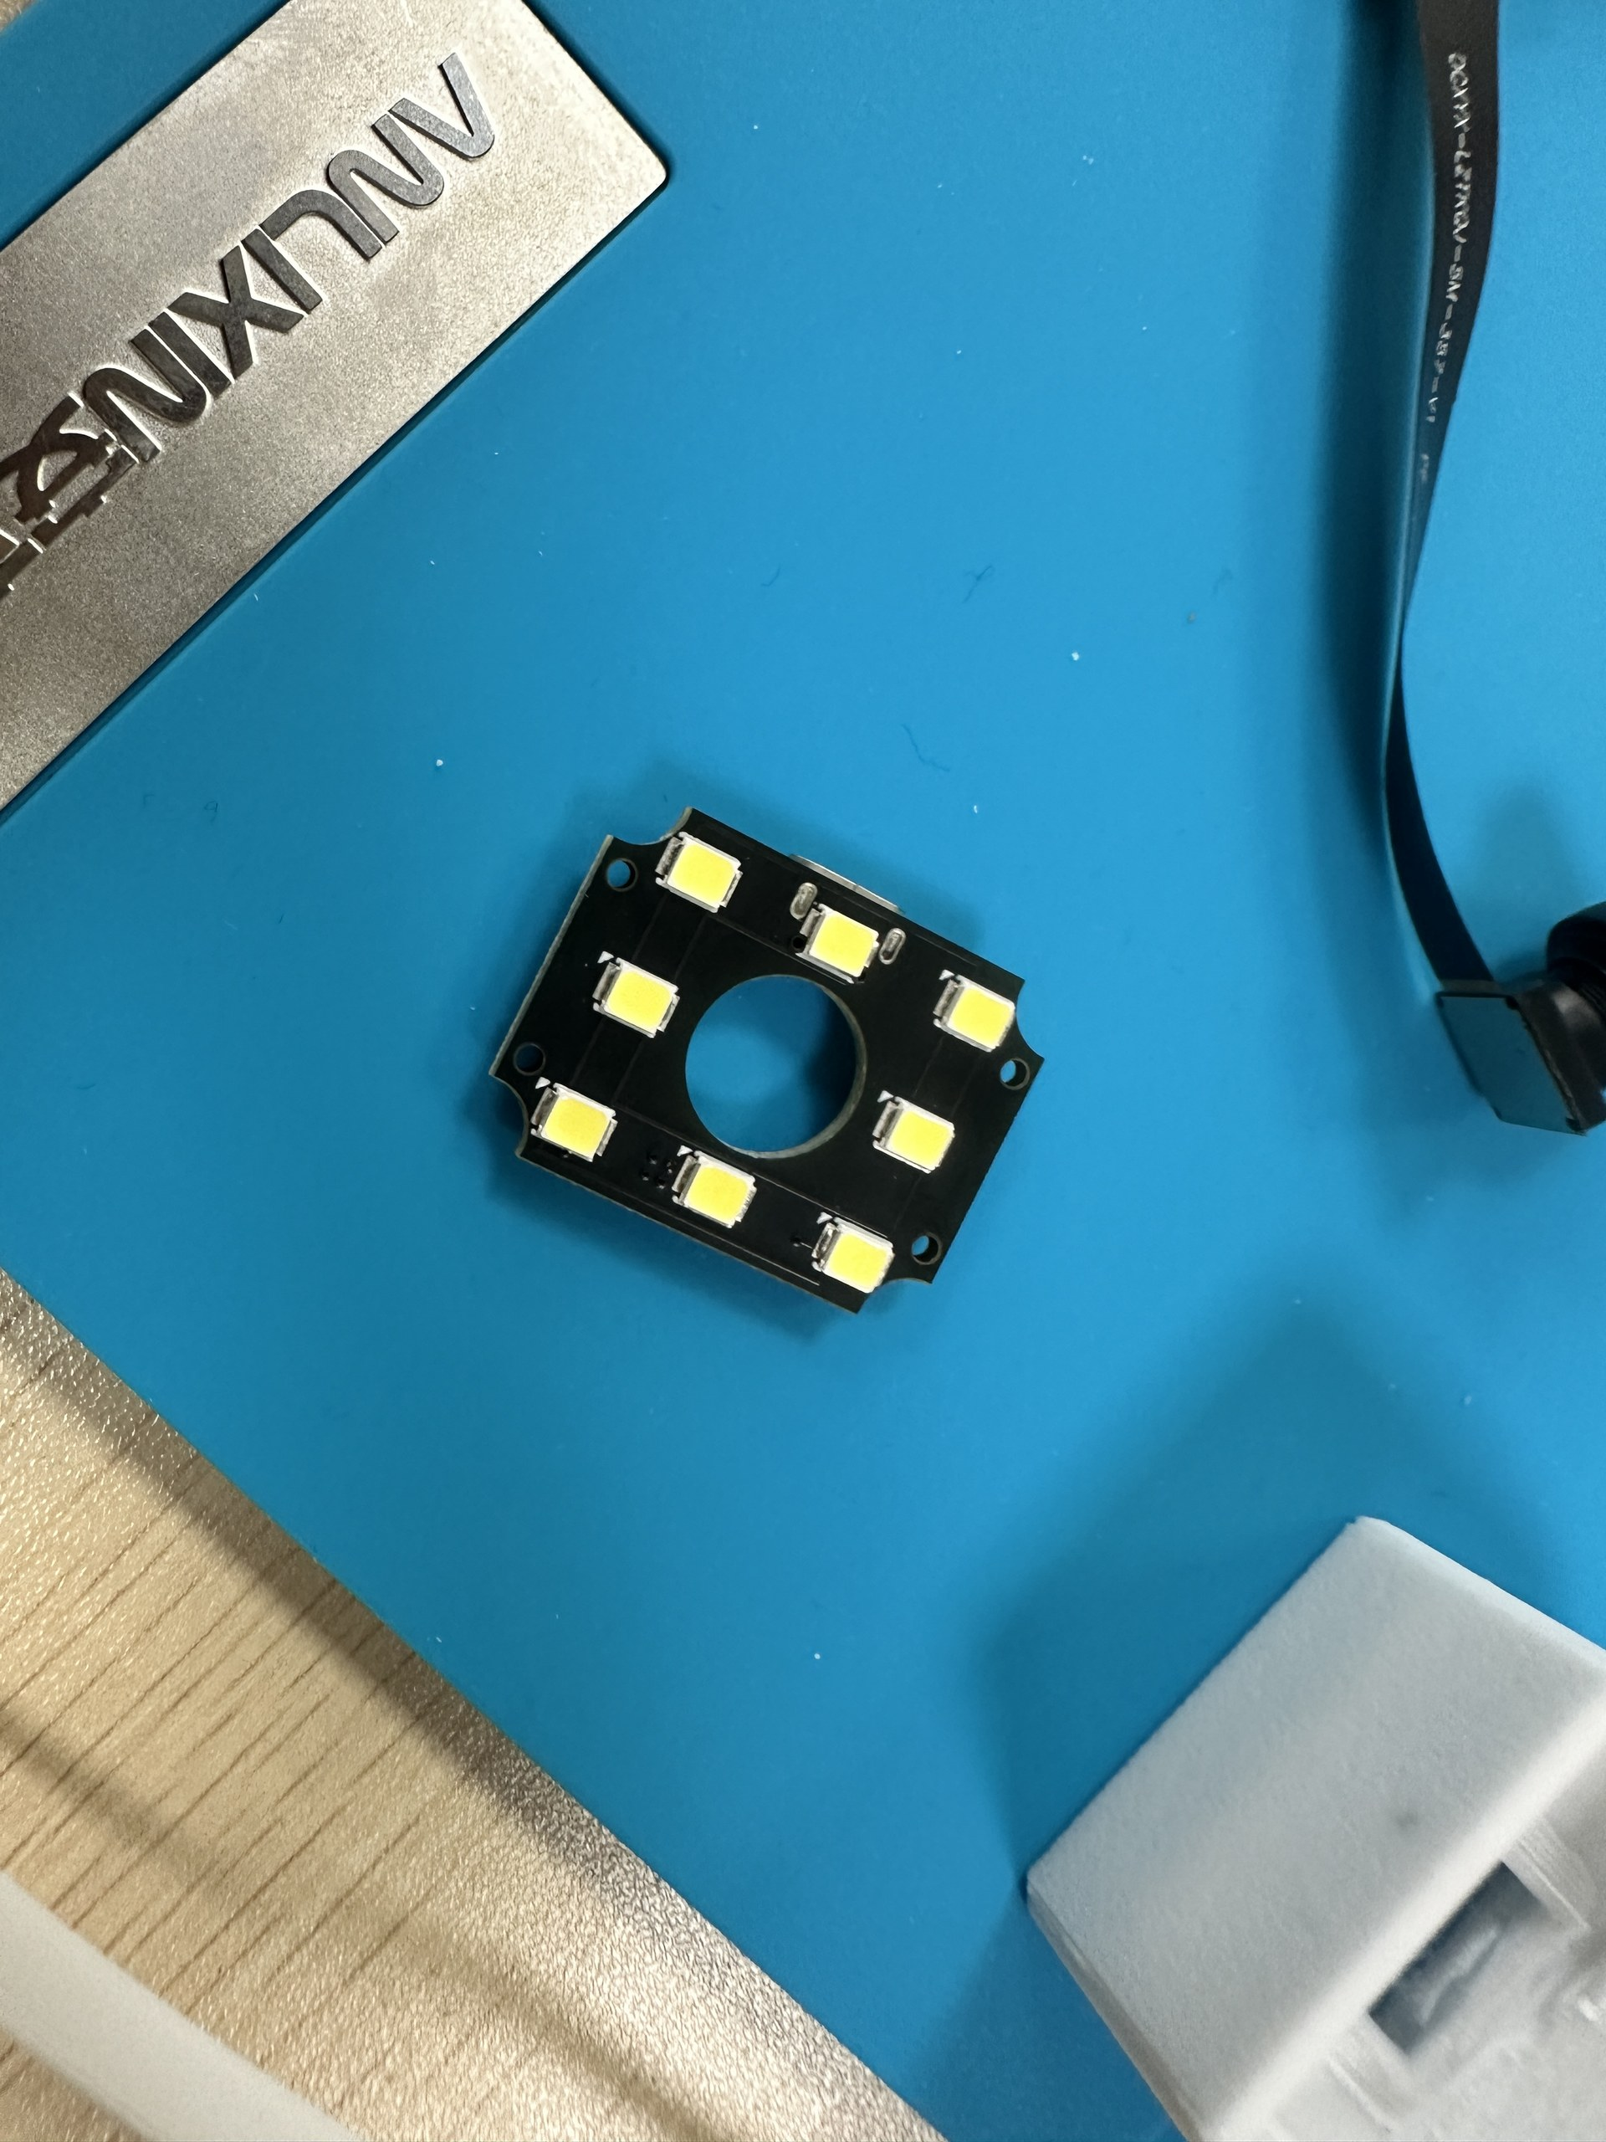
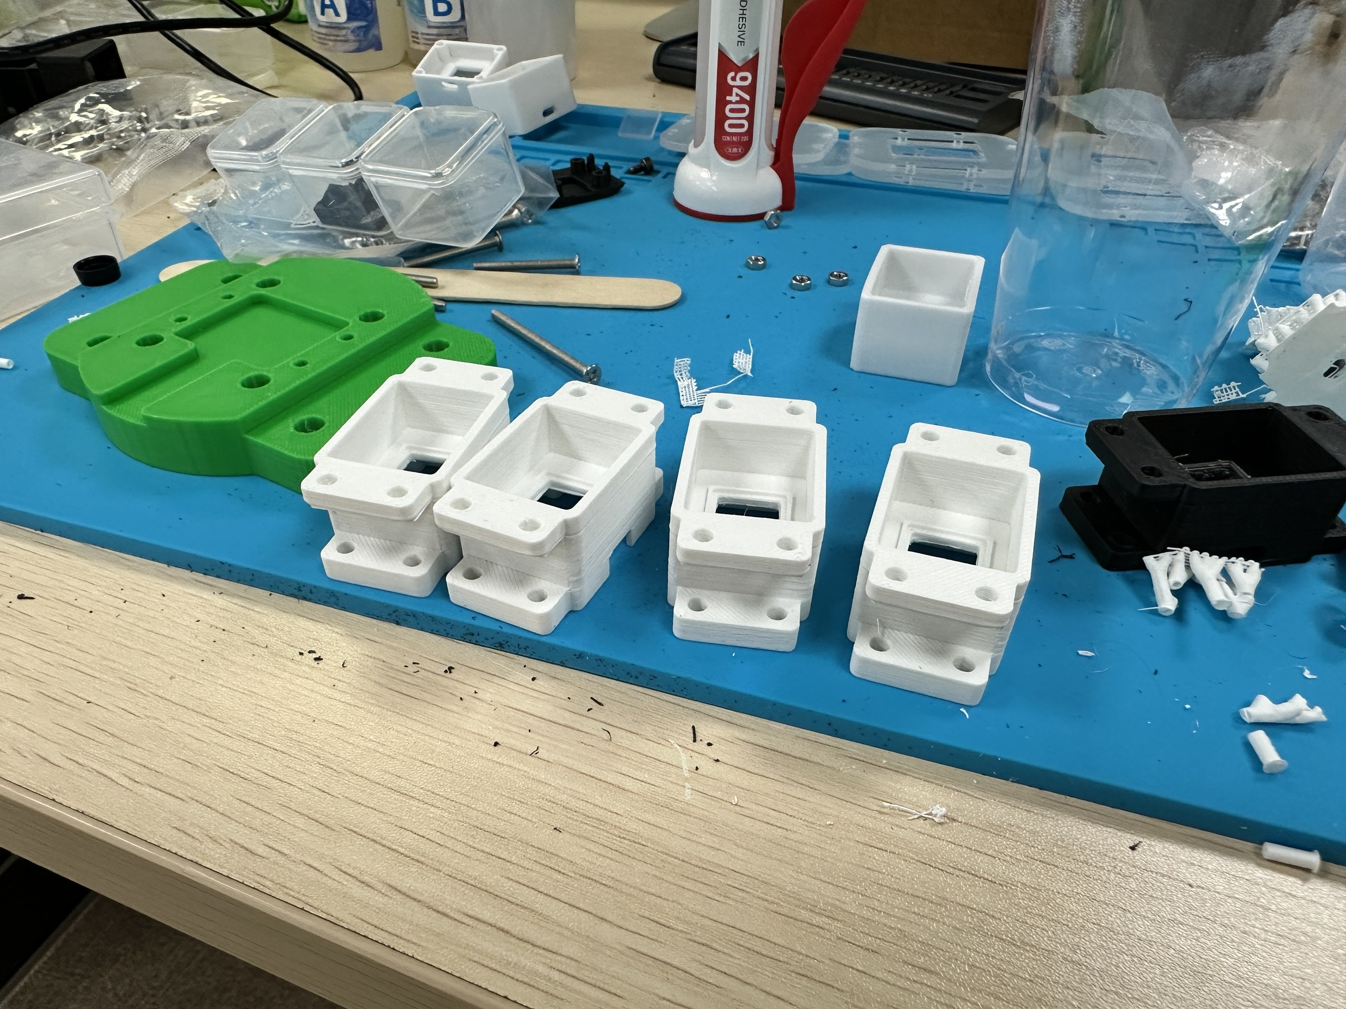
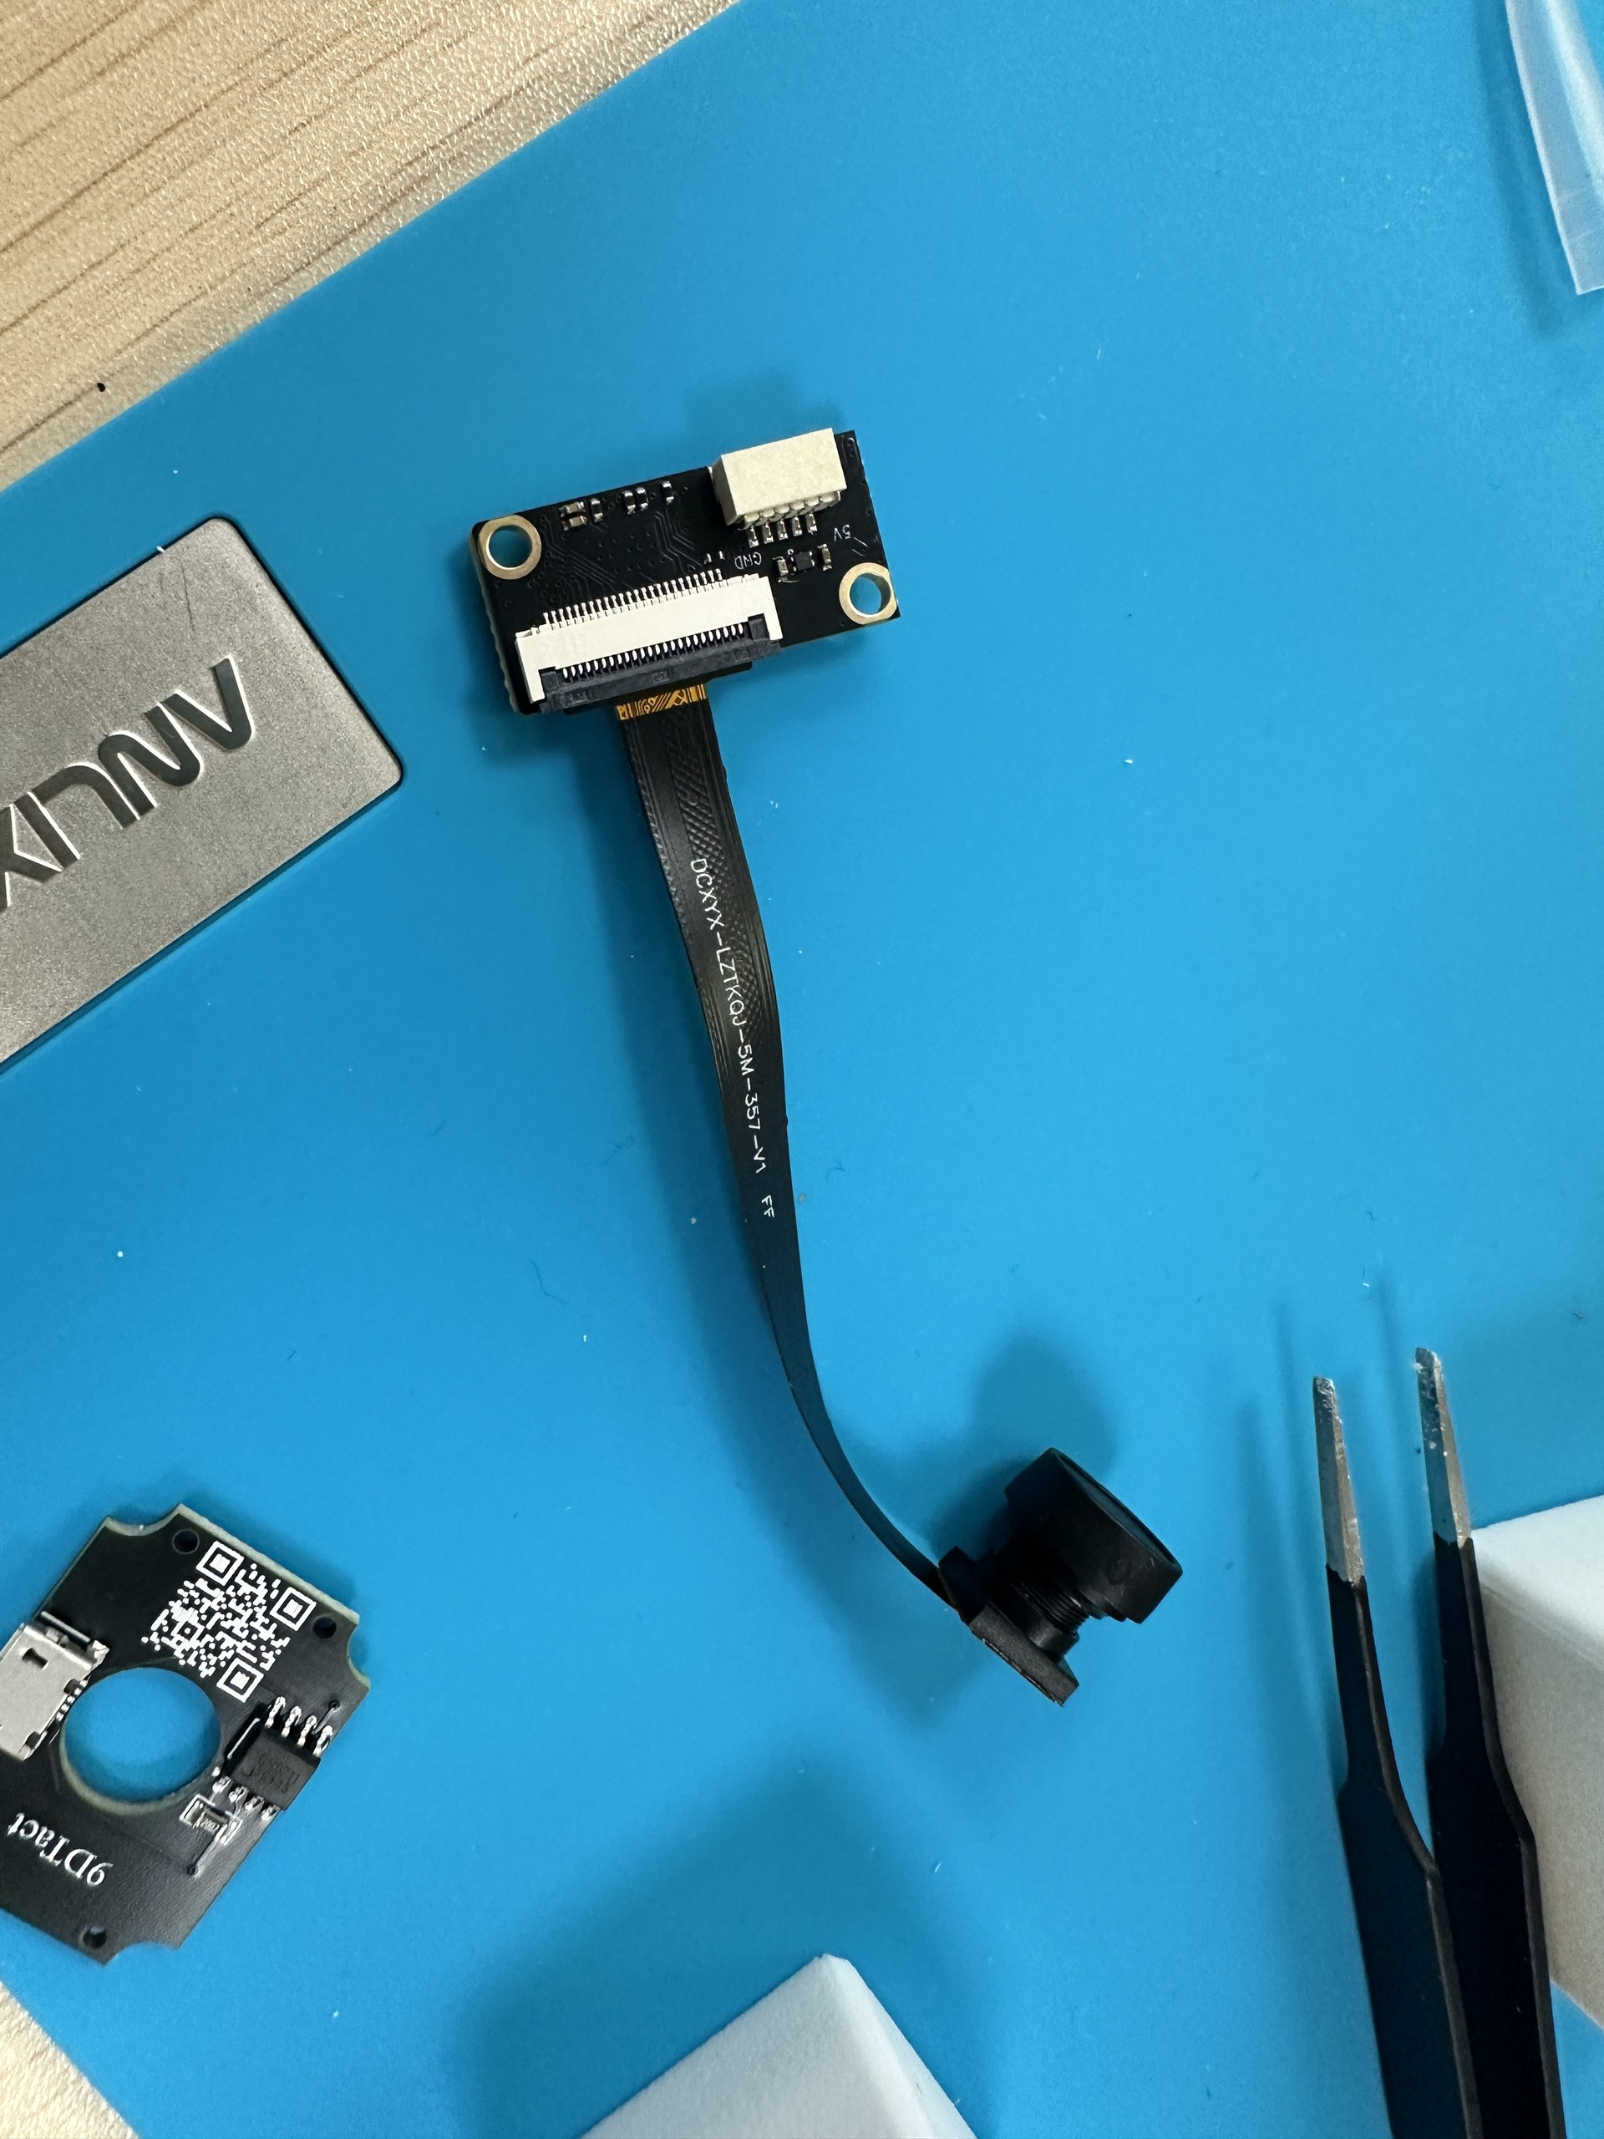
1.1 Hardware Setup of the Newly Designed Sensor
Hardware Fabrication Process

Slide 4
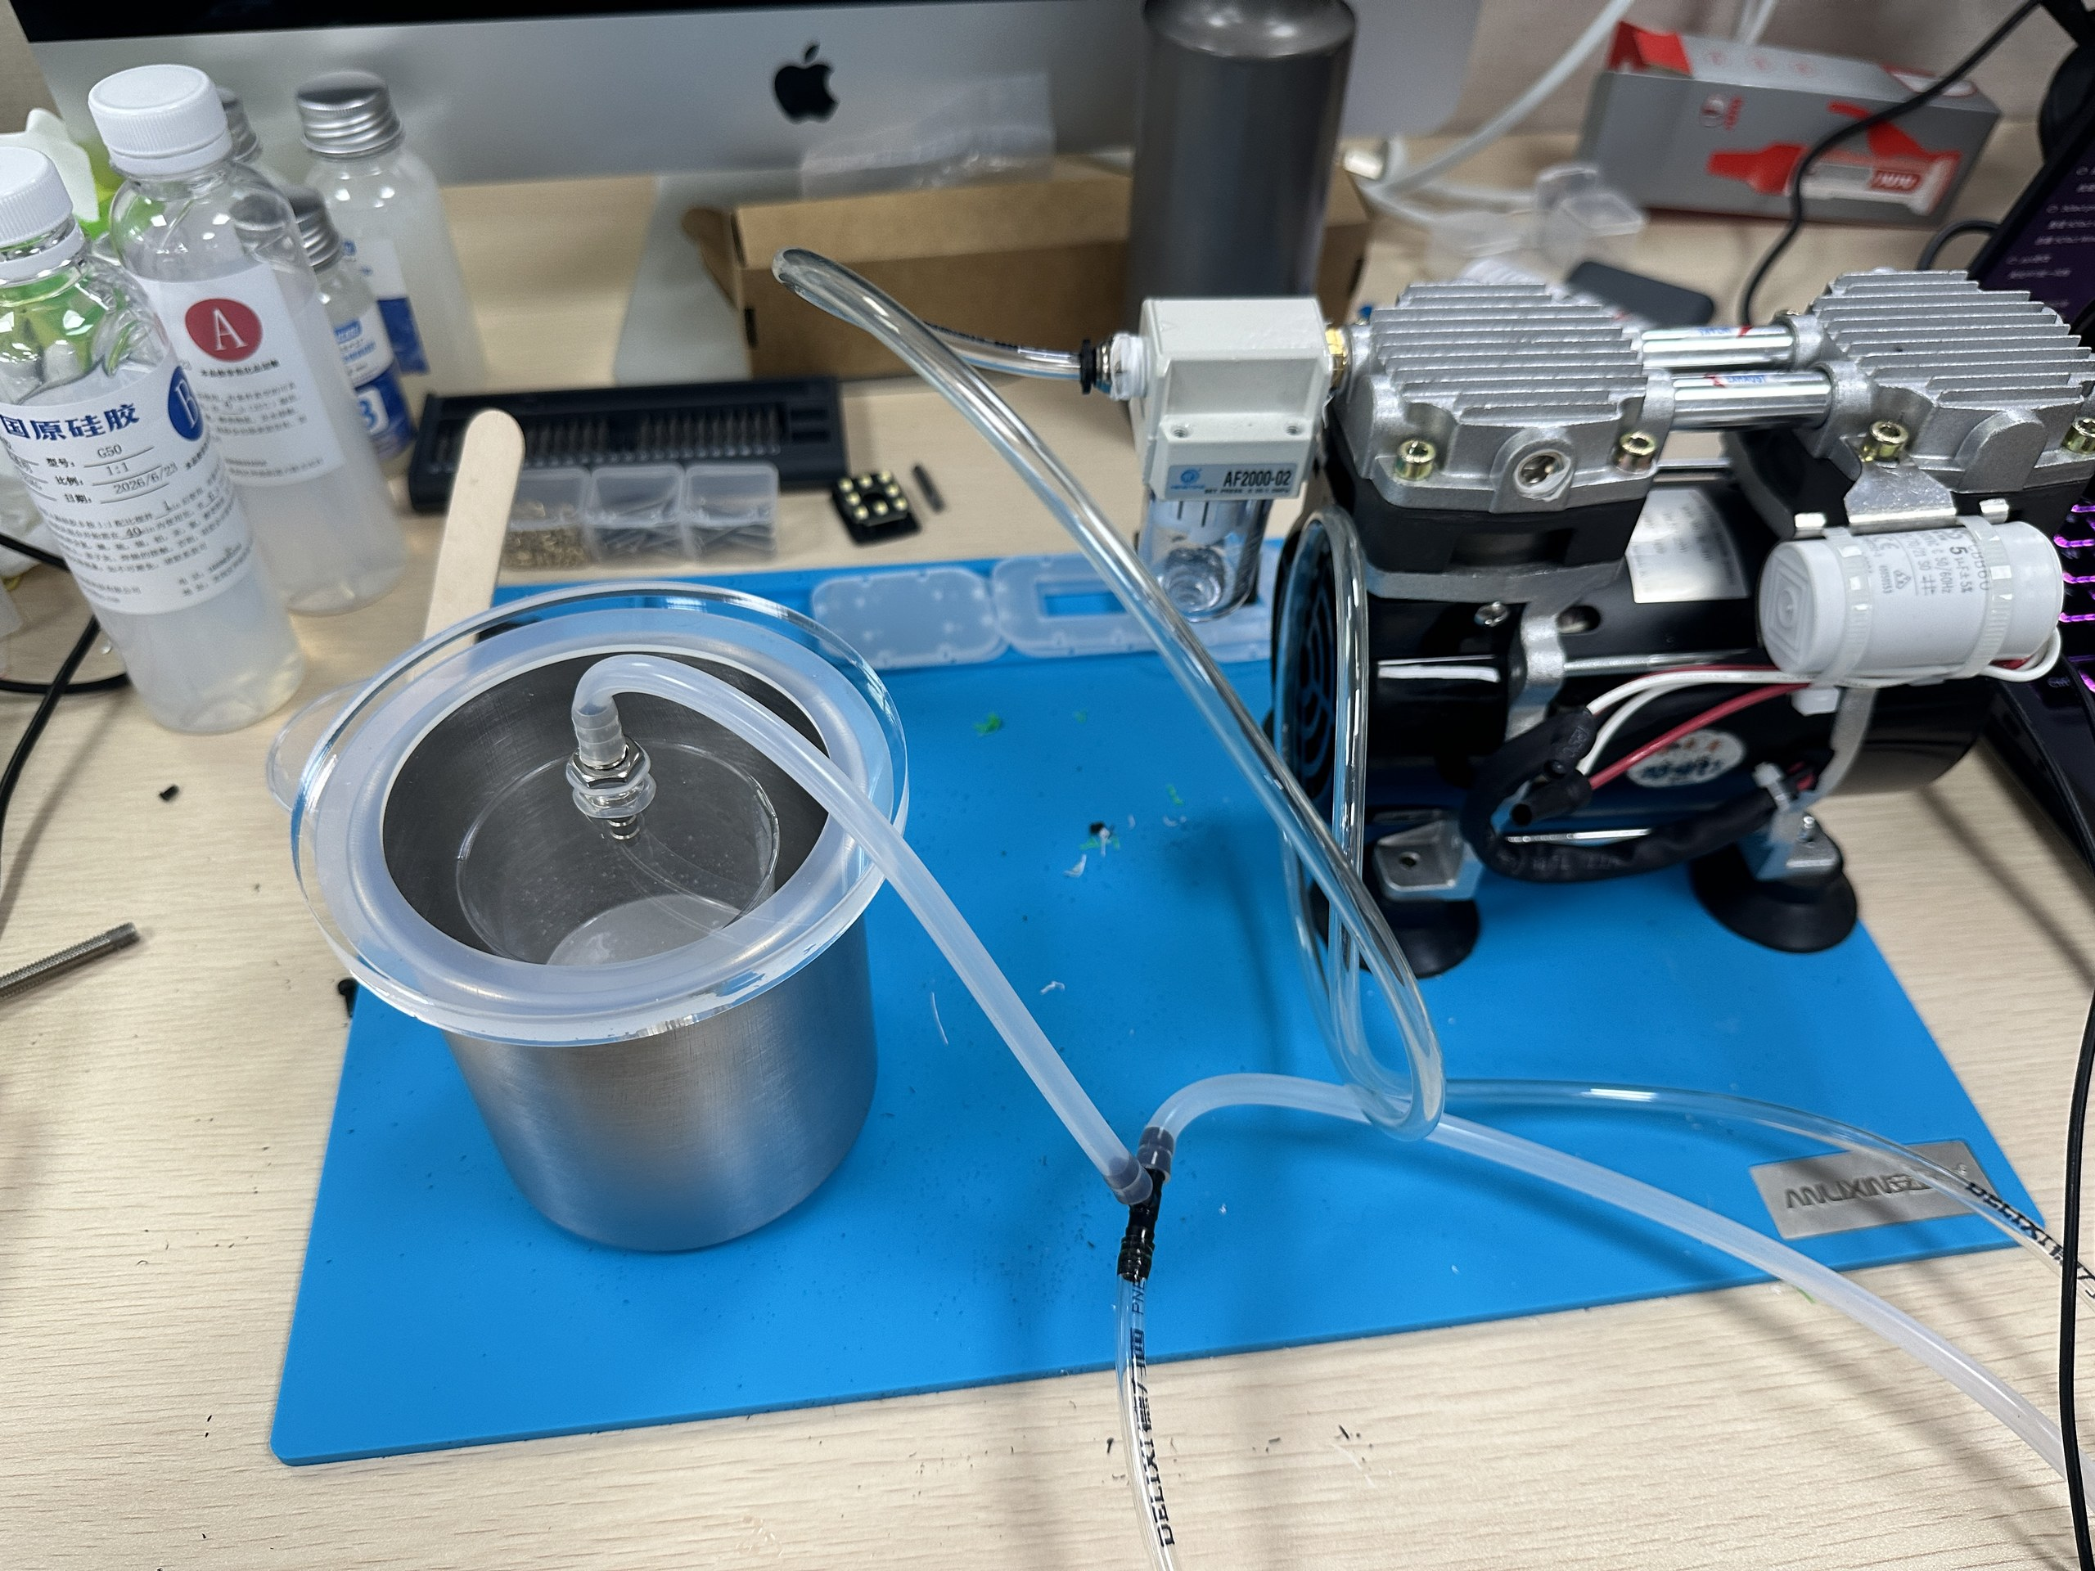
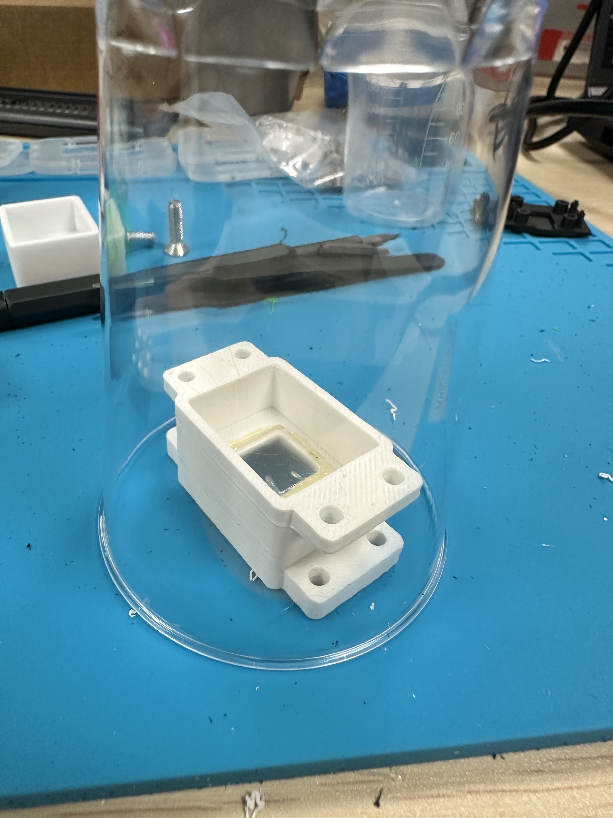
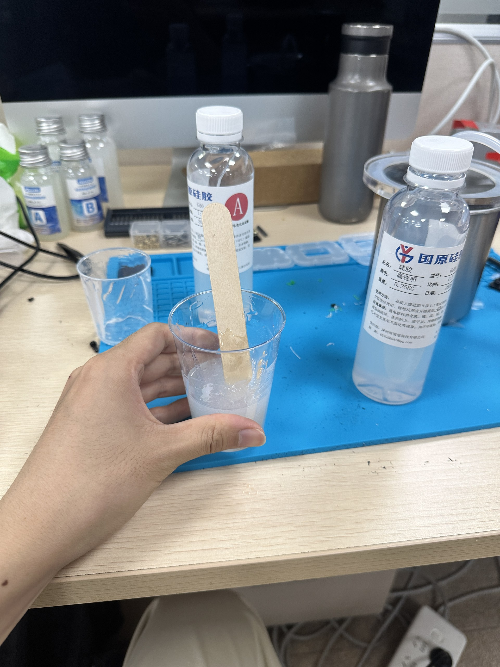
1.1 Hardware Setup of the Newly Designed Sensor
Hardware Fabrication Process

Slide 5
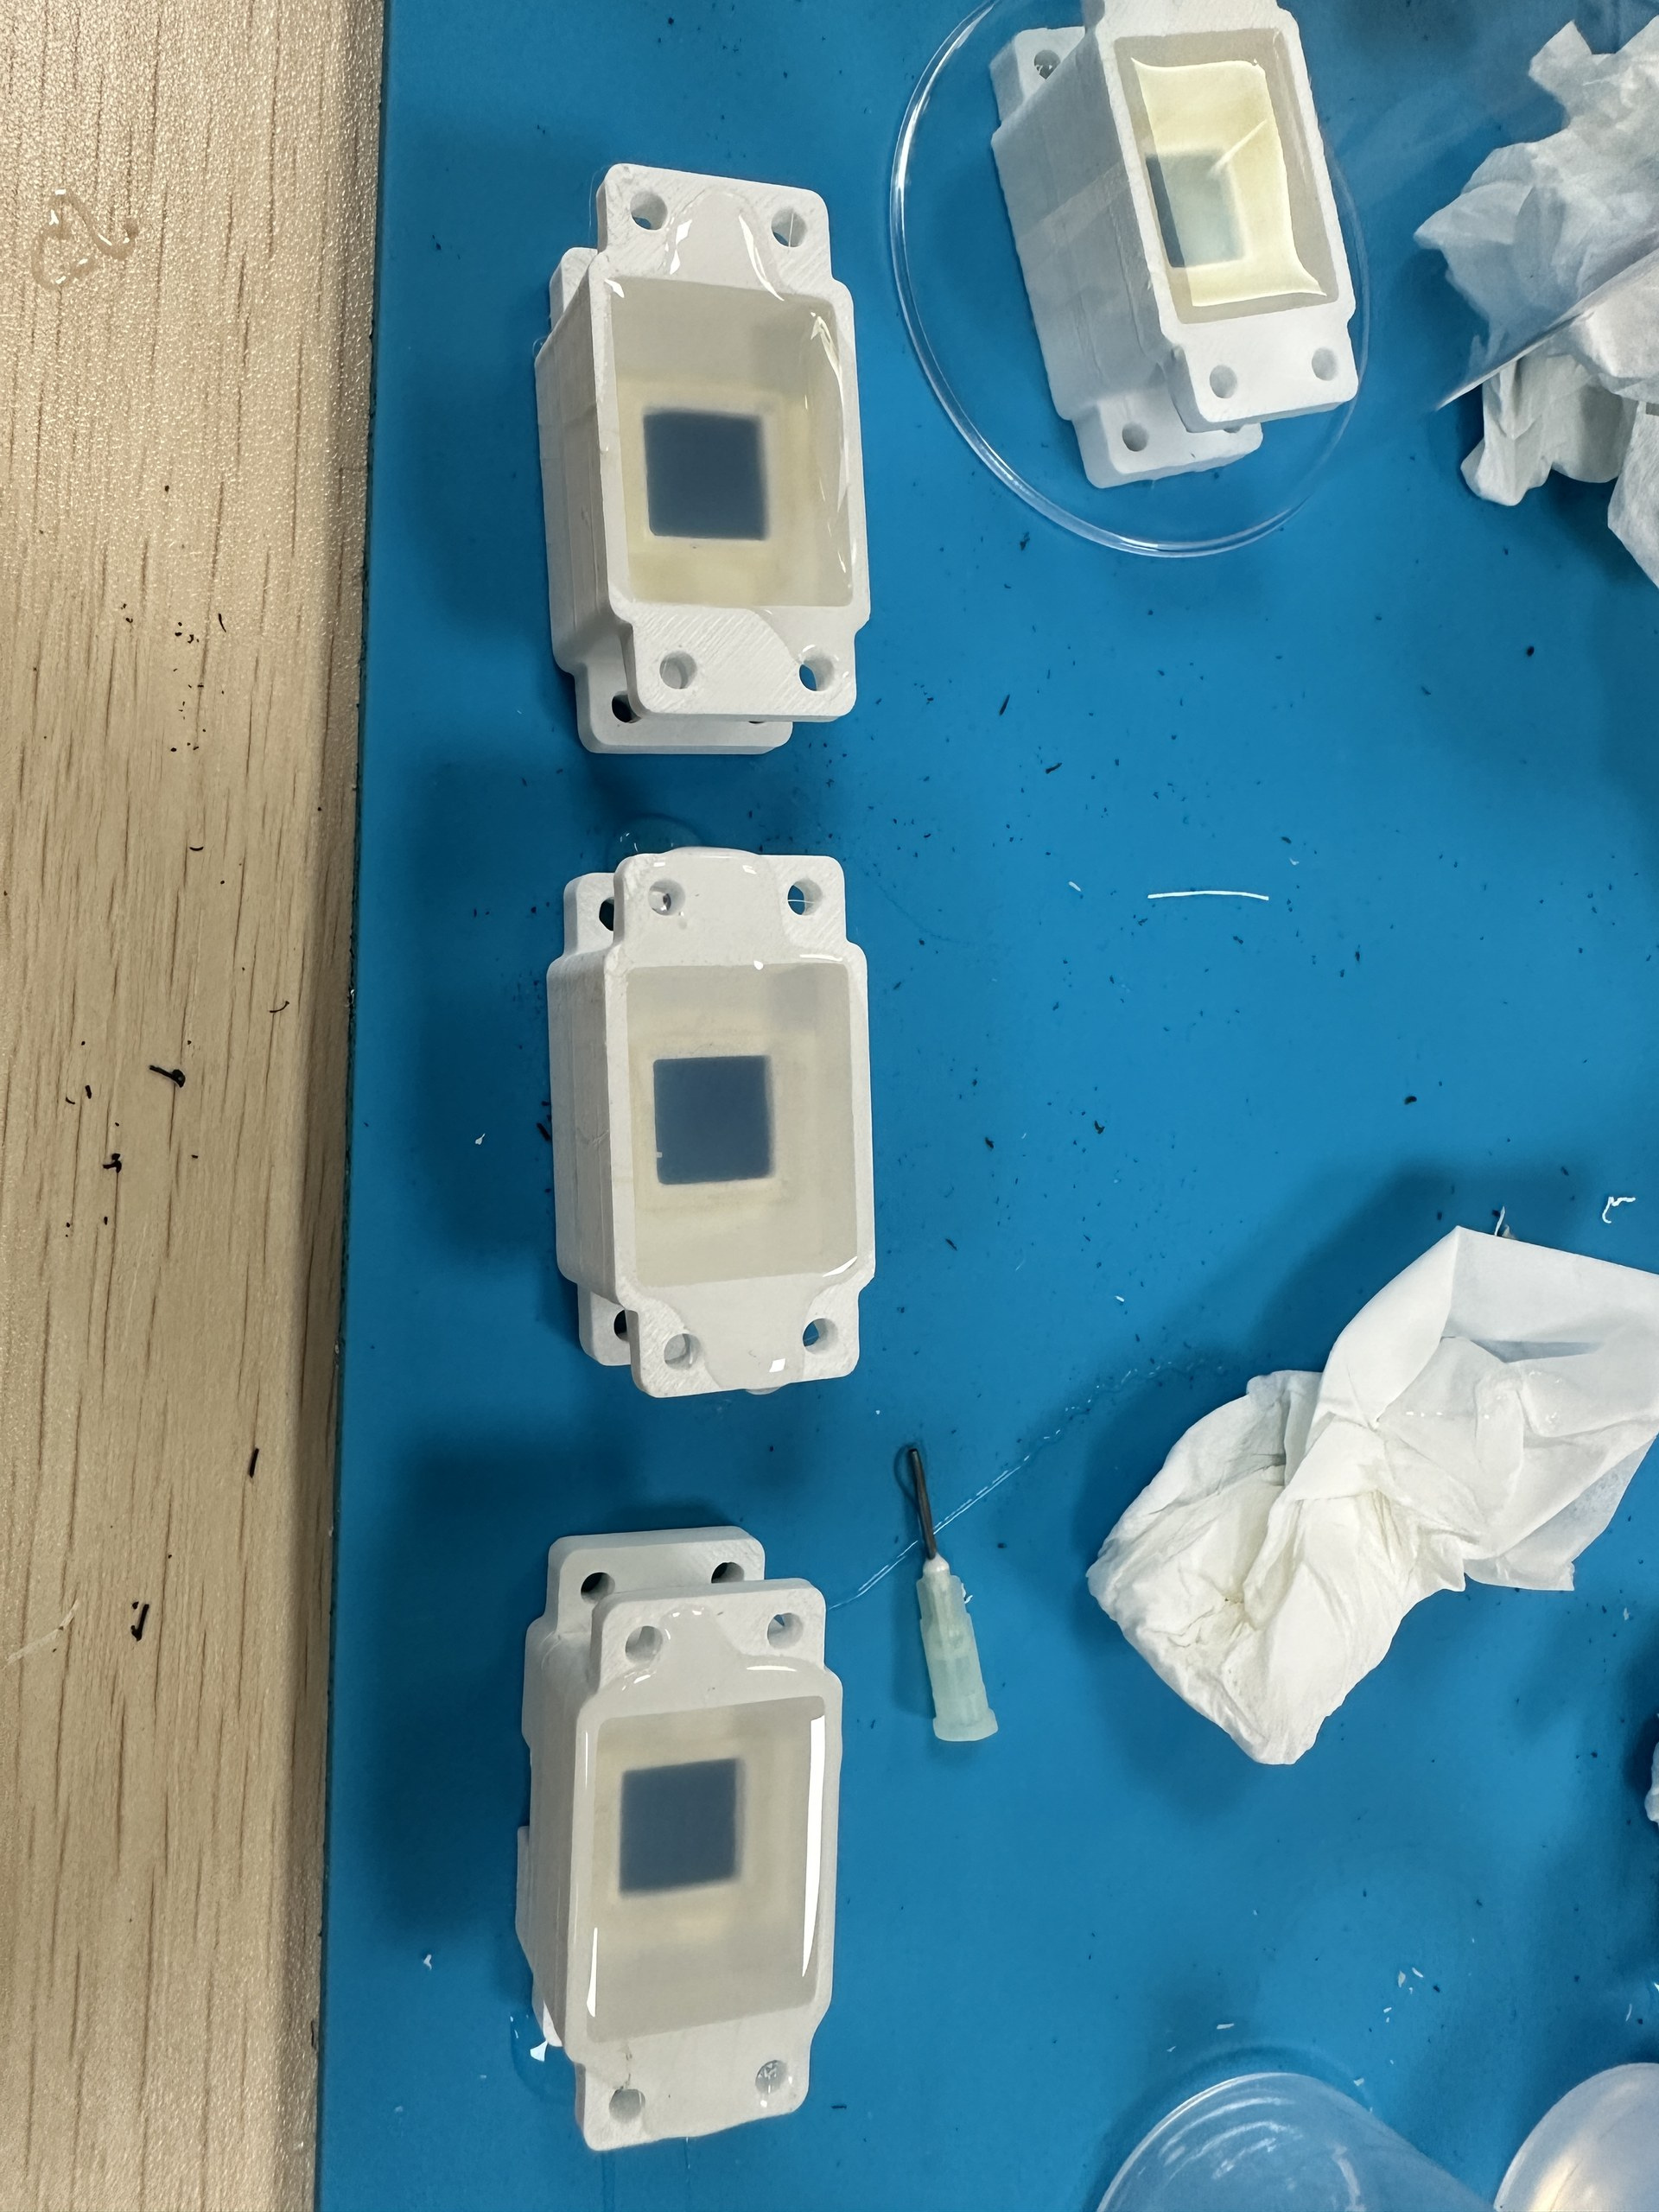
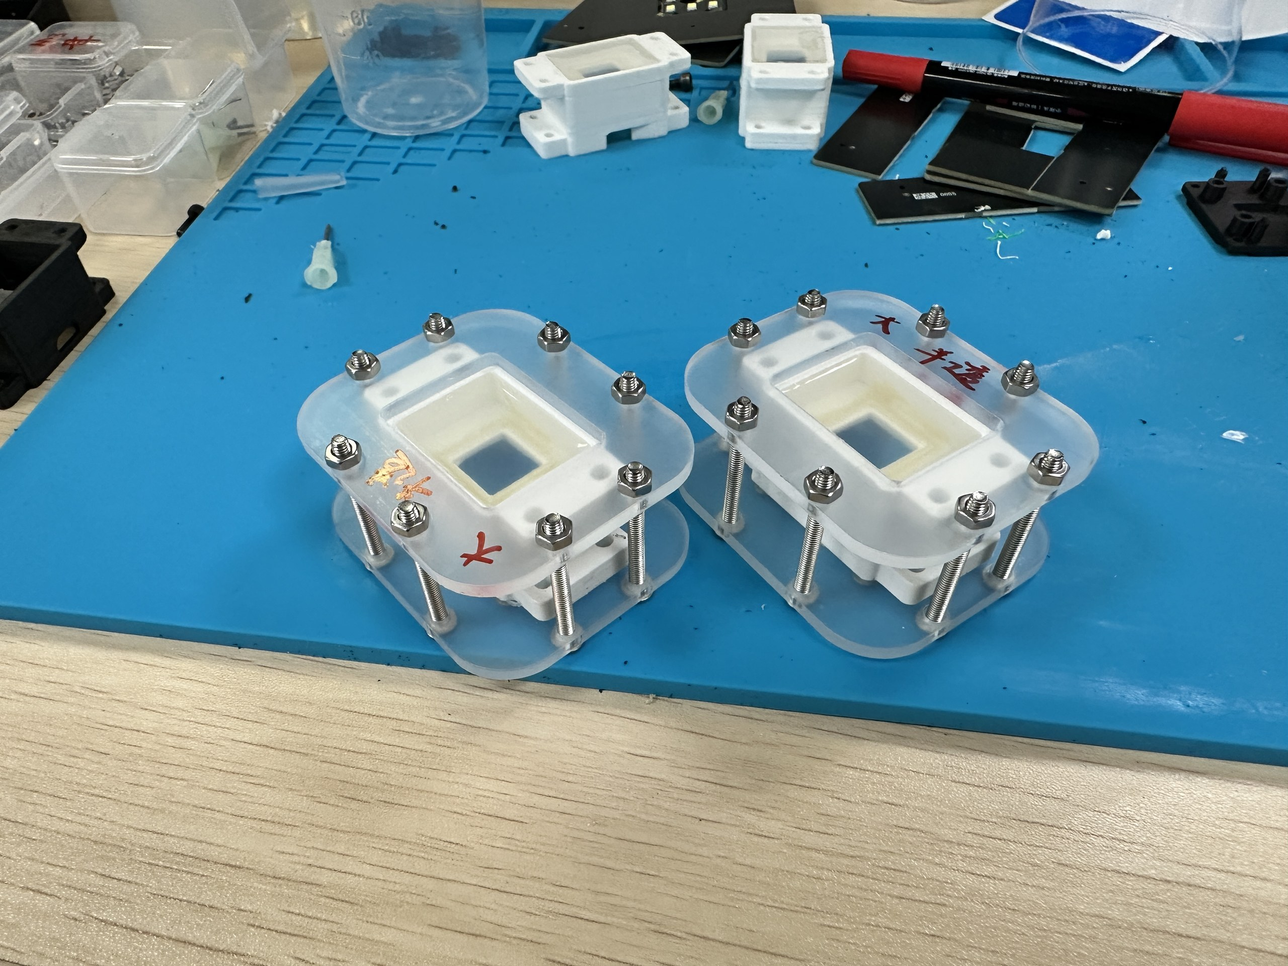
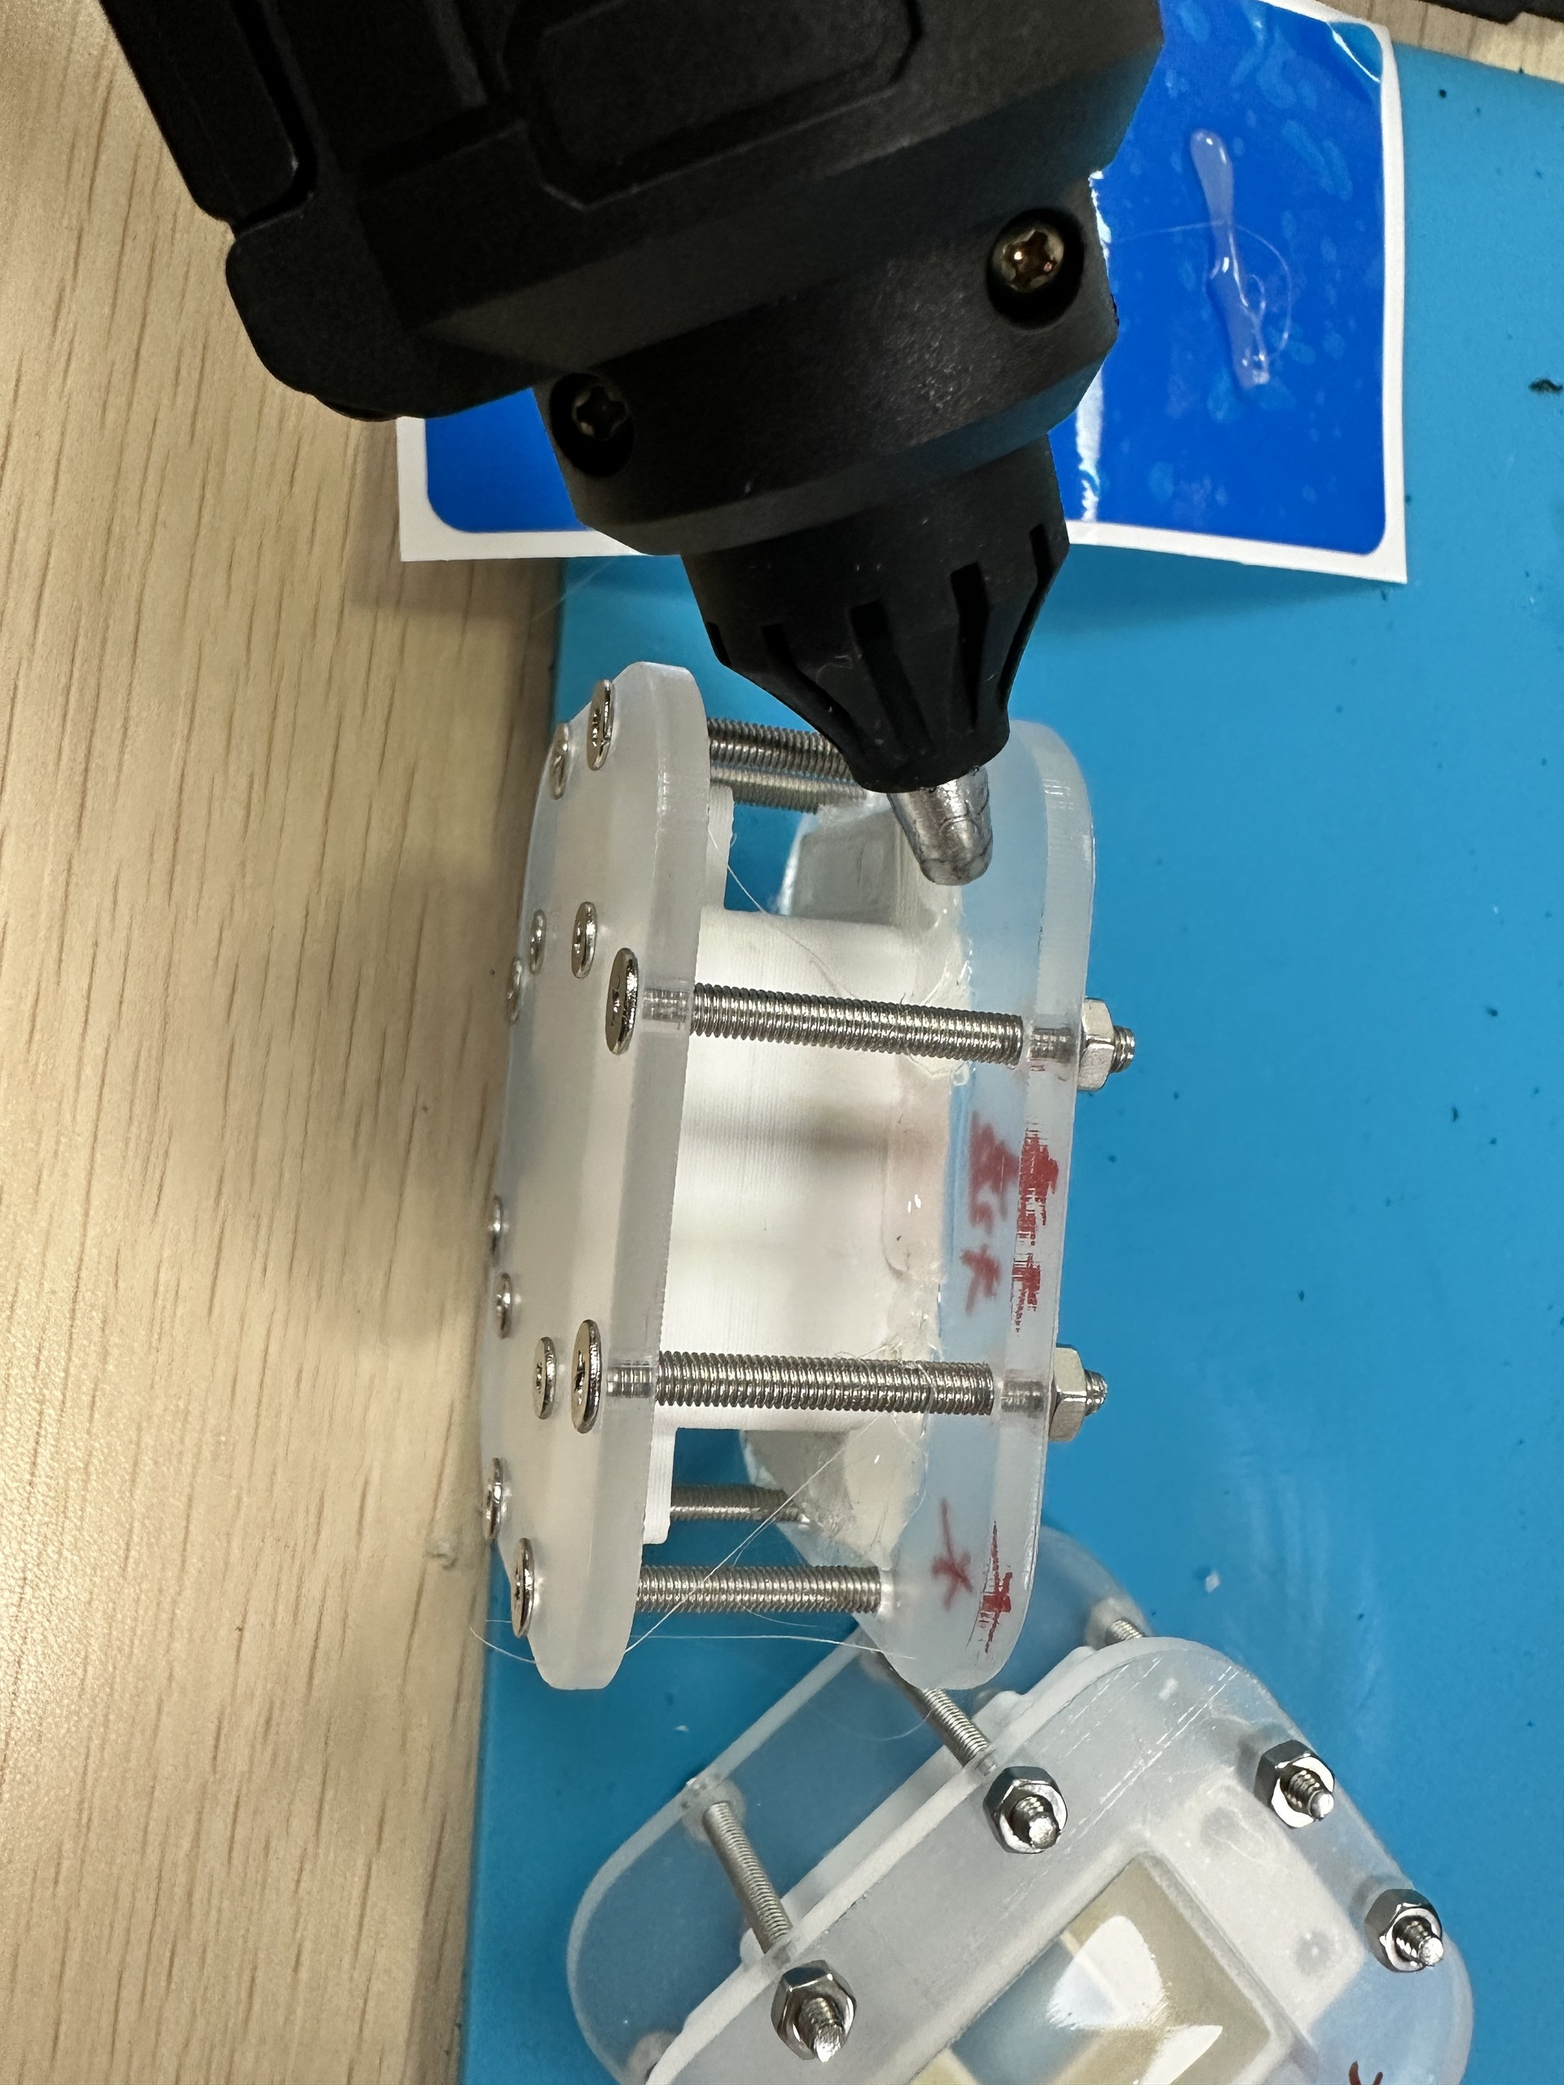
1.1 Hardware Setup of the Newly Designed Sensor
Hardware Fabrication Process

Slide 6
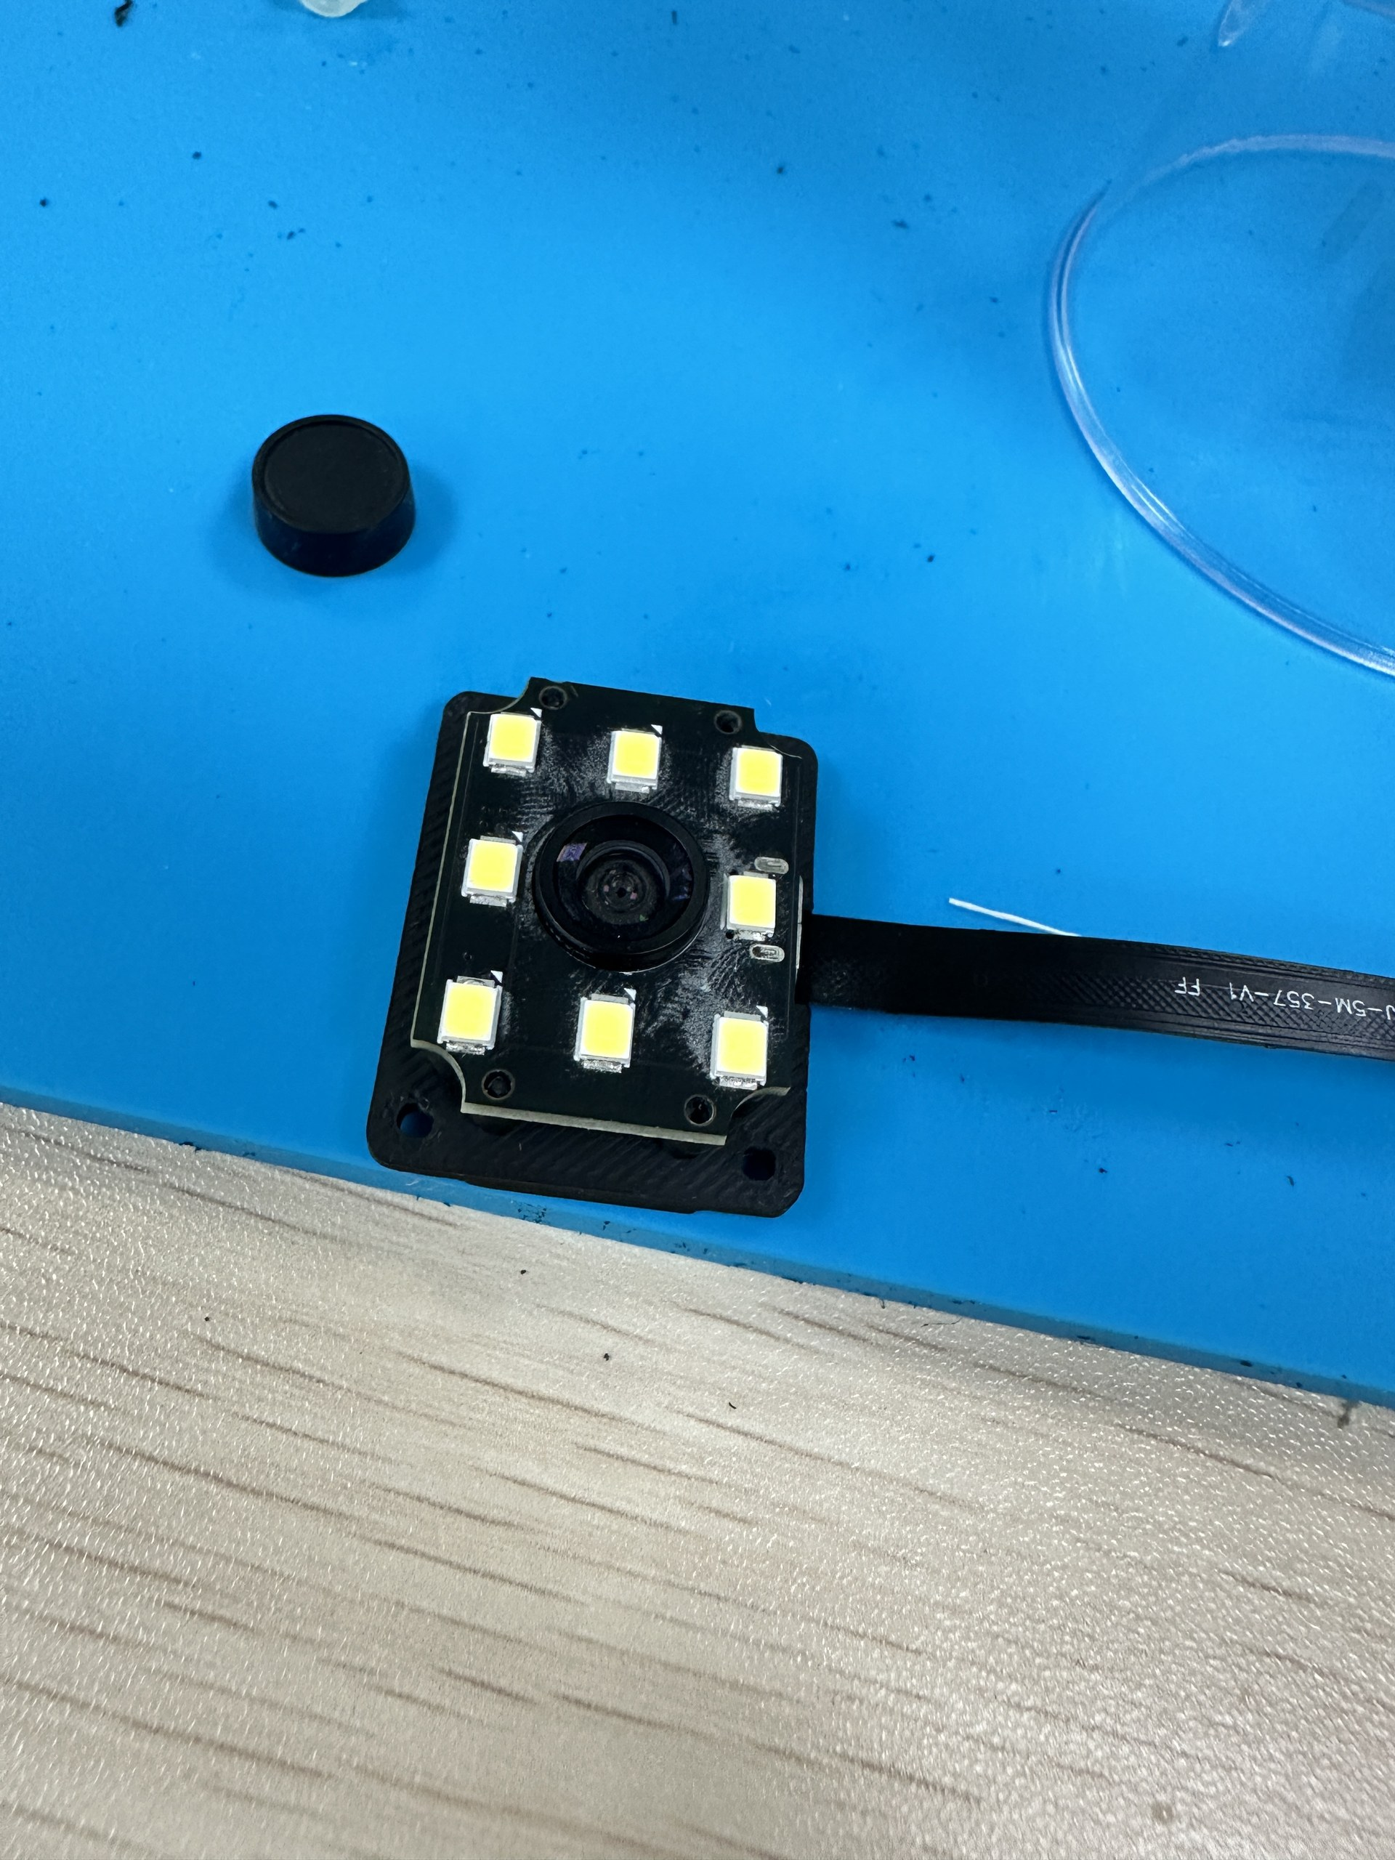
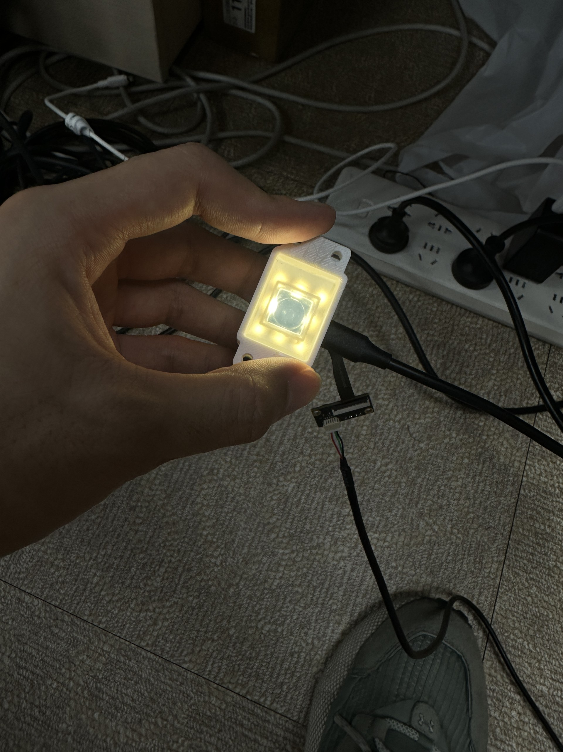
1.1 Hardware Setup of the Newly Designed Sensor
Electrical Testing

Slide 7
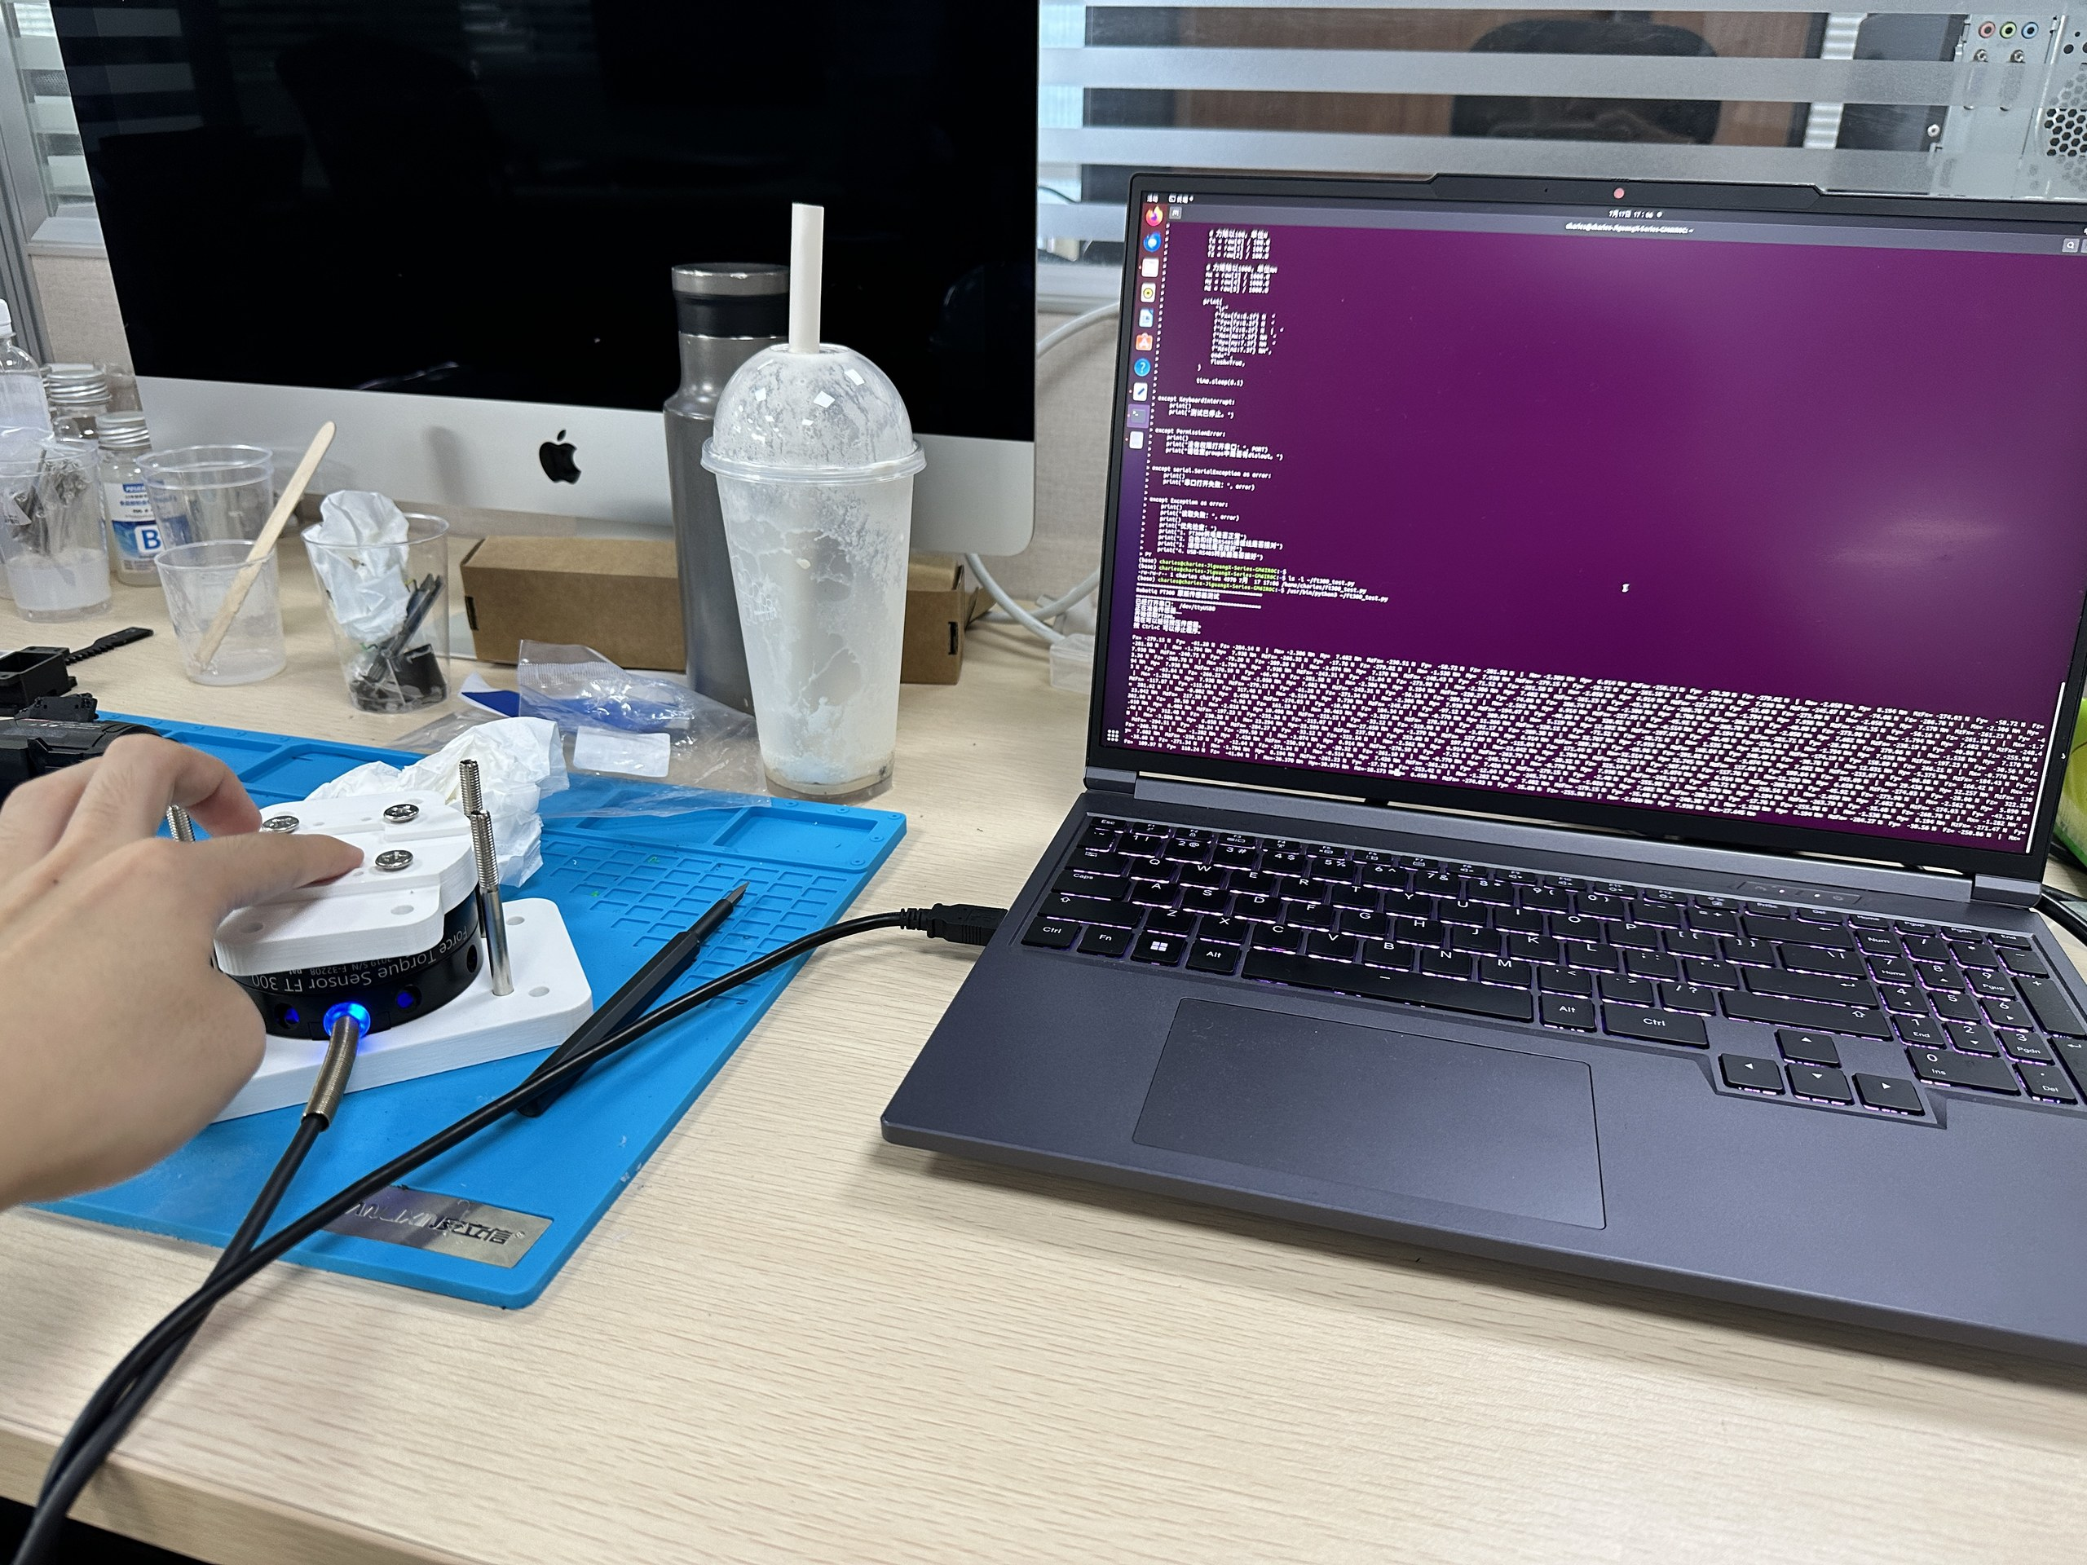
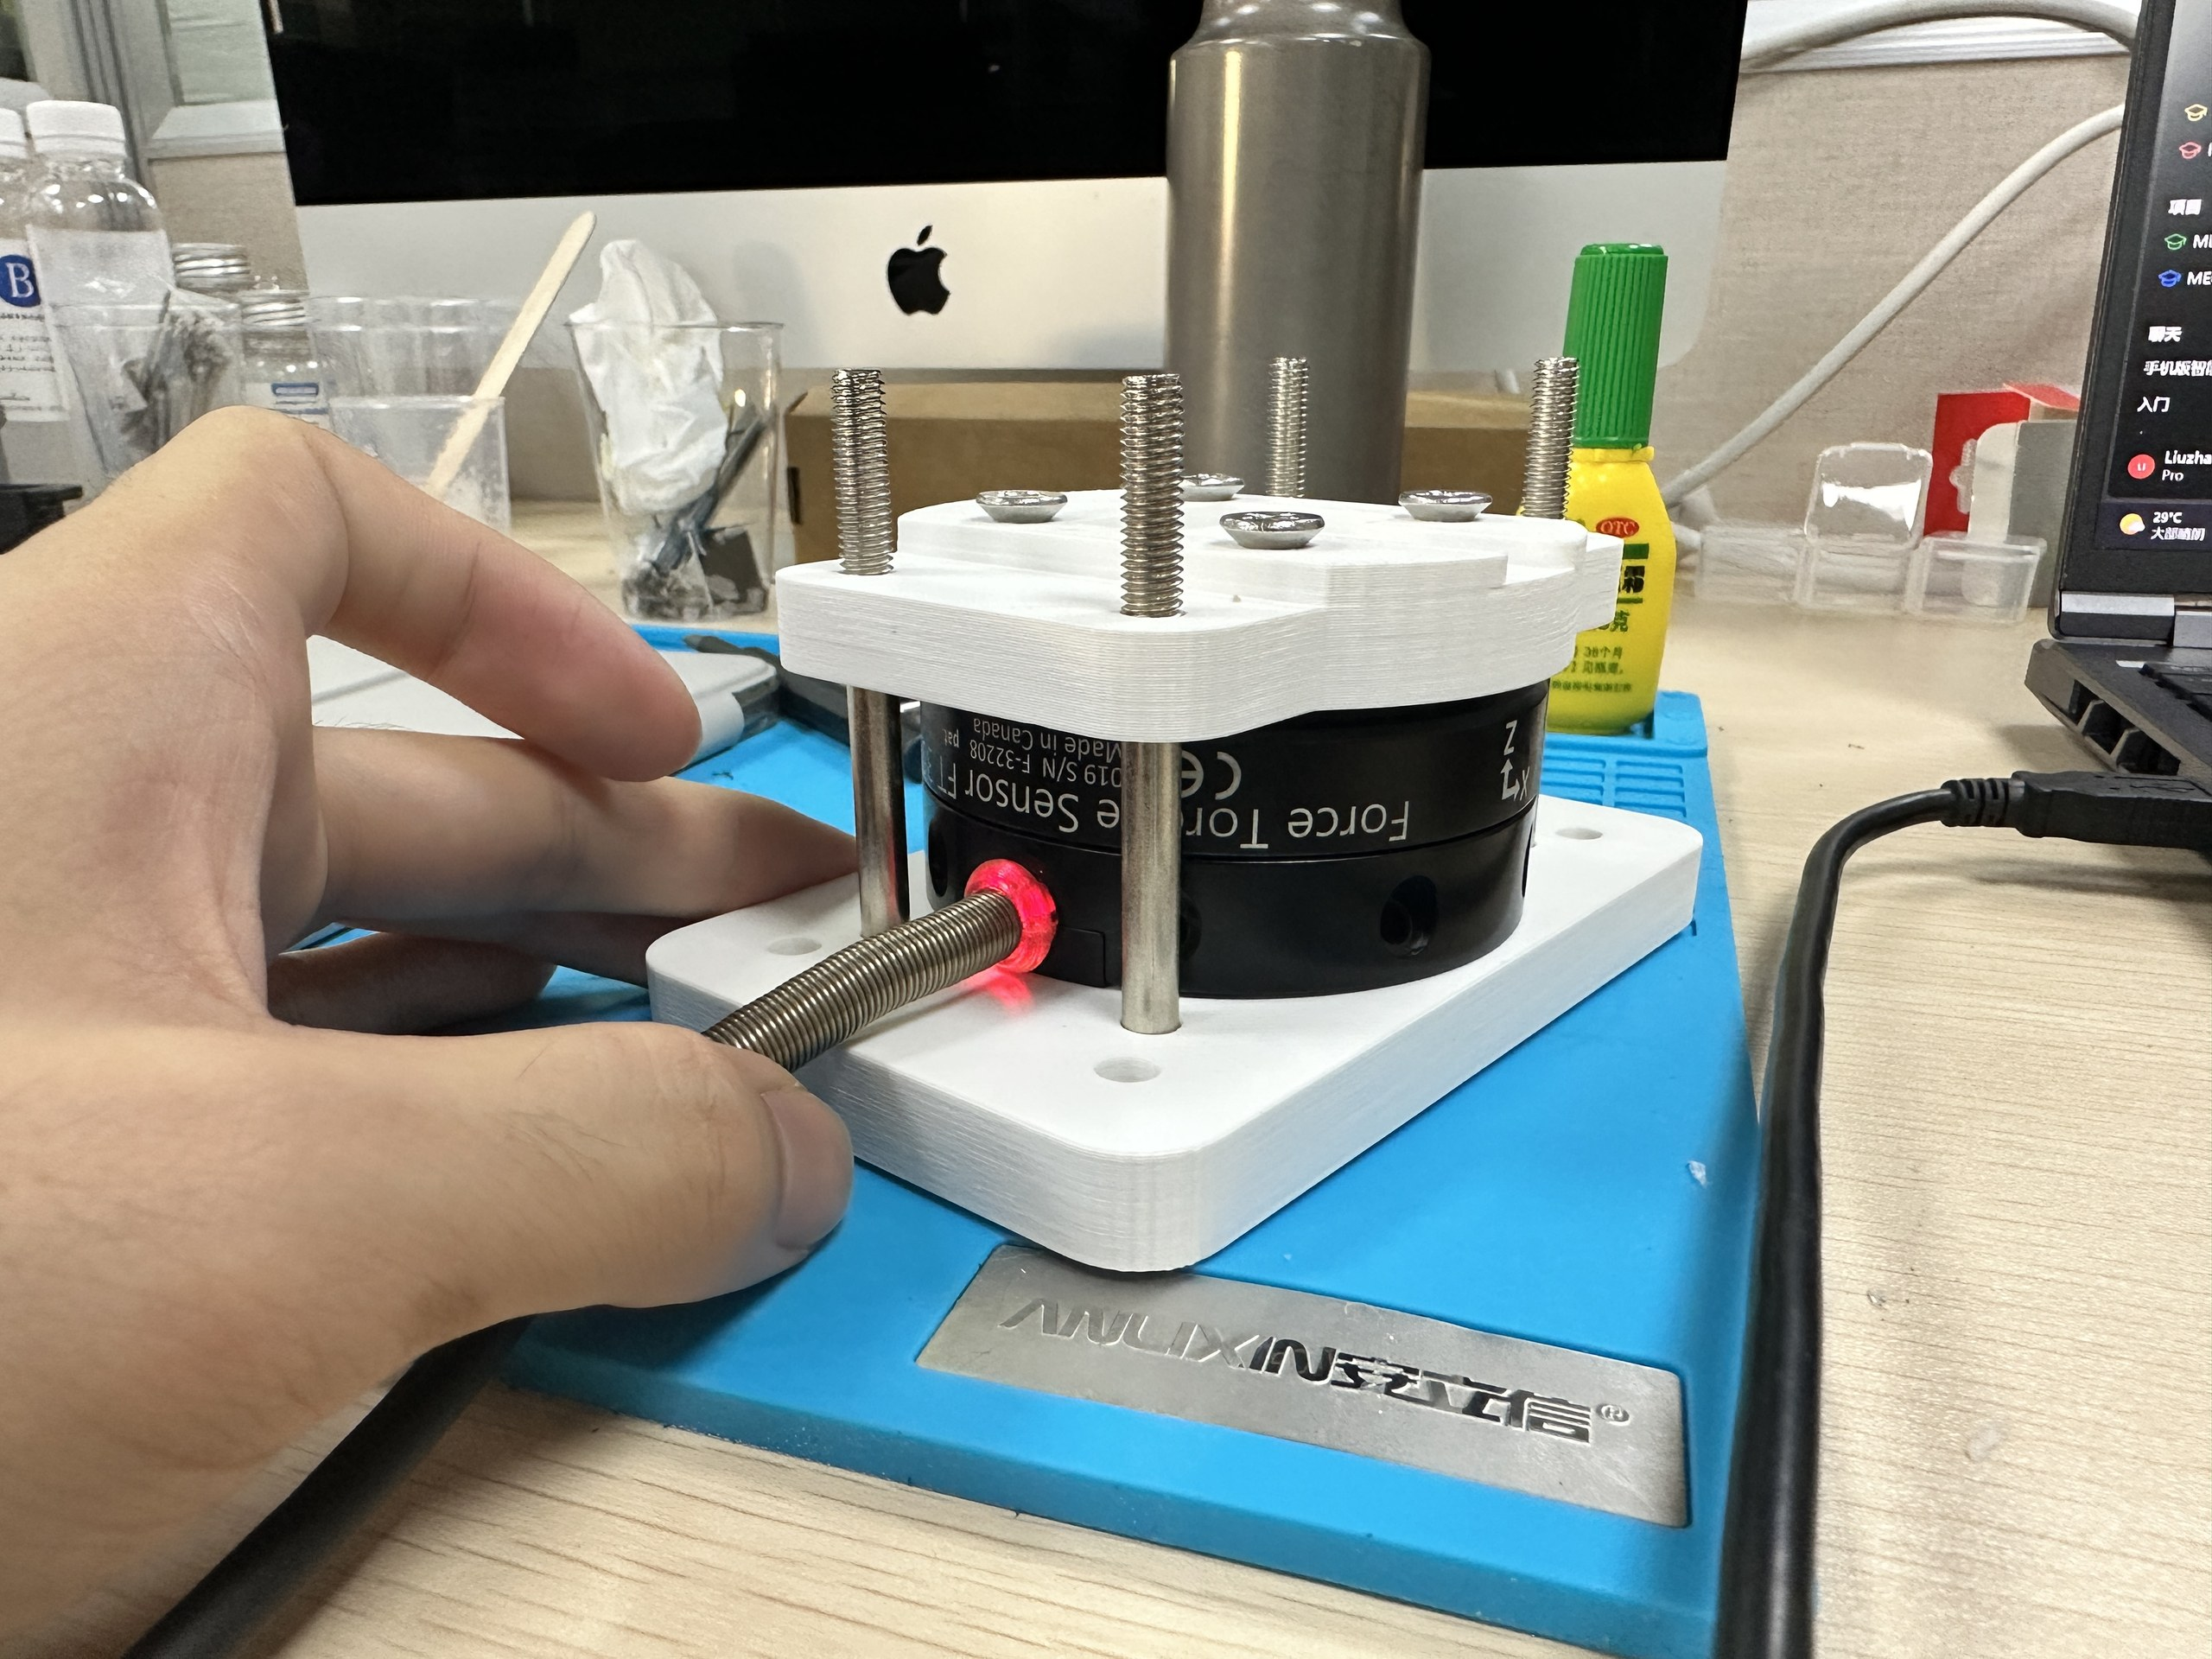
1.1 Hardware Setup of the Newly Designed Sensor
Six-Axis Force Sensor Setup and Testing

Slide 8
2. Next Week‘s Work Plan
For the hardware：
Build a synchronized acquisition system for 9DTact images and FT300 six-axis force labels.
Collect a larger and more diverse dataset, including normal pressing, shear, eccentric loading, and torsion.
Repeat experiments under different loads, directions, and contact positions to improve data reliability.
Perform timestamp alignment, outlier removal, and data normalization.
For the software：
Perform timestamp alignment, outlier removal, and data normalization.
Train a model to estimate 6Dforces from 9Dtact images.
Improve estimation accuracy through model tuning and additional data collection.
Evaluate the model

