Slide 1

TARTU ÜLIKOOL
Arvutiteaduste instituut
Infotehnoloogia mitteinformaatikule
Tree Species Mapping Using Sentinel-2 Time Series and Machine Learning
Liis Lille
2026

Slide 2

Background
Accurate forest tree species mapping
sustainable forest management
biodiversity monitoring
carbon accounting
environmental reporting
Remote sensing with machine learning provides a scalable and cost-effective alternative for forest monitoring
Sentinel-2 satellite imagery offers high temporal and spectral resolution
Notes:
Accurate forest tree species mapping is important for sustainable forest management, biodiversity monitoring, carbon accounting, and environmental reporting. Traditional field inventories are time-consuming and expensive over large areas. Remote sensing provides a scalable and cost-effective alternative for forest monitoring.
Sentinel-2 satellite imagery offers high temporal and spectral resolution, making it suitable for detecting seasonal differences between tree species. In addition to spectral information, environmental variables such as elevation and soil characteristics can improve species classification performance.

Slide 3
Objective / Research Question
Can multi-temporal Sentinel-2 data combined with elevation and soil features improve forest tree species classification accuracy in Estonian forests?
The project focused on classifying dominant Estonian forest species:
Birch
Pine
Spruce
Grey alder
Black alder
Aspen
Other species

Slide 4
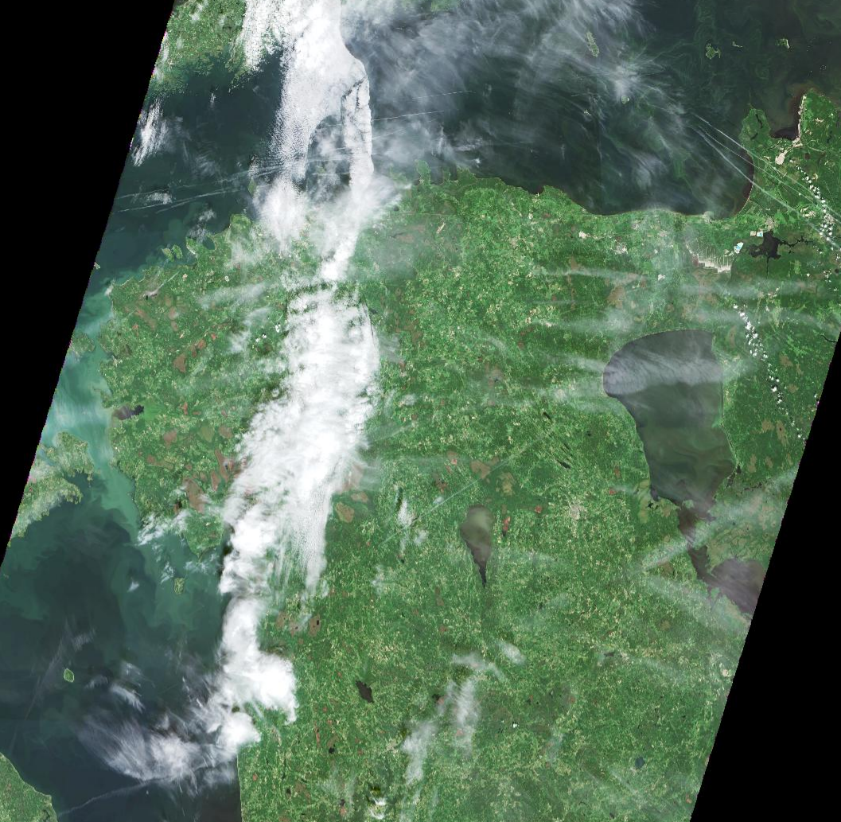
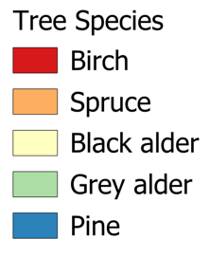
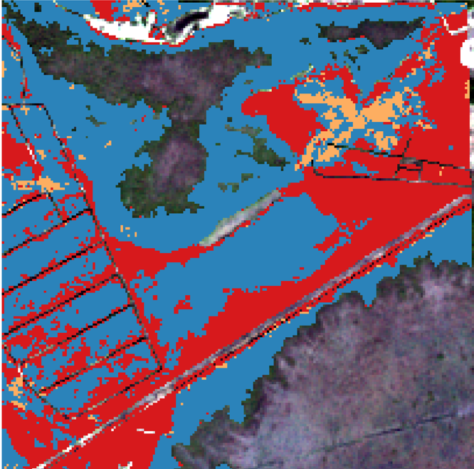
Datasets and Methodology
ML
Machine Learning model: Random Forest
Datasets:
Forest parcels (Forest Registry)
Sentinel-2 images (2025)
Forest height map
Soil map:
Data types:
S2 time-series (10-day interval)
raster + vector
Sentinel-2 satellite images
Datasets +ML
Pixel-based tree species map

Slide 5
Processing Steps
Convert time-series data from long format to wide format
Merge auxiliary environmental data
Handle missing values using median imputation
Encode categorical soil variables
Train and validate the Random Forest model
Evaluate performance using:
Accuracy
Precision
Recall
F1-score
Confusion matrix

Slide 6
Results
Overall Performance
Validation accuracy: 82.8%
Test accuracy: 80.1%
The model performed well for dominant species, especially:
Birch
Pine
Key Findings
Red-edge and moisture-sensitive indices (NDRE, NDMI) were among the most important predictors.
September–October observations provided strong species separability.
Elevation and soil features improved classification stability.
Multi-temporal data significantly improved classification compared to single-date imagery.

Slide 7
Results
Classification Challenges
Some confusion remained between ecologically similar species:
Aspen ↔ Birch
Spruce ↔ Pine
Grey alder ↔ Birch
Minority classes such as “Other” were difficult to classify because of limited training samples.

Slide 8
Conclusion
This project demonstrated that combining:
Sentinel-2 time-series imagery,
elevation data,
and soil features
can provide reliable forest tree species classification in Estonian forests.
The Random Forest model achieved strong overall accuracy and showed that seasonal spectral dynamics are highly informative for distinguishing tree species.

Slide 9
Futute work
Possible future improvements include:
Increasing training data for minority classes
Testing deep learning approaches
Incorporating LiDAR data
Using multi-year satellite time series
Improving mixed-forest stand classification
Applying the workflow for operational forest monitoring and LULUCF reporting

Slide 10
Thank you!
Questions?

