Slide 1

Performance Evaluation of Computer Systems and Networks
CRAN 2
Federico Montini
Emanuele Tinghi
Veronica Torraca

Slide 2
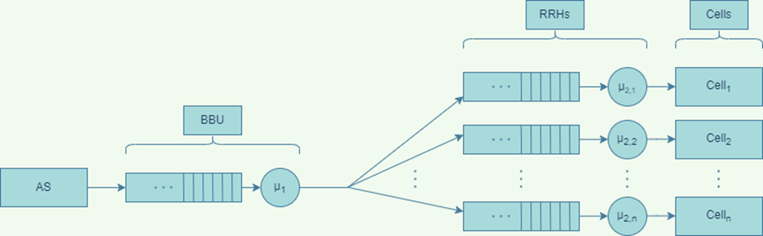
Project Guidelines
System description
A cellular system is composed of a BBU and N RRH-cell pairs.
The packets are sent from the BBU to the RRHs, on a channel with data rate dr, in two ways:
Using Compression: the packet is compressed at the BBU and, once at the RRH, is decompressed in S seconds (S = α*𝑋*50𝑚𝑠 where X = compression rate and α is a constant), and then sent to the cell
Without compression: once at the RRH the packet is immediately forwarded to the cell
Workload
Inter-arrival times, IID RVs with Exponential distribution
Size of the packets, IID RVs with Exponential or Lognormal distribution
Objectives
Compare the case with compression with the case without it
Check, in the case with compression, different combination of N, α, 𝑋, dr, size mean and size variance (in the case with lognormal distribution)
Confidence Interval
99% Confidence level in all experiments

Slide 3
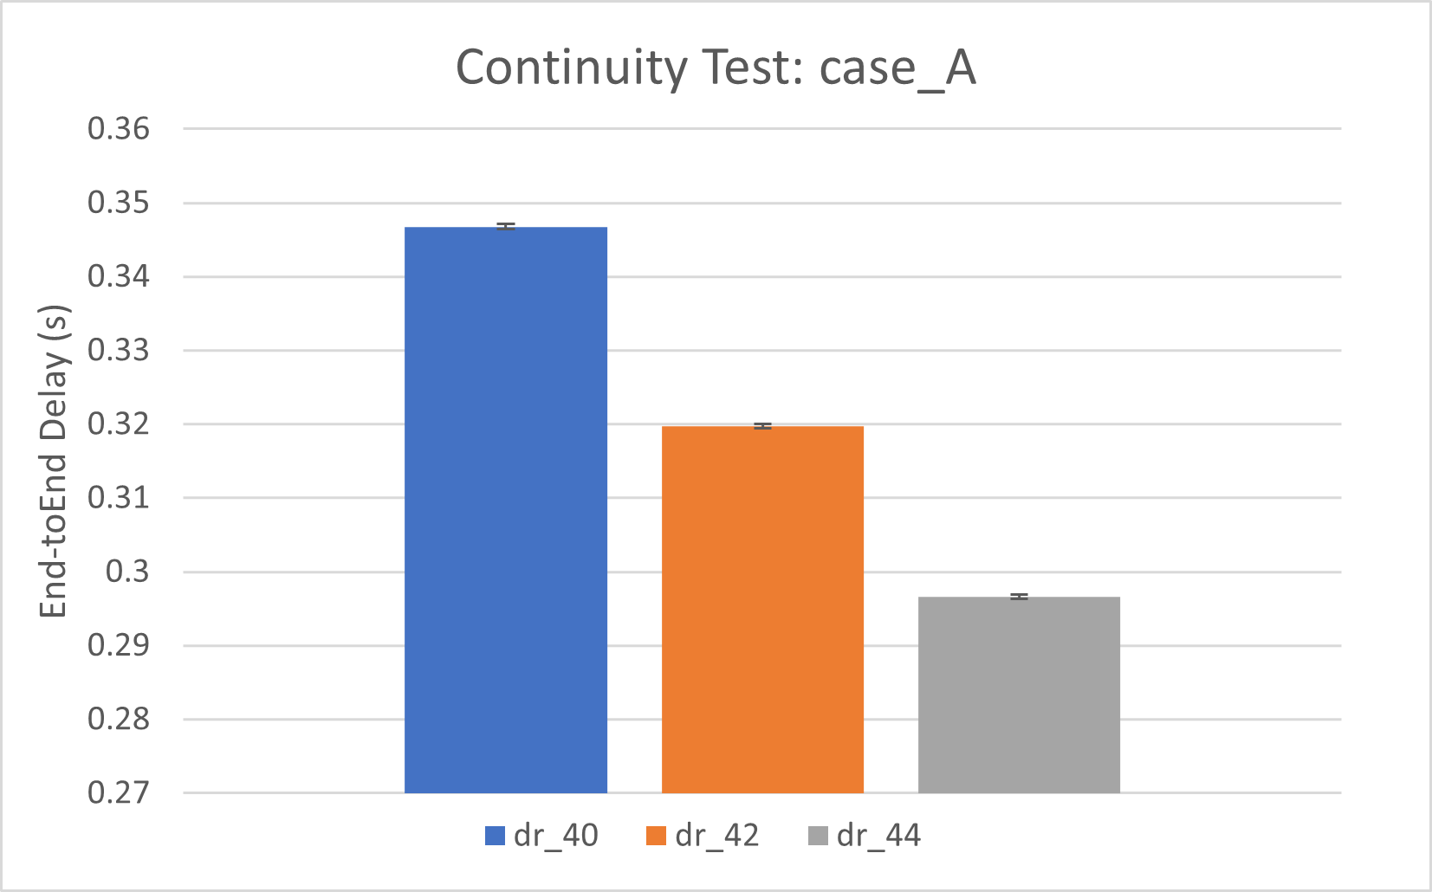
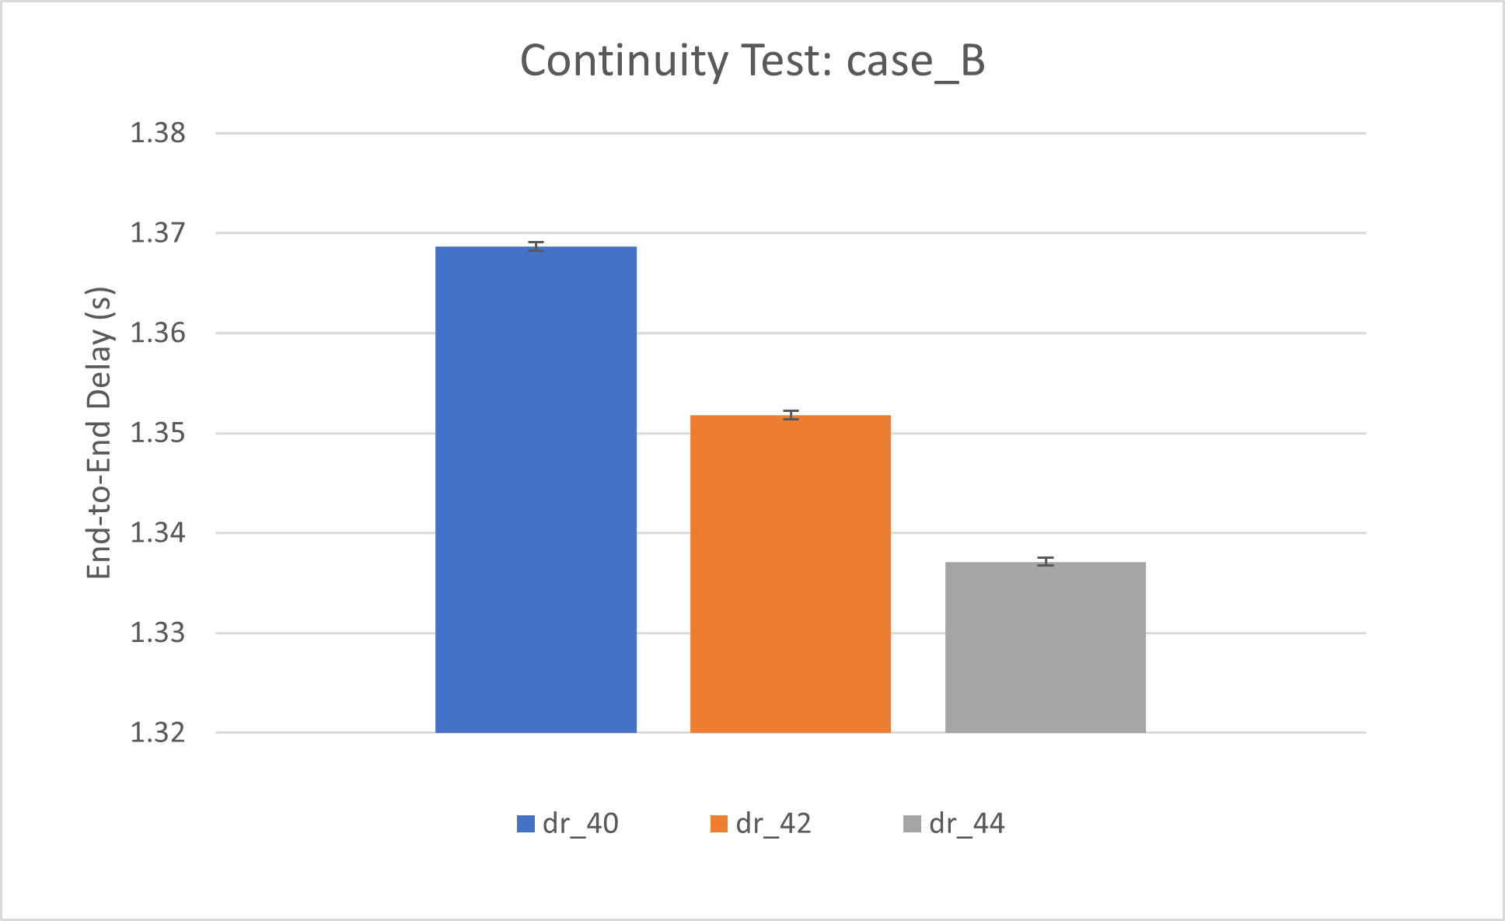
Degeneracy verification
Test performed to analyse the system under extreme conditions, by degenerating some parameters:
E[s] = 0: mean packet size equal to zero -> there are no queues nor delays in the system
dr = 0: BBU-RRH link is an ideal channel -> the average BBU queue is equal to zero
dr = 0.1kbps: very low data rate -> tendence to infinite queue in the BBU and a very high end-to-end delay
Continuity verification
Check that small changes in the inputs are reflected by small changes in the output.
In our case a change of around 5% in the data rate implies an analogous modification in the End-To-End delay

Slide 4
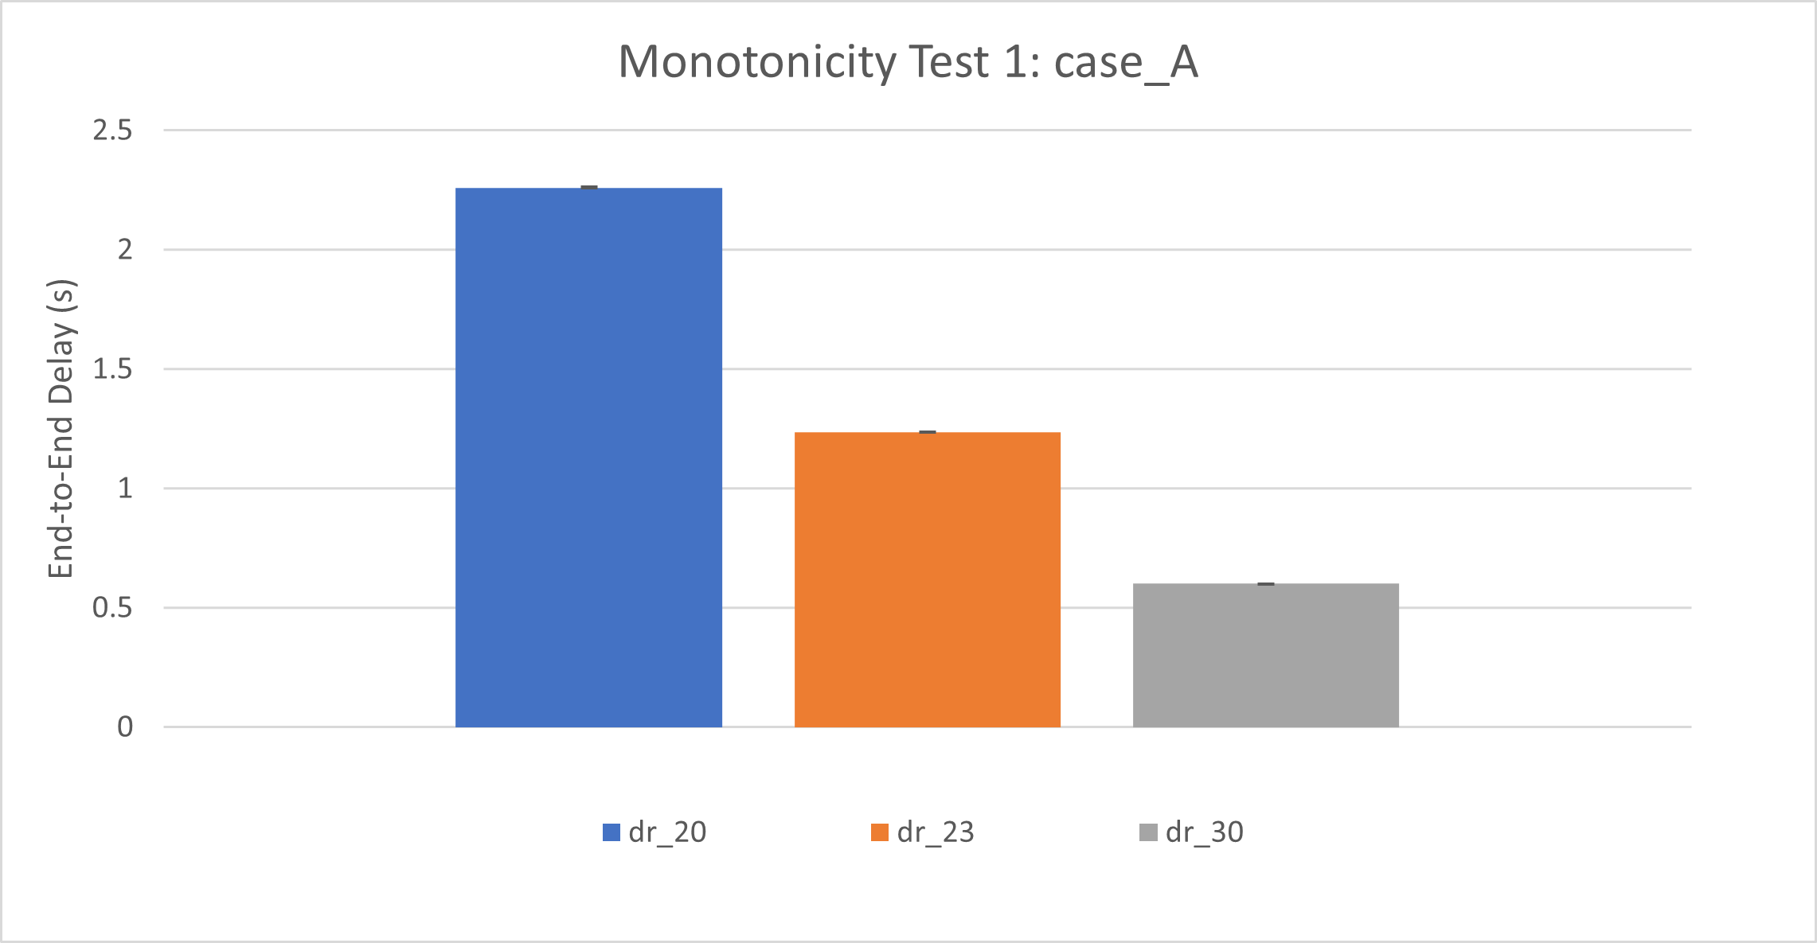
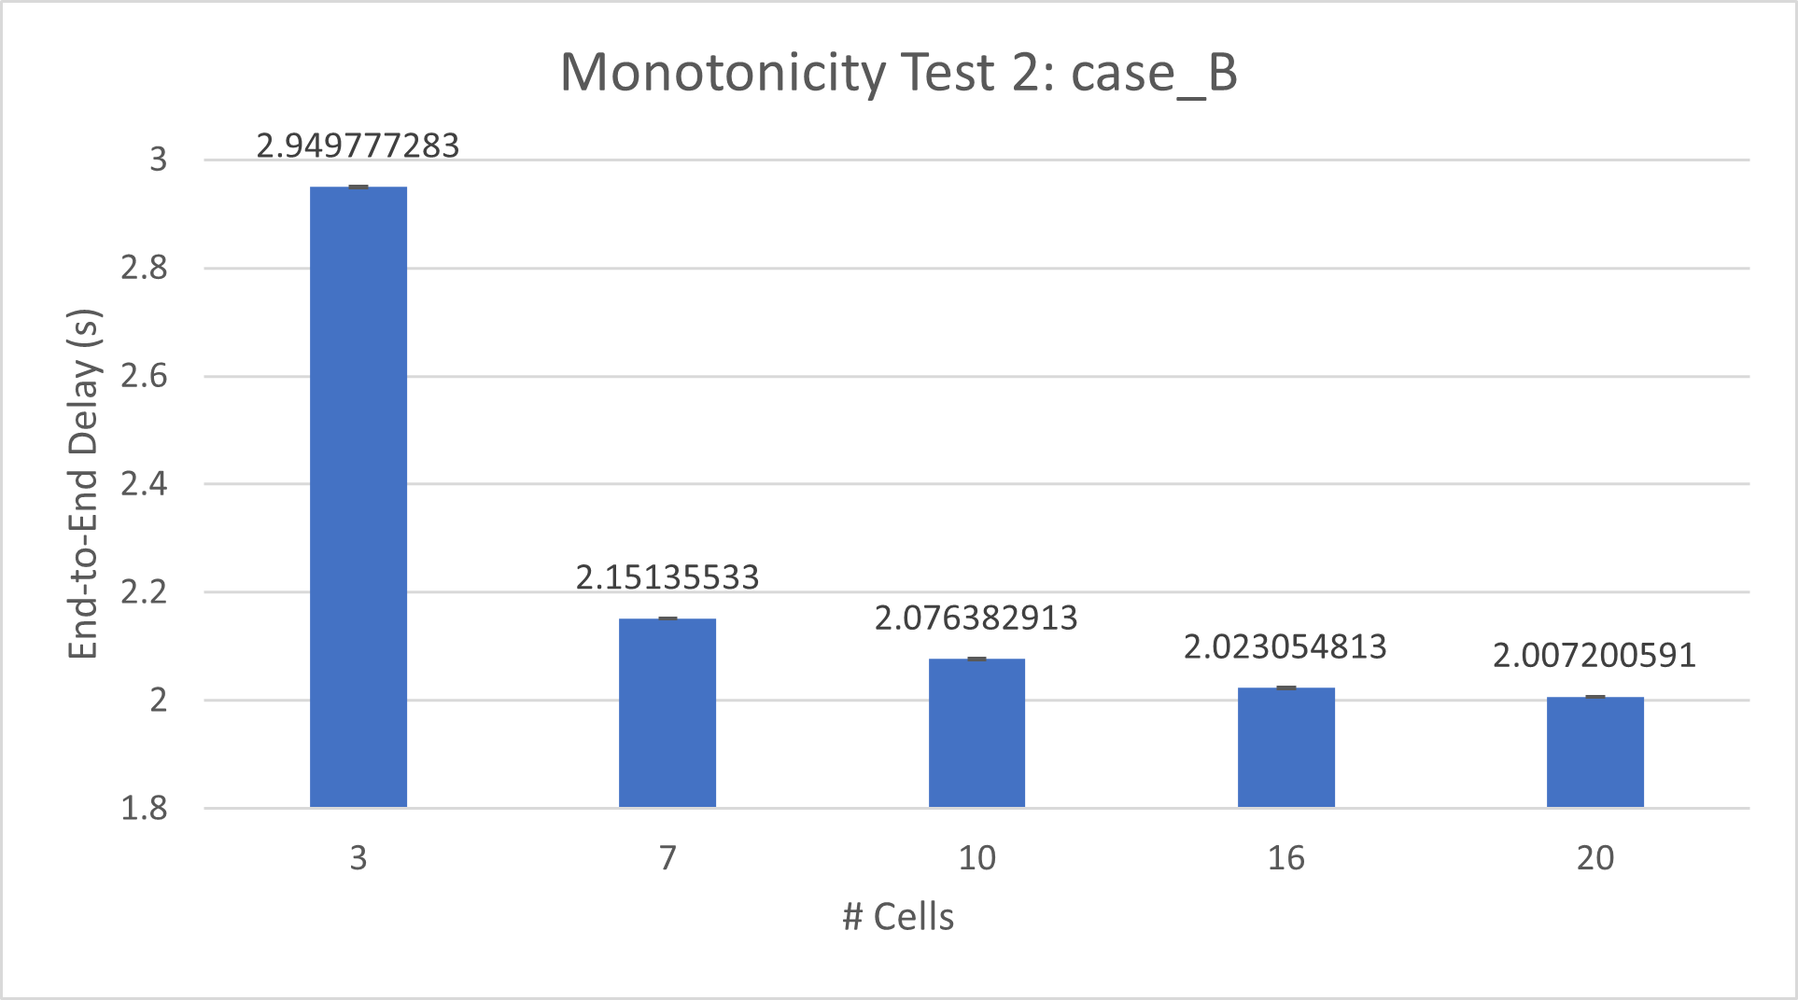
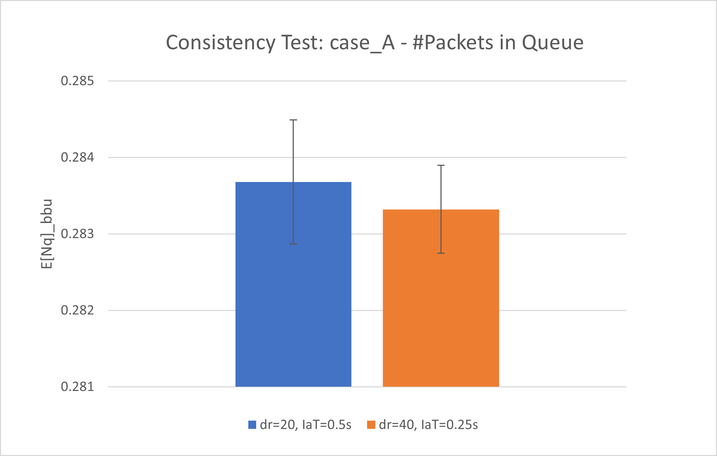
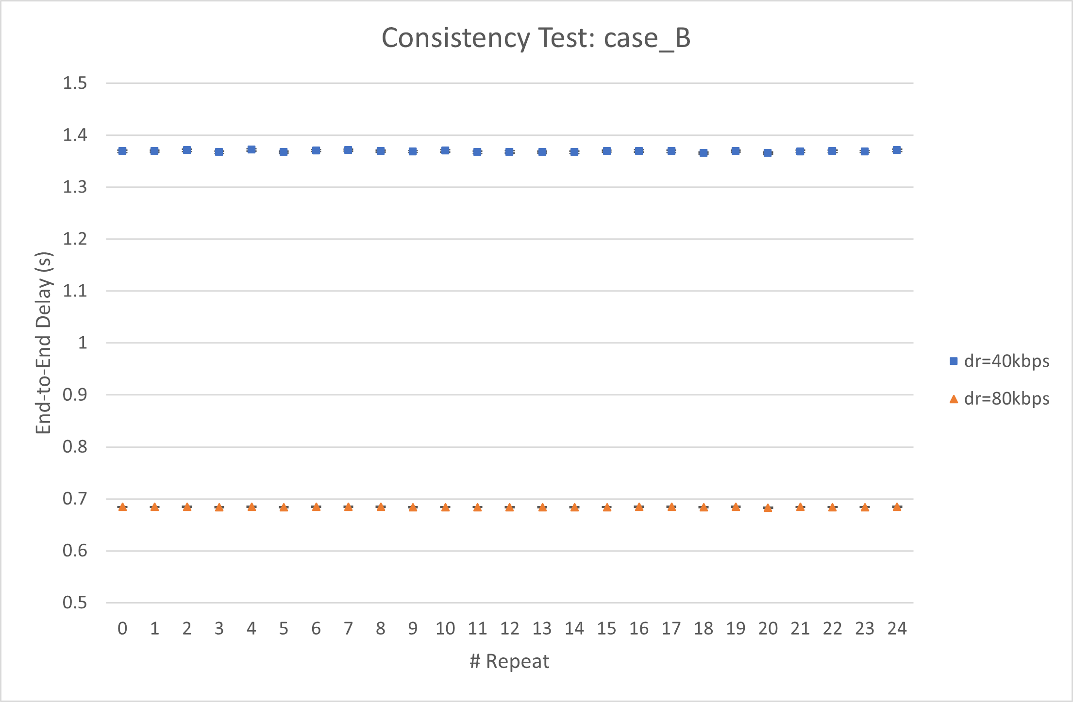
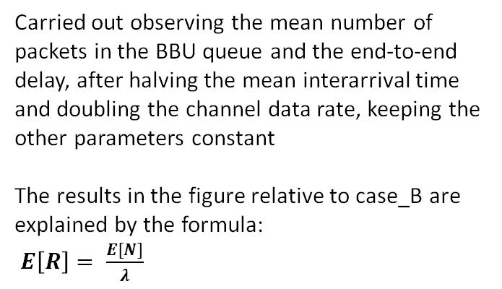
Monotonicity verification
Performed to see if changing some parameters in a specific way will result in a monotonic trend in the end-to-end delay
We checked how End-To-End delay reacts to changes in:
Data rate (case_B in the documentation)
# of Cells (meaningful only in case_B)
Consistency verification
Carried out observing the mean number of packets in the BBU queue and the end-to-end delay, after halving the mean interarrival time and doubling the channel data rate, keeping the other parameters constant
The results in the figure relative to case_B are explained by the formula:
$E\left[R\right]= \frac{E[N]}{λ}$

Slide 5
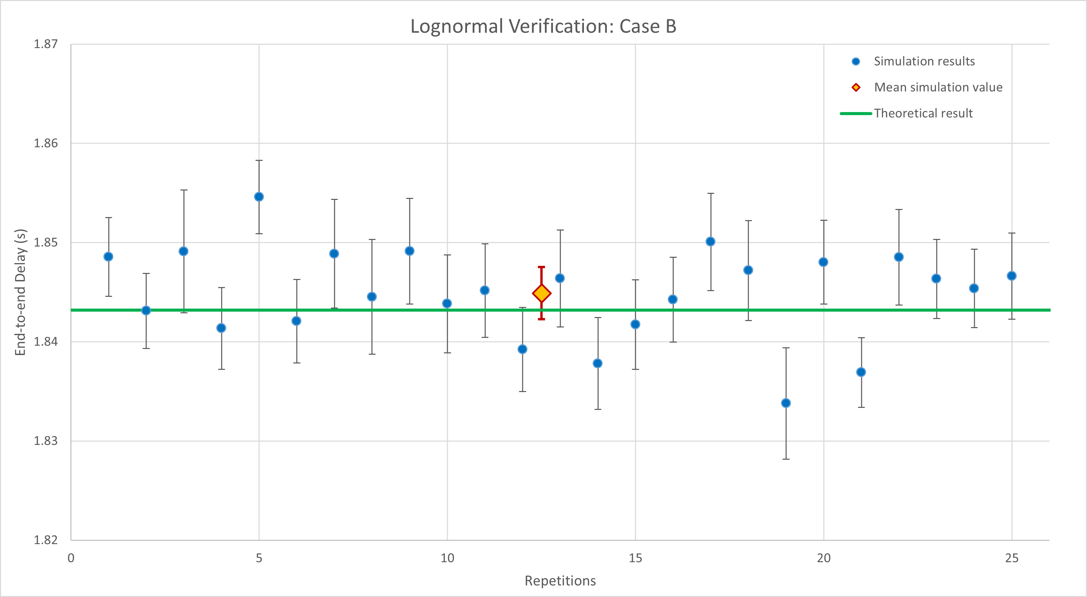
Validation against theoretical model
Assumptions:
Exponential (Lognormal) packet size distribution
Negligible overhead to switch between two packets processing
Negligible compression time (into the BBU)
No packet-loss or data corruption was considered
Sending packets from BBU to RRHs is the service time of the BBU -> negligible transmission time to RRHs
Negligible transmission time between RRH-Cell pair
RRH-Cell pairs are equal
Random packet routing from BBU to RRHs, but with equal probability
 | Packet’s size distribution
Compression |  | Exponential | Lognormal
 | Off | M/M/1 | M/G/1
 | On | M/M/1 + M/D/N | M/G/1 + M/D/N

Slide 6
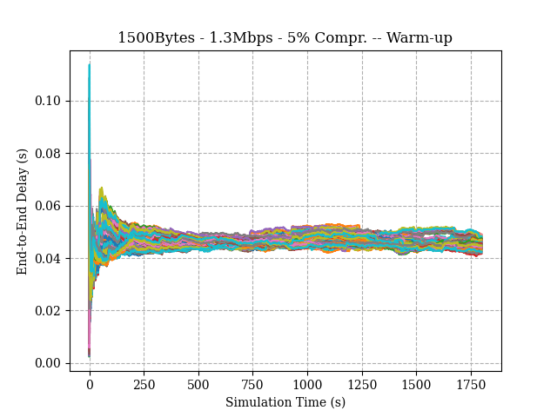
Calibration Phase
Warm-up period: 350s
Parameter | Range of Values
Data rate (dr) | [1.3; 2]
Compression (%) | [30; 60]
Std Deviation (σ) | [0.1; 0.5]
Constant alfa (α) | [0.01; 0.015]
Number of cells | [8; 18]
Mean Inter-arrival time | 0.01
Mean Packet size | 1400 Bytes
Exponential distribution

Slide 7
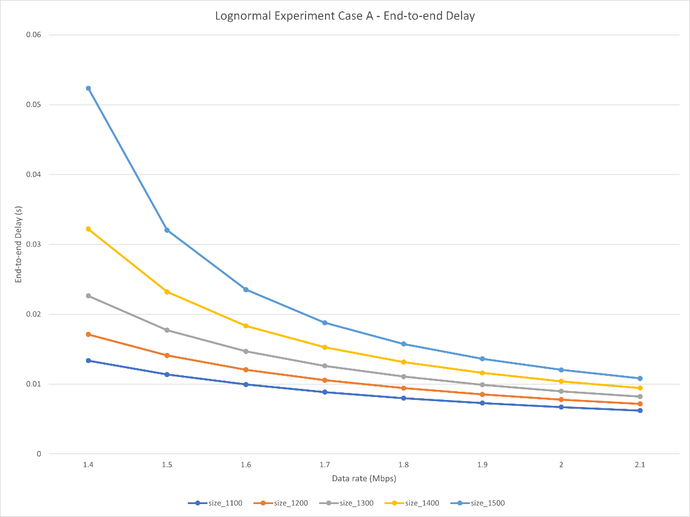
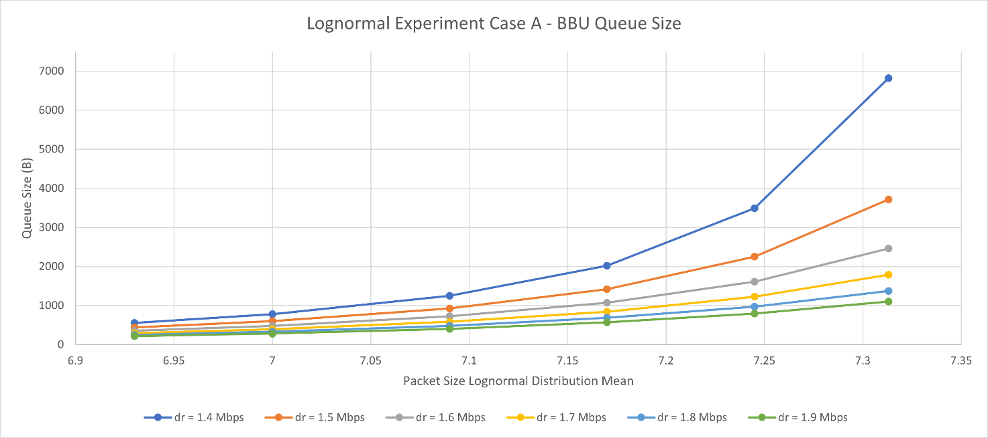
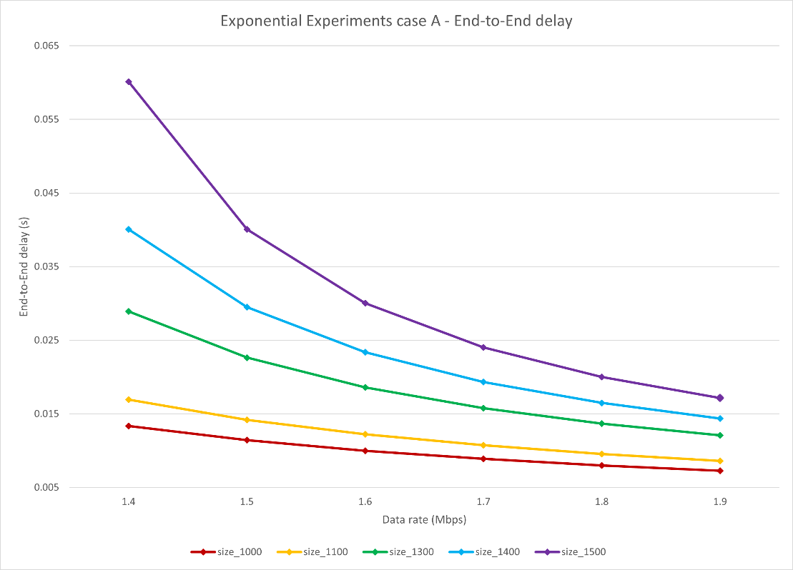
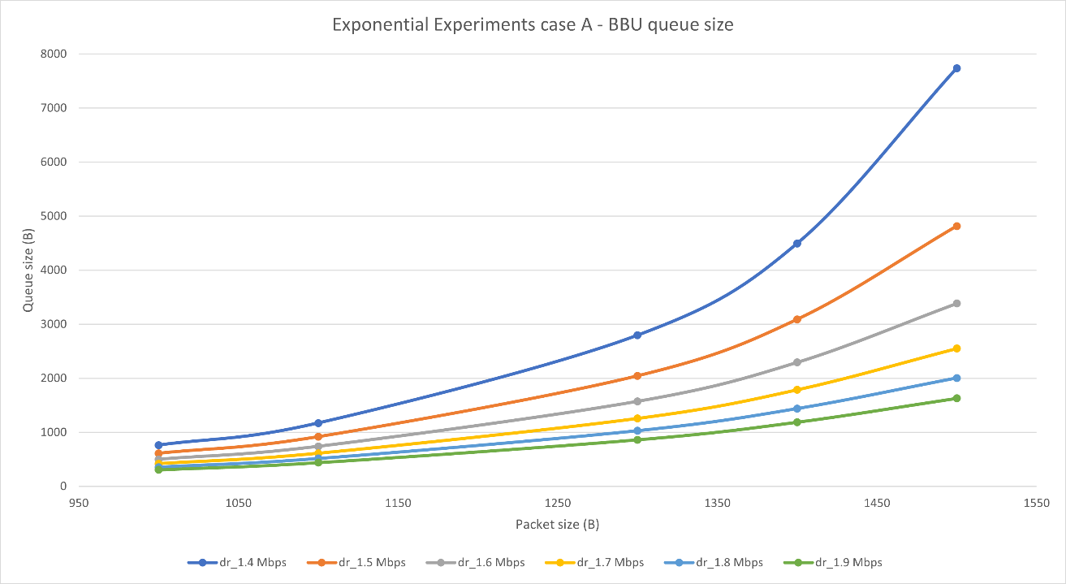
Experiments (Exponential/Lognormal – no Compression)

Slide 8
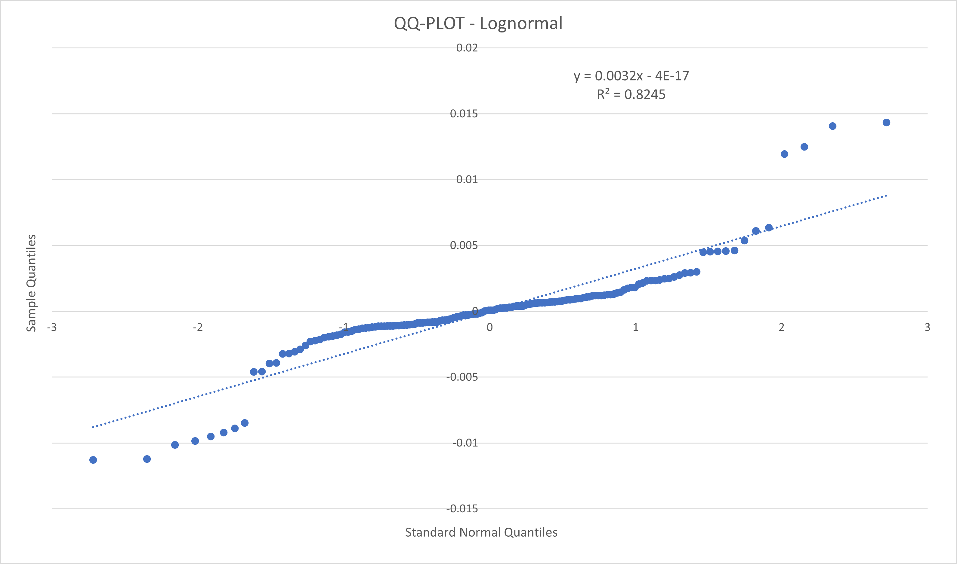
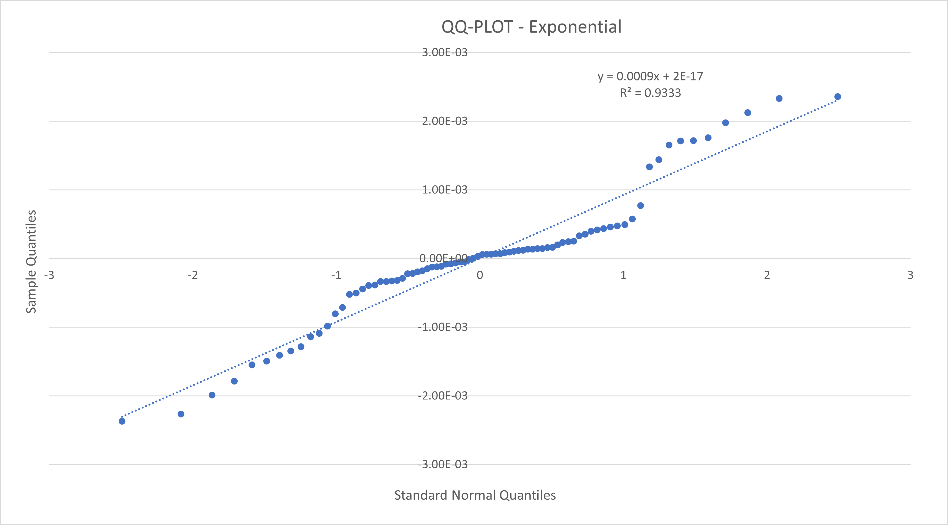


$2^{k}r$ Analysis
Performed with parameters set in the calibration phase, ended up with the following main outcomes:
For the lognormal distribution
The channel data rate affects performance by 14.17%
The compression affects performance by 36.46%
The constant alfa affects performance by 27.12%
For the exponential distribution
The data rate affects performance by 23.40%
The compression affects performance by 33.43%
The constant alfa affects performance by 23.38%
Negligible errors in both cases.
The result obtained in the lognormal case is not completely reliable given that $R^{2}≈0.82$ even after various transformations.
The homoskedasticity doesn’t show any trend in both cases.

Slide 9
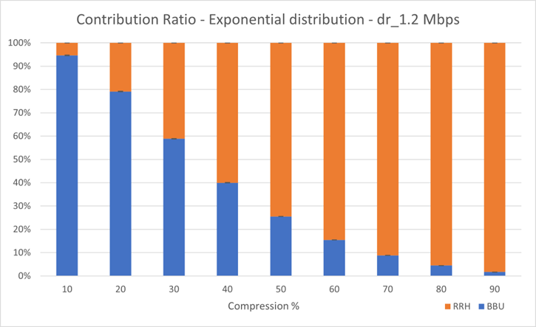
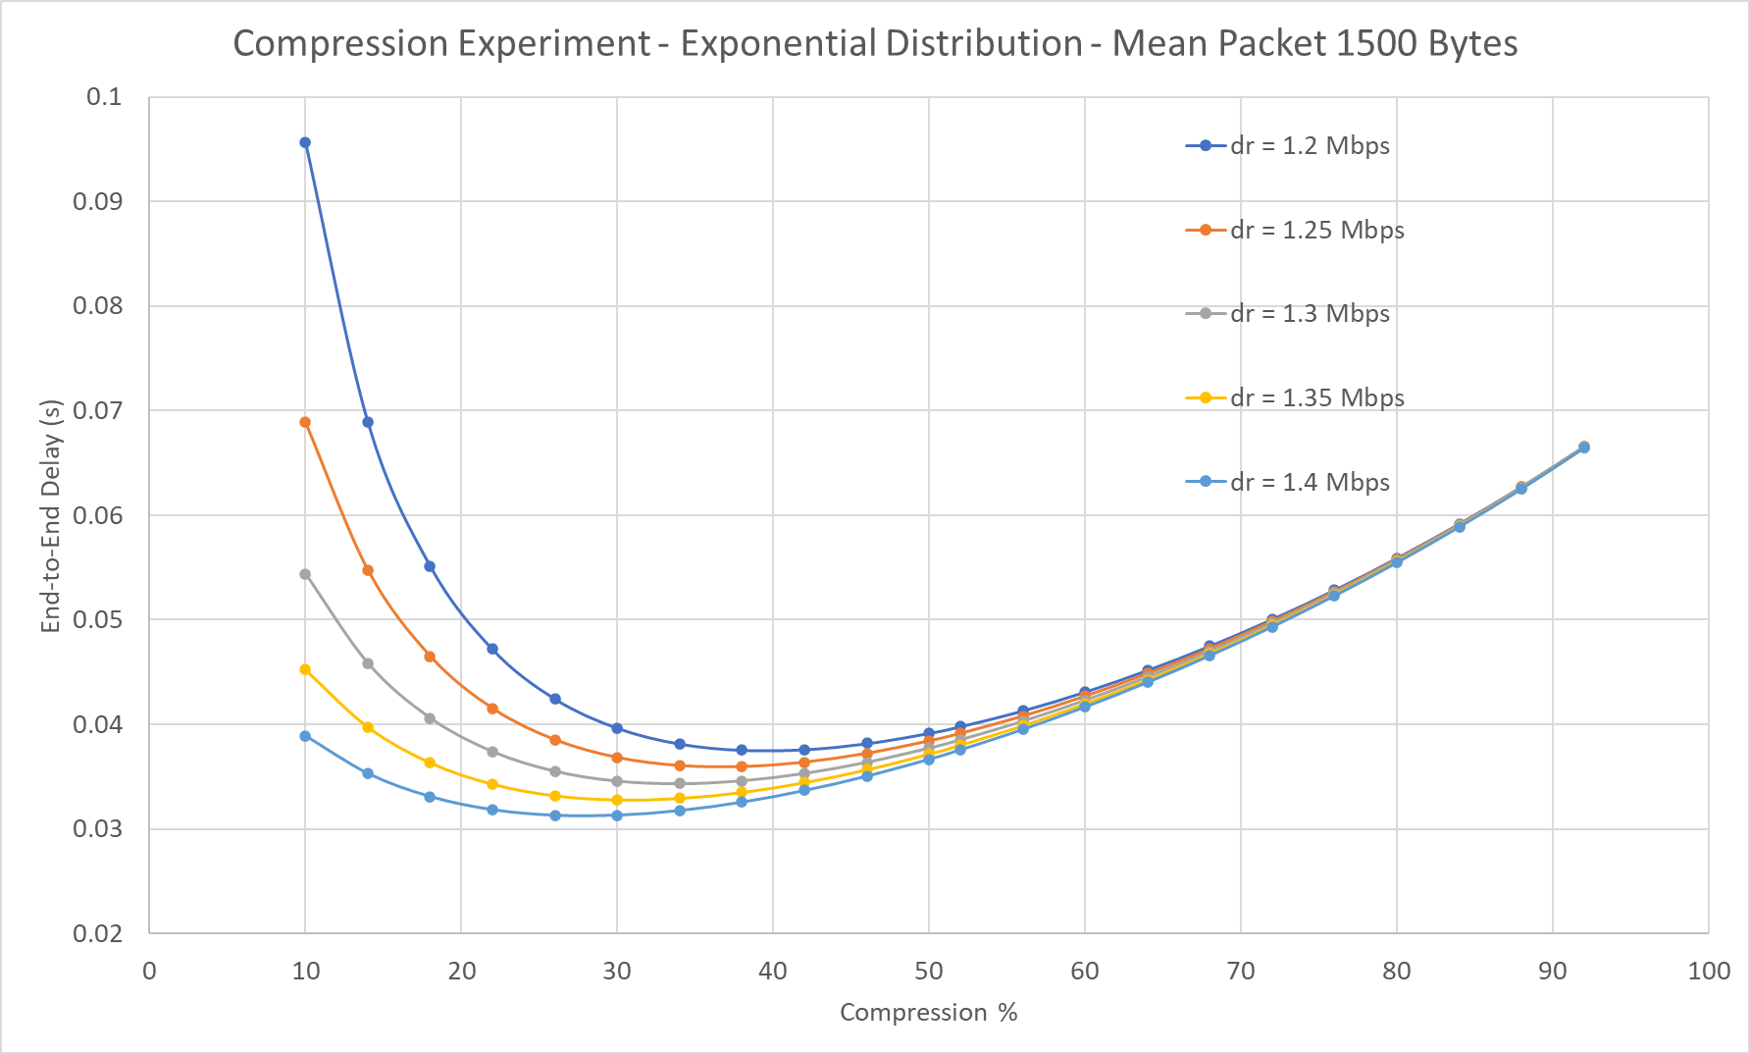
Experiments (Exponential – Compression on)
Simulations run with 10 repetitions, obtaining:
Higher compression level: end-to-end delay most affected by RRH response time
Low compression level: end-to-end delay most affected by BBU response time
This allowed us to find an optimal ratio between the delay generated by the BBU and that by the RRH:
BBU is responsible for about 40% of the overall delay
RRH is responsible for about 60% of the overall delay
Optimal performance reached when the BBU utilization is in the range [58% ; 64%]

Slide 10
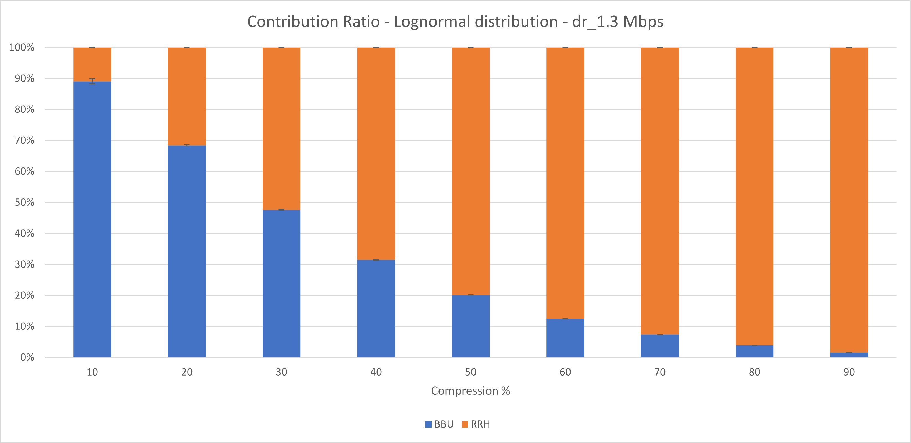
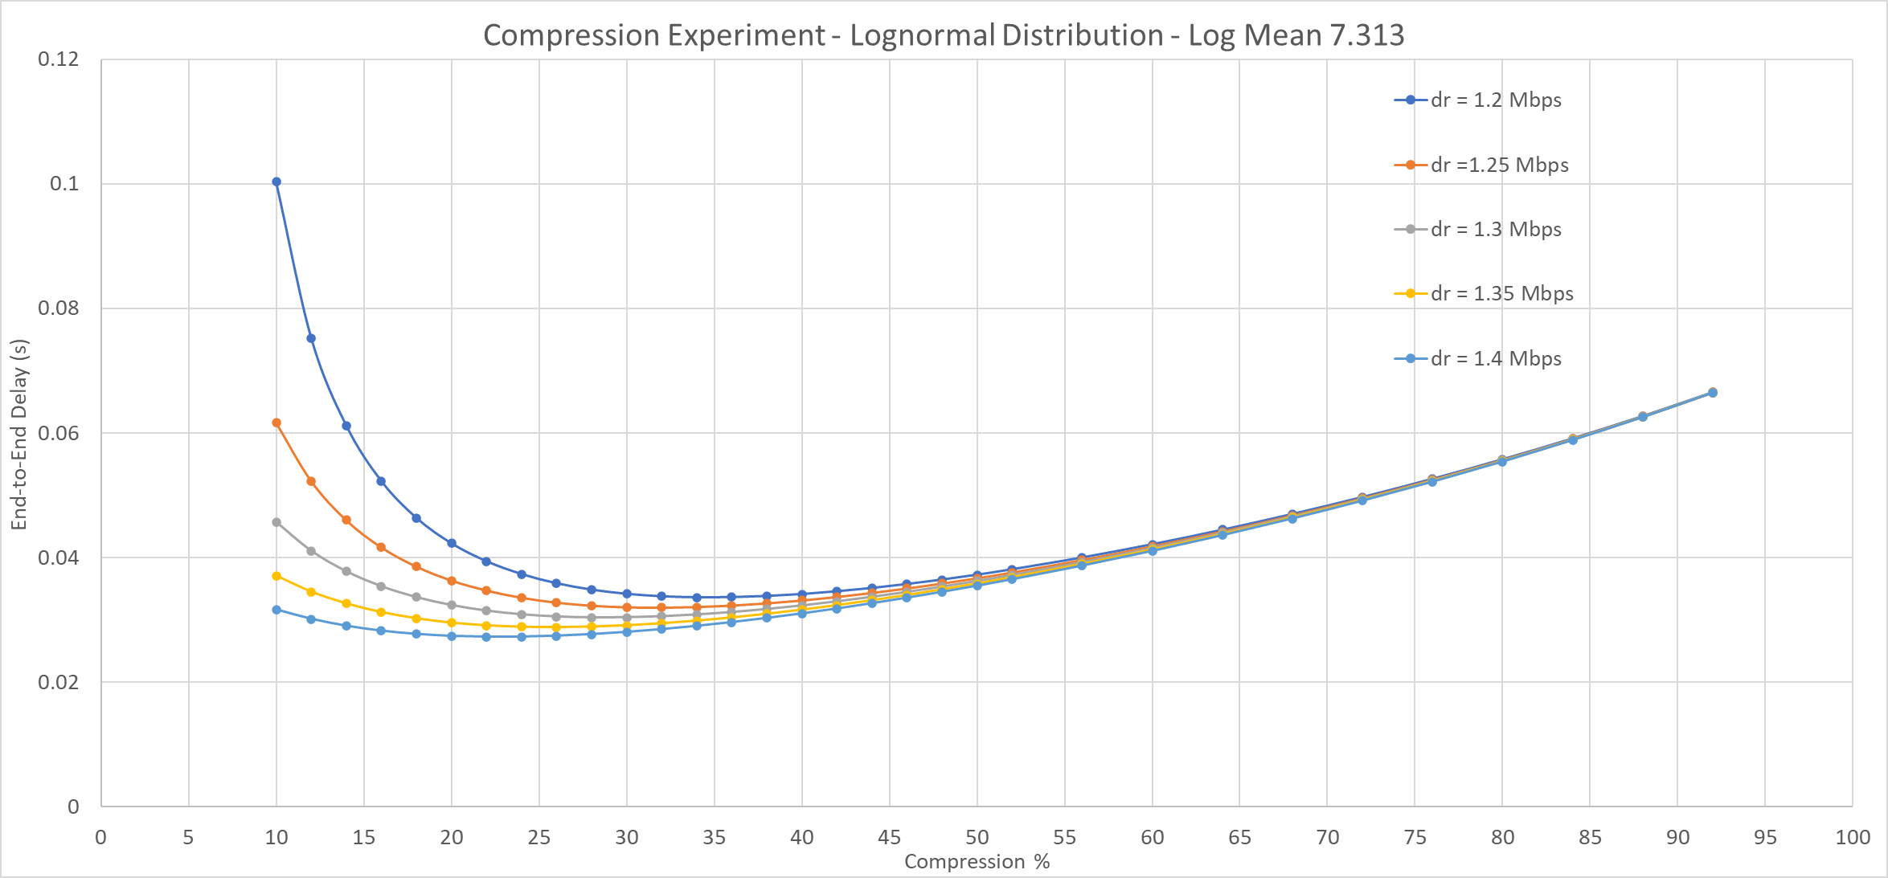
Experiments (Lognormal - compression)
Like previously, simulations run with 10 repetitions, obtaining:
High compression level: end-to-end delay most affected by RRH response time
Low compression level: end-to-end delay most affected by BBU response
This allowed us to find an optimal ratio between the delay generated by the BBU and that by the RRH:
BBU is responsible for about 50% of the overall delay
RRH is responsible for about 50% of the overall delay
Optimal performance reached when the BBU utilization is in the range [67%; 71%] .

Slide 11
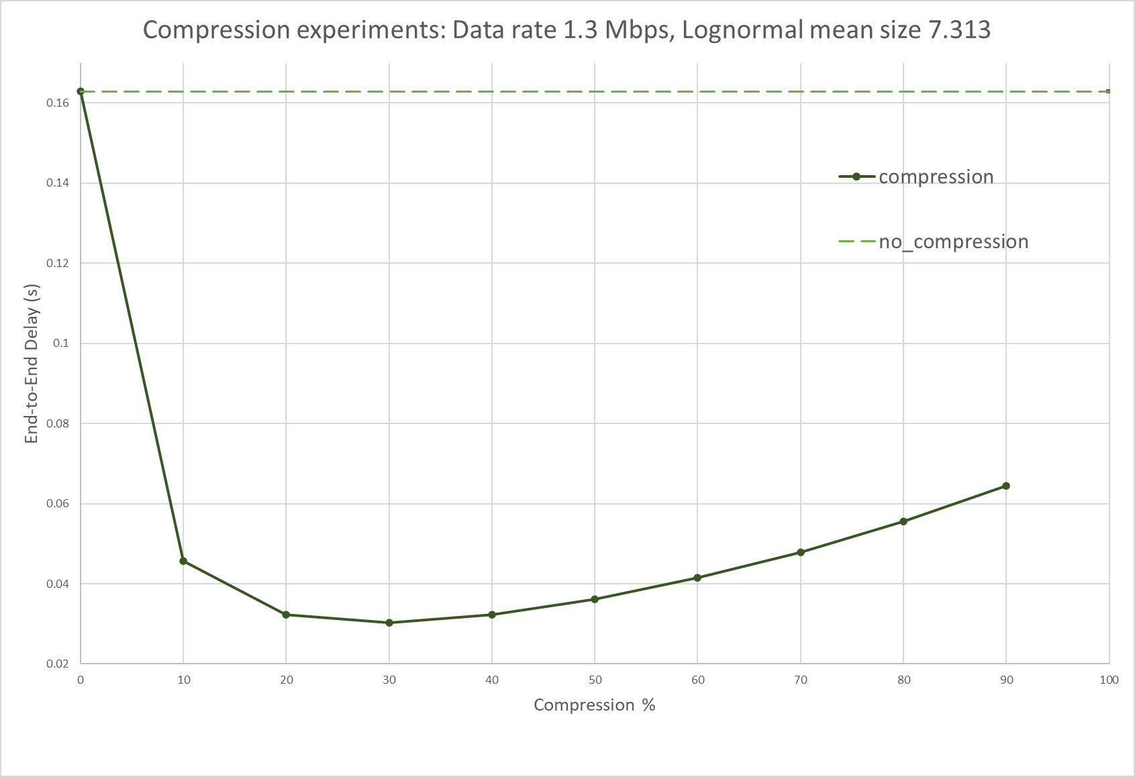
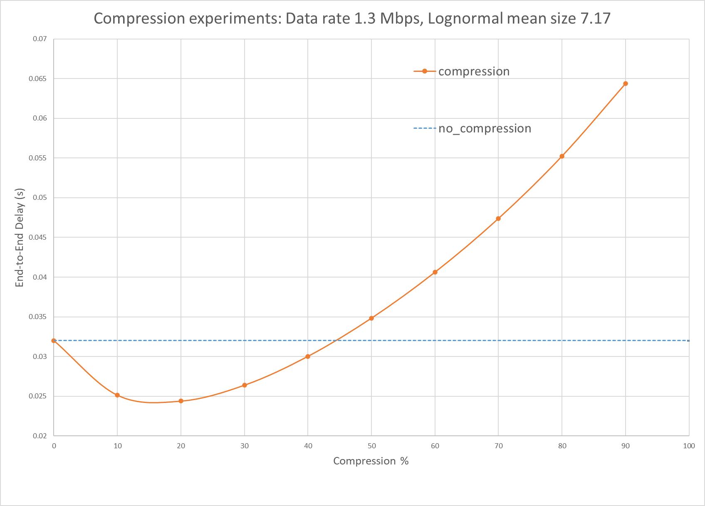
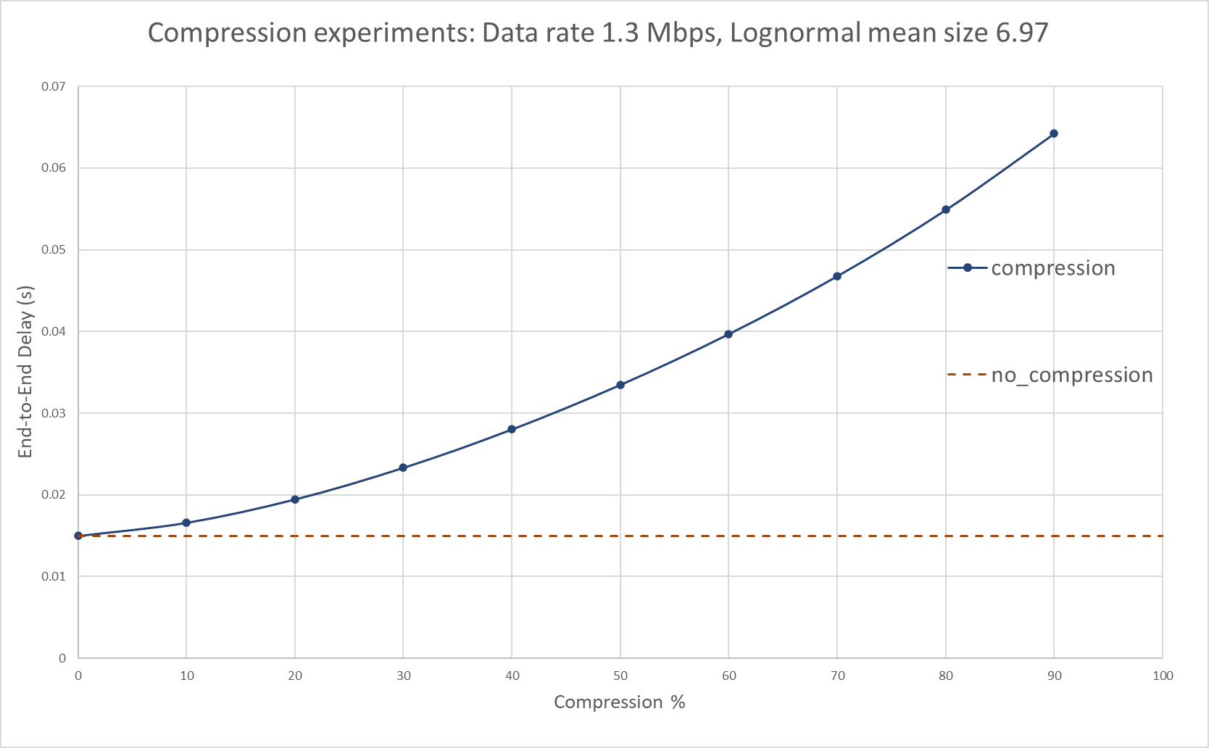
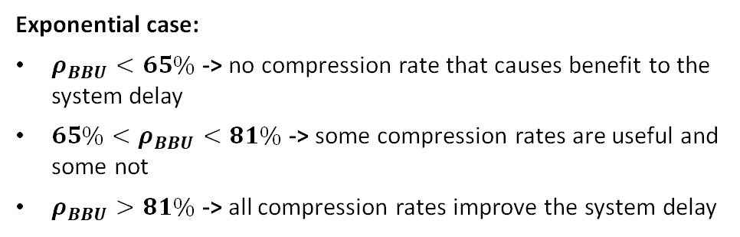
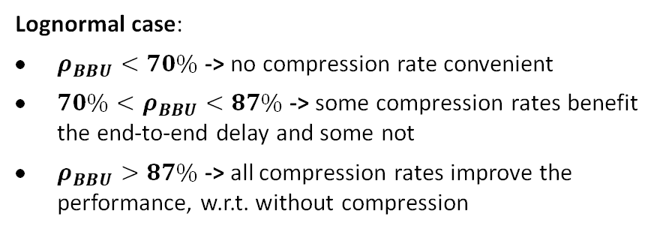
Experiments (System with different loads)
Fixed the data-rate and testing different mean packet sizes, we found the thresholds for which below the minimum the compression is no longer convenient, and above the maximum it is always convenient, instead, between these it depends
Considering a compression level up to 65% and looking at the BBU utilization, we found that
Lognormal case:
$ρ_{BBU}<70\%$ -> no compression rate convenient
$70\%<ρ_{BBU}<87\%$ -> some compression rates benefit the end-to-end delay and some not
$ρ_{BBU}>87\%$ -> all compression rates improve the performance, w.r.t. without compression
Exponential case:
$ρ_{BBU}<65\%$ -> no compression rate that causes benefit to the system delay
$65\%<ρ_{BBU}<81\%$ -> some compression rates are useful and some not
$ρ_{BBU}>81\%$ -> all compression rates improve the system delay

Slide 12
Conclusion
Compression off -> end-to-end delay influenced by the system load and specially by the data-rate
Compression on -> compression can help to minimize the end-to-end delay and some consideration can be done
Considering a system where the BBU is the bottleneck, the compression will help to keep the system in a steady state, reducing the BBU utilization, so in general it can be always convenient, but more precisely:
With a low load -> compression is no longer convenient because the delay due to the decompression of the packets in the RRH is greater than the gain of the service time in the BBU
With average load -> there is a maximum compression threshold for which compressing packets is better than not doing it
With high load -> compression is always convenient because the decompression delay in the RRH is lower than the gain in service time of the BBU

