Slide 1
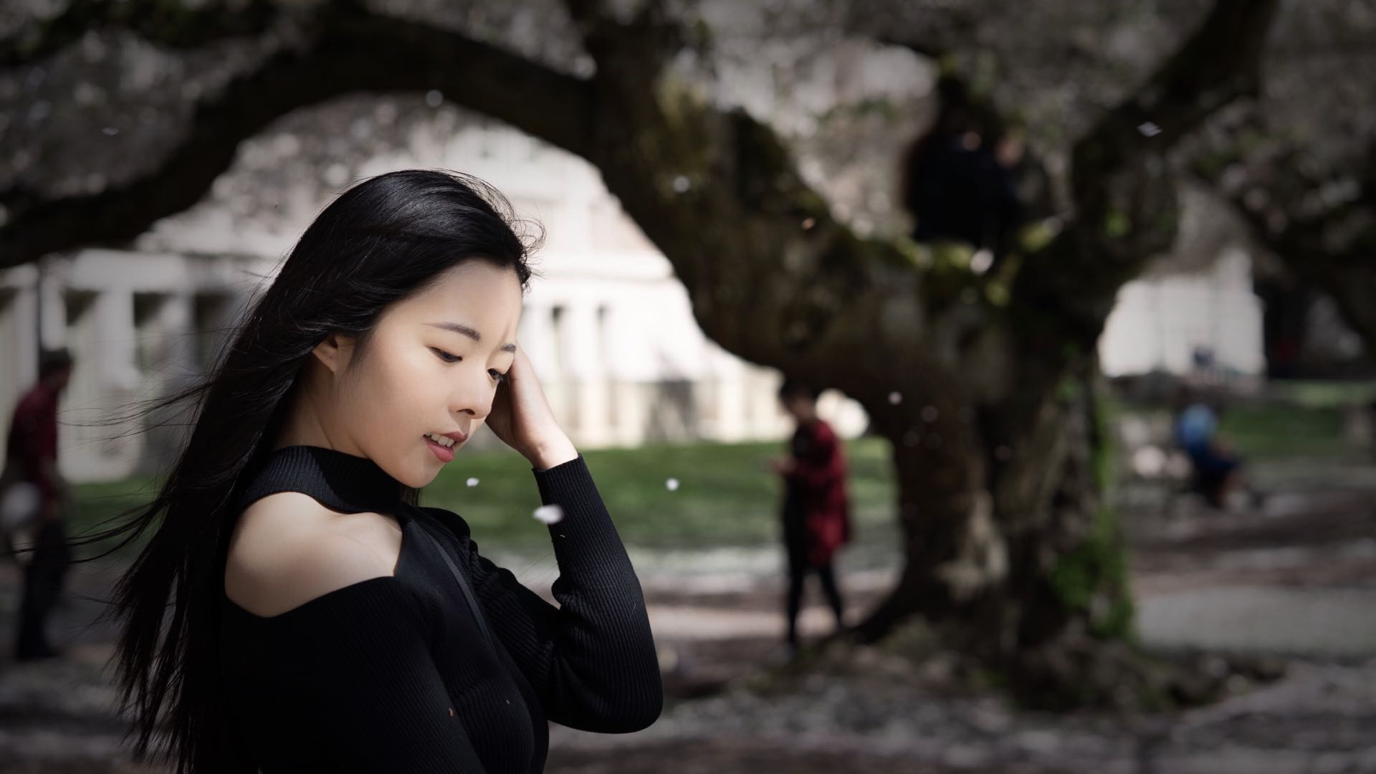

Slide 2
About me
Hi, I am Lijia Zhao.
I was born and raised in Kunming, China. I lived in South Bend, Indiana and now I call Seattle home. I’ve always drawn inspirations from my experiences, from my travels and from the amazing people I met along the way. I hope you catch the sparks of inspiration from my work.
Enjoy!

Slide 3
Contact Information
Email: lijiaz2017@gmail.com
LinkedIn: linkedin.com/lijia-zhao

Slide 4
Lijia Zhao
Software Developer

