Slide 1
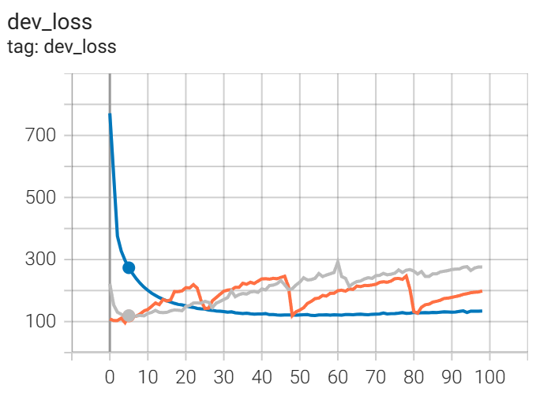
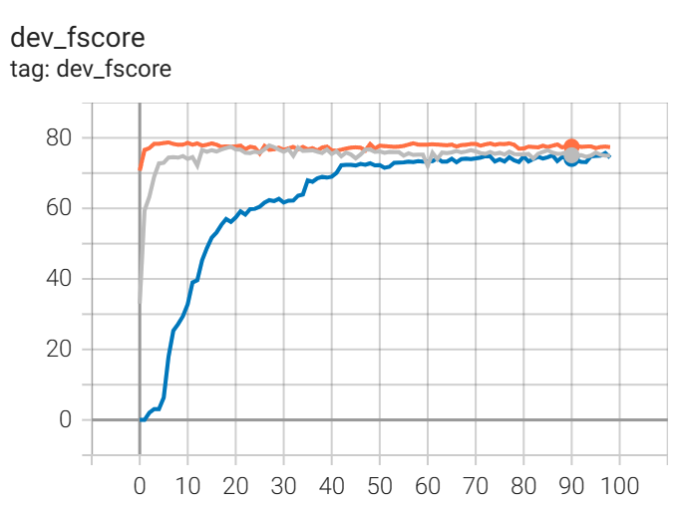
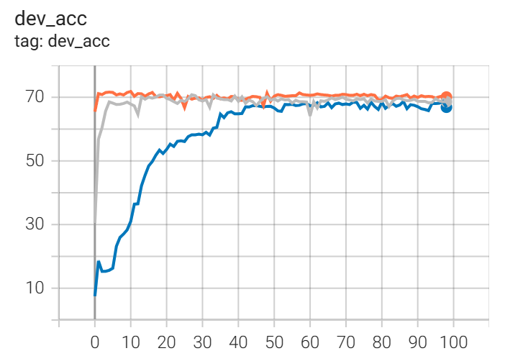
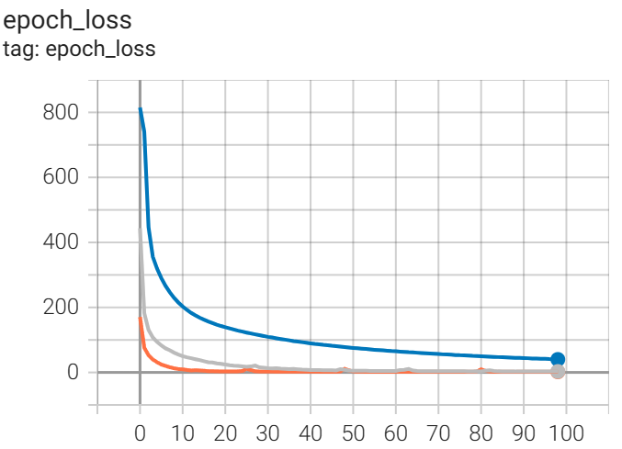
LSTM-CRF
1e-5
Dev acc: 68.72 Dev fscore(p/r/f): (80.45/70.39/75.08)
1e-4
Dev acc: 70.84 Dev fscore(p/r/f): (82.84/73.51/77.90)
1e-3
Dev acc: 71.84 Dev fscore(p/r/f): (83.73/74.04/78.58)
Lr: 1e-5
Lr: 1e-4
Lr: 1e-3

Slide 2
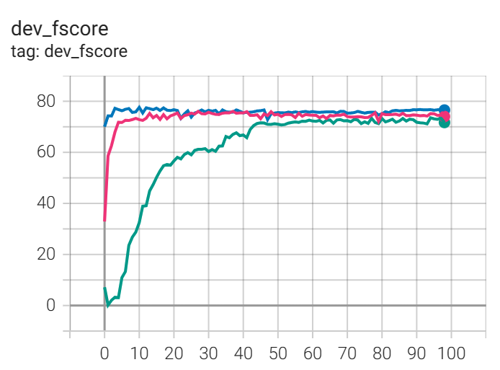
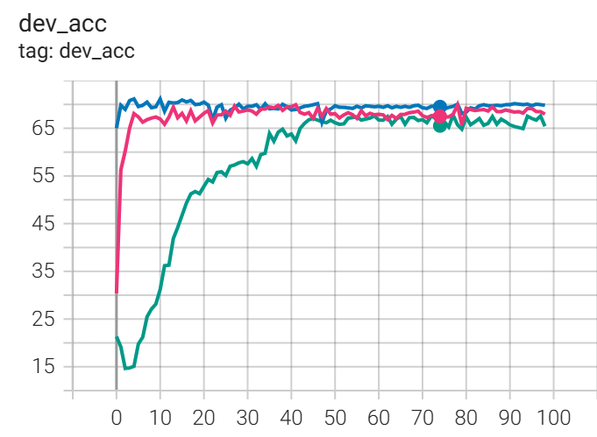
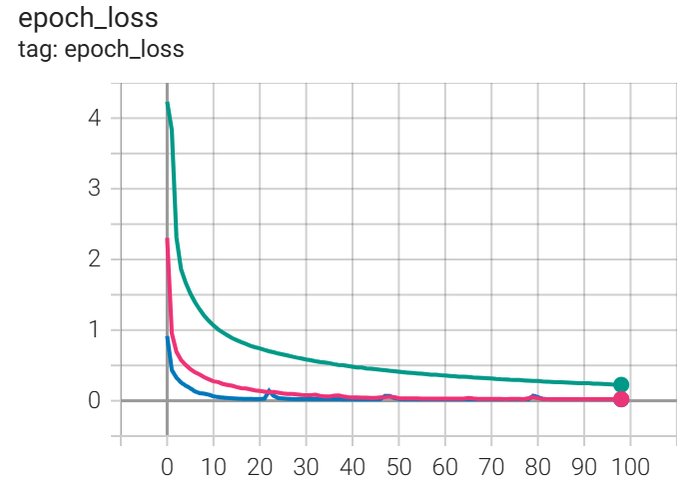
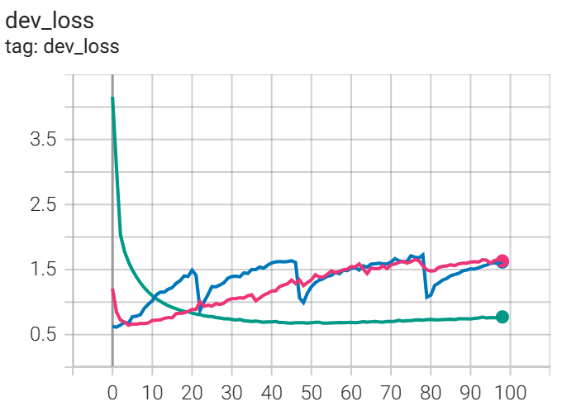
Baseline
1e-5
Dev acc: 67.82 Dev fscore(p/r/f): (77.80/69.45/73.39)
1e-4
Dev acc: 69.94 Dev fscore(p/r/f): (79.70/72.47/75.91)
1e-3
Dev acc: 71.17 Dev fscore(p/r/f): (80.20/73.51/76.71)
Lr: 1e-5
Lr: 1e-4
Lr: 1e-3

Slide 3
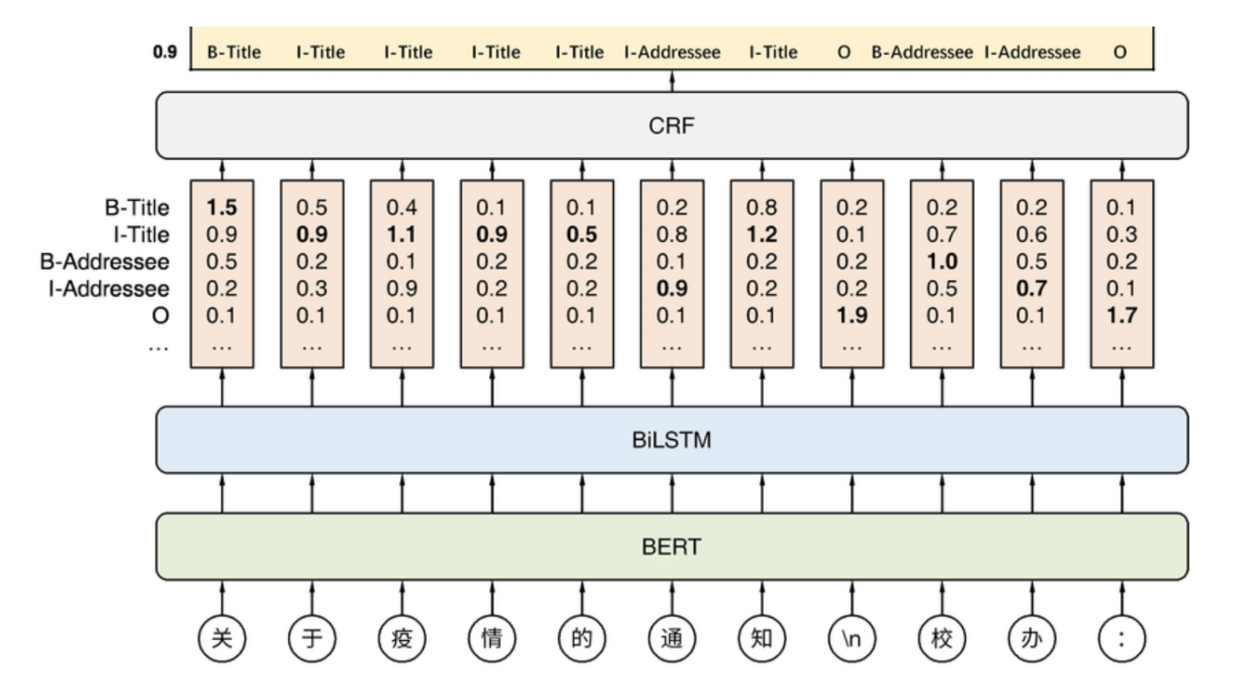
Pure BERT
BERT LSTM CRF
O
O
O
B
I
I
I
Tagging FNNDecoder
Drop out layer
BERT
我
要
去
上
海
交
大

Slide 4
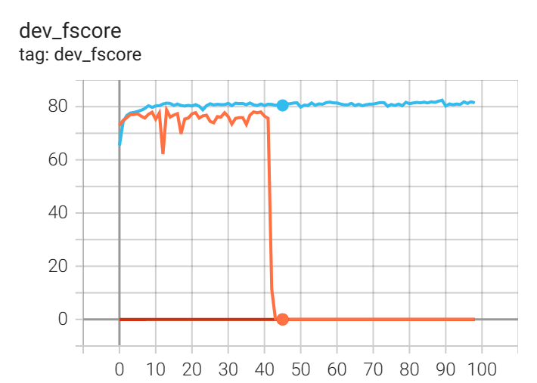
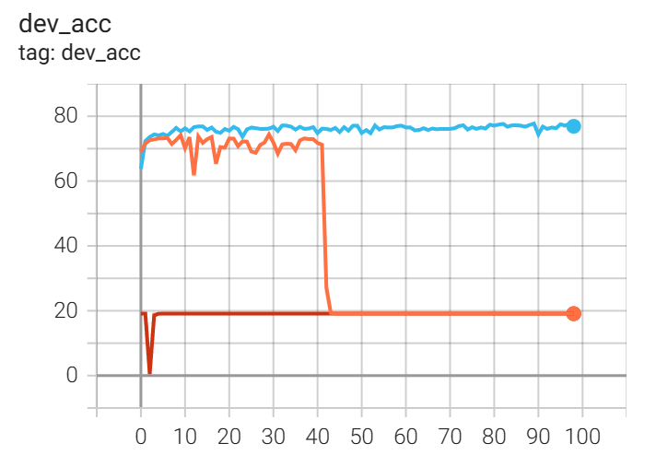
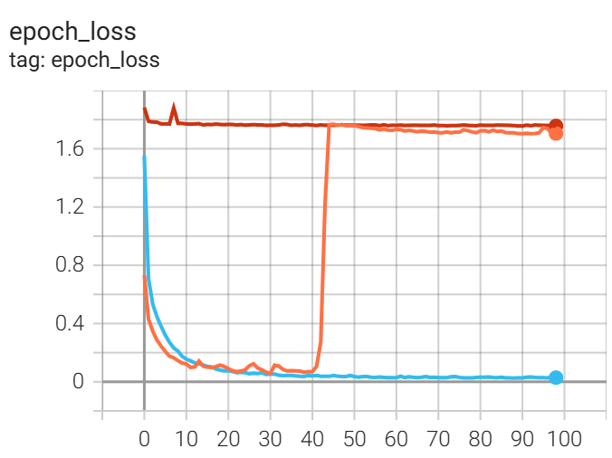
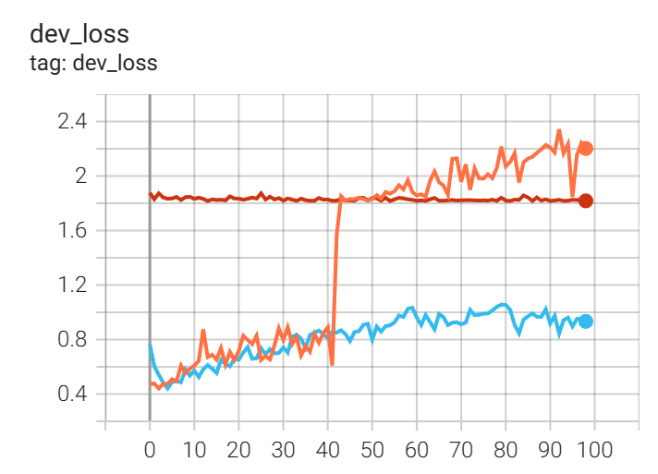
Pure BERT
1e-5
Dev acc: 77.77 Dev fscore(p/r/f): (84.22/80.71/82.43)
1e-4
Dev acc: 74.41 Dev fscore(p/r/f): (77.79/77.79/77.79)
1e-3
Dev acc: 19.11 Dev fscore(p/r/f): (0.00/0.00/0.00)
Lr: 1e-5
Lr: 1e-4
Lr: 1e-3

Slide 5
Dev acc: 77.32 Dev fscore(p/r/f): (83.59/79.67/81.58)
Dev acc: 30.61 Dev fscore(p/r/f): (33.88/34.62/34.24)
Dev acc: 26.37 Dev fscore(p/r/f): (34.74/22.31/27.17)

Slide 6
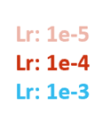
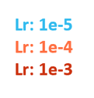
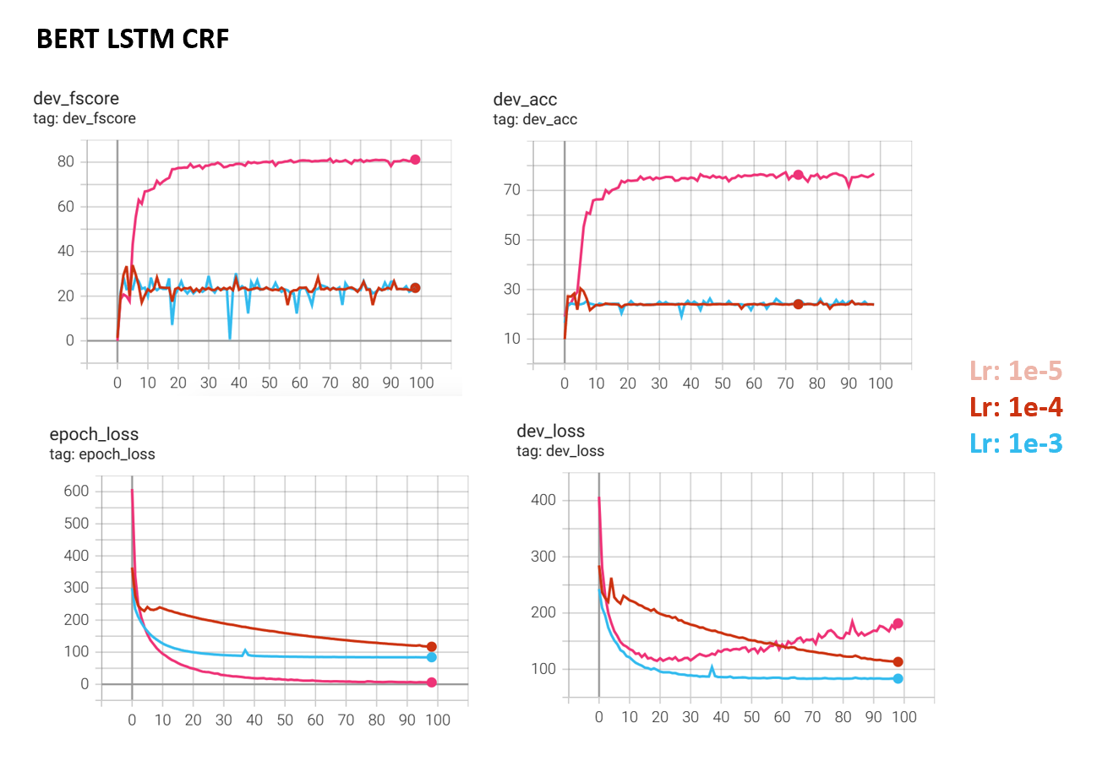
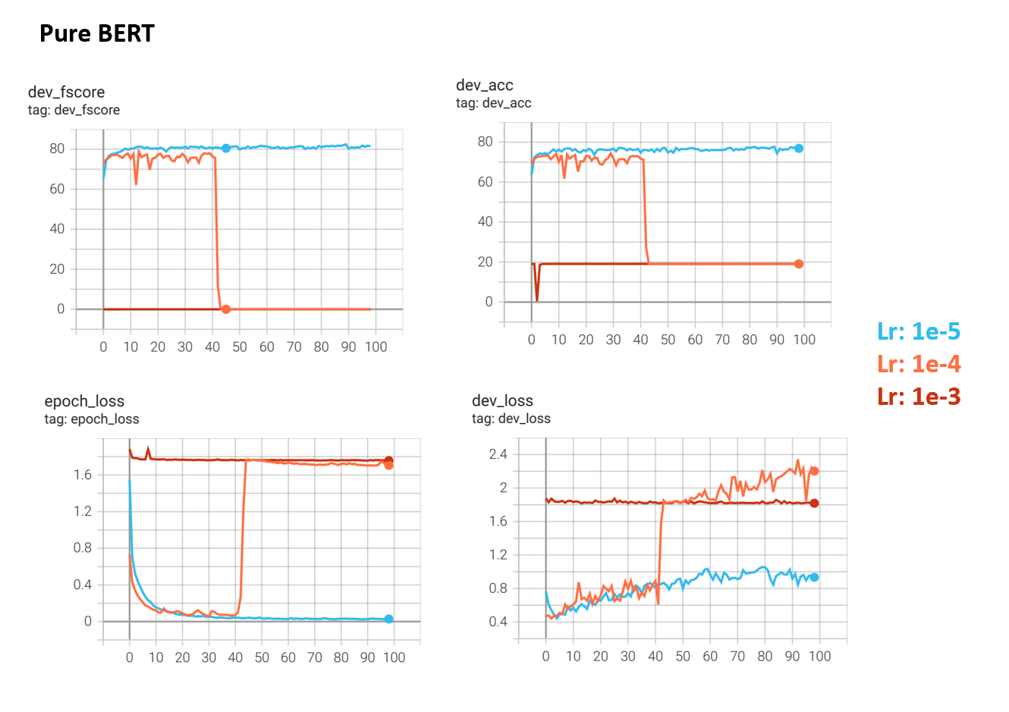


Slide 7
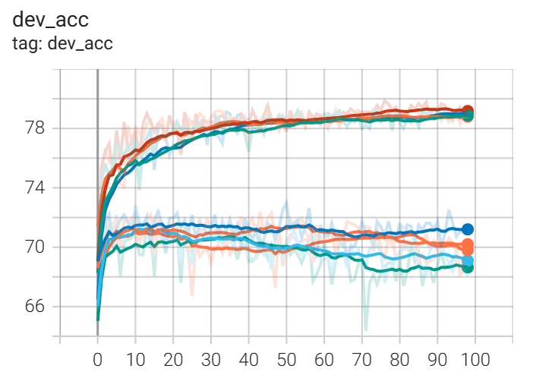
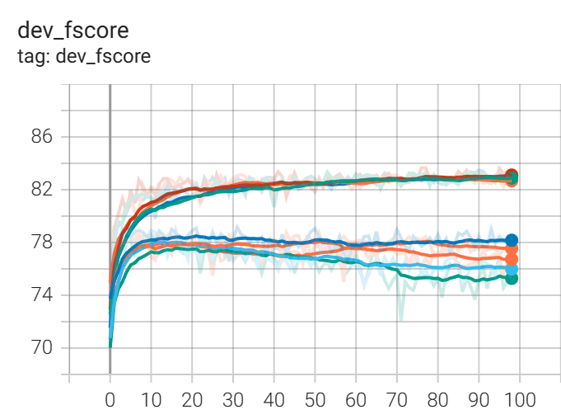
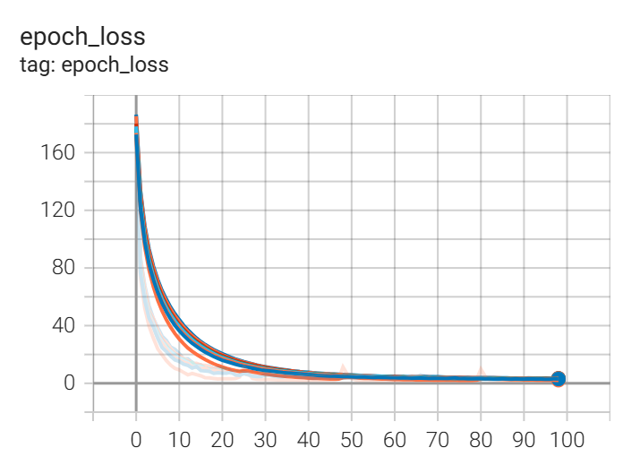
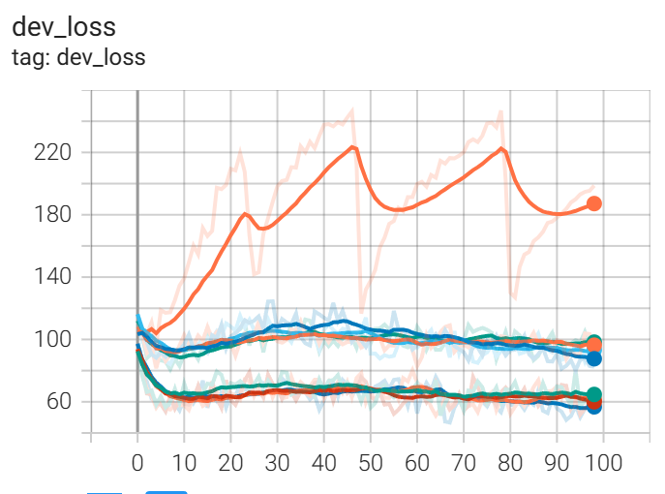
ontology augment
1e-3
Dev acc: 71.84
Dev fscore(p/r/f):
(83.73/74.04/78.58)
ontology augment
Without augment
Without augment
trainset augment
trainset augment
Train Set augratio= 0.3
Dev acc: 72.96
Dev fscore(p/r/f):
(81.97/76.33/79.05)
Without augment
trainset augment
Ontology: augratio= 0.3
Dev acc: 79.22
Dev fscore(p/r/f):
(84.55/82.17/83.34)
ontology augment

Slide 8
拼音记录
Dev acc: 85.25 Dev fscore(p/r/f): (89.77/87.80/88.77)
Dev acc: 85.03 Dev fscore(p/r/f): (89.55/87.59/88.56)
Dev acc: 85.59 Dev fscore(p/r/f): (90.09/88.11/89.09）
Dev acc: 85.36 Dev fscore(p/r/f): (89.87/87.90/88.88)

Slide 9
结果汇总：
Pure Bert: Dev acc: 84.69 Dev fscore(p/r/f): (88.17/88.63/88.40)
Baseline Dev acc: 84.69 Dev fscore(p/r/f): (88.51/87.59/88.05)
LSTM_BERT_CRF: Dev acc: 84.47 Dev fscore(p/r/f): (88.71/87.70/88.20)

