Slide 1
Generalized linear models: a unification
蒋智超
2022年 秋

Slide 2

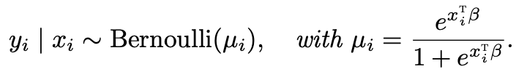


Generalized linear models
We have discussed the following models for independent observations
Normal linear model for continuous outcomes
Logistic model for binary outcomes
Poisson model for count outcomes
Negative-Binomial model for overdispersed count outcomes

Slide 3
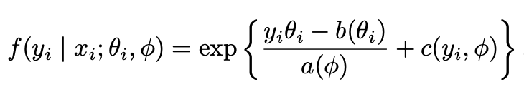
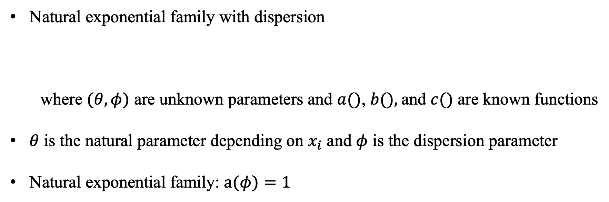
Exponential family
Natural exponential family with dispersion
where $(θ,φ)$ are unknown parameters and $a()$, $b(),$and $c()$ are known functions
$θ$ is the natural parameter depending on $x_{i}$ and $φ$ is the dispersion parameter
Natural exponential family: $a(φ)=1$

Slide 4
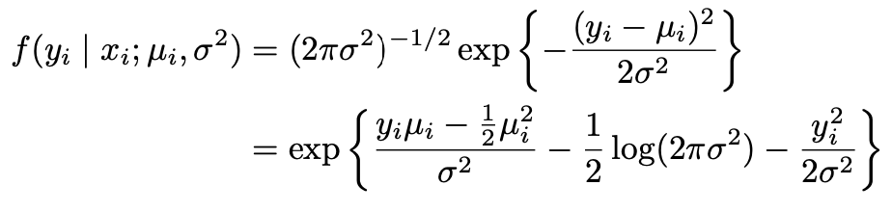
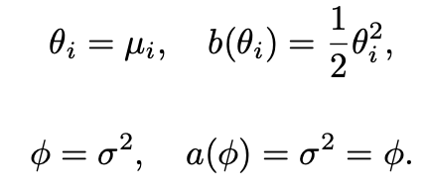
Normal linear model

Slide 5
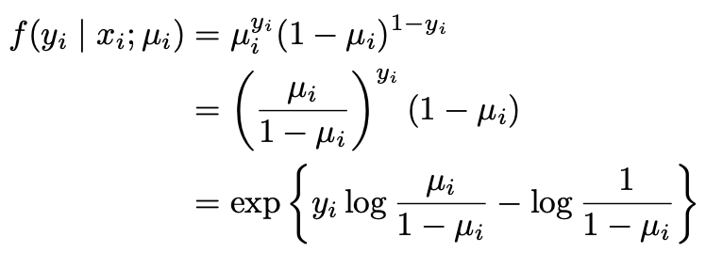

Logistic model

Slide 6
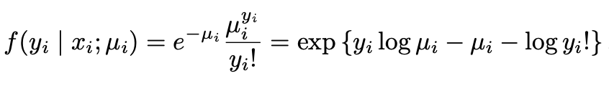


Poisson model

Slide 7
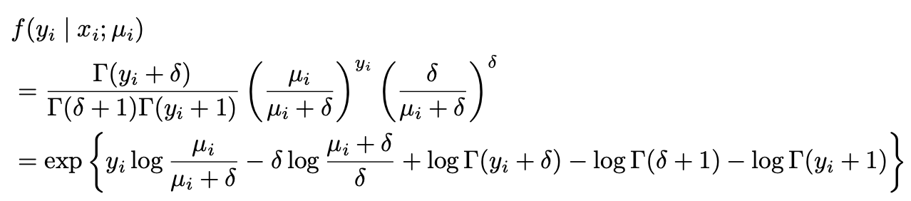


Negative-Binomial model
With fixed $δ$
Without fixed $δ$, it does not belong to an exponential family

Slide 8
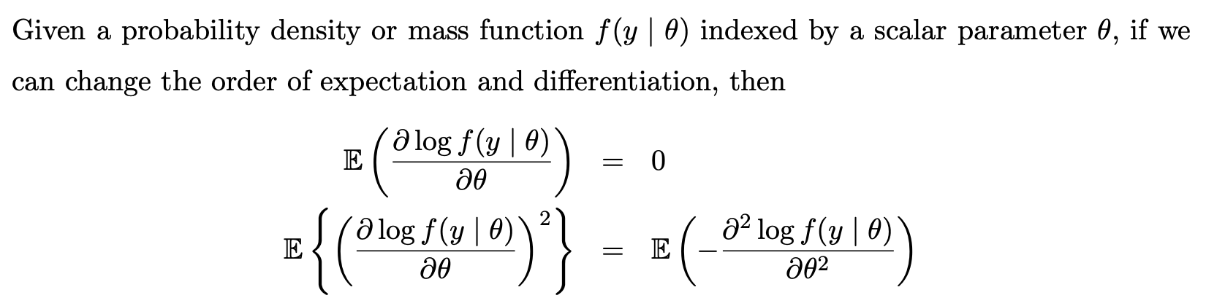
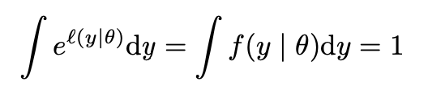

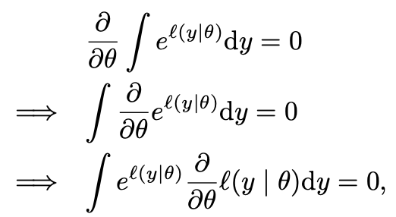
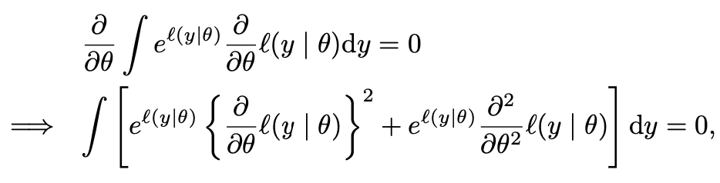
Bartlett’s identities
Proof:

Slide 9
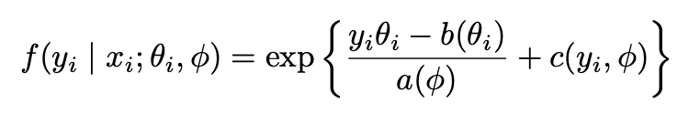


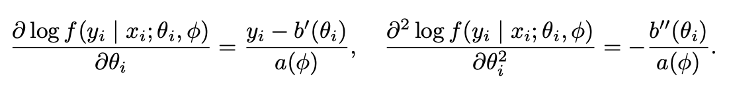
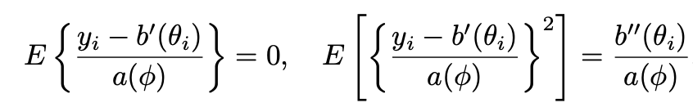
Moments
Proof:

Slide 10


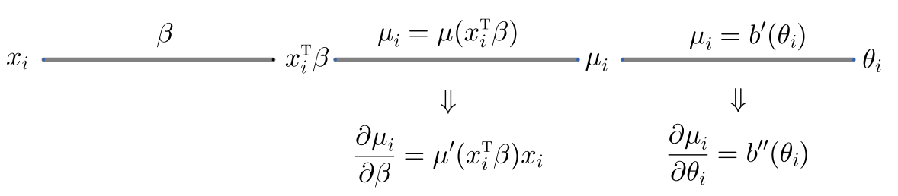
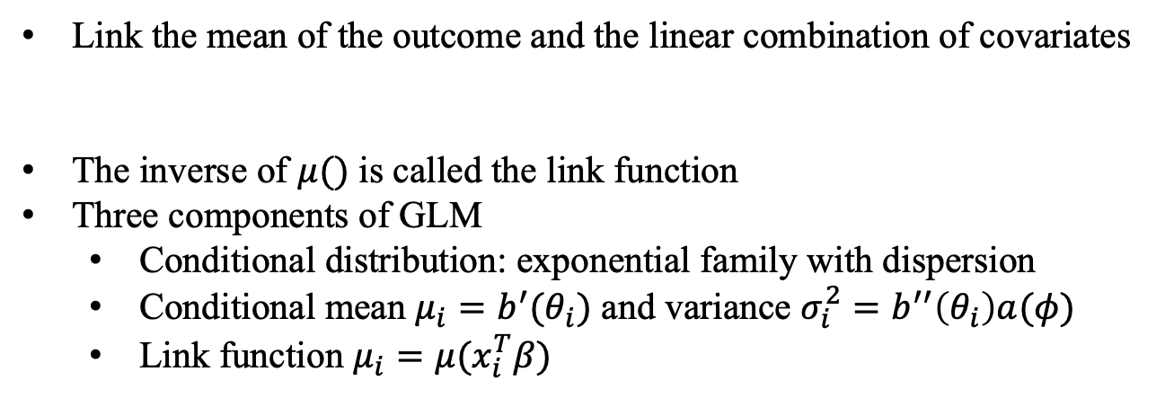
Generalized linear model
Link the mean of the outcome and the linear combination of covariates
The inverse of $μ()$ is called the link function
Three components of GLM
Conditional distribution: exponential family with dispersion
Conditional mean $μ_{i}=b^{′}(θ_{i})$ and variance $σ_{i}^{2}=b^{′′}\left(θ_{i}\right)a(φ)$
Link function $μ_{i}=μ(x_{i}^{T}β)$

Slide 11
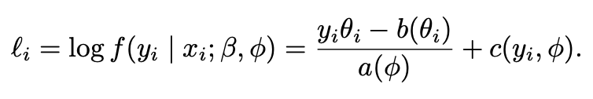
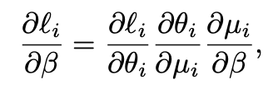
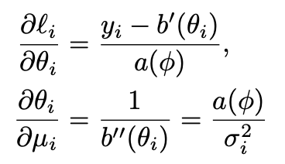
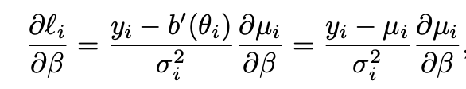
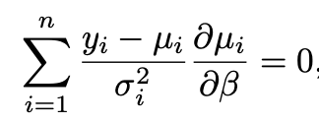
MLE for GLM
MLE:

Slide 12
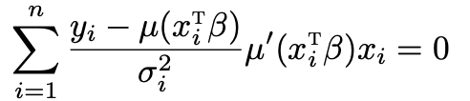


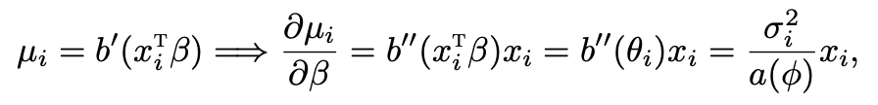
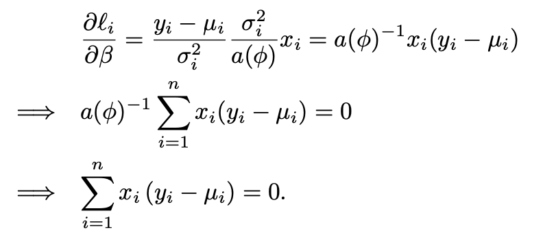
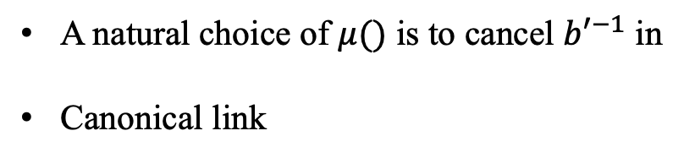
MLE for GLM
A natural choice of $μ()$ is to cancel ${b′}^{−1}$ in
Canonical link
Notes:
The normal linear, logistic, poisson models all satisfy this equation, but the NB model does not

Slide 13
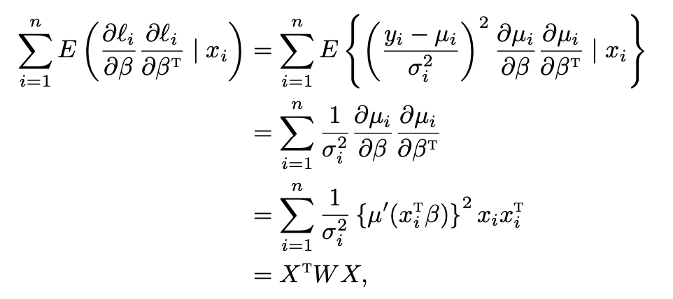
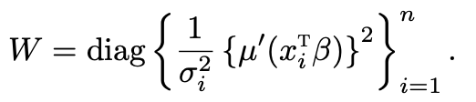
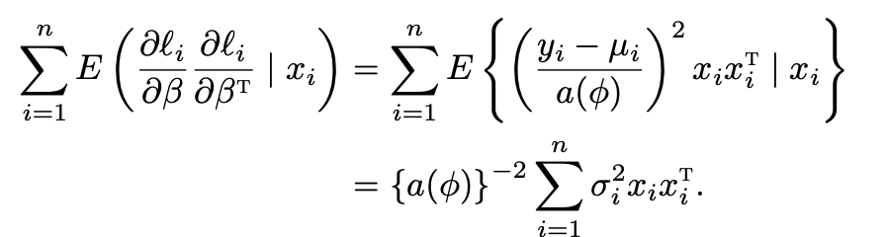
Variance
With canonical link

Slide 14







Estimation
Replace the unknown parameters with their estimates
Normal linear model
Logistic model
Poisson model

Slide 15
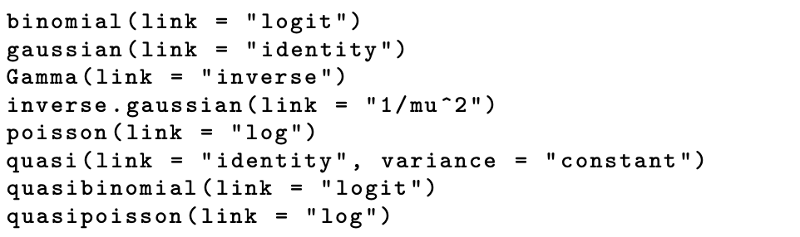
Other GLMs
The glm function allows for the specification of the family parameters
See the help file of the glm function and McCullagh and Nelder (1989) for more details

Slide 16
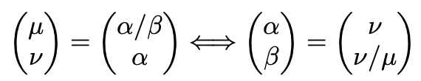
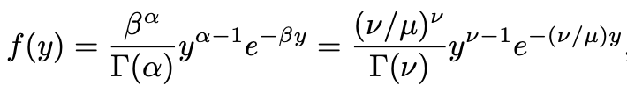



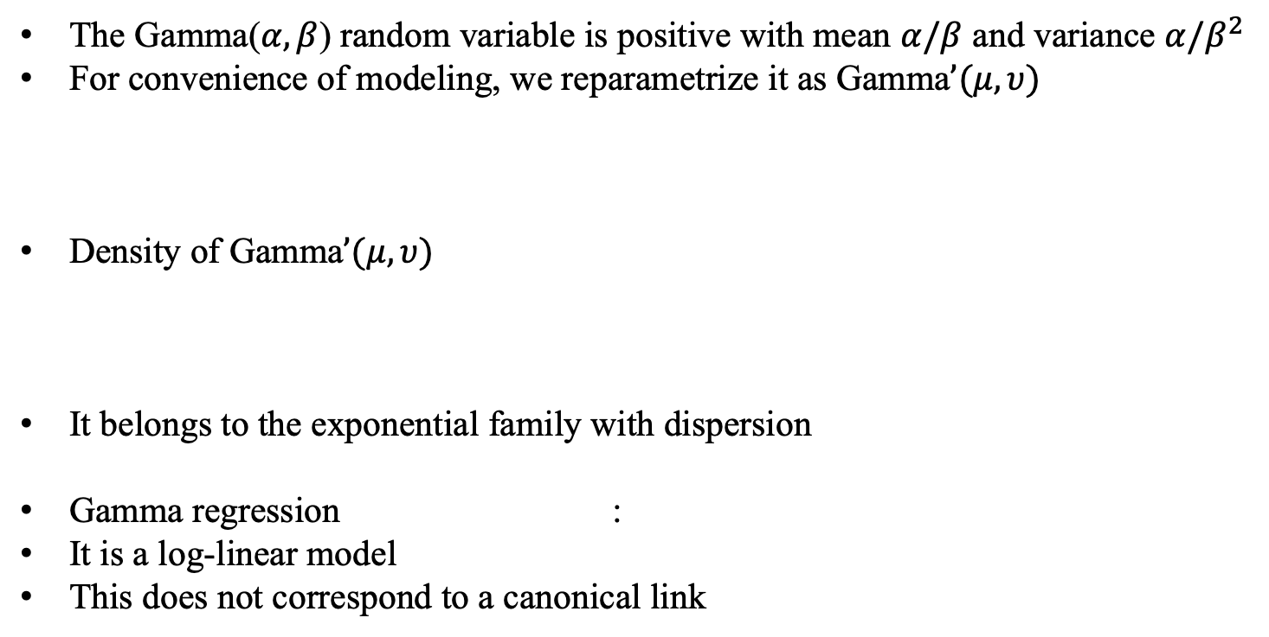
Gamma regression
The Gamma($α,β$) random variable is positive with mean $α/β$ and variance $α/β^{2}$
For convenience of modeling, we reparametrize it as Gamma$’(μ,υ)$
Density of Gamma$’(μ,υ)$
It belongs to the exponential family with dispersion
Gamma regression :
It is a log-linear model
This does not correspond to a canonical link

Slide 17
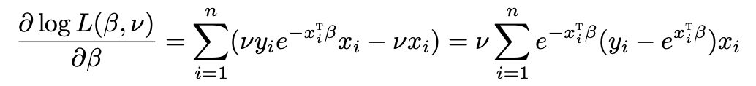
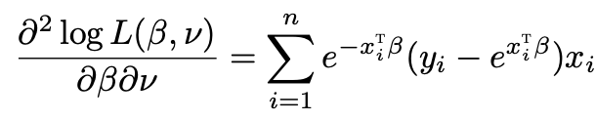
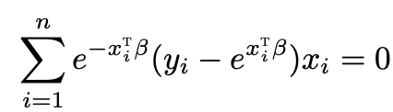
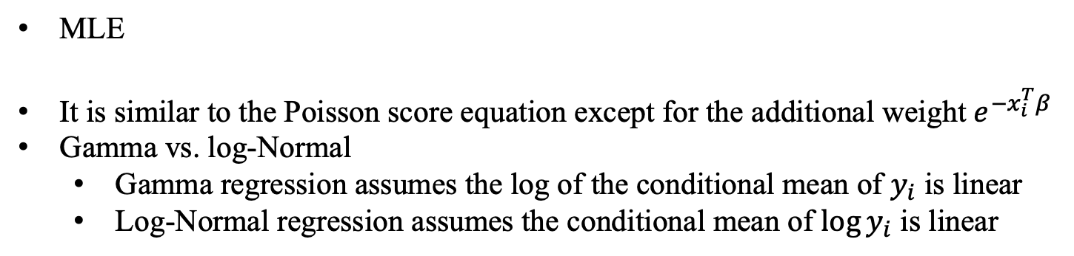
MLE for log-linear Gamma regression
MLE
It is similar to the Poisson score equation except for the additional weight $e^{{−x}_{i}^{T}β}$
Gamma vs. log-Normal
Gamma regression assumes the log of the conditional mean of $y_{i}$ is linear
Log-Normal regression assumes the conditional mean of $\log{y_{i}}$ is linear

