Slide 1
Lasso
蒋智超
2022年 秋

Slide 2
Motivation
Ridge regression works well for prediction, but it is difficult to interpret many small but non-zero
coefficients
Tibshirani (1996) proposed to use the lasso, the acronym for the Least Absolute Shrinkage
and Selection Operator
Simultaneously estimate parameters and select important variables in the linear regression
By changing the penalty in the ridge regression, the lasso automatically estimates some
parameter as zero, dropping them out of the model and thus selecting the remaining variables
as important predictors

Slide 3
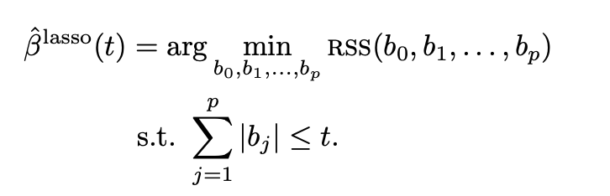
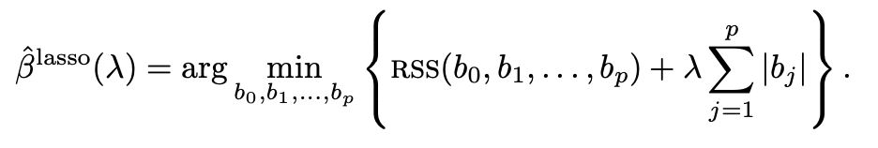
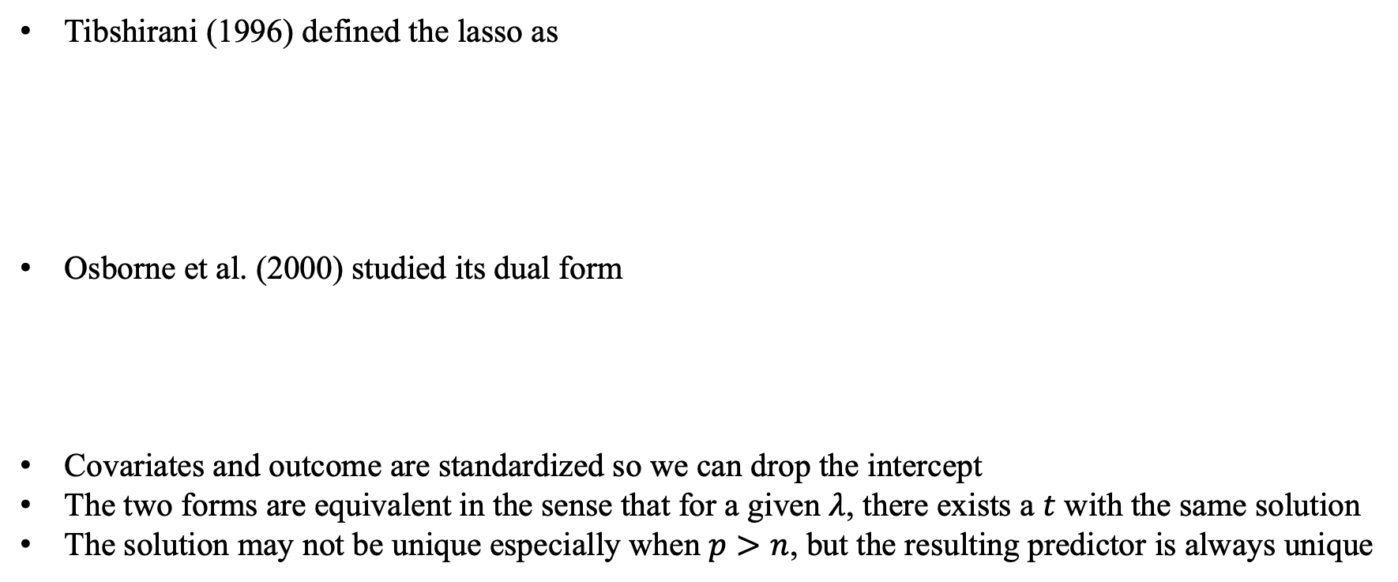
Definition
Tibshirani (1996) defined the lasso as
Osborne et al. (2000) studied its dual form
Covariates and outcome are standardized so we can drop the intercept
The two forms are equivalent in the sense that for a given $λ$, there exists a $t$ with the same solution
The solution may not be unique especially when $p>n$, but the resulting predictor is always unique

Slide 4



A geometric perspective of the lasso
The OLS minimizes
With the penalty, the OLS coefficient may not be in the region defined by
We can consider the contour plot of and the border of the
restriction region
The lasso can give sparse solutions due to the non-smooth penalty term

Slide 5
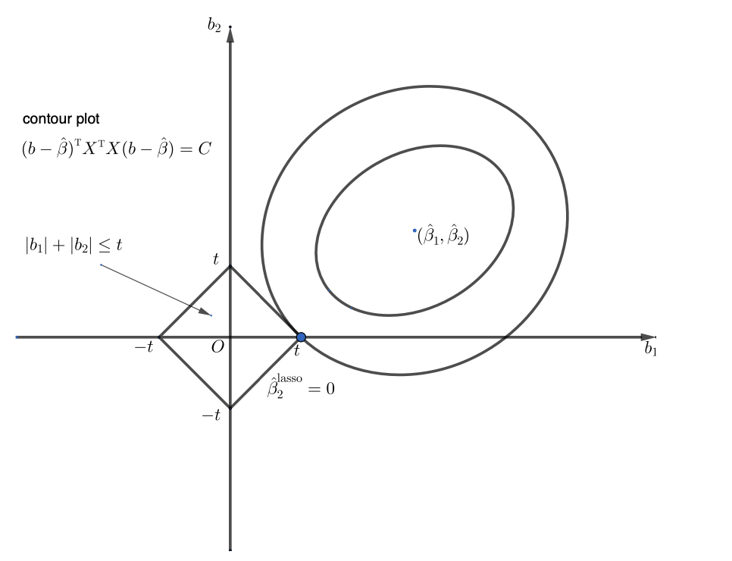
A geometric perspective of the lasso

Slide 6
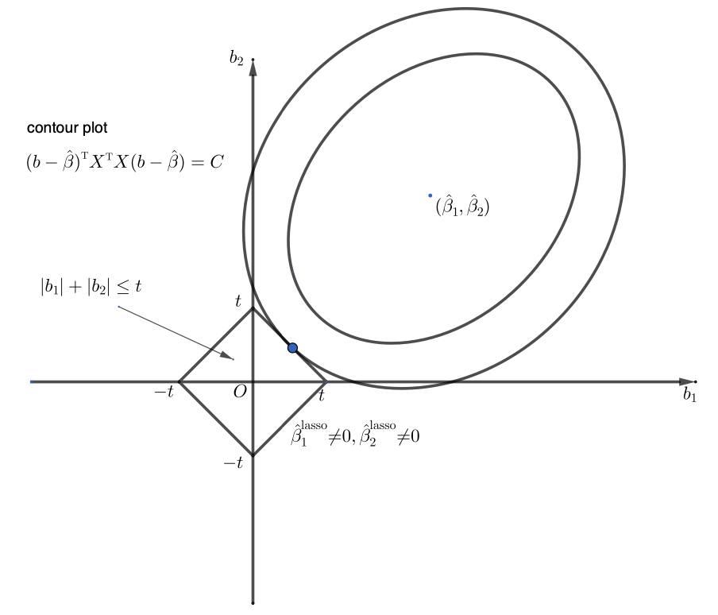
A geometric perspective of the lasso

Slide 7
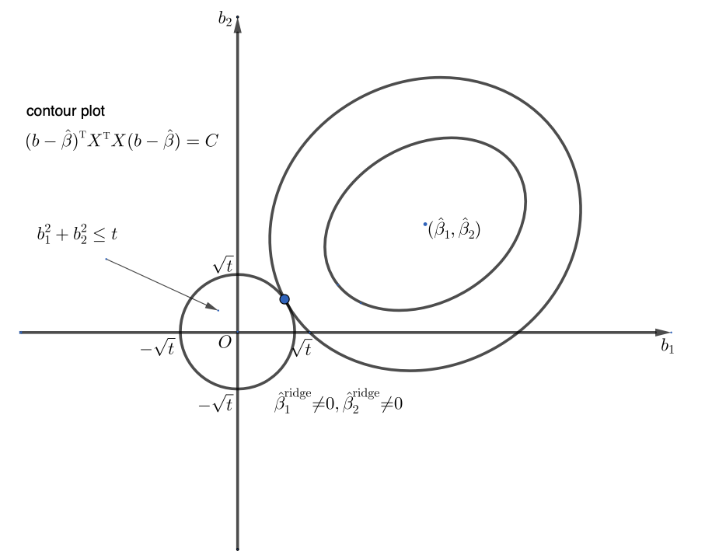
A geometric perspective of the lasso

Slide 8
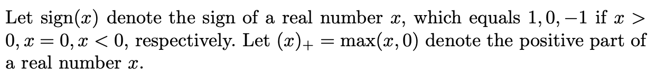
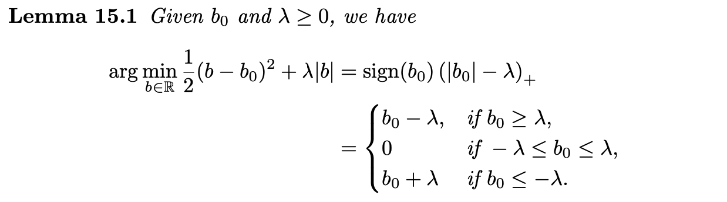

Computing the lasso via coordinate descent
Denote
Notes:
The glmnet package in R uses the coordinate descent algorithm

Slide 9
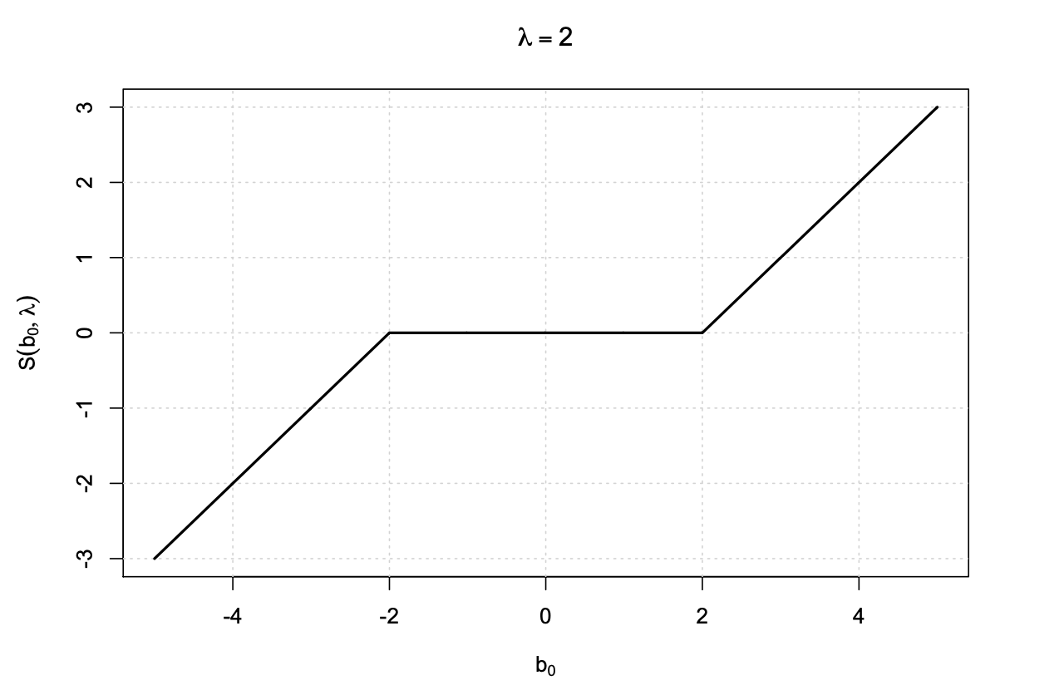
Soft thresholding

Slide 10
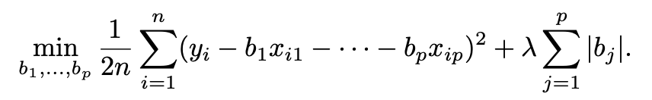
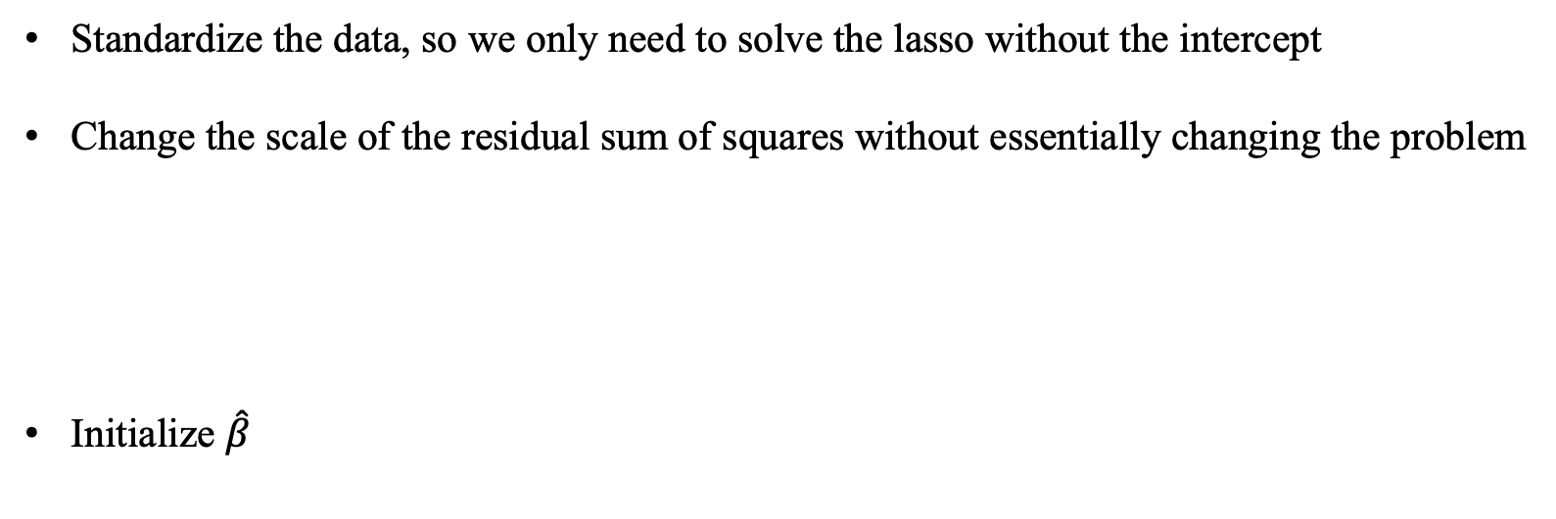
Coordinate descent for the lasso
Standardize the data, so we only need to solve the lasso without the intercept
Change the scale of the residual sum of squares without essentially changing the problem
Initialize $\hat{β}$

Slide 11
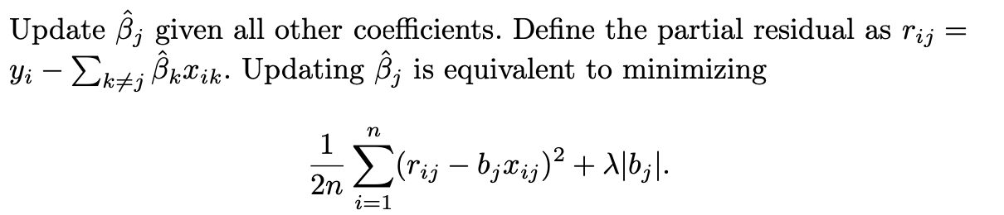
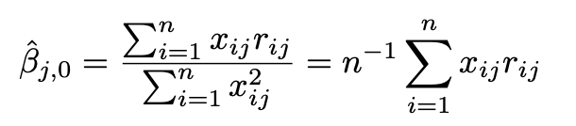
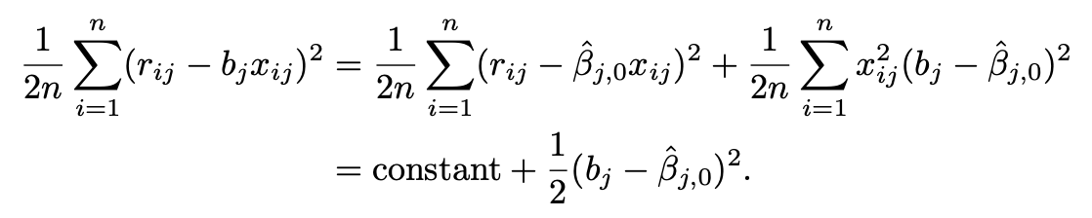

Coordinate descent for the lasso
Define
Iterate until convergence

Slide 12
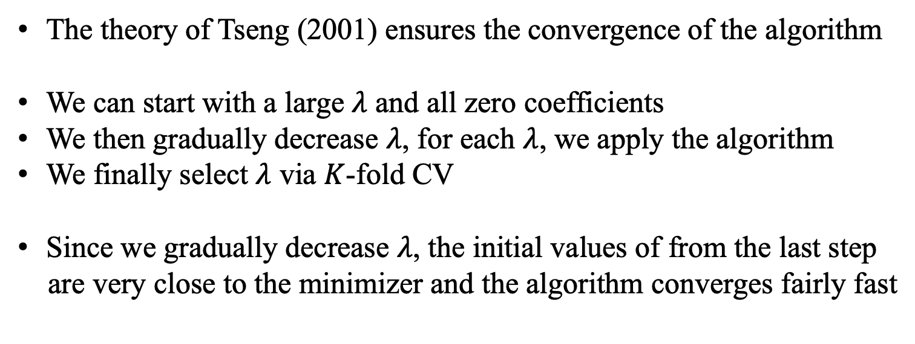
Coordinate descent for the lasso
The theory of Tseng (2001) ensures the convergence of the algorithm
We can start with a large $λ$ and all zero coefficients
We then gradually decrease $λ$, for each $λ$, we apply the algorithm
We finally select $λ$ via $K$-fold CV
Since we gradually decrease $λ$, the initial values of from the last step
are very close to the minimizer and the algorithm converges fairly fast

Slide 13
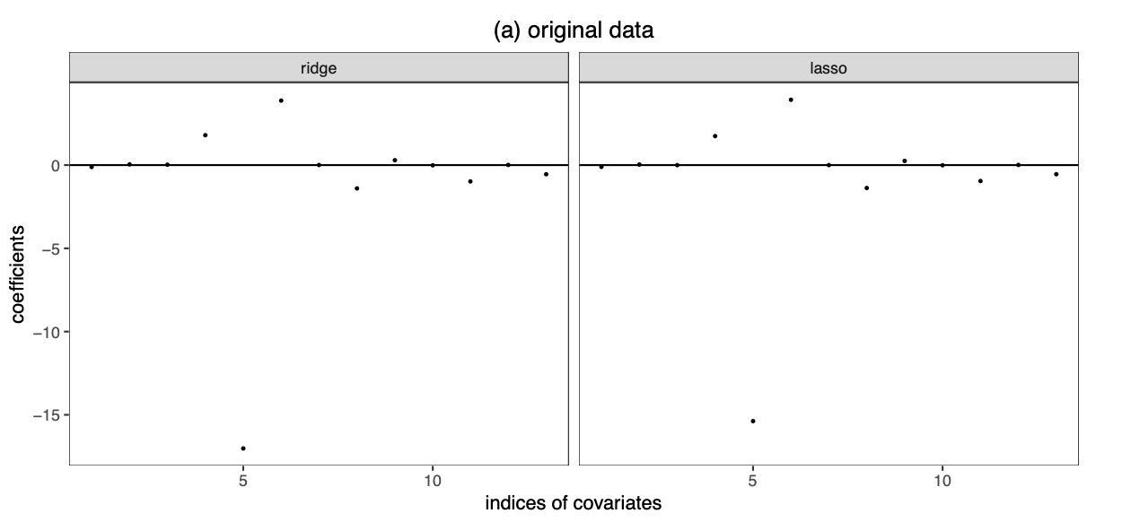

Boston housing data analysis

Slide 14
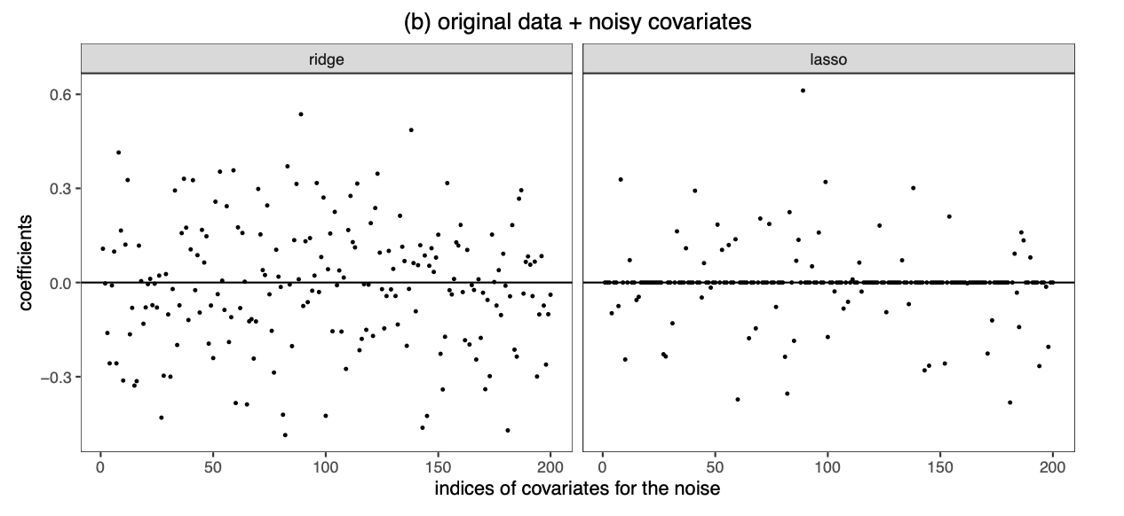

Boston housing data analysis

Slide 15
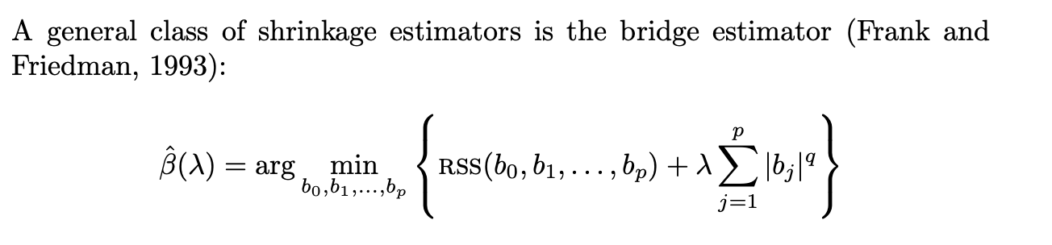
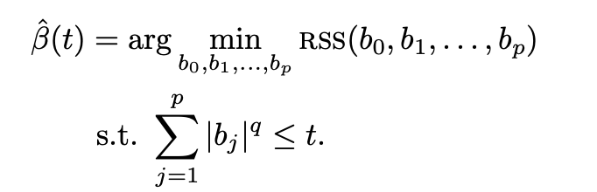
Other shrinkage estimator
Dual form

Slide 16
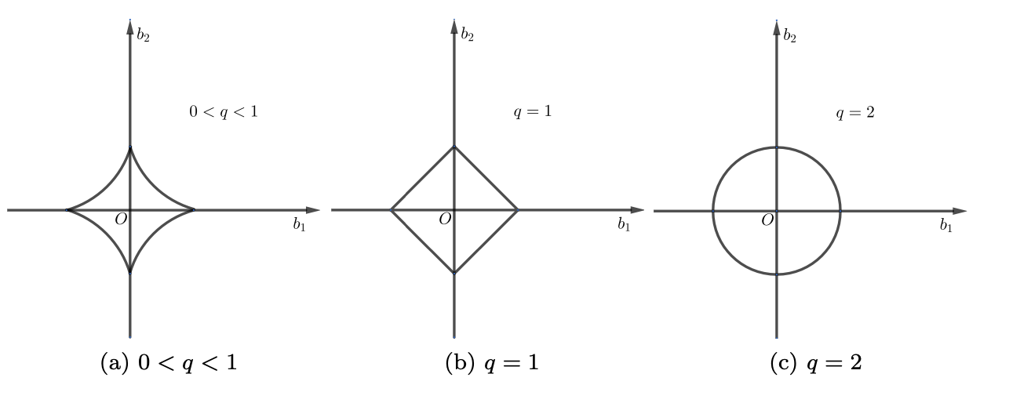
Other shrinkage estimator

Slide 17
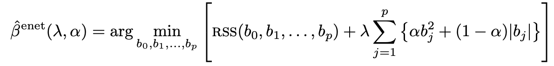
Other shrinkage estimator
Zou and Hastie (2005) proposed the elastic net, which combines the penalties of the
lasso and ridge
Because the constraint is not smooth, it encourages sparse solution as the lasso
Due to the ridge penalty, it can deal with collinearity of the covariates better than
the lasso
Implemented in glmnet package

Slide 18
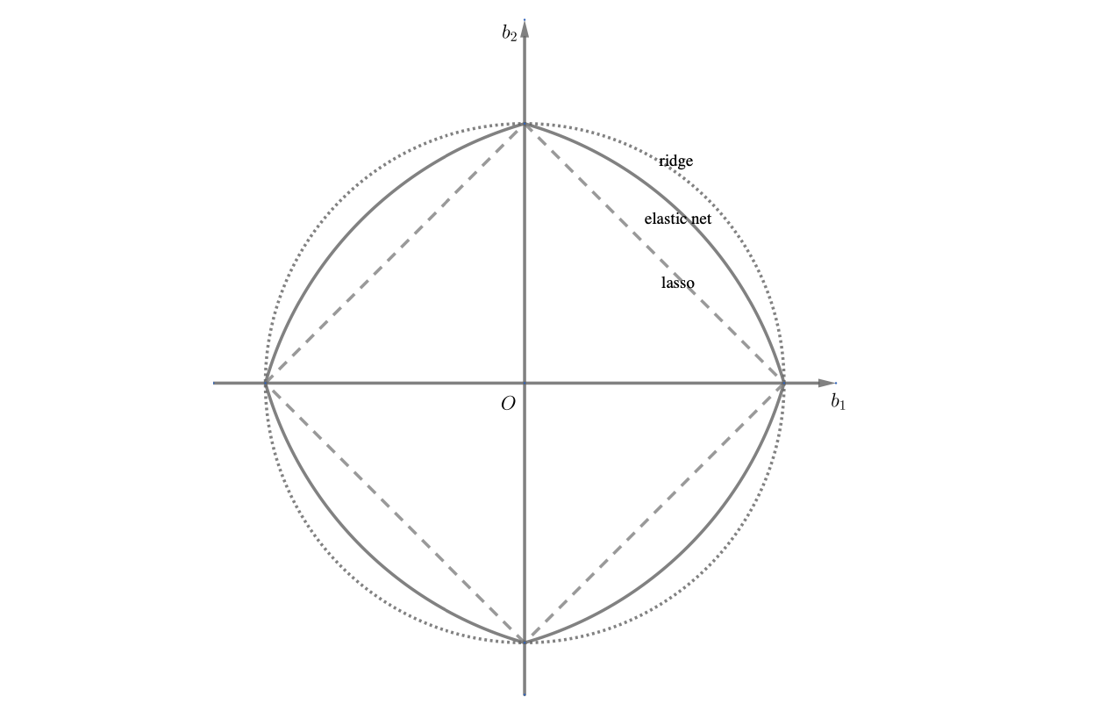
Other shrinkage estimator

