Slide 1
Ordinary least squares
蒋智超
2022年 秋

Slide 2
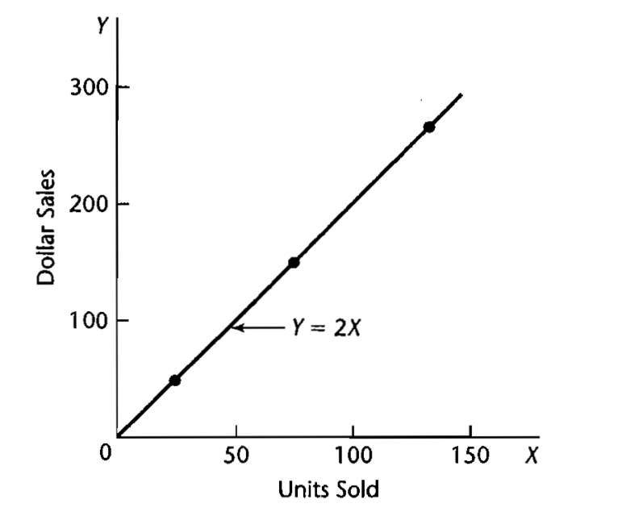
Functional relation
Y and X have function relationship if Y can be determined by X perfectly with a function.
Example: Let Y represent the total dollar sales for a product sold at a fixed price. Let X represent the number of units sold. If the selling price is $2 per unit, then Y = 2X.

Slide 3
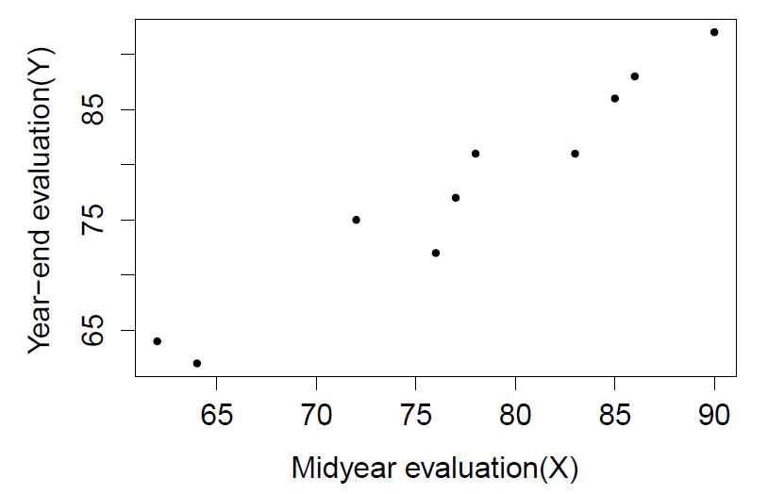
Statistical relation
Y cannot be perfectly determined by X with a function form. But there is a tendency of Y varies with X in some systematic fashion.
Example: Performance evaluations for 10 employees at midyear and year-end.
Notes:
每一个点代表一个数据，矩阵中的一行

Slide 4
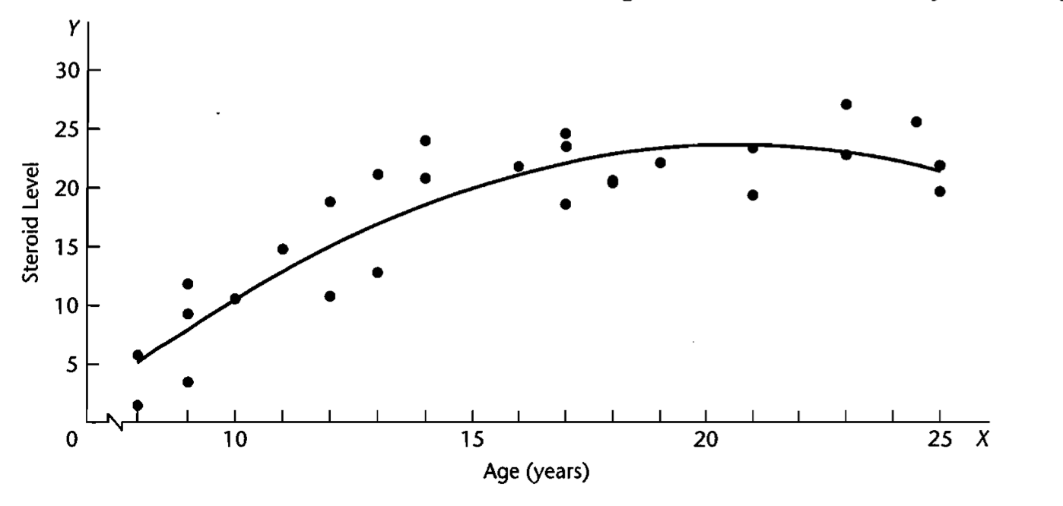
Non-linear statistical relation

Slide 5
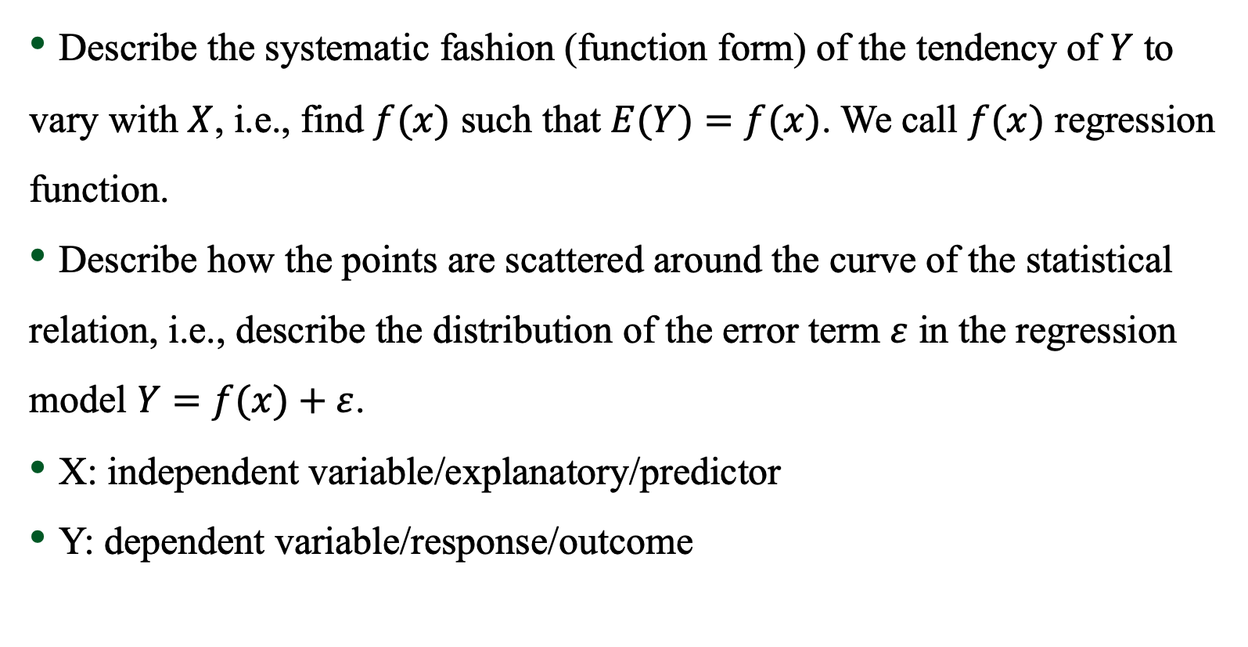
Regression model
Describe the systematic fashion (function form) of the tendency of $Y$ to vary with $X$, i.e., find $f(x)$ such that $E(Y)=f(x)$. We call $f(x)$ regression function.
Describe how the points are scattered around the curve of the statistical relation, i.e., describe the distribution of the error term $ε$ in the regression model $Y=f(x)+ε$.
X: independent variable/explanatory/predictor
Y: dependent variable/response/outcome
Notes:
EY 而不是 Y

Slide 6
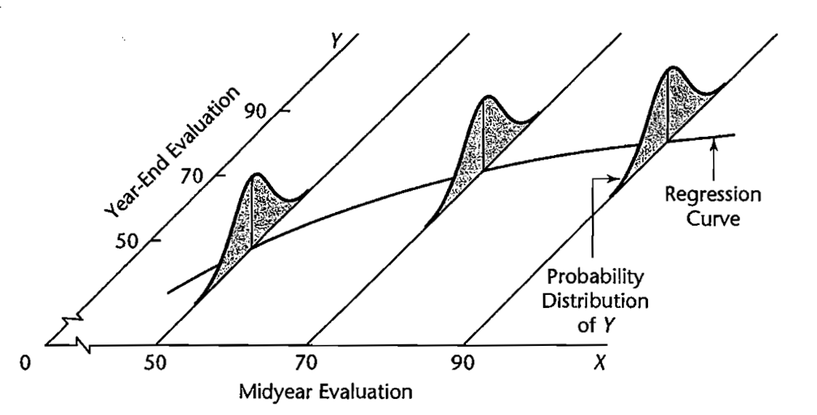
Regression model

Slide 7

Linear model
f(x) is a linear function: Y = a+bX+$ε$
A unit increase in X is associated with b unit increase in Y
Regression model does not necessarily imply causal relationship
Construction of linear models
Select predictors
Determine the function form, e.g. a+bX, a+bX+cX^2
Determine the range of the predictors

Slide 8
Linear model overview
Theory for linear model
Estimation
Inference
Model checking
Model selection
Different assumptions on the error terms
Strong results require restrictive assumptions, which may be unrealistic

Slide 9
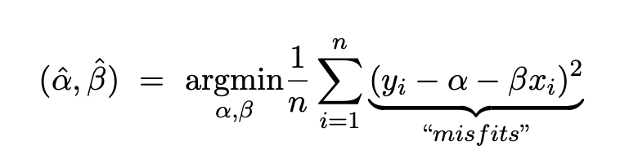
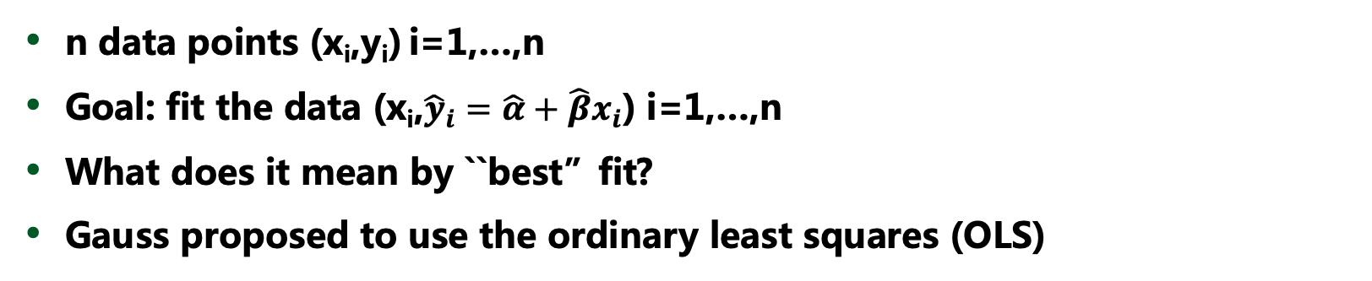
Univariate ordinary least squares (OLS)
n data points (x_{i},y_{i}) i=1,…,n
Goal: fit the data (x_{i},${\hat{y}}_{i}=\hat{α}+\hat{β}x_{i}$) i=1,…,n
What does it mean by ``best”fit?
Gauss proposed to use the ordinary least squares (OLS)
Can we use other functions of the ``misfits”?
Notes:
Estimation: how to estimate the line, no assumptions required for this step.
Some criterion to define the ``best’’ fit
Compare different functions of the “”misfits”

Slide 10
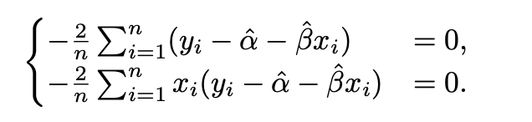
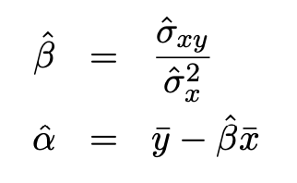
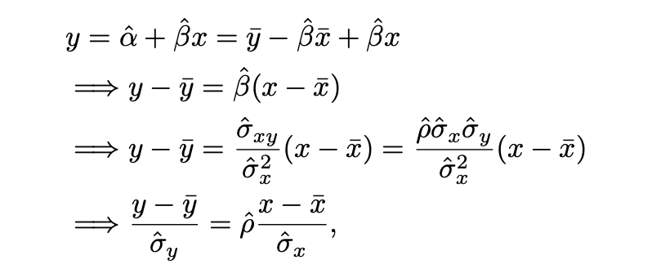
Univariate OLS
First order condition
Regression towards the mean
Notes:
The objective function diverges as alpha and beta diverge, so the first order condition gives the minimizer

Slide 11
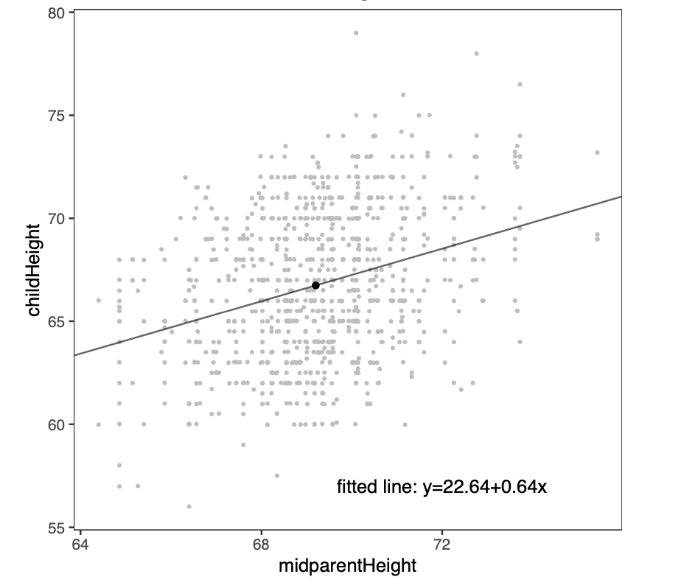
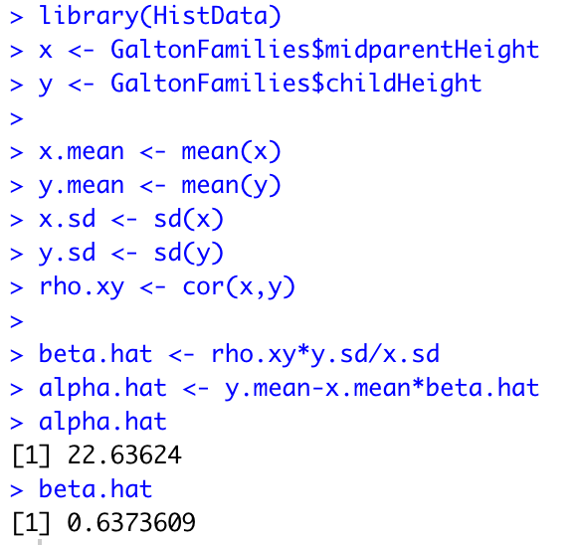
Galton’s regression
Notes:
Interpretation of the coefficients

Slide 12
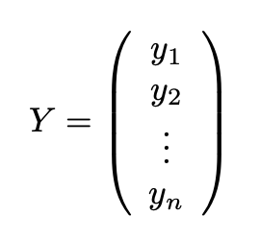
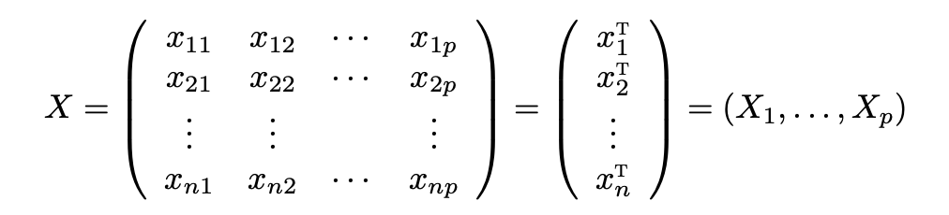
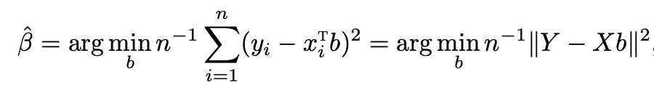
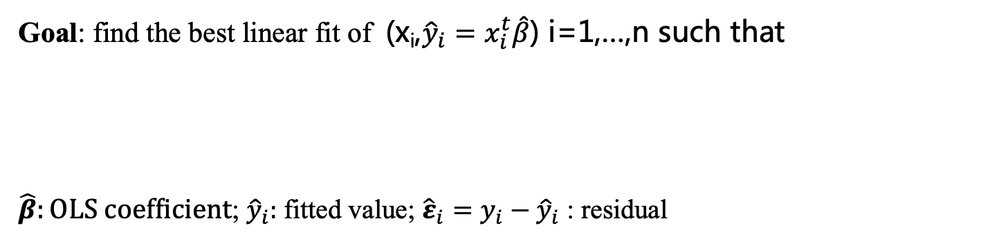
OLS with multiple covariates
Goal: find the best linear fit of (x_{i},${\hat{y}}_{i}=x_{i}^{t}\hat{β}$) i=1,…,n such that
$\hat{β}:OLS coefficient$; ${\hat{y}}_{i}:$ fitted value; ${{{\hat{ε}}_{i}=y}_{i}−\hat{y}}_{i}$ : residual
Notes:
所有的向量均为列向量，X_1 变量1， x_1 unit I 的数据 x_1 = (x_11,…,x_1p);

Slide 13
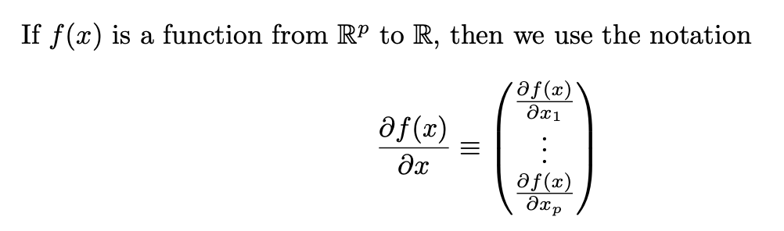
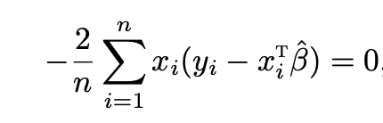
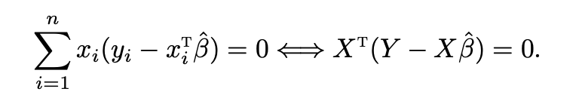
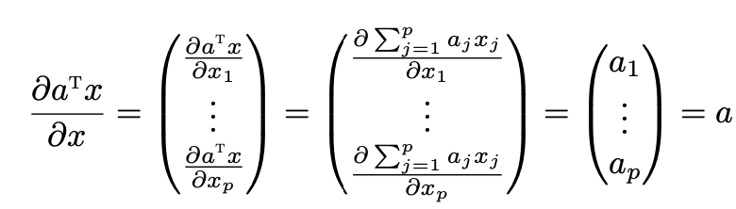
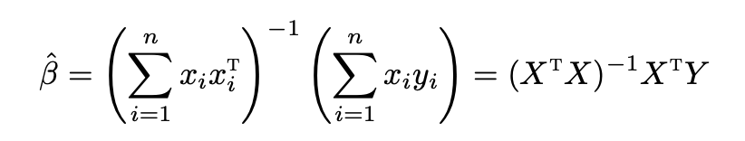
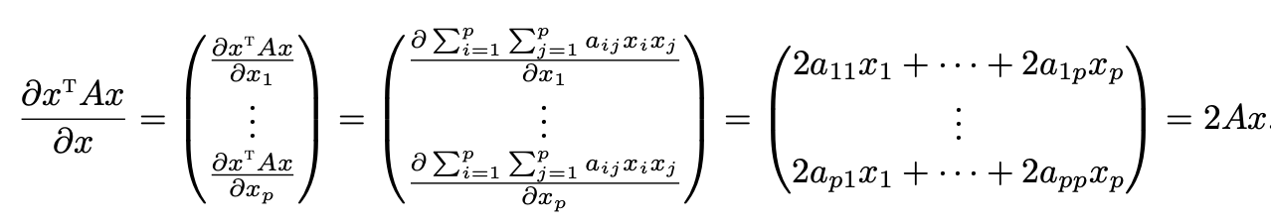

OLS solution
Requires $X^{T}X$ to be invertible: for any non-zero vector $α$ ,
Notes:
Symmetric matrix invertible = positive definite
线性相关 e.g. 身高 in cm 身高 in m
问题，身高，体重， bmi，是否线性相关？

Slide 14
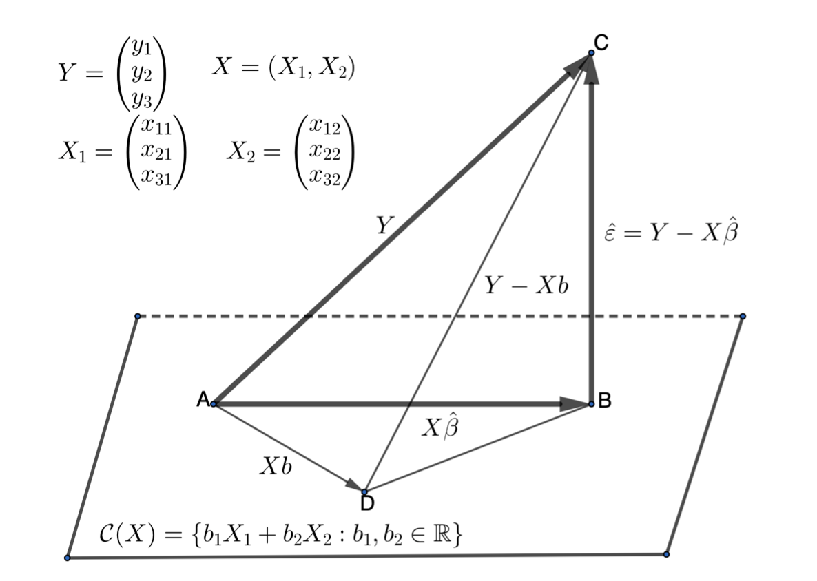
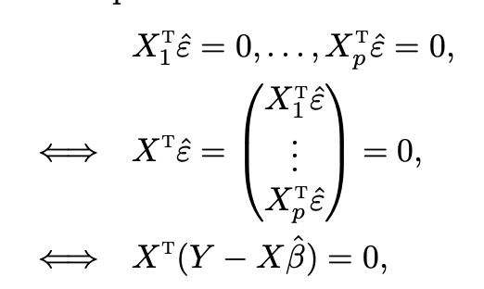
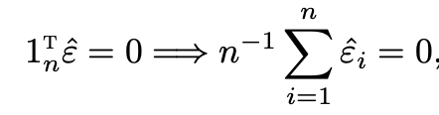

The geometry of OLS
Residual is orthogonal to the covariates
In most cases, X contains an intercept $1_{n}=$(1,…,1)

Slide 15
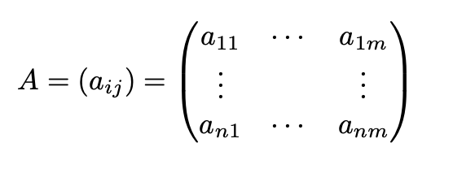







Column space of a matrix
$$v=Xb$$
$$X^{T}w=0$$
Notes:
Interpretation of the coefficients

Slide 16
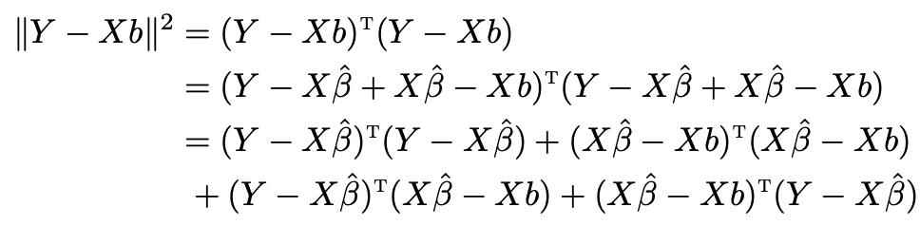



An alternative proof of OLS
Equality holds only if

Slide 17

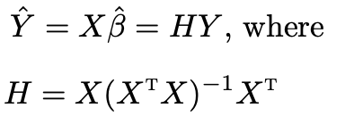
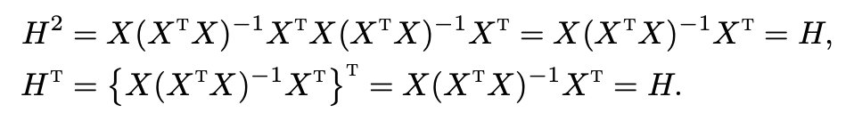
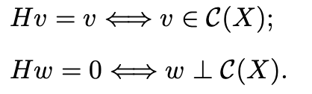
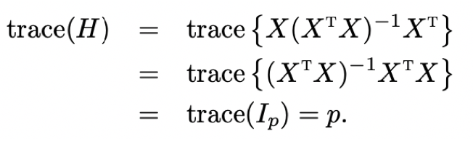

Hat matrix
Solution:
H is called hat matrix
The eigenvalue values of H
must be either 0 or 1

Slide 18
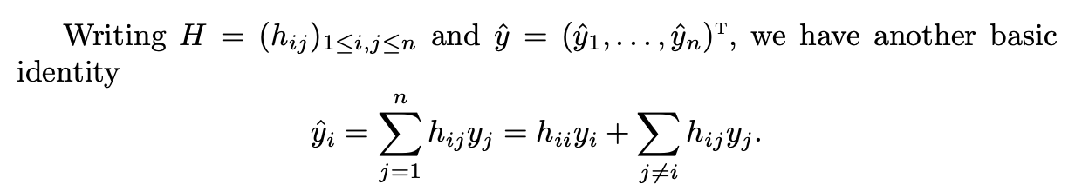
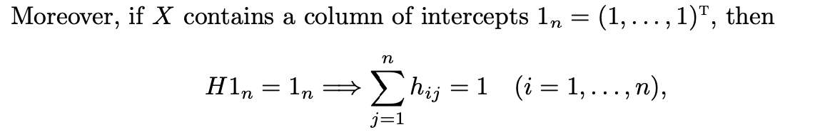

Hat matrix: property
${\hat{y}}_{i}$ is a linear combination of all the outcomes
Notes:
Question: is In-H a projection matrix?

Slide 19







Decomposition
Both $H$ and $I_{n}−H$ are projection matrices
$HX=X$ and ${(I}_{n}−H)X=0$
Notes:
orthogonal

Slide 20
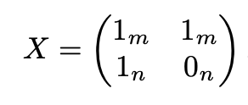



Hat matrix: examples
In a treatment-control experiment with m treated and n control units
In an experiment with $n_{j}$ units under treatment condition j (j=1 ,…, J)
Notes:
到目前为止所有的结论都只是从最小二乘得到，并不需要任何模型假设

