Slide 1
Overfitting
蒋智超
2022年 秋

Slide 2


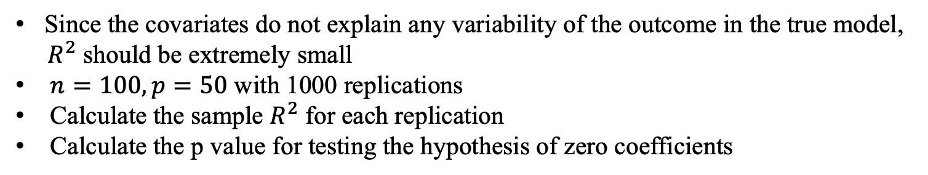
David Freedman’s simulation
Since the covariates do not explain any variability of the outcome in the true model,
$R^{2}$ should be extremely small
$n=100, p=50$ with 1000 replications
Calculate the sample $R^{2}$ for each replication
Calculate the p value for testing the hypothesis of zero coefficients

Slide 3
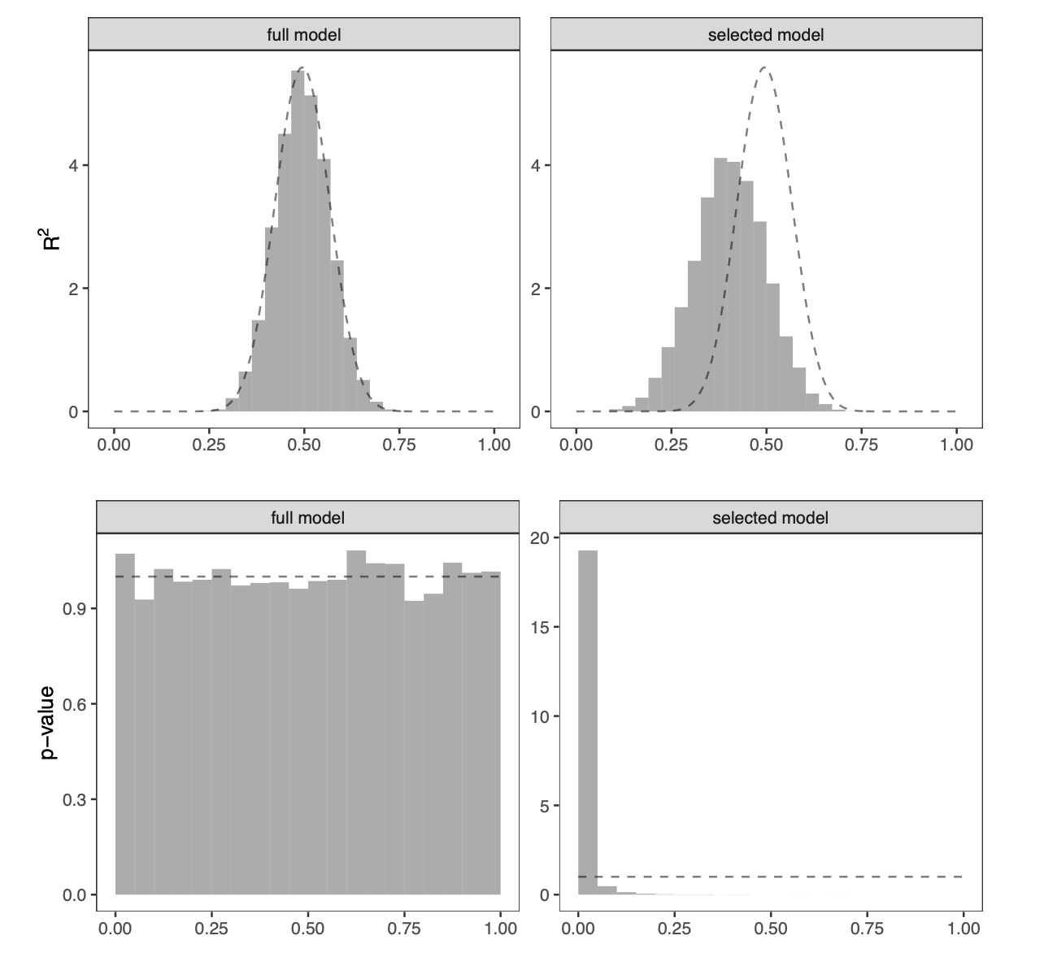
Notes:
The (1,2)th subfigure shows the histogram of the R2 based on a model selection first step by dropping all covariates with p-values larger than 0.25.

Slide 4
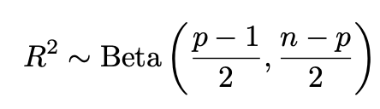
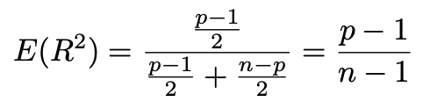
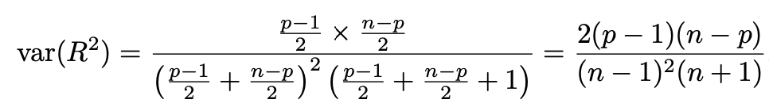
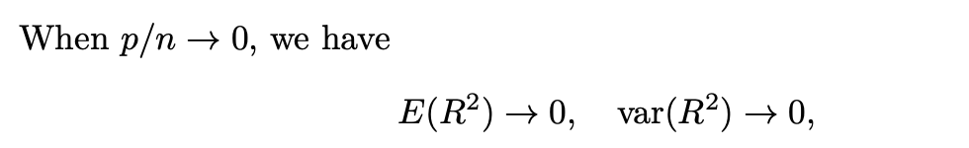


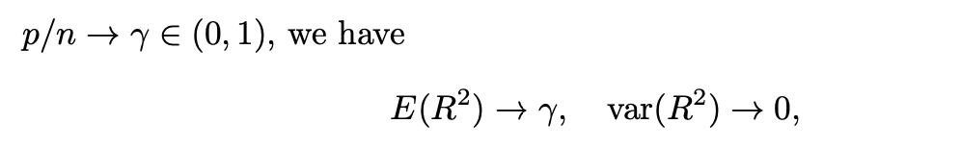

David Freedman’s simulation
We cannot over interpret the sample $R^{2}$ since it can be too optimistic about model fitting.

Slide 5
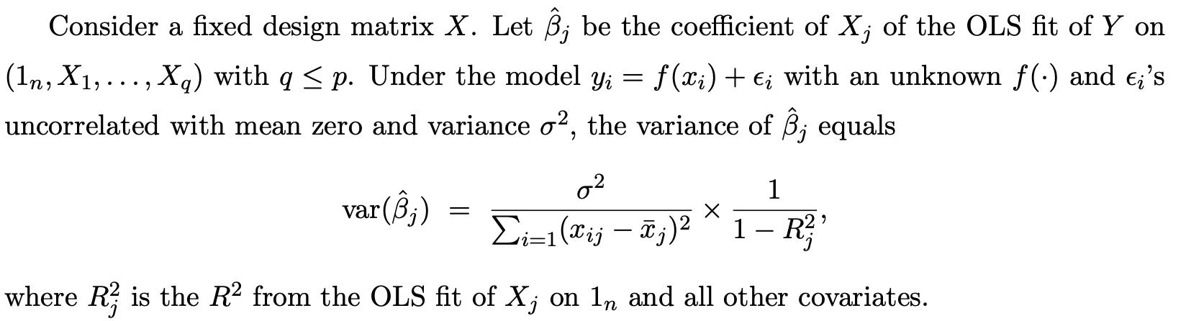
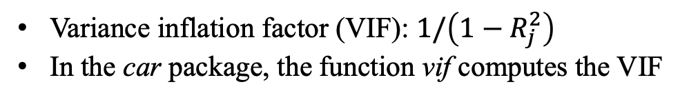
Variance inflation factor
Variance inflation factor (VIF): $1/\left(1−R_{j}^{2}\right)$
In the car package, the function vif computes the VIF

Slide 6
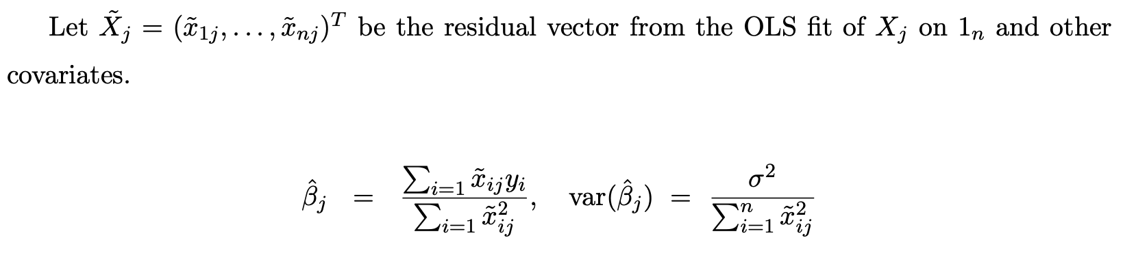
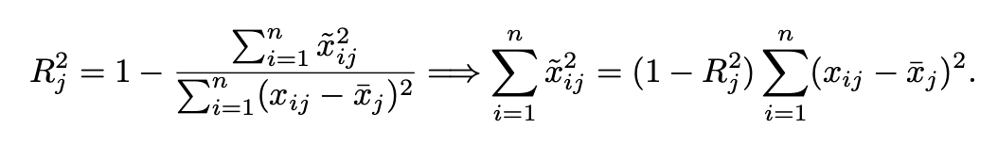
Variance inflation factor
FWL theorem implies

Slide 7





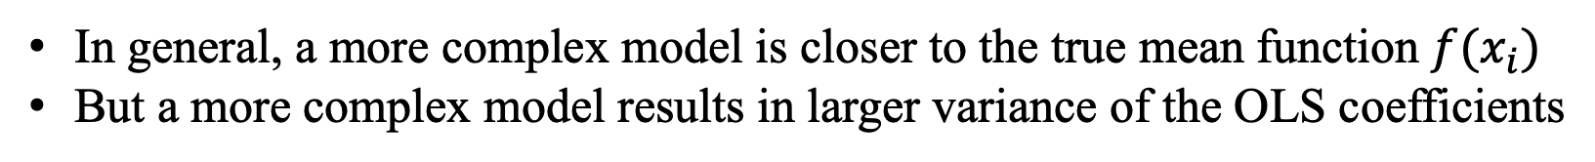
Bias-variance trade-off
In general, a more complex model is closer to the true mean function $f(x_{i})$
But a more complex model results in larger variance of the OLS coefficients
True model
Underfitted model
Overfitted model

Slide 8


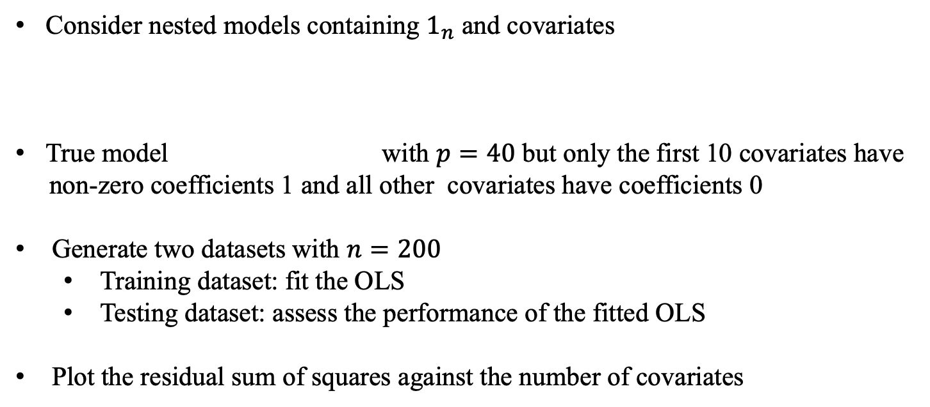
Simulation
Consider nested models containing $1_{n}$ and covariates
True model with $p=40$ but only the first 10 covariates have
non-zero coefficients 1 and all other covariates have coefficients 0
Generate two datasets with $n=200$
Training dataset: fit the OLS
Testing dataset: assess the performance of the fitted OLS
Plot the residual sum of squares against the number of covariates
Notes:
all covariates have IID N(0,1) entries

Slide 9
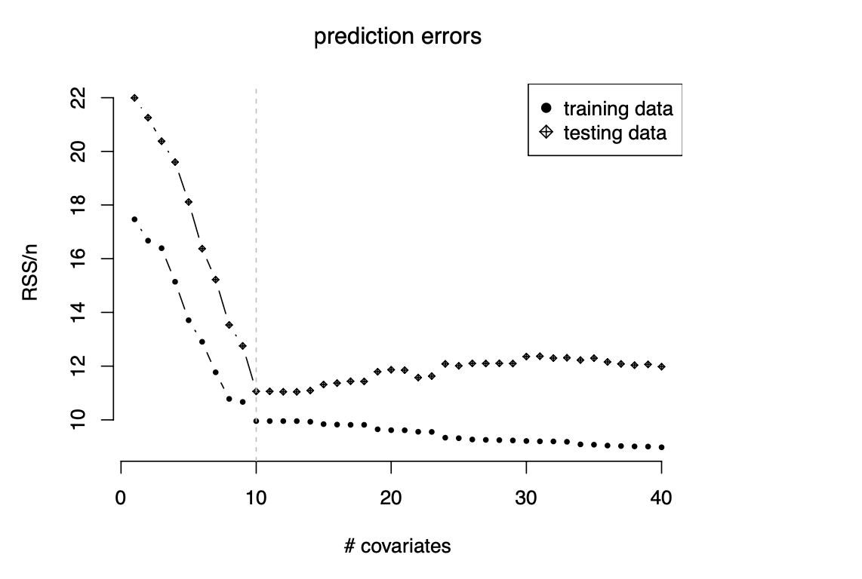
Simulation

Slide 10

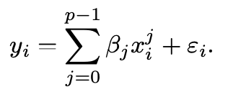
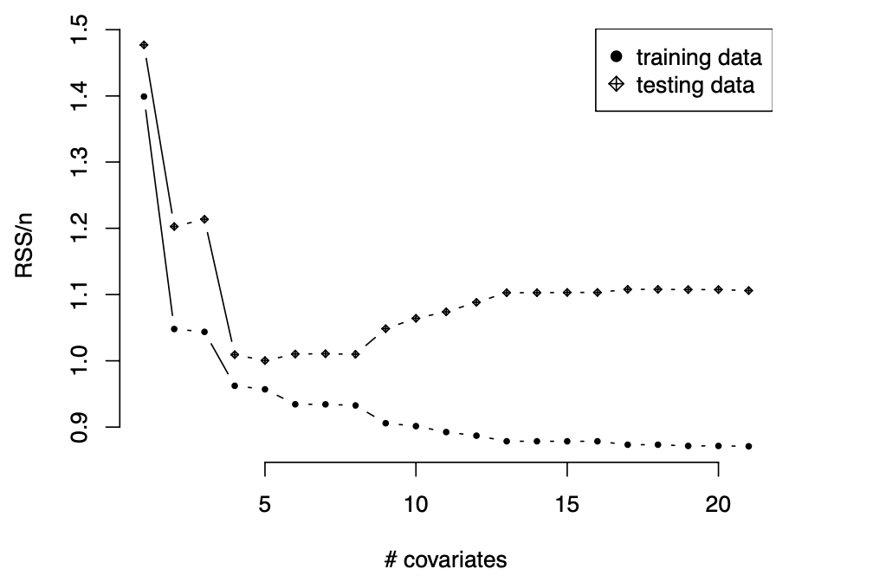
Simulation: non-linear true model
The true model is with the $x_{i}$’s equally spaced in $[0,1]$
The OLS model

Slide 11
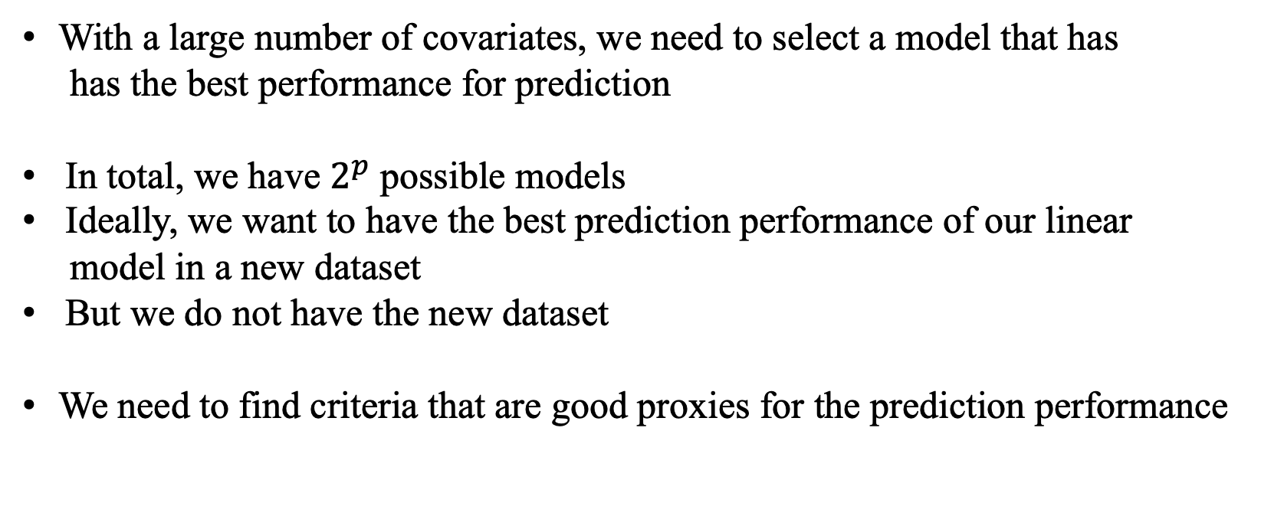
Model selection criteria
With a large number of covariates, we need to select a model that has
has the best performance for prediction
In total, we have $2^{p}$ possible models
Ideally, we want to have the best prediction performance of our linear
model in a new dataset
But we do not have the new dataset
We need to find criteria that are good proxies for the prediction performance

Slide 12
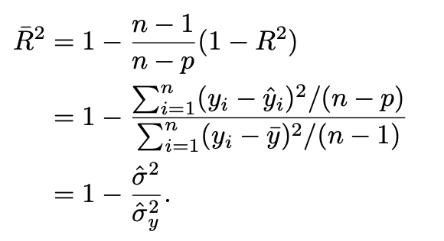


RSS, $R^{2}$, and adjusted $R^{2}$
RSS and $R^{2}$favor the largest model
The adjusted $R^{2}$ takes into account the complexity of the model
Based on ${\overline{R}}^{2}$, the best model has the smallest ${\hat{σ}}^{2}$

Slide 13
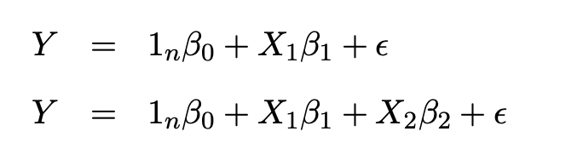

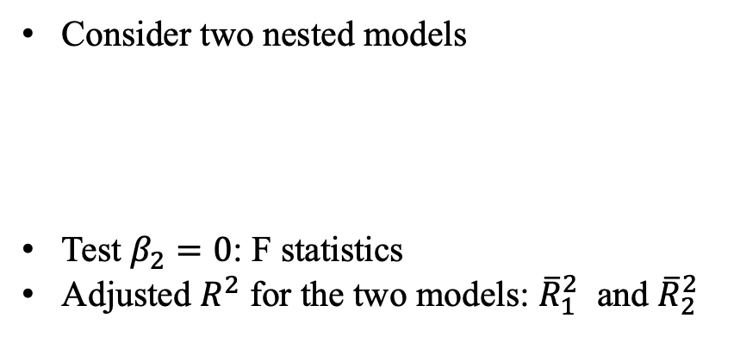
RSS, $R^{2}$, and adjusted $R^{2}$
Consider two nested models
Test $β_{2}=0$: F statistics
Adjusted $R^{2}$ for the two models: ${\overline{R}}_{1}^{2}$ and ${\overline{R}}_{2}^{2}$
Notes:
Homework,
the mean of F is approximately 1, but the upper quantile of F is much larger than 1 (for example, the 95% quantile of F1,n−p is larger than 3.8, and the 95% quantile of F2,n−p is larger than 2.9). So compared to the usual hypothesis testing based on the Normal linear model, R ̄2 favors unnecessarily large models.

Slide 14


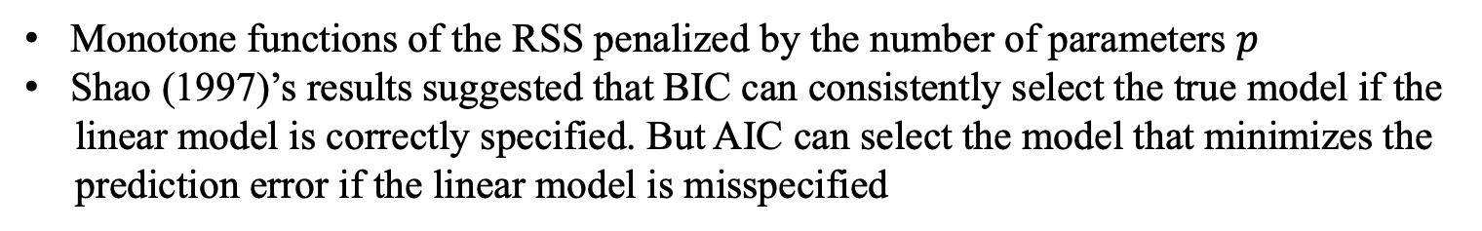
Information criteria
Akaike’s information criterion
Bayesian information criterion
Monotone functions of the RSS penalized by the number of parameters $p$
Shao (1997)’s results suggested that BIC can consistently select the true model if the
linear model is correctly specified. But AIC can select the model that minimizes the
prediction error if the linear model is misspecified
Notes:
In most statistical practice, the linear model assumption cannot be justified, so we recommend using aic.

Slide 15
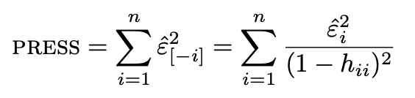
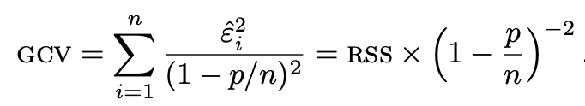
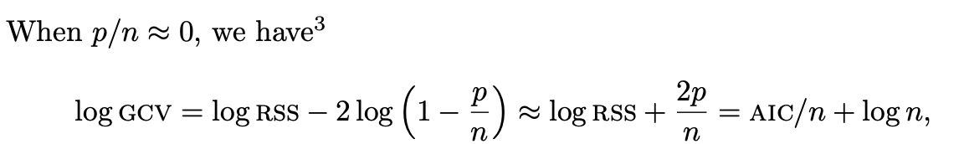
Cross validation
Leave-one-out cross validation based on the predicted residuals
Approximate PRESS by generalized cross validation (GCV)
Predicted residual error sum of squares
Notes:
GCV is not crucial for OLS because it is easy to compute PRESS. However, it is much more useful in other models where we need to fit the data n times to compute PRESS

Slide 16
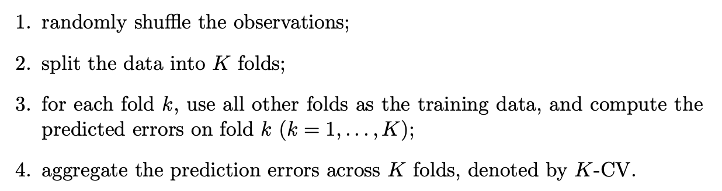

Cross validation
For general models without simple leave-one-out formulas, it is computationally intensive
to obtain PRESS
K-fold cross validation
Usually, people choose $K=5$or $10$

Slide 17
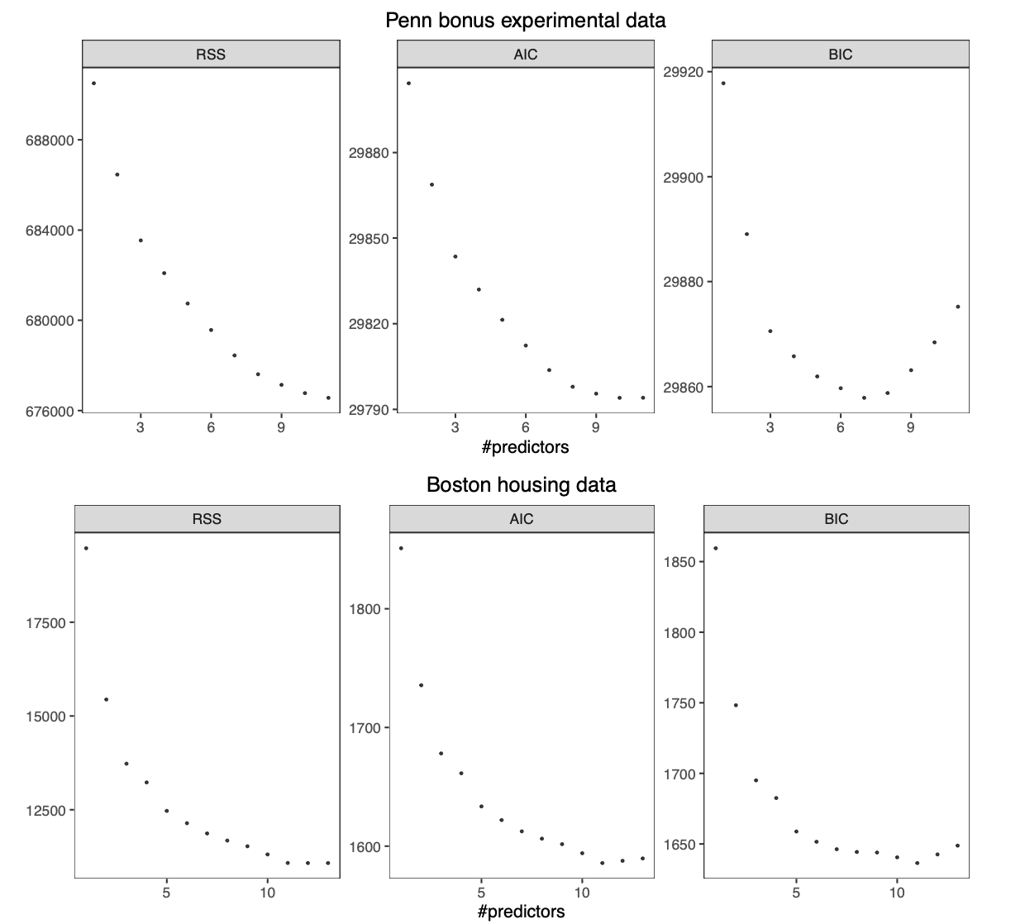
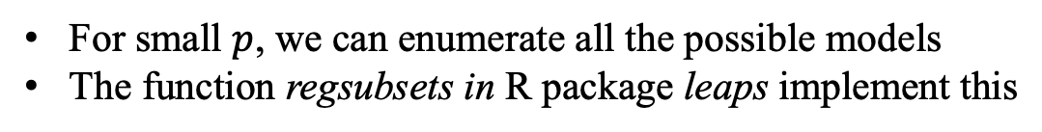
Best subset
For small $p$, we can enumerate all the possible models
The function regsubsets in R package leaps implement this

Slide 18
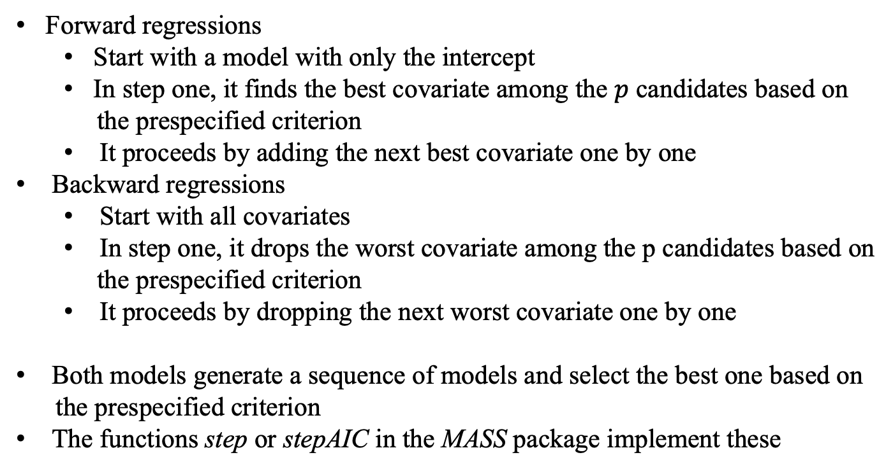
Forward/backward selection
Forward regressions
Start with a model with only the intercept
In step one, it finds the best covariate among the $p$ candidates based on
the prespecified criterion
It proceeds by adding the next best covariate one by one
Backward regressions
Start with all covariates
In step one, it drops the worst covariate among the p candidates based on
the prespecified criterion
It proceeds by dropping the next worst covariate one by one
Both models generate a sequence of models and select the best one based on
the prespecified criterion
The functions step or stepAIC in the MASS package implement these
Notes:
Forward regression works in the case with p ≥ n but it stops at step n − 1; backward regression works only in the case with p < n.

