Slide 1
Transformation
蒋智超
2022年 秋

Slide 2
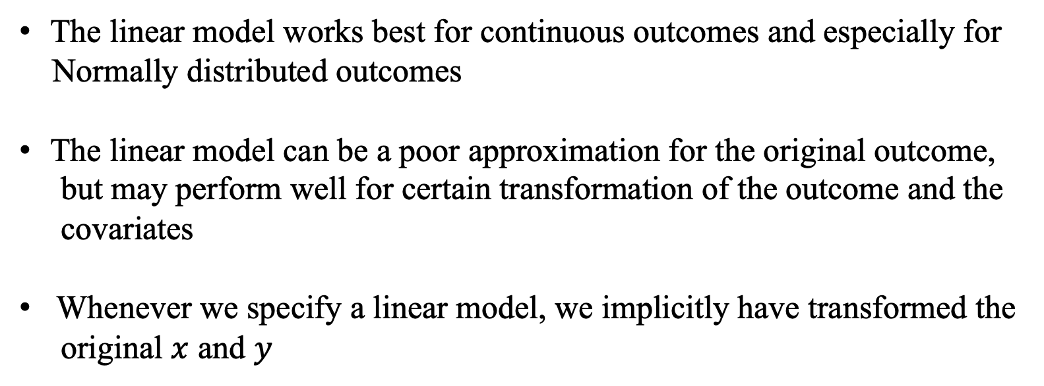
Transformation
The linear model works best for continuous outcomes and especially for
Normally distributed outcomes
The linear model can be a poor approximation for the original outcome,
but may perform well for certain transformation of the outcome and the
covariates
Whenever we specify a linear model, we implicitly have transformed the
original $x$ and $y$
Notes:
Carroll and Ruppert (1988) is a textbook on this topic

Slide 3

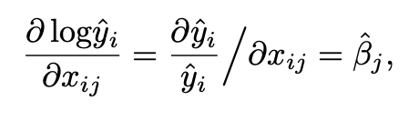

Transformation of the outcome
With positive, especially heavy-tailed outcomes, a standard transformation is the
log transformation
Interpretation: if $x_{ij}$ increases by one unit, then the proportion increase in the fitted
outcome is ${\hat{β}}_{j}$, controlling for other variables
Notes:
In economics, βˆj is the semi-elasticity of y on xj in the model with log transformation on the outcome.

Slide 4
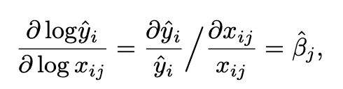

Log transformation
Sometimes, we may apply the log transformation on both the outcome and a certain covariate
Interpretation: if $x_{ij}$ increases by 1%, then the fitted outcome will increase by ${\hat{β}}_{j}$%,
controlling for other variables
The log transformation only work for positive variables. For a nonnegative outcome, we can
modify the log transformation to $log⁡(y_{i}+1)$
Notes:
In economics, βˆj is the xj-elasticity of y in the model with log transformation on both the outcome and xj.

Slide 5
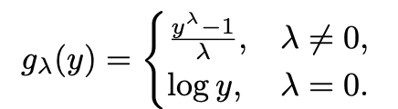
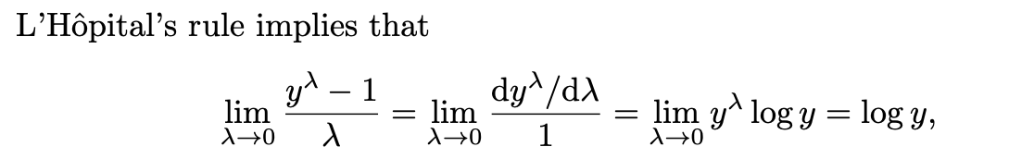

Box-Cox transformation
Box-Cox transformation unifies the log transformation and the power transformation
$g_{λ}(y)$ is continuous at $λ=0$
Can we choose $λ$ based on data?

Slide 6
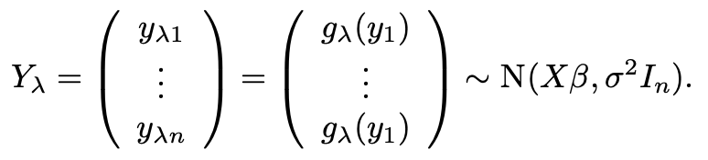
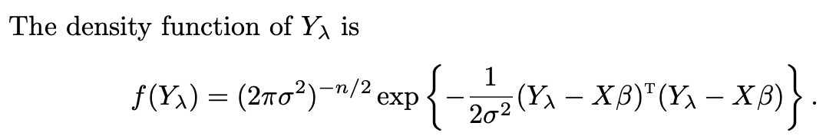


Estimating $λ$
Box and Cox (1964) proposed a strategy based on the maximum likelihood under
the Normal linear model
$$n$$

Slide 7
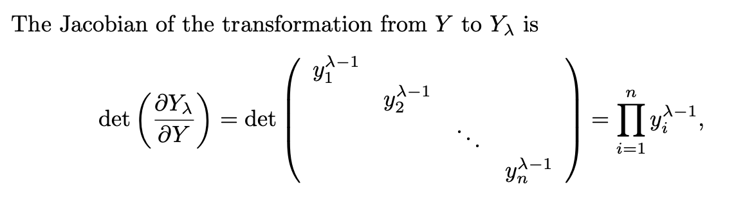
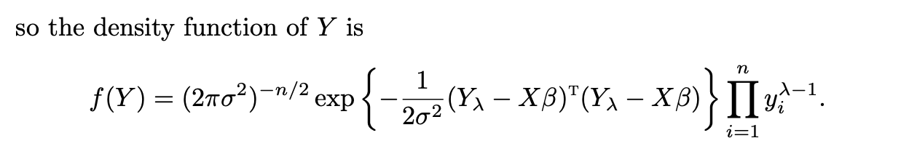
Estimating $λ$
We can treat this as the likelihood function, defined as $L(β,σ^{2},λ)$

Slide 8


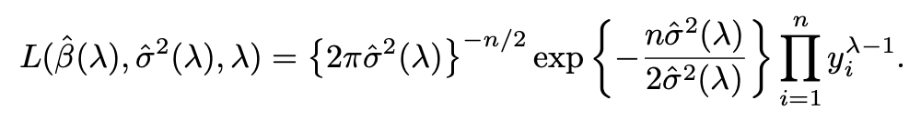
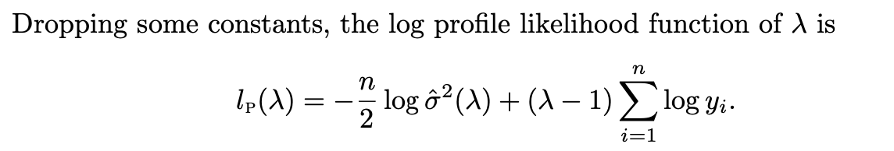

Estimating $λ$
Profile MLE
Given $λ$, maximizing the likelihood to obtain and
Maximize the profile likelihood as a function of $λ$
The boxcox function in the MASS package plots $l_{p}(λ)$, find its maximizer and
construct a 95% confidence interval

Slide 9
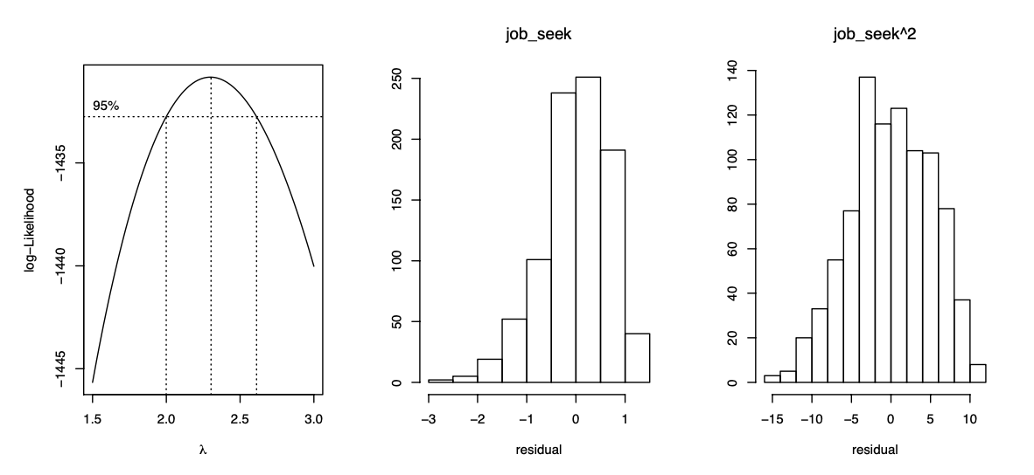
Jobs data analysis

Slide 10



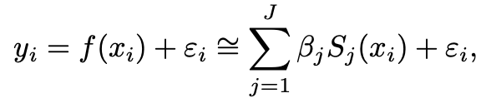
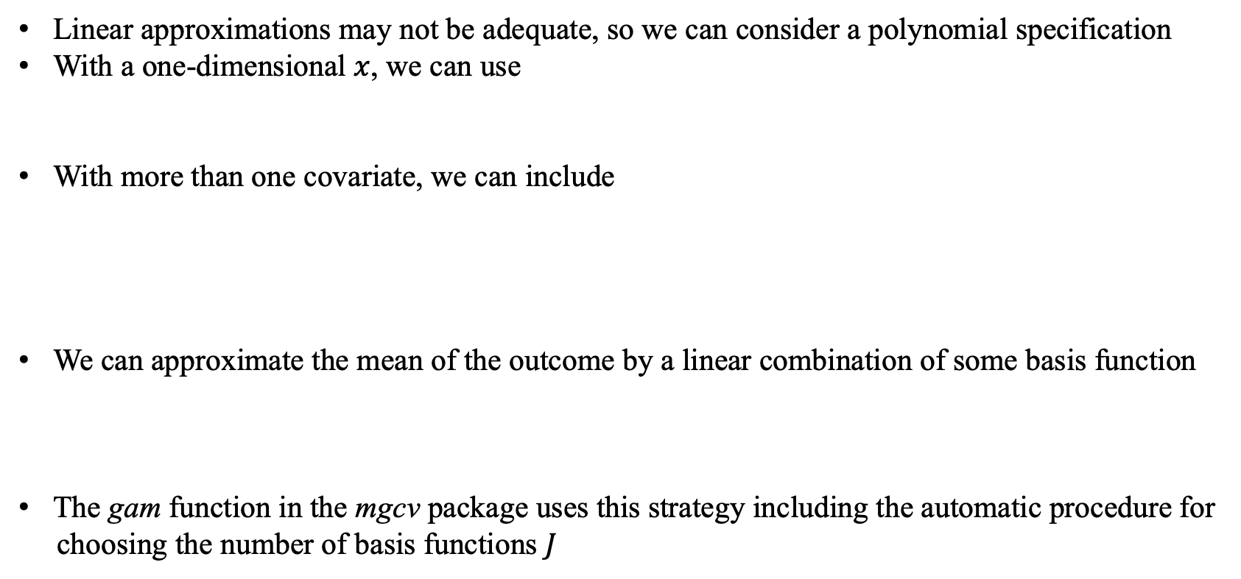
Transformation of the covariates
Linear approximations may not be adequate, so we can consider a polynomial specification
With a one-dimensional $x$, we can use
With more than one covariate, we can include
We can approximate the mean of the outcome by a linear combination of some basis function
The gam function in the mgcv package uses this strategy including the automatic procedure for
choosing the number of basis functions $J$
or
Notes:
In economics, it is almost the default choice to include the quadratic term of working experience in the log wage equation.

Slide 11
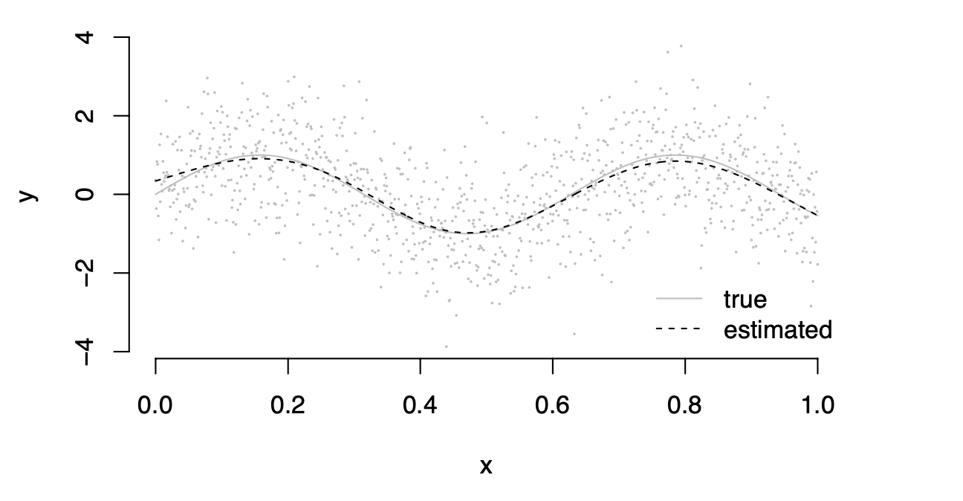
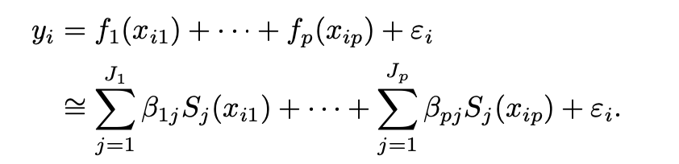
Example
True function is a sine function
The generalized additive model is an extension to the multivariate case

Slide 12
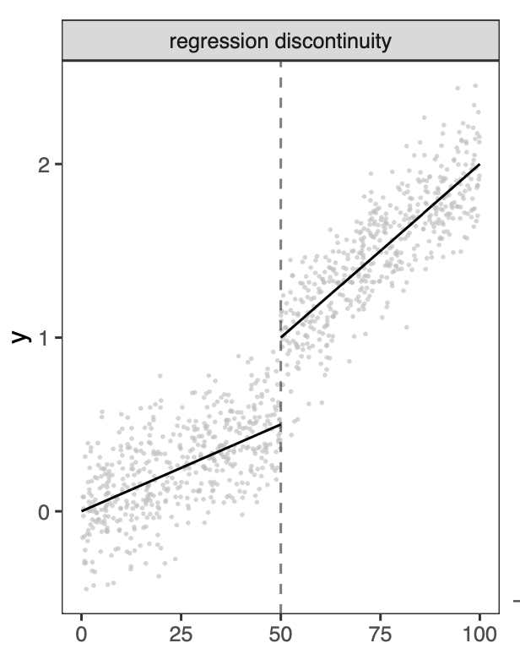
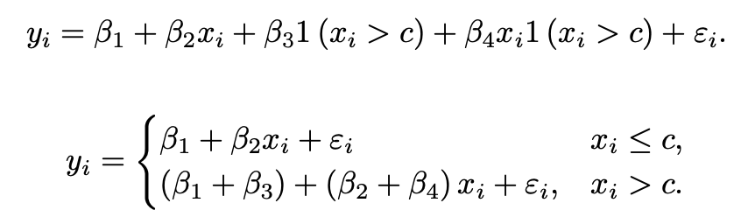

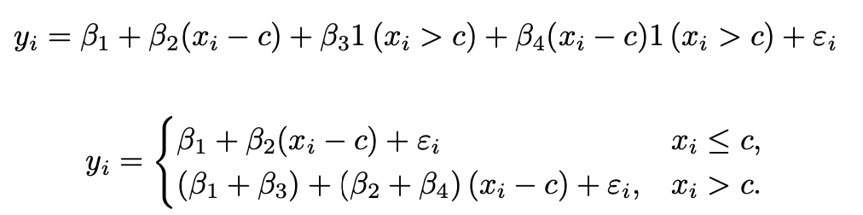

Regression discontinuity
If we center the covariates at $c$

Slide 13
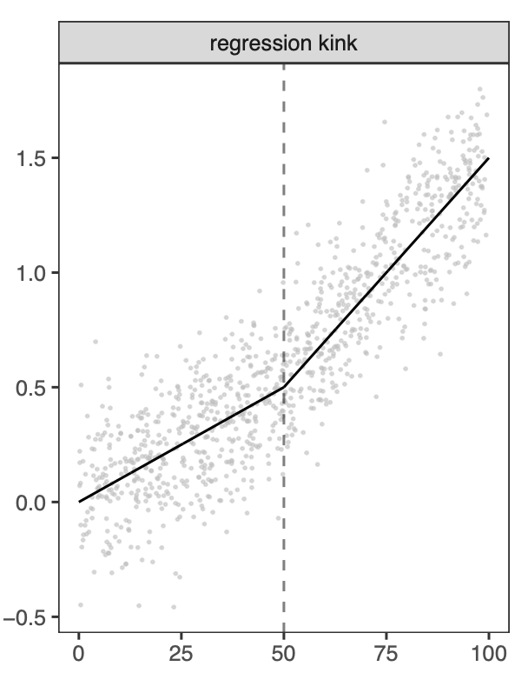
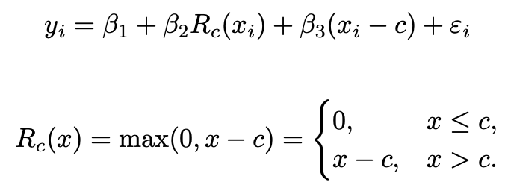
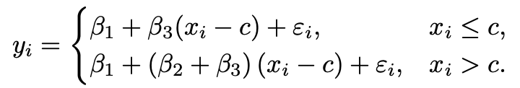
Regression kink
Notes:
more discussions in Angrist and Pischke (2008) and Card et al. (2015).

