Slide 1
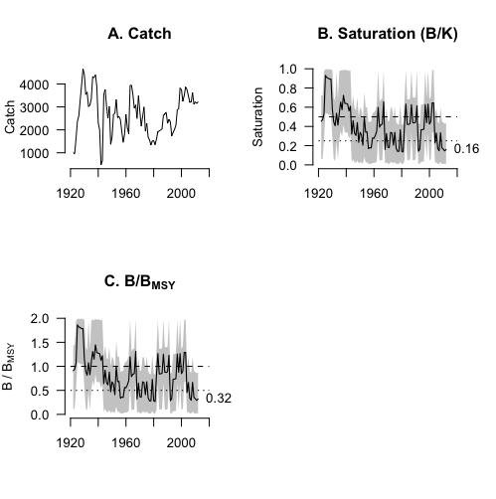
zBRT model
Inputs:
Year – time series of years
Catch – time series of catch
Outputs:
A data frame containing time series of years, catch, saturation, and B/B_{MSY} estimates. Saturation values are provided for the S8- and S38-predictor models and the final saturation estimate is the mean of these two estimates. B/B_{MSY} = 2 * saturation. 95% confidence intervals for saturation, and thus for B/B_{MSY}, are derived using the skew normal distribution described in Zhou et al. (2017) and used in OCOM.
Tiger flathead
(Neoplatycephalus richardsoni)
SE Australia 1915-2012

Slide 2
OCOM
Inputs:
Year – time series of years
Catch – time series of catch
M - natural morality estimate (1/yr)
Outputs:
A list containing the following:
A data frame of biomass time series (with confidence intervals)
A data frame of saturation time series (with confidence intervals)
A data frame of B/BMSY time series (with confidence intervals)
1000 randomly selected biomass trajectories
1000 corresponding saturation trajectories
1000 corresponding B/BMSY trajectories
Estimates of biological quantities: r, K, MSY, S (with confidence intervals)
10000 draws underpinning these values

Slide 3
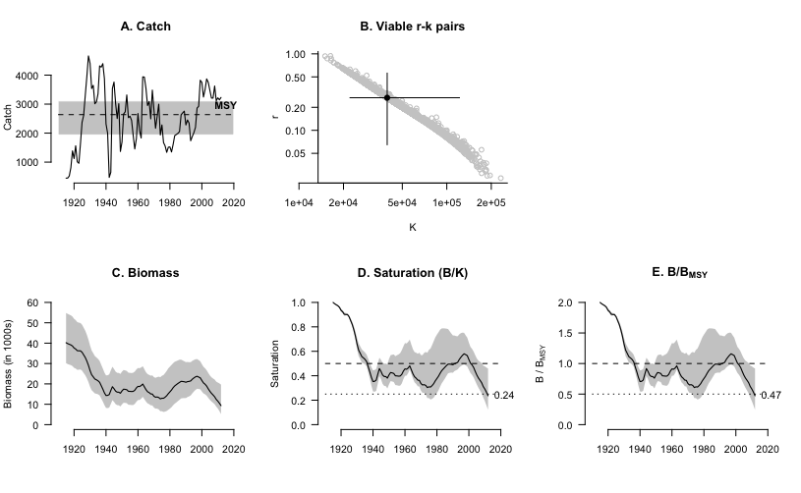
OCOM plots
Tiger flathead
(Neoplatycephalus richardsoni)
SE Australia 1915-2012

Slide 4
cMSY
Inputs:
Required inputs
Year – time series of years
Catch – time series of catch
Resilience -
r.low/hi -
Optional inputs
Stb.low/hi
Int.yr
Intb.low/hi –
Endb.low/hi –
q.Start –
q.End –
Verbose -
Outputs:
A list containing the following elements:
ref_pts - A dataframe with biological quantity / reference point estimates with 95% confidence intervals;
ref_ts - A dataframe with B/BMSY and reference point time series with 95% confidence intervals;
priors - A dataframe with the priors used in the cMSY analysis;
rv.all - A vector with the viable r values;
kv.all - A vector with the viable k values;
btv.all - A dataframe with the biomass trajectories produced by the viable r/K pairs.

Slide 5
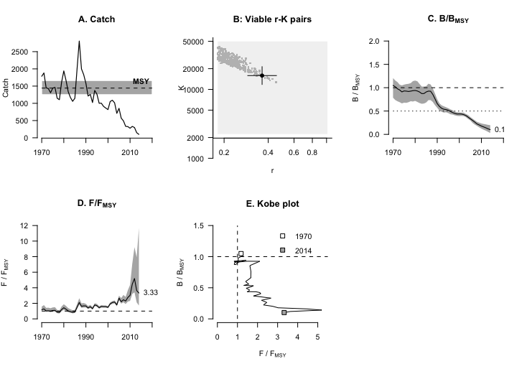
cMSY plots
Common sole (Solea solea)
Irish Sea 1970-2014

Slide 6
BSM
Inputs:
Required inputs
Year – time series of years
Catch – time series of catch
Resilience -
r.low/hi -
Optional inputs
Stb.low/hi
Int.yr
Intb.low/hi –
Endb.low/hi –
q.Start –
q.End –
Verbose -
Outputs:
A list containing the following elements:
ref_pts - A dataframe with biological quantity / reference point estimates with 95% confidence intervals;
ref_ts - A dataframe with B/BMSY and reference point time series with 95% confidence intervals;
priors - A dataframe with the priors used in the cMSY analysis;
rv.all - A vector with the viable r values;
kv.all - A vector with the viable k values;
btv.all - A dataframe with the biomass trajectories produced by the viable r/K pairs.

Slide 7
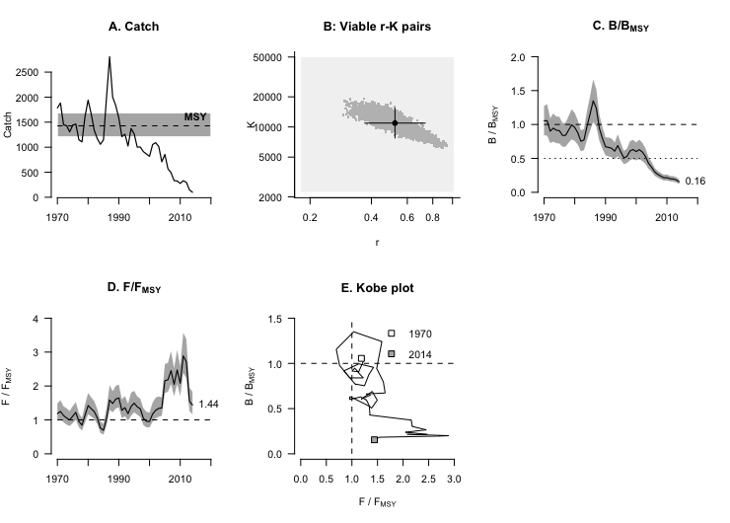
BSM plots
Common sole (Solea solea)
Irish Sea 1970-2014

