Slide 1


Securing Windows Active Directory
Additional Content

Slide 2
Windows Hello for Business

Slide 3
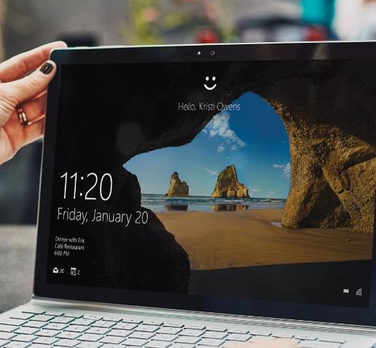
Windows Hello for Business
User Friendly
Passwordless biometrics or PIN
SSO for on-premises and the cloud
Enterprise Grade
Asymmetric key pair authentication model
Strong two-factor authentication
Multiple accounts per device
Deploy in the cloud, hybrid, or on-prem
Notes:
Slides Notes
Currently Windows 10 only supports up to 10 Windows Hello for Business users per device
PIN always must be set even if the customer is using biometrics
If customer questions this make note of that any device (iPhone, Android) ask users to create a PIN to go along with biometric authentication as a backup method
In case the device has a driver issue or the user has something preventing biometric reading, PIN is required so that the user is able to log into their device, and a PIN will still be better than a fallback to password (covered in the deep dive)
It is possible to configure multi-factor unlock, which may require both biometrics and PIN

Slide 4
Windows Hello for Business
Replace Passwords with Keys
Unlocked through a user gesture of biometrics or PIN
FIDO2 Certified
Can leverage enterprise PKI for certificates
Private Key is Never Shared
Keys are always generated in hardware by Trusted Platform Module [TPM]
Hardware bound keys are attested by Trusted Computing Group Protocols
Notes:
Slide Notes
Covered further in deep dive, but TPM anti-hammering is 32 failed PIN attempts will lock the TPM for 2 hours, and then a subsequent failed attempt locks the TPM again for another 2 hours, this pattern continues until successful logon.
Windows Hello for Business is a FIDO2 certified provider, if customers have questions relative to the “uniqueness” compared to FIDO2 keys, or regarding the security of Windows Hello for Business.
If customers deploy certificate trust models for on-premises, note that WHfB still uses the raw key pair for Azure AD authentication.

Slide 5
Windows Hello for Business Adoption
10 Million Monthly active Windows Hello for Business users
50K+ Enterprises have deployed Windows Hello for Business
>450K
Largest single enterprise deployment
Statistics, June 2022
Notes:
Slide Notes
As of October 2020 we are seeing an adoption rate of Windows Hello for Business monthly at about 300,000 new monthly active users
The numbers above are specific to Windows Hello for Business, and contain no “consumer Windows Hello” metrics

Slide 6





Windows Hello for Business Deployment Scenarios
Cloud
Hybrid
On-Premises
Cert Trust
Cert Trust
Key Trust
Key Trust
Key Trust
Cloud Trust
(Preview)
Microsoft Confidential
Notes:
Slide Notes
Discuss with customer the deployment scenarios available
Customers can go with a mixed cert trust/key trust model for hybrid
Customers can go with a mixed key trust/cloud trust model for hybrid
Cloud and cert trust cannot be mixed
The following scenarios aren't supported using Windows Hello for Business cloud trust:
On-premises only deployments
RDP/VDI scenarios using supplied credentials (RDP/VDI can be used with Remote Credential Guard or if a certificate is enrolled into the Windows Hello for Business container)
Scenarios that require a certificate for authentication
Using cloud trust for "Run as"
Signing in with cloud trust on a Hybrid Azure AD joined device without previously signing in with DC connectivity
If customer has Azure AD connected to Active Directory, they cannot choose an on-premises model (PG not supported)
Customers could choose to go with a Cloud Cert Trust model, however note that Azure AD will still only leverage the raw key trust, and the certificates are only there to be leveraged by the customers infrastructure (Wifi, VPN, other cert based authentication mechanisms, etc)

Slide 7
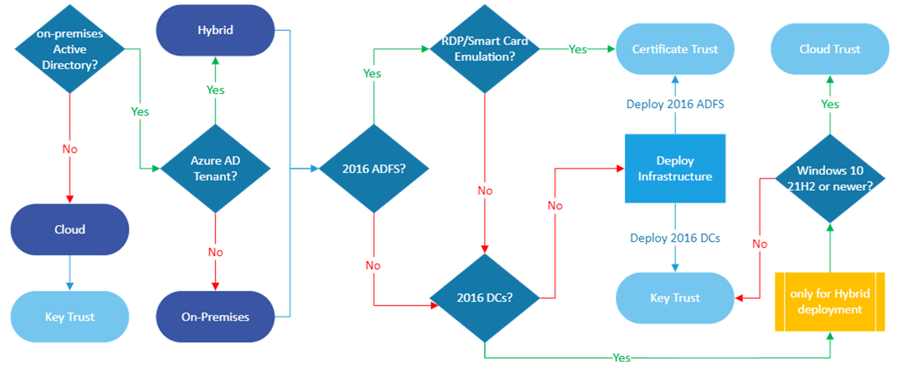
WH4B - Choosing a Deployment Model

Slide 8
Key, Certificate and Cloud Trust: Security Comparison
Cloud
Hybrid
Authenticates using raw key to Azure AD
Authenticates using raw key to Active Directory
Does not require issuance of end user certificate from PKI
Requires 2016 or later Domain Controllers
Key Trust
Authenticates using raw key to Azure AD
Authenticates using PKI user cert to Active Directory
Requires issuance of end user certificate from PKI
Requires 2012 or later Domain Controllers
Cert Trust
Authenticates using raw key to Azure AD
Authenticates using TGT issued from Azure AD Kerberos to Active Directory
Does not require issuance of any certificate
Requires 2016 or later Domain Controllers
Cloud Trust
Cert Trust
All trusts use asymmetric key pairs
All trusts use the same TPM hardware
All trusts require the same strong proof-up [MFA] for enrollment
Key Trust
Key Trust
Microsoft Confidential

Slide 9



Hybrid Cloud Trust Components (Preview)
CLIENT
DIRECTORY
INFRASTRUCTURE
MANAGEMENT
Windows 10 Windows 11
Active Directory Domain Services
Azure Active Directory
Azure Active Directory Connect
NDES Role
Active Directory Federation Services
Multi-factor Auth
Group Policy
Certificate Registration Authority for MDM
Windows 10 21H2 or later
Windows 11
Server 2016 or later
2008 R2 DFL/FFL or later
Azure AD Kerberos PowerShell module
Device Registration
Optional
Optional:
AD FS 2016 or later
Needed for 3rd party MFA provider
Azure MFA
or
3rd party MFA provider
WHFB Config
NDES Role
MDM
Certificate Registration Authority for MDM
Optional:
WHFB Config
Notes:
Windows Hello for Business cloud trust is recommended instead of key trust if you meet the prerequisites to deploy cloud trust. Cloud trust is the preferred deployment model if you do not need to support certificate authentication scenarios.

Slide 10
Hybrid Key Trust Components
CLIENT
DIRECTORY
INFRASTRUCTURE
MANAGEMENT
Windows 10
Active Directory Domain Services
Azure Active Directory
Azure Active Directory Connect
Active Directory Certificate Services
Active Directory Federation Services
Multi-factor Auth
Group Policy
Server 2016 or later
2008 R2 DFL/FFL or later
Device Registration
Key Registration
Directory Synchronization with write-back (ADP)
AD CS 2012 or later
KDC Certificate
Optional:
AD FS 2016 or later
Needed for 3rd party MFA provider
Azure MFA
or
3rd party MFA provider
Autoenrollment
Intranet Zone
WHFB Config
NDES Role
MDM
Certificate Registration Authority for MDM
Optional:
WHFB Config
Notes:
Note that if customers have ADFS in their environment, they can still choose to go with a Hybrid Key Trust model, and they do not have to go with certificates, as long as they meet the Active Directory requirements
Prerequisites:
Windows 10, the currently minimum supported version, (1809 version has limitations for non-destructive PIN reset, we recommend customers use 1903 or higher to be able to use non-destructive PIN reset).
At least one domain controller working under Windows 2016 accessible for pilot group of machines.
Windows 2008 R2 forest functional level or higher.
Certificate Authority server (minimum version 2012).
Azure AD Connect configured to sync user accounts to Azure AD.
TPM 2.0 strongly recommended for Windows Hello deployment in production environment.
Azure MFA or third-party MFA with ADFS adapter compatible with Windows Server 2016 ADFS.
Optional: Devices for biometric authentication (camera with infrared sensor, fingerprint scanner).

Slide 11
Hybrid Certificate Trust Components
CLIENT
DIRECTORY
INFRASTRUCTURE
MANAGEMENT
Windows 10
Active Directory Domain Services
Azure Active Directory
Azure Active Directory Connect
Active Directory Certificate Services
Active Directory Federation Services
Multi-factor Auth
Group Policy
Server 2012 or later
2008 R2 DFL/FFL or later
Device Registration
Key Registration
Directory Synchronization with write-back (ADP)
AD CS 2012 or later
KDC, Enrollment, and User Certificate
AD FS 2016 or later
Registration Authority
MFA
Azure MFA
or
3rd party MFA provider
Autoenrollment
Intranet Zone
WHFB Config
NDES Role
MDM
Optional:
MDM Certificate Registration Authority
Optional:
WHFB Config
Notes:
Prerequisites:
Windows 10 image, minimum version 1703 (1809 or higher version recommended to be able to use biometrics for RDP sign-in).
ADFS farm behaviour level: Windows Server 2016.
Active Directory Schema version: Windows 2016.
Windows 2008 R2 forest functional level or higher.
Azure MFA or third-party MFA with ADFS adapter compatible with Windows Server 2016 ADFS.
AD Connect configured to sync user accounts to Azure AD.
Certificate Authority server (minimum version 2012 R2) or prepare new server to deploy certificate authority:
TPM 2.0 strongly recommended for Windows Hello deployment in production environment.
Optional: Devices for biometric authentication (camera with infrared sensor, fingerprint scanner).

Slide 12
WH4B – Trust Types (Hybrid)
 | Cloud Trust | Key Trust | Certificate Trust
AuthN factor to Azure AD | Keys | Keys | Keys
AuthN factor to AD DS | Kerberos | Keys | Certificate
Domain controller min version | Win Svr 2016 + KB3534307 Win Svr 2019 + KB4534321 | Server 2016 | Server 2012 R2
Client min version | Win 10 21H2 + KB5010415 Win 11 21H2 + KB5010414
DFL/FFL min version | Server 2008 R2 | Server 2008 R2 | Server 2008 R2
DC cert requirement | No | Yes* | Yes*
Client cert requirement | No | No | Yes
AD DS Schema min version | Server 2016 | Server 2016 | Server 2016
Authentication Type Support | Federated and Managed (PHS / PTA) | Federated and Managed (PHS / PTA) | Federated only
AD FS Required | No | No | Yes (Server 2016+)
Device Writeback Required | No | No | Yes

Slide 13
Enterprise Access Model

Slide 14
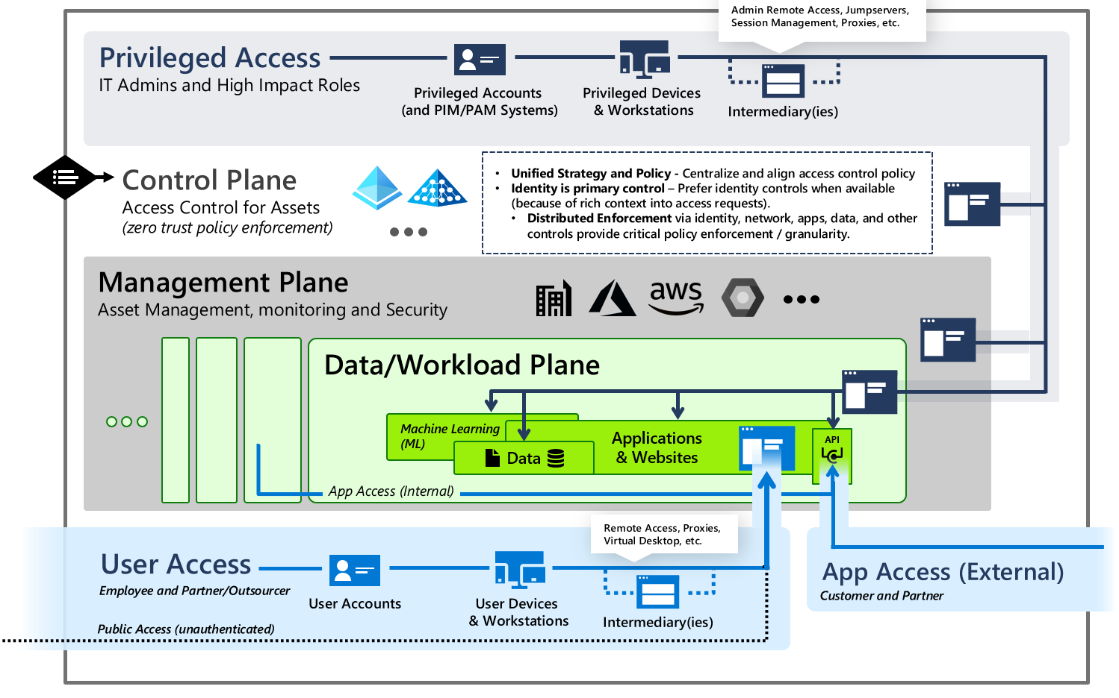
Enterprise Access Model
Incorporates on-premises tiering with cloud services
Tier 0 expanded to control plane – Access Control
Tier 1 split
Management plane – IT management
Data/Workload plane – per-workload management
Tier 2 split
User access – internal users + collaboration (B2B / B2C)
App access – API access

Slide 15
Privileged Access Management Optional Feature
Windows Server 2016 FFL

Slide 16
Time-limited Group Memberships
Users can be added to a security group with time-to-live (TTL)
When the TTL expires, the user’s membership in that group disappears
Kerberos token lifetime will be determined by TTL of the user’s memberships
TGT based on shortest group membership
Service ticket based on TGT and resource local domain group membership
Member: <TTL,user-DN>
Group
User
TGT: Shortest group
lifetime
ST: Shortest of TGT and resource local domain group

Slide 17
Just In Time Forest
Existing
Forest
JIT
Forest
Create new Server 2016 forest
No need to change existing forest
Create new PIM trust to existing forest
Add shadow principals in new forest
Shadow group which is new object class created in config NC. Unlike security group, the security identifier (SID) with a domain in another forest
Add shadow admin user
Remove admins from existing groups
PIM Forest Trust
PIM

Slide 18
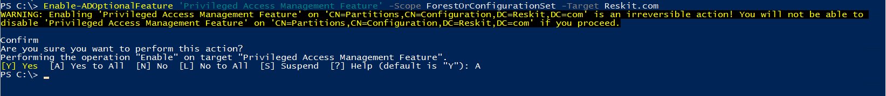
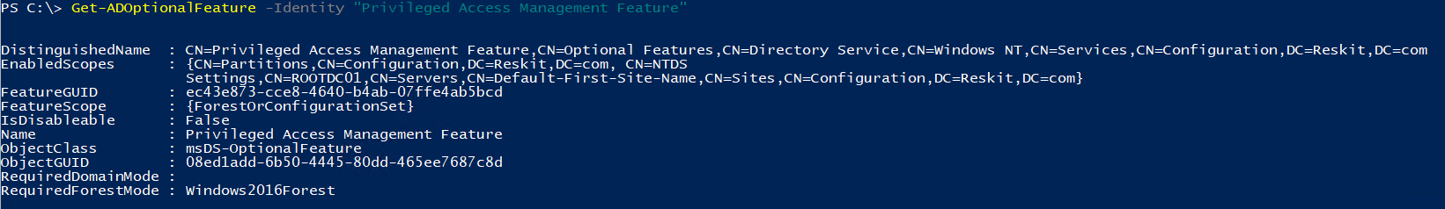
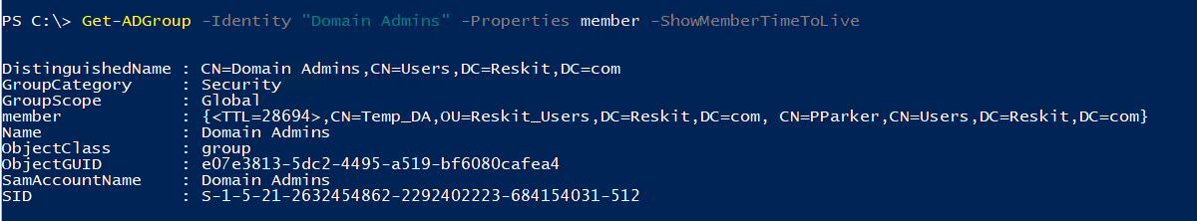

Slide 19
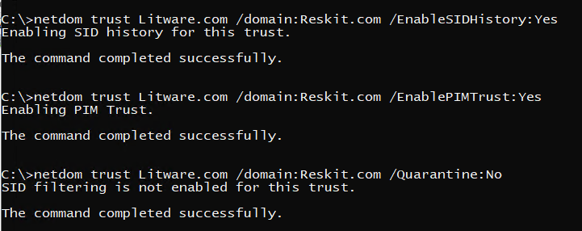

Slide 20
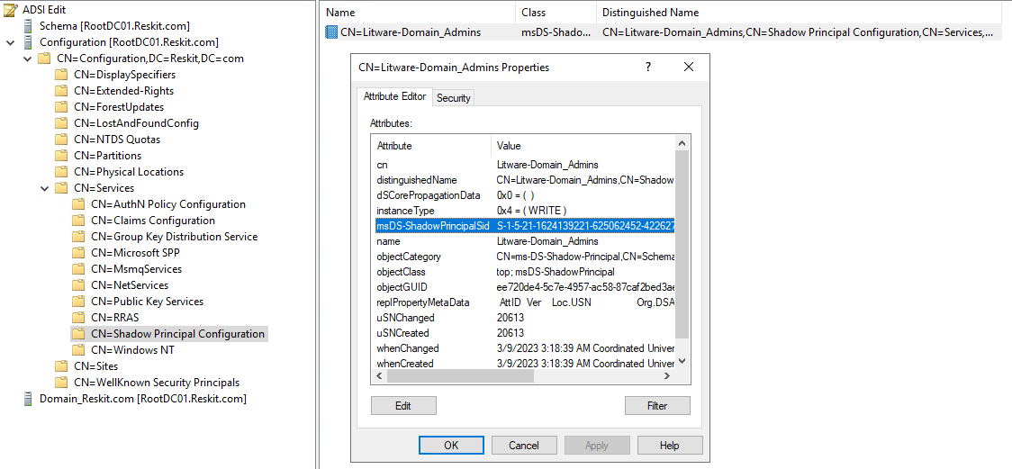
$LitwareDomainAdminsSID = (Get-ADGroup -Identity "Domain Admins" -Properties ObjectSID -Server RootDC02.Litware.com).ObjectSID.Value
New-ADObject -Type "msDS-ShadowPrincipal" `
-Name "Litware-Domain_Admins" `
-Path "CN=Shadow Principal Configuration,CN=Services,CN=Configuration,DC=Reskit,DC=com" `
-OtherAttributes @{'msDS-ShadowPrincipalSid'= $LitwareDomainAdminsSID}

Slide 21
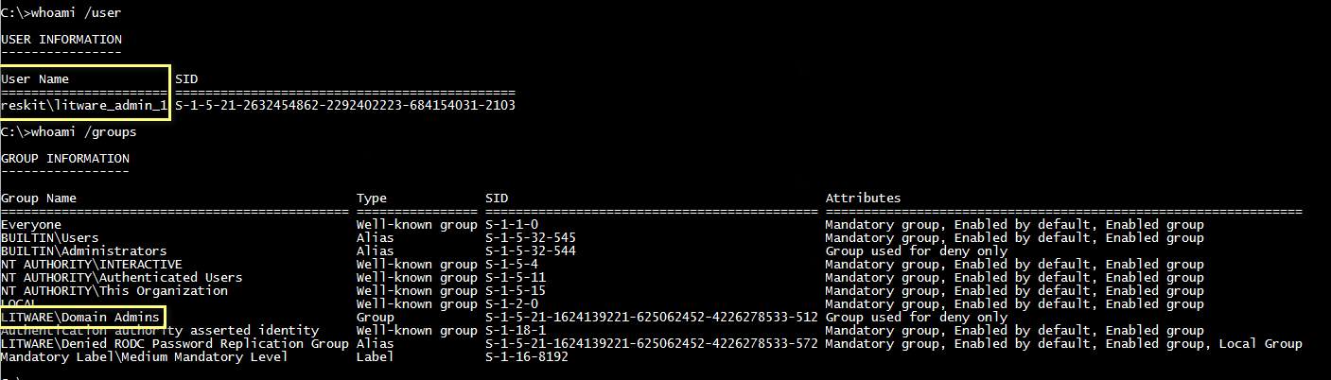
Set-ADObject -Identity "CN=Litware-Domain_Admins,CN=Shadow Principal Configuration,CN=Services,CN=Configuration,DC=Reskit,DC=com" `
-Add @{'member'="<TTL=3600,CN=Litware_Admin_1,OU=Reskit-Admins,DC=Reskit,DC=com>"}

Slide 22
