Slide 1
Kerberos Primer
Key Exchange, Delegation, Attacks and Mitigations

Slide 2
Kerberos Entities
Client
Kerberos Key Distribution Center (KDC)
Server

Slide 3
Kerberos Exchanges
Authentication Service (AS) exchange
Ticket-Granting Service (TGS) exchange
Authentication Protocol (AP) exchange

Slide 4
Kerberos Exchanges and Entities
Authentication Service (AS) exchange
Client <-> KDC
Ticket-Granting Service (TGS) exchange
Client <-> KDC
Authentication Protocol (AP) exchange
Client <-> Server

Slide 5
Kerberos Exchanges - Purpose
Authentication Service (AS) exchange
Client <-> KDC
Authentication of client to KDC
Ticket-Granting Service (TGS) exchange
Client <-> KDC
Service ticket from KDC for access to server
Authentication Protocol (AP) exchange
Client <-> Server
Authentication to server using service ticket

Slide 6
Authentication Service (AS) exchange
Request – client sends:
UPN
(Timestamp) encrypted with user pwd hash - Pre-authentication data
Response – KDC sends
(TGT) encrypted with krbtgt pwd hash
(Session key-c) encrypted with user pwd hash

Slide 7
Kerberoasting (var. AS-REP Roasting)
(Session key-c) encrypted with user pwd hash can be subject to brute-force attack
Successful cracking reveals user pwd
Attack mitigated by requiring pre-authentication data
Requestor must prove knowledge of password

Slide 8

Kerberoasting – making it easier
User account configured to “Do not require Kerberos preauthentication”
Attacker can make AS request without pre-authentication data
No proof of password knowledge provided.

Slide 9
UserAccountControl Flags to Monitor
Description | UserAccountControl Value | Property Flag | Risk
Unconstrained Delegation | 524288 | TRUSTED_FOR_DELEGATION | High
Constrained Delegation (S4U2S) | 16777216 | TRUSTED_TO_AUTH_FOR_DELEGATION | Low
Password Never Expires | 65536 | DONT_EXPIRE_PASSWORD | High
Store Pwd Using Reversible Encryption | 128 | ENCRYPTED_TEXT_PWD_ALLOWED | High
Account is Sensitive and Cannot Be Delegated | 1048576 | NOT_DELEGATED | Low
Use Only Kerberos DES Encryption Types for This Account | 2097152 | USE_DES_KEY_ONLY | High
Do Not Require Kerberos PreAuthentication | 4194304 | DONT_REQ_PREAUTH | High
Service Accounts AT RISK! |  | DONT_EXPIRE_PASSWORD + DONT_REQ_PREAUTH | High

Slide 10
Ticket-Granting Service (TGS) exchange
Request – client sends:
SPN of service
(TGT) encrypted with krbtgt pwd hash
(UPN + timestamp) encrypted with Session key
Response – KDC sends:
(Service ticket) encrypted with server/svc account pwd hash
(Session key-s) encrypted with Session key-c

Slide 11
Kerberoasting (var. TGS-REP Roasting)
(Service ticket) encrypted with server/svc account pwd hash can be subject to brute-force attack
Successful cracking reveals server/svc account pwd

Slide 12

Kerberoasting – making it easier
Service accounts configured with “Password never expires”
Indefinite time to brute-force
Svc account passwords just meets domain pwd policy
Easier to crack 8-character password than 25-character password

Slide 13

Kerberoasting – making it easier
Svc accounts configured with “Use only Kerberos DES encryption types for this account”
Encryption uses DES algorithm instead of default RC4 for user accounts and AES for machine accounts
Orders of magnitude easier

Slide 14

Kerberoasting – making it harder
Set passwords of 25 characters or more for service accounts
Periodically reset service account passwords
Set service accounts to use AES
Use Group Managed Service Accounts when possible

Slide 15
Authentication Protocol (AP) exchange
Request
Service ticket
Authenticator encrypted with Session key-s
Response
Authenticator encrypted with Session key-s

Slide 16
The Need for Kerberos Delegation
Three entities:
User
Front-end service (IIS web service) or service account (worker process)
Back-end service (SQL server instance) or service account (svc account)
Allows access to back-end resources based on the user connecting to front-end service.
Examples:
Administrator connecting to web server able to view all tables in a SQL database
Regular user only able to view a subset of tables.

Slide 17
The Need for Kerberos Delegation
Allows access to back-end resources based on the user connecting to front-end service
i.e. IIS web server accesses SQL Server based on the user connecting to IIS web server
IIS web server requests KDC for Kerberos service ticket for SQL Server, impersonating user.

Slide 18
Delegation Types
Unconstrained Delegation
Windows 2000+
Constrained Delegation
Windows Server 2003+
Resource-based constrained delegation
Windows Server 2012+

Slide 19
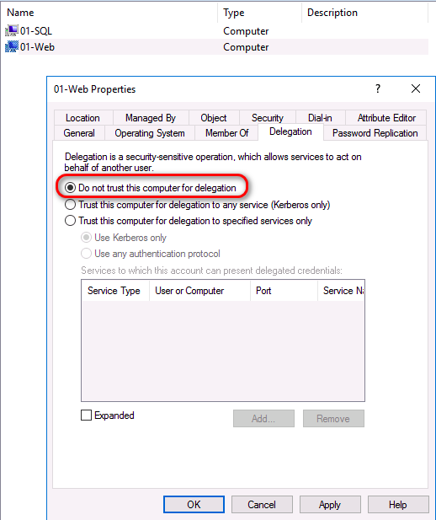
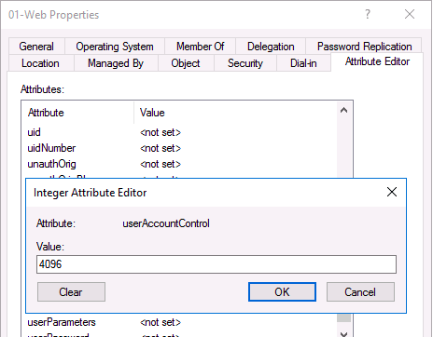
No Delegation

Slide 20
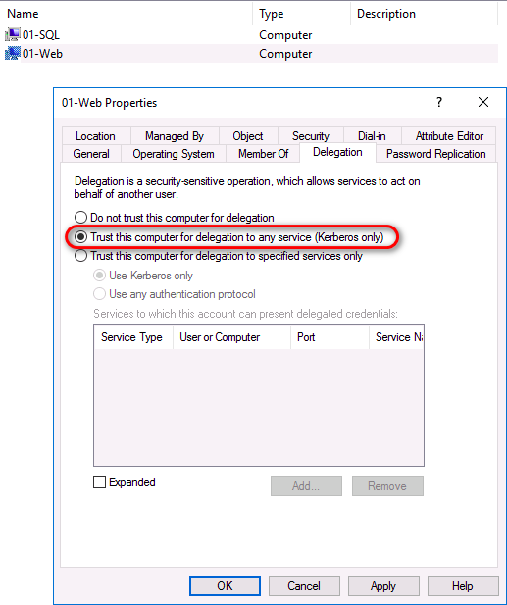
Unconstrained Delegation
Delegation without bounds - front-end server can impersonate any user to any back-end service
userAccountControl: 528384

Slide 21
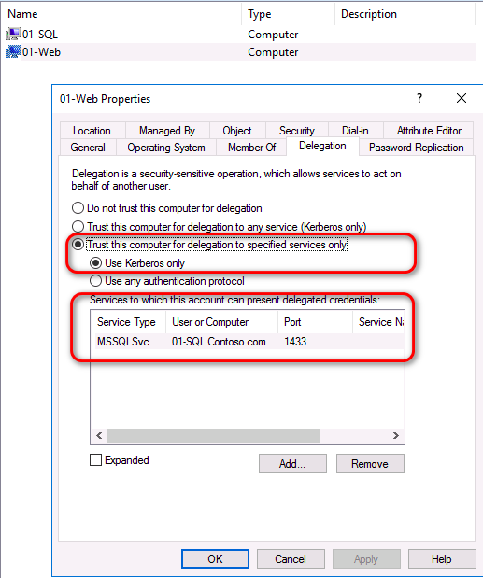
Constrained Delegation
Aka Services for User to Proxy (S4U2P)
Limited delegation starting Windows Server 2003
Domain Admins control which back-end services a front-end service can impersonate to.
userAccountControl: 4096

Slide 22
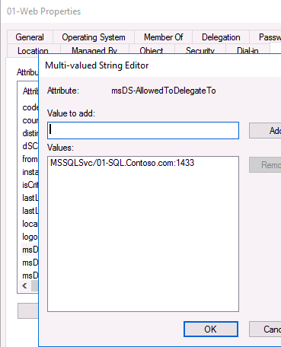
Constrained Delegation
Aka Services for User to Proxy (S4U2P)
Limited delegation starting Windows Server 2003
Domain Admins control which back-end services a front-end service can impersonate to.
userAccountControl: 4096

Slide 23
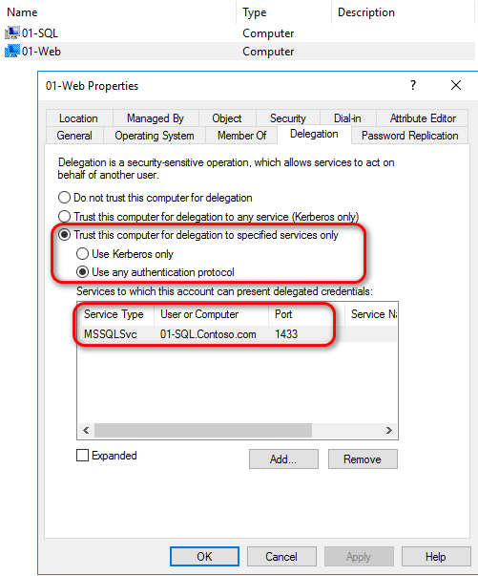
Constrained Delegation w/ Protocol Transition
Aka Services For User to Self (S4U2S)
Provides the ability for a service running on a server to get a Kerberos ticket for an end client, even if the end client did not authenticate using Kerberos.
userAccountControl: 16781312

Slide 24
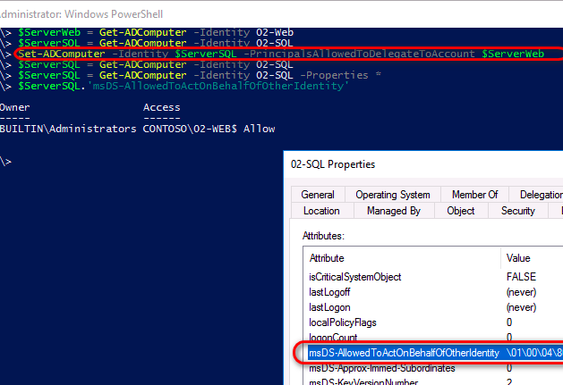
Resource-based constrained delegation
Delegation available beginning Windows Server 2012
Back-end service administrators control which front-end services can impersonate to it.
Cross-domain delegation now supported

Slide 25

Prevent Delegation of Privileged Accounts
Enable Account is sensitive and cannot be delegated for high privileged accounts
Or add as members of Protected Users security group.

