Slide 1
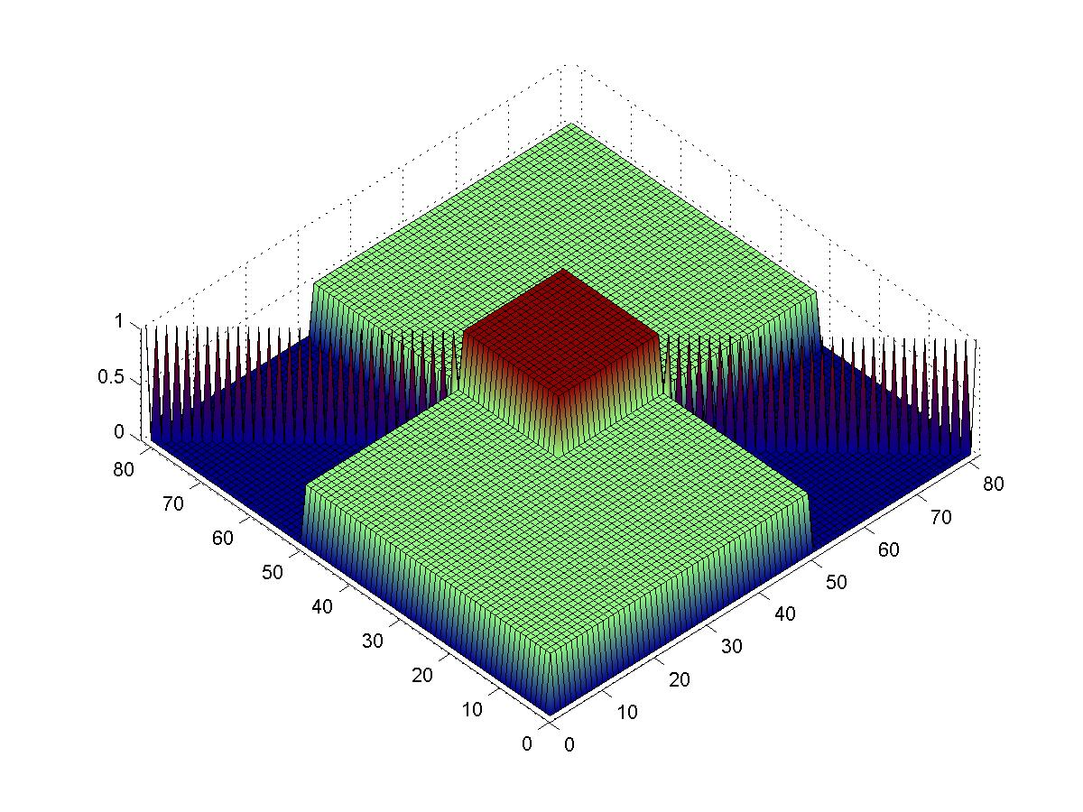
ECE 8443 – Pattern Recognition
LECTURE 15: EXAM NO. 1 (CHAP. 2)
• Spring 2004
Solutions:
1a 1b 1c
2a 2b 2c 2d 2e 2f 2g
• URL: .../publications/courses/ece_8443/lectures/current/exam/2004/

Slide 2
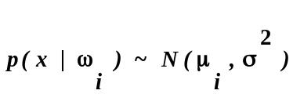
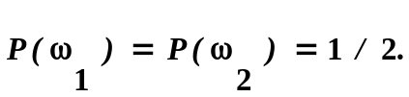
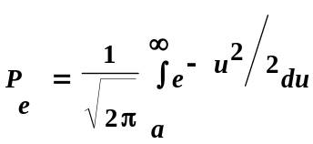

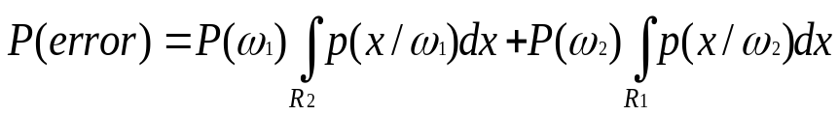



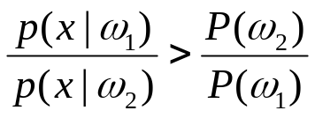
LECTURE 15: EXAM NO. 1 (CHAP. 2)
PROBLEM 1
Problem No. 1: Let for a two-category one-dimensional problem with
Show that the minimum probability of error is
given by: where
Solution:
The probability of error is given by:
--------------------- ( 1 )
Where R1 denotes class region and R2, . To determine R1 and R2 , the decision region must
be determined.
Calculate the decision rule with the Likelihood Ratio : For a two–category problem place in if
the likelihood ratio exceeds a threshold value . Otherwise decide
--------------------- ( 2 )

Slide 3
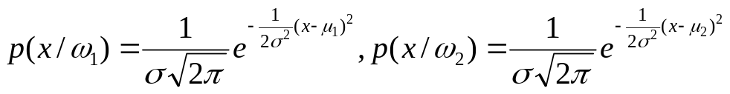
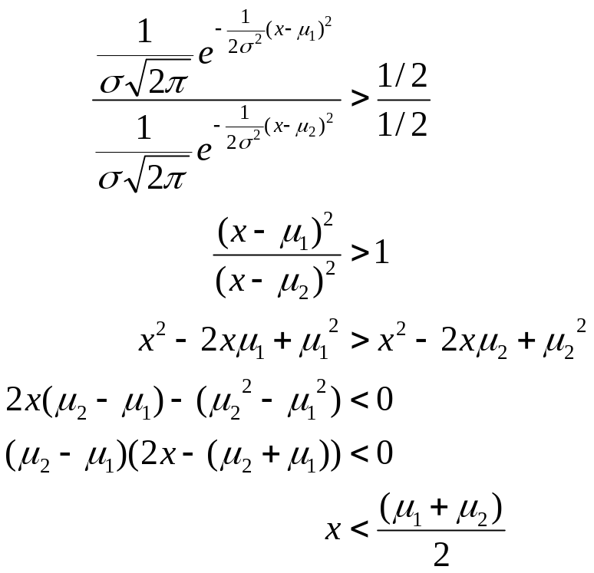
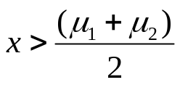
The class conditional densities are
and the Prior probabilities are
For a given feature , the likelihood ratio (1) can be used to determine the decision rule:
,taking log
,changing signs
, decide
Else If
, decide

Slide 4
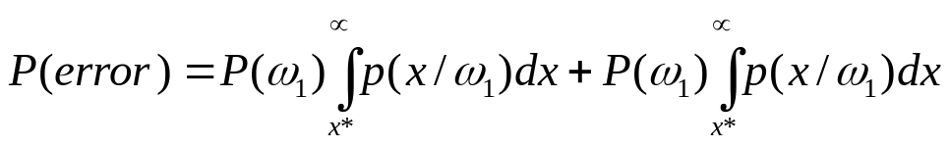
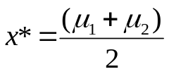
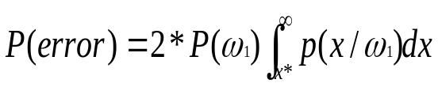
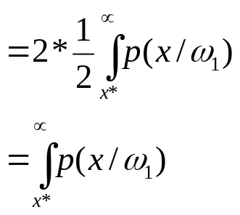
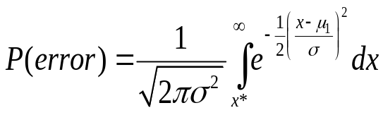

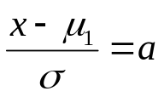

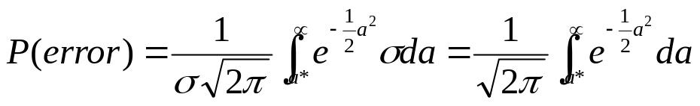
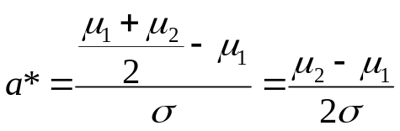
LECTURE 15: EXAM NO. 1 (CHAP. 2)
PROBLEM 1
The decision region is half way between the two means. This result makes sense from an intuitive point of
view since the likelihoods are identical and differ only in their mean value.
Probability of error ( 1 ) becomes:
where ,
Assume ,
Let
then,
Where,

Slide 5
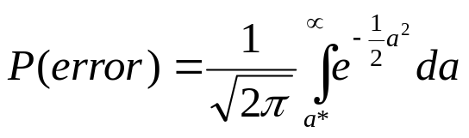
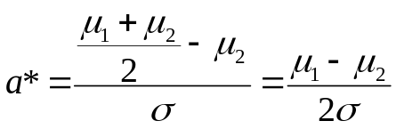
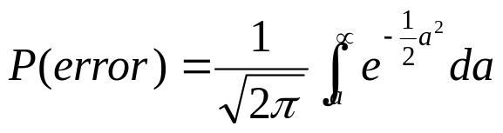
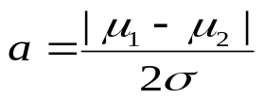
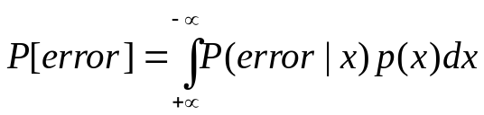
LECTURE 15: EXAM NO. 1 (CHAP. 2)
PROBLEM 1
We get a similar result if μ₂<μ_{1.}
Where,
Combining these two results we get:
Where,
OK. But how to be sure if this is the minimum probability of error?
P[error] in terms of the posterior P[error|x]
The optimal decision rule will minimize P[error|x] for every value of x. At each feature value x,
P[error|x] = P[ω2|x] when ω1 was chosen.
Therefore, when we integrate over the limit, the decision rule yields a minimum P[error] . This probability of
error is the Bayes Error.

Slide 6
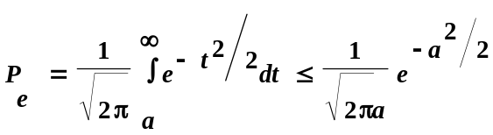


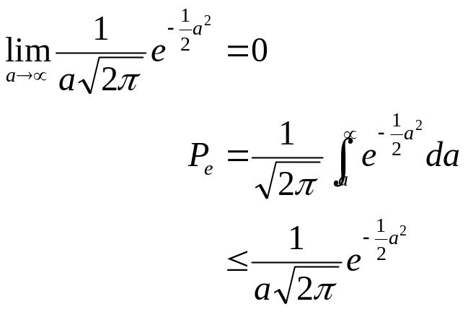

LECTURE 15: EXAM NO. 1 (CHAP. 2)
PROBLEM 1
(b) Use the inequality to show that P_{e} goes to zero as
goes to infinity.
Solution:
and
as the distance between the means of the two distribution
tend to infinity.

Slide 7
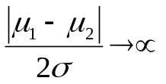

LECTURE 15: EXAM NO. 1 (CHAP. 2)
PROBLEM 1
(c) How does your result for (b) change if the prior probabilities are not equal?
Making , puts infinite distance between the classes . The probability of
error will still tend to zero if the Prior probabilities are not equal.

Slide 8
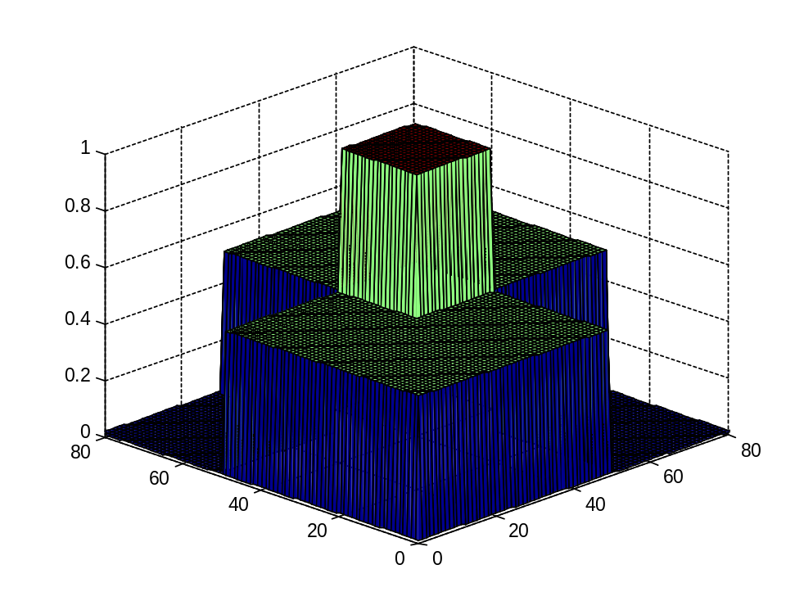
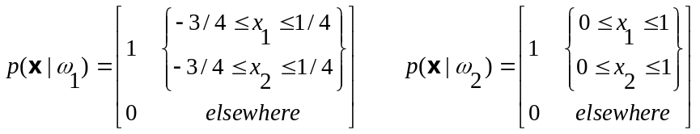

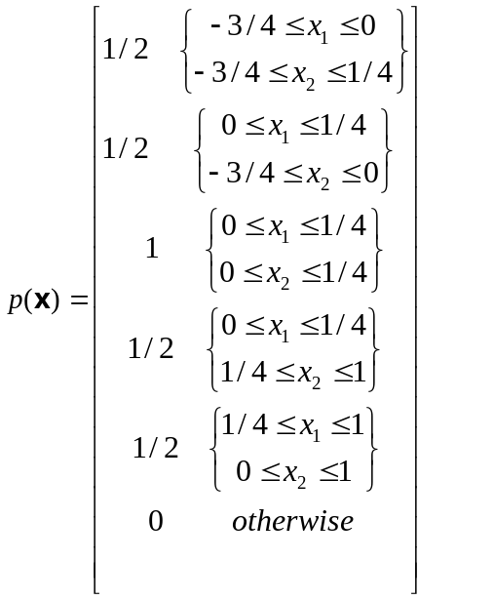
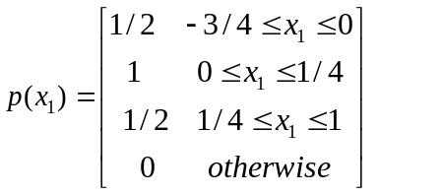
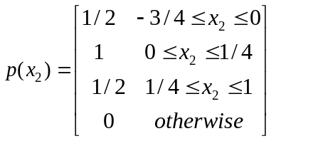
PROBLEM 2
LECTURE 15: EXAM NO. 1 (CHAP. 2)
Problem No. 2: Given a two-class two-dimensional classification problem (x = {x₁,x₂}) with the following parameters (uniform distributions):
Compute the mean and covariance
(hint: plot the distributions).
I. Using Independent class approach,
we get joint pdf as
We can obtain marginal probability distribution function as

Slide 9
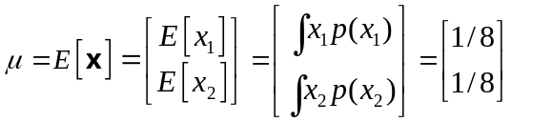
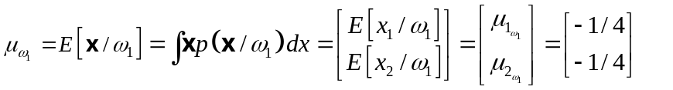
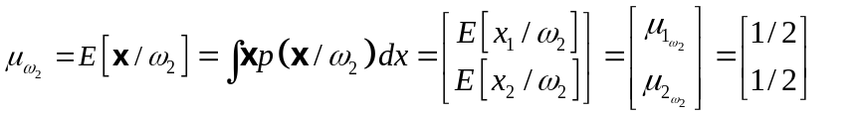
PROBLEM 2
LECTURE 15: EXAM NO. 1 (CHAP. 2)
We can calculate mean and covariance as,
II. Using class-dependent approach,

Slide 10
PROBLEM 2
LECTURE 15: EXAM NO. 1 (CHAP. 2)
Figure showing the decision surface and the distribution of two classes

Slide 11

PROBLEM 2
LECTURE 15: EXAM NO. 1 (CHAP. 2)
b) Find the discriminant functions(e.g., g_{i} (x) ).
There are infinite numbers of solutions for the case of P(w₁)=P(w₂) and P(x/w₁)=P(x/w₂) in the overlap area.
The simplest one can be defined as
g(x)= x₁+ x₂-1/4 such that
if g(x)>0 decide class w₂
else class w₁
C) Write the Bayes decision rule for this case (hint: draw the decision boundary). Is this solution unique? Explain.
Since P(w₁)=P(w₂) and P(x/w₁)=P(x/w₂) in the overlap area, the posterior probability will be same in the overlap area.
Hence, the solution won’t be unique.
d) Compute the probability of error.

Slide 12

PROBLEM 2
LECTURE 15: EXAM NO. 1 (CHAP. 2)
e) How will the decision surface change if the priors are not equal? Explain.
When the priors are equal, the decision region is at the point where two distribution meet if the distributions are similar. If the priors are not equal the decision region moves away from the higher prior class.
f) How will the probability of error change if the priors are not equal?
As the prior probability changes, the decision surface changes. Hence the probability of error changes. For ex, if P(w₁)=1 and P(w₂)=0. In this case, the decision line will move such that the overlapped rectangle region belongs to region 1. Hence probability of error is zero.
g) Draw the minimax decision surface. Compare and contrast this to your answer in part (c).
The requirement for the minimax decision surface is
Since P(x/w₁)=P(x/w₂), we need to obtain R₁= R₂
The minimax decision surface also will have infinite solution compared to Bayes’ decision surface.
The contrast is the overlap region needs to be divided into equal area to get R₁= R₂

