Slide 1
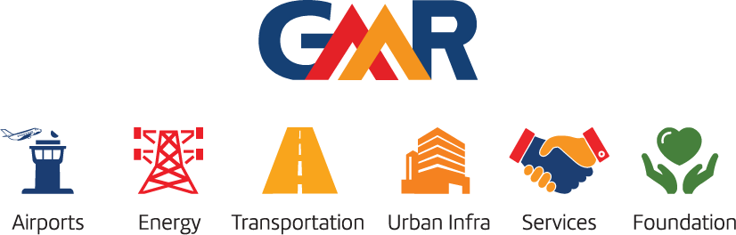
Medi-Diagnos: Revolutionizing Telemedicine for Enhanced Healthcare Accessibility
Names of the students :
CH.D.S.S.Kiran
G.LIKASH
Name of the mentor:
Dr. A. V. Ramana, HoD CSE
Dr.K.Srividya, HoD CSE-AI&ML
www.gmrgroup.in

Slide 2
MEDI-Diagnos : The Future of Diagnosis
Introduction
In an era marked by technological advancement, the landscape of healthcare is evolving rapidly, with telemedicine emerging as a transformative solution. Medi-Diagnos stands at the forefront of this evolution, leveraging cutting-edge AI and ML technologies to redefine medical care accessibility and precision.
Rooted in the premise of addressing healthcare barriers in remote regions, particularly in India, this innovative platform streamlines the diagnostic process, offering personalized treatment planning and multi-language medical support. From oral health to diabetes management, Medi-Diagnos caters to diverse medical needs, empowering both doctors and patients with efficient, accurate, and inclusive healthcare solutions.

Slide 3
MEDI-Diagnos : The Future of Diagnosis
Project Details
Medi-Diagnos, a pioneering telemedicine platform, focuses on enhancing healthcare accessibility and effectiveness, particularly in remote regions like India. The platform aims to streamline diagnosis, reduce errors, and optimize treatment outcomes through advanced AI and ML technologies. Offering specialized medical departments and multi-language support, Medi-Diagnos ensures comprehensive healthcare access for both patients and doctors.
Integrating cutting-edge technologies like protein DNA analysis, Medi-Diagnos empowers healthcare providers with accurate insights. Its user-friendly interface targets medical practitioners, doctors, scientists, and patients, revolutionizing healthcare delivery. By breaking language barriers and leveraging innovative solutions, Medi-Diagnos strives to drive positive change in healthcare accessibility and quality globally.

Slide 4
MEDI-Diagnos : The Future of Diagnosis
Objective of the Project:
Deploy a comprehensive telemedicine platform accessible beyond hospital settings.
Facilitate accurate diagnosis and personalized treatment planning through advanced AI and ML technologies.
Provide multi-language medical assistance for improved accessibility and patient support.
Enhance medical diagnostics with innovative technologies, such as protein DNA analysis.
Significance/Need of the Project:
Revolutionize healthcare accessibility for doctors, enabling accurate diagnosis and personalized treatment planning through a comprehensive telemedicine platform like Medi-Diagnos.
Empower patients with improved access to healthcare services, facilitating accurate diagnosis, personalized treatment planning, and multi-language medical assistance, all accessible from the comfort of their homes.

Slide 5
MEDI-Diagnos : The Future of Diagnosis
Technologies used and Working Procedure:
AI,DL and ML: Utilizing advanced AI ,DL, ML algorithms, including neural networks such as CNNs, RNNs, LSTM, and GRU, for accurate diagnosis and personalized treatment planning.
Multi-Language Support: Incorporating language processing technologies to offer multi-language medical assistance, ensuring accessibility to healthcare services for diverse populations.
Data Integration: Integrating data from various sources to provide a holistic view of patients' health, allowing for better-informed decision-making by healthcare professionals.
Web Development: Built on the Python-Django framework, HTML, CSS, and JavaScript, the web application facilitates seamless interaction between patients and healthcare providers.
Security Measures: Implementing robust encryption protocols and adherence to stringent data protection regulations to safeguard patients' sensitive health data.
Cloud Computing: Leveraging cloud infrastructure to ensure scalability, flexibility, and reliability of the platform, facilitating seamless access to medical records and resources for both doctors and patients.
End Beneficiaries:
Patients, Doctors

Slide 6
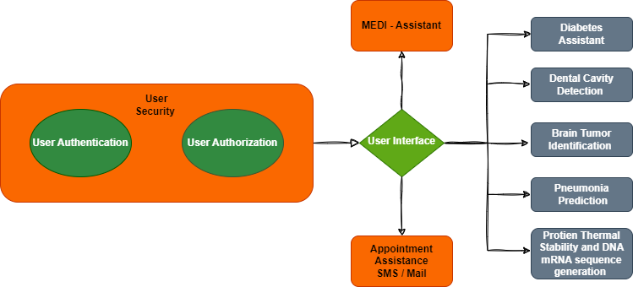
MEDI-Diagnos : The Future of Diagnosis
Block Diagram:

