Slide 1
Enterprise Integration Patterns with Apache Camel

Slide 2
Why?
Decoupling
Events produced in some place can be handled at some later time elsewhere
The producer may or may not wait for (an answer) from the producer
Separation of concerns
The producer and consumer knows (hardly) nothing of Camel
The routing is a configuration issue

Slide 3
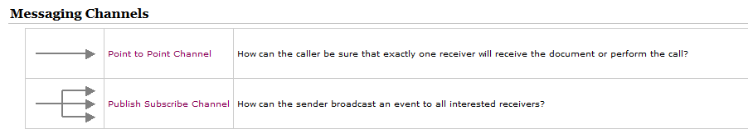
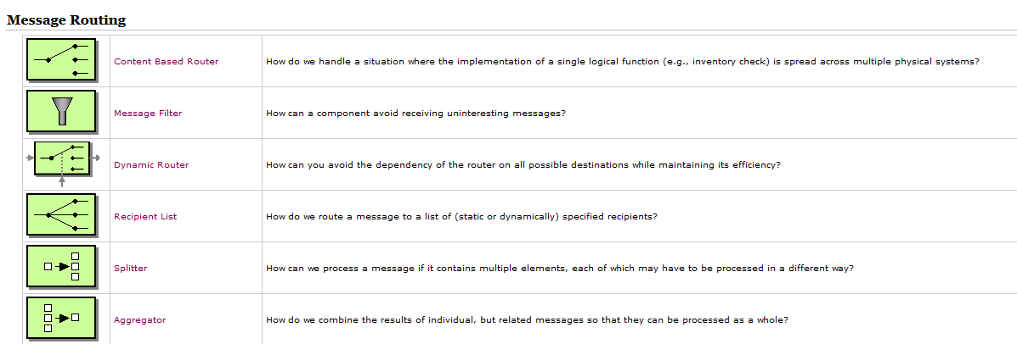

EIPs
http://camel.apache.org/eip.html

Slide 4
Demo implementation
https://github.com/amalm/eventsdemo

Slide 5
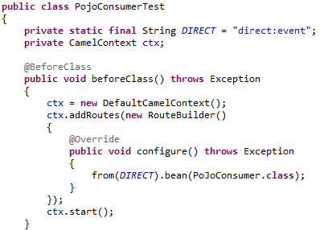
First step, the Camel Context/Java
/events-camel/src/test/java/events/camel/PojoConsumerTest.java
JVM
JVM
Camel Context
Camel Context
Camel Context

Slide 6
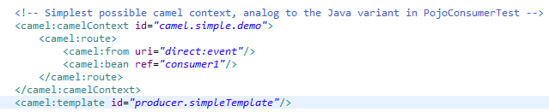
Camel Context/Spring
/events-camel/src/main/resources/META-INF/event.camel.spring.xml /events-camel/src/test/java/events/camel/CamelEventSpringTest.java

Slide 7
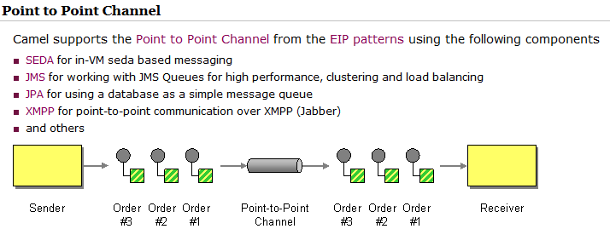
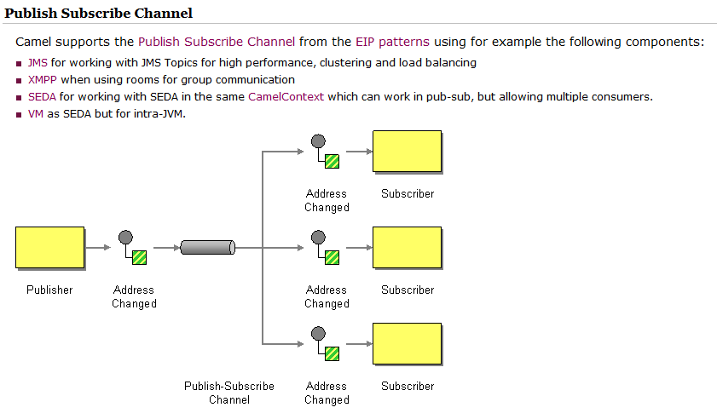
Camel Components
http://camel.apache.org/components.html
The camel components represent channels

Slide 8
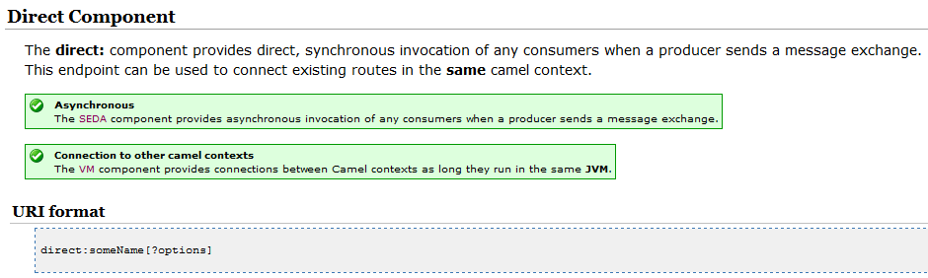
Direct component

Slide 9
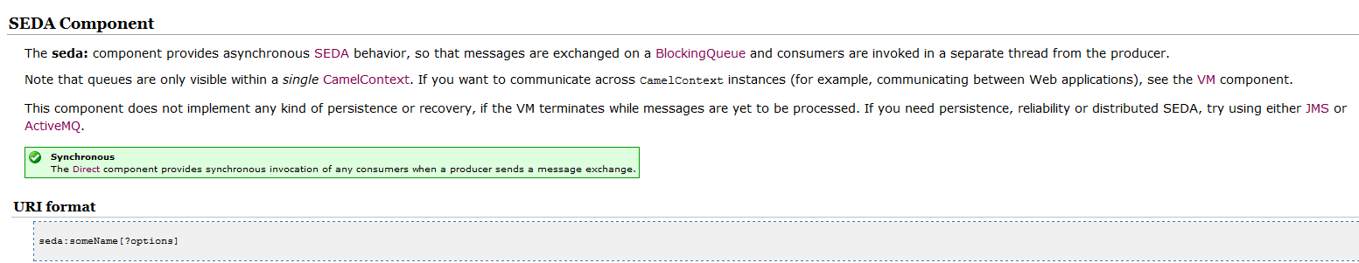
SEDA component
Change the implementation in
/events-camel/src/test/java/events/camel/PojoConsumerTest.java
to use seda.

Slide 10
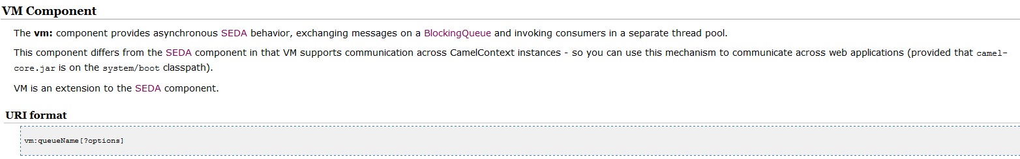
VM component
Change the implementation in
/events-camel/src/test/java/events/camel/PojoConsumerTest.java
to use vm.
Add another camel context and consume the event there instead.
Hint multipleConsumers=true

Slide 11
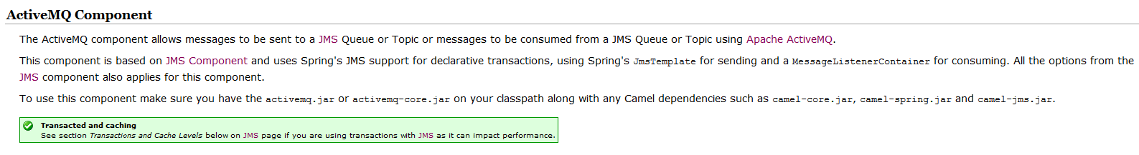
JMS/ActiveMQ component
Source code walkthrough....

Slide 12
Synchronous Query/Answer
http://camel.apache.org/spring-remoting.html
As in SystemConfig, Gate-UMS,...

Slide 13
Publish/Subscribe
How to handle transactions?
Transaction listener
Synchronize transaction for JMS(ActiveMQ) and database.
Source code walkthrough....

