Slide 1
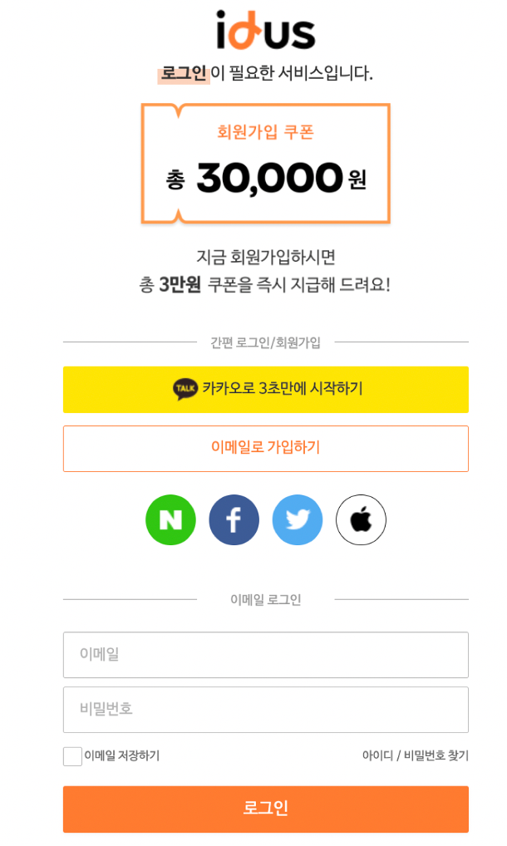
- Header center
– 1 logo click->item페이지
- 2
-2.1 <div>+padding(vh%)
-2.2 <div>+padding(vh%)
-2.3 <div <a>*4 >
- 3
-3.1 <input>
-3.2 <input>
-3.3 space-between
<div<input type=checkbox>>
<div <a><a>>
-3.4 <div>+padding(vh%)
폴더 구조
Item
Login
32 13 3

