Slide 1
Practical byzantine fault tolerance
-- Lu Yu
The Holcombe Department of Electrical & Computer Engineering

Slide 2
Practical Byzantine Fault Tolerance (PBFT)
Derived from the classic paper “The Byzantine Generals Problem” (https://people.eecs.berkeley.edu/~luca/cs174/byzantine.pdf)

Slide 3
Practical Byzantine Fault Tolerance (PBFT)
Derived from the classic paper “The Byzantine Generals Problem” (https://people.eecs.berkeley.edu/~luca/cs174/byzantine.pdf)
PBFT does NOT apply to public environment.
A system that allows anyone to join/leave any time. Each user does not have a unique ID.
Notes:
3f+1

Slide 4
Practical Byzantine Fault Tolerance (PBFT)
Derived from the classic paper “The Byzantine Generals Problem” (https://people.eecs.berkeley.edu/~luca/cs174/byzantine.pdf)
PBFT does NOT apply to public environment.
A system that allows anyone to join/leave any time. Each user does not have a unique ID.
The blockchain hype inspired researchers to re-examine PBFT.

Slide 5
Sustainable System
A sustainable system is a system that is resistant to failures.

Slide 6
Sustainable System
A sustainable system is a system that is resistant to failures.
How to achieve sustainability?

Slide 7
Sustainable System
A sustainable system is a system that is resistant to failures.
How to achieve sustainability?
Adding some degree of redundancy to the system.

Slide 8
Sustainable System
A sustainable system is a system that is resistant to failures.
How to achieve sustainability?
Adding some degree of redundancy to the system.
How to add redundancy?
One way is to have multiple nodes with the same state and make them operate simultaneously.
In a decentralized system, this is called State Machine Replication.

Slide 9
State Machine Replication
Input
Initial State
S’

Slide 10
State Machine Replication
Input
Initial State
S’
Each node in a distributed network is a state machine.
Deterministic state transition
Given input and current state, the next state is determined and does not depend on time.

Slide 11
State Machine Replication
Input
Initial State
S’
Each node in a distributed network is a state machine.
Deterministic state transition
Given input and current state, the next state is determined and does not depend on time.
A consensus needs to be reached among the nodes.

Slide 12
State Machine Replication
Input
Initial State
S’
Each node in a distributed network is a state machine.
Deterministic state transition
Given input and current state, the next state is determined and does not depend on time.
A consensus needs to be reached among the nodes.
All the nodes exchange messages following some communication protocol to achieve a consensus.

Slide 13
Byzantine Generals Problem
It is hard to achieve a consensus exclusively relying on communication.

Slide 14
Byzantine Generals Problem
It is hard to achieve a consensus exclusively relying on communication.
The famous and infamous Byzantine Generals Problem

Slide 15
Byzantine Generals Problem
It is hard to achieve a consensus exclusively relying on communication.
The famous and infamous Byzantine Generals Problem
A consensus as to whether to attack or retreat needs to be achieved at the same time.
Messengers can be unreliable.
Send different messages to different generals (traitrors).
Messages may not reach some generals.

Slide 16
Byzantine Generals Problem
Node == General
Communication protocol = messenger
The random behavior of the general(s) = Byzantine fault
The property that the good generals achieve a consensus in the presence of traitor(s) is called Byzantine Fault Tolerance.

Slide 17
Byzantine Generals Problem
Node == General
Communication protocol = messenger
The random behavior of the general(s) = Byzantine fault
The property that the good generals achieve a consensus in the presence of traitor(s) is called Byzantine Fault Tolerance.

Slide 18
Different Approaches
FLP impossibility:
In a fully asynchronous system there is no consensus solution that can tolerate one or more crash failures.

Slide 19
Different Approaches
FLP impossibility:
In a fully asynchronous system there is no consensus solution that can tolerate one or more crash failures.
Approach 1: Assume the system (network communictaions) is synchronous.

Slide 20
Different Approaches
FLP impossibility:
In a fully asynchronous system there is no consensus solution that can tolerate one or more crash failures.
Approach 1: Assume the system (network communications) is synchronous, e.g., PBFT.
Approach 2: Non-deterministic protocols. Very complicated.
PBFT is the game changer.

Slide 21
PBFT
The main idea of PBFT is to use multiple rounds of voting.

Slide 22
PBFT
The main idea of PBFT is to use multiple rounds of voting.
Who is voting on what?
How many rounds of voting are needed?

Slide 23
PBFT
The main idea of PBFT is to use multiple rounds of voting.
Who is voting on what?
How many rounds of voting are needed?
Three stages:
Pre-prepare
Prepare
Commit

Slide 24
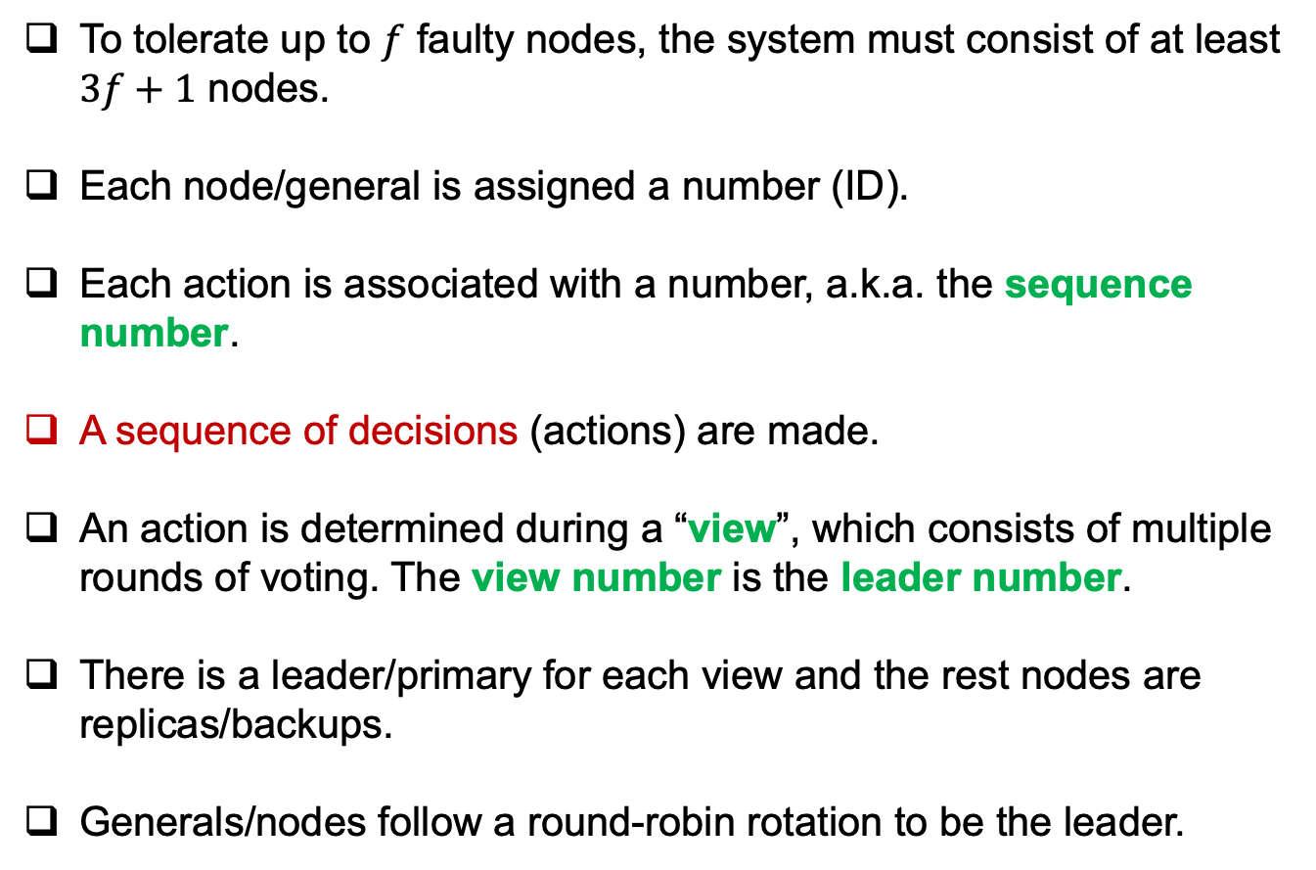
Assumptions of PBFT
To tolerate up to $f$ faulty nodes, the system must consist of at least $3f+1$ nodes.
Each node/general is assigned a number (ID).
Each action is associated with a number, a.k.a. the sequence number.
A sequence of decisions (actions) are made.
An action is determined during a “view”, which consists of multiple rounds of voting. The view number is the leader number.
There is a leader/primary for each view and the rest nodes are replicas/backups.
Generals/nodes follow a round-robin rotation to be the leader.

Slide 25
Phase I: Pre-prepare
Leader/Primary
<pp, s, v, r>_{sig0}
0
1
Replica
<pp, s, v, r>_{sig0}
<pp, s, v, r>_{sig0}
3
2
Replica
Replica

Slide 26
Phase I: Pre-prepare
Leader/Primary
<pp, s, v, r>_{sig0}
0
1
Replica
<pp, s, v, r>_{sig0}
<pp, s, v, r>_{sig0}
Let everyone know about the request.
3
2
Replica
Replica

Slide 27
Phase II: Prepare
Leader/Primary
Replica
<p, s, v>_{sig1}
0
1
Prepare Stage
<p, s, v>_{sig2}
<p, s, v>_{sig3}
<p, s, v>_{sig2}
<p, s, v>_{sig1}
Prepared Stage
3
<p, s, v>_{sig2}
2
<p, s, v>_{sig3}
Replica
Replica

Slide 28
Phase II: Prepare
Leader/Primary
Replica
<p, s, v>_{sig1}
0
1
Prepare Stage
<p, s, v>_{sig2}
Let the leader know their decisions.
<p, s, v>_{sig3}
<p, s, v>_{sig2}
<p, s, v>_{sig1}
Prepared Stage
3
<p, s, v>_{sig2}
2
<p, s, v>_{sig3}
Replica
Replica

Slide 29
Phase III: Commit
Leader/Primary
Replica
<c, s, v>_{sig0}
Prepared Stage
0
1
Commit Stage
<c, s, v>_{sig1}
Committed Stage
3
<c, s, v>_{sig2}
2
<c, s, v>_{sig3}
Replica
Replica

Slide 30
Phase III: Commit
Leader/Primary
Replica
0
1
Client
3
2
Replica
Replica

Slide 31
PBFT
http://pmg.csail.mit.edu/papers/osdi99.pdf

Slide 32
Leader Rotation
Why changing the leader?
A leader can be a traitor.
Not broadcast the message or only send it to some generals.
Message fabrication is not viable.

Slide 33
Leader Rotation/View Change
Old Primary
New Primary
<vc, v+1, c>_{sig1}
0
1
<vc, v+1, c>_{sig3}
<vc, v+1,c >_{sig2}
3
<vc, v+1,c >_{sig2}
2
<vc, v+1, c>_{sig3}
Replica
Replica

Slide 34
Leader Rotation/View Change
Old Primary
New Primary
<nv, v+1, c>_{sig1}
0
1
<nv, v+1, c>_{sig1}
<nv, v+1, c>_{sig1}
3
2
Replica
Replica

Slide 35
Safety of PBFT
Each node/replica performs the same operation in the same order if they are going to perform a sequence of operations.

Slide 36
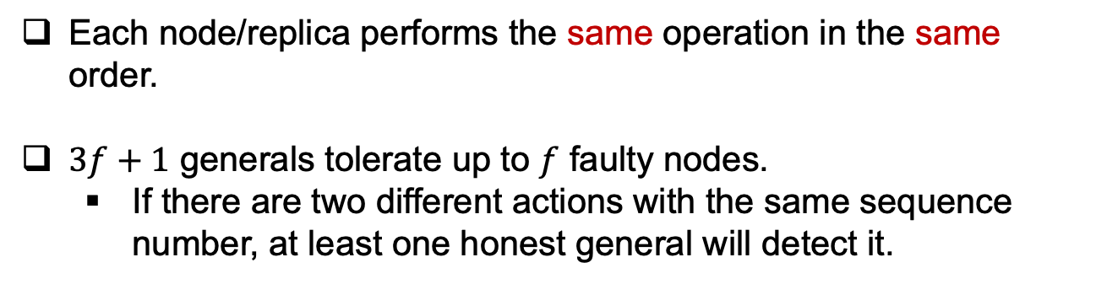
Safety of PBFT
Each node/replica performs the same operation in the same order.
$3f+1$ generals tolerate up to $f$ faulty nodes.
If there are two different actions with the same sequence number, at least one honest general will detect it.

Slide 37
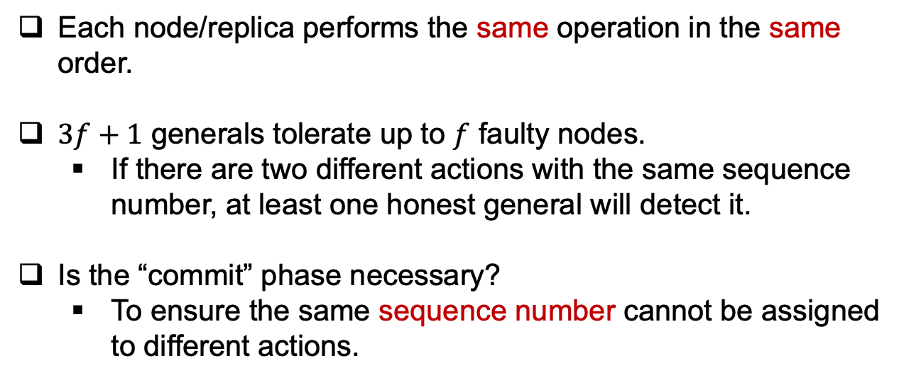
Safety of PBFT
Each node/replica performs the same operation in the same order.
$3f+1$ generals tolerate up to $f$ faulty nodes.
If there are two different actions with the same sequence number, at least one honest general will detect it.
Is the “commit” phase necessary?
To ensure the same sequence number cannot be assigned to different actions.

Slide 38
Liveness of PBFT
The protocol will proceed.
Guaranteed by “view change”*.

Slide 39
PBFT vs. Blockchain
Permissioned vs. Permission-less

Slide 40
PBFT vs. Blockchain
Permissioned vs. Permission-less
PBFT is leader-based.

Slide 41
PBFT vs. Blockchain
Permissioned vs. Permission-less
PBFT is leader-based.
PBFT is communication-based.

Slide 42
PBFT vs. Blockchain
Permissioned vs. Permission-less
PBFT is leader-based.
PBFT is computation-based.
PBFT is safety-based.

Slide 43
Reference
Ethereum Wiki, “Proof of Stake FAQs”. Available at: https://eth.wiki/en/concepts/proof-of-stake-faqs
https://blog.cosmos.network/consensus-compare-casper-vs-tendermint-6df154ad56ae
Juin Chiu, “Casper FFG: Consensus Protocol for the Realization of Proof-of-Stake”. Available at: https://medium.com/unitychain/intro-to-casper-ffg-9ed944d98b2d
Juin Chiu, “Introduction to PBFT”. Available at: https://medium.com/unitychain/if-you-really-want-to-make-sense-of-blockchain-you-cannot-ignore-the-classics-an-introduction-to-3c72dc8c5515

