Slide 2
How Fourier Transformation Became The Key Component in Breaking Modern Cryptography

Slide 3
How Fourier Transformation Became The Key Component in Breaking Modern Cryptography
University of Toronto Scarborough
Supervisor: Marcelo Ponce Presenter: Like Wang

Slide 4
Recall Shor’s algorithm

Slide 5

Recall Shor’s algorithm
Problem: Given $N=pq$ for some $p$ and $q$ s.t. $\gcd\left(p,q\right)=1$, find $p$ and $q$.
Algorithm:
1. Select a random number $a$ , s.t. $1<a<N−1$. (Classical)
2. Compute $K=gcd\left(a,N\right)$ with Euclidean algorithm. (Classical)
3. If $K≠1$ ($a, N$ not coprime), $p=gcd(a,N)$, $q=N/p$, done. (Classical)
4. Else, period-finding subroutine to find the order $r$ of $a$ modulo $N$. (Quantum)
5. If $r$ is odd, then go back to step 1. (Classical)
6. Else, If $a^{r/2}≡−1 (mod N)$, then go back to step 1. (Classical)
Else, $p=gcd⁡(a^{r/2}+1,N)$, $q= gcd⁡(a^{r/2}−1,N)$, done. (Classical)

Slide 6
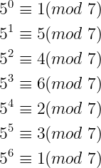

Number theory
If $a$ and $b$ have the same remainder when divided by $N$, then we say $a$ is congruent to $b$, denoted as
$$a≡b \left(mod N\right)$$
The remainder of $a^{x}$ when divided by $N$ is periodic. The smallest number $r≠0$ such that $a^{r}≡1 (mod N)$ is called order of $a$ modulo $N$.
Example: The order 5 modulo 7 is 6.

Slide 7

RSA encryption
Let $N=pq$ where $p$ and $q$ are prime numbers.
The Euler’s totient function, $φ\left(N\right)=(p−1)(q−1)$.
Let $e$ be a number between 1 and $φ(n)$, $1<e<φ(N)$, such that $e$ is coprime to $φ(N)$.
Let $d$ be the inverse of $e$ modulo $φ\left(N\right)$, $ed≡1 (mod φ(N))$.
Public key: $N,e$
Private key: $N,d$
Public key is to encrypt info; Private key is to decrypt info.

Slide 8

RSA encryption (continued)
Public key are public, everyone can use it to encrypt info.
Private key is only visible to the receiver.
RSA relies on the fact that large number is hard to factor!
If one can factor $N$ into $pq$, then he/she knows your private key!

Slide 9

Example
Suppose $N=15$, how to factor it?
1. Pick a random number, $1<a<N$. Say, $a=7$
2. $K=gcd\left(a,N\right)=1$. It is trivial, we need to find the order of $a$.
4. The order $r=4$ since $a^{4}≡1 (mod N)$.
5. $\gcd\left(a^{\frac{r}{2}}+1,N\right)=5$ and $\gcd\left(a^{\frac{r}{2}}−1,N\right)=3$ are nontrivial factors of $N$.

Slide 10
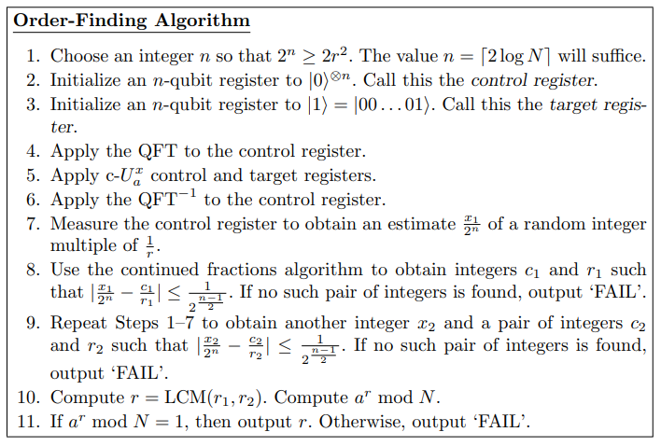
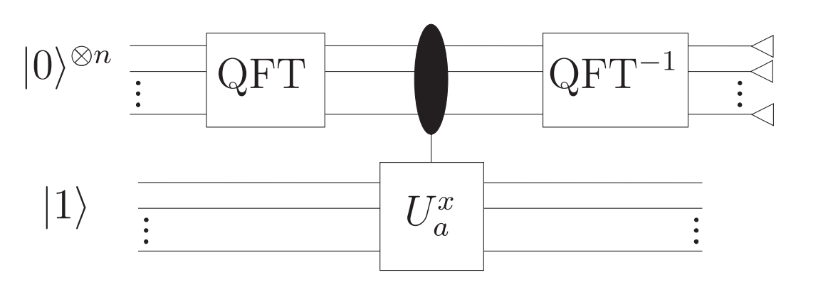
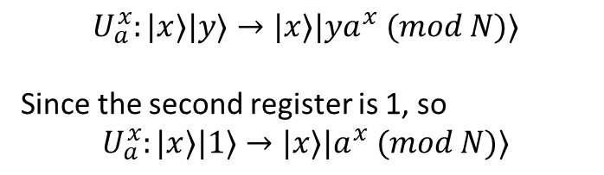
Shor’s algorithm (Quantum subroutine)
The quantum part of Shor’s algorithm is for order-finding.
$$U_{a}^{x}:|x⟩|y⟩→|x⟩|{ya}^{x} (mod N)⟩$$
Since the second register is 1, so
$$U_{a}^{x}:|x⟩|1⟩→|x⟩|a^{x} (mod N)⟩$$

Slide 11
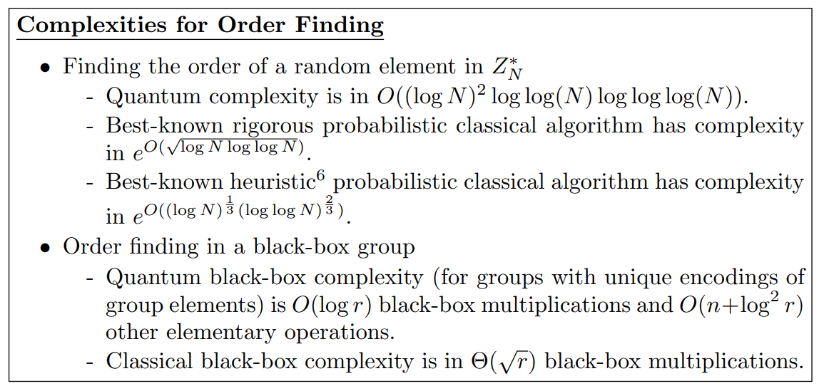
Time-complexity

Slide 12

Summary
Shor’s algorithm can factor number in polynomial time (some polynomial of $\log{N}$).

