Slide 1
БД 5

Slide 2
JOINs
CROSS JOIN
INNER JOIN
NATURAL JOIN
LEFT [OUTER] JOIN
RIGHT [OUTER] JOIN
FULL [OUTER] JOIN
Notes:
In MySQL, JOIN, CROSS JOIN, and INNER JOIN are syntactic equivalents (they can replace each other). In standard SQL, they are not equivalent. INNER JOIN is used with an ON clause, CROSS JOIN is used otherwise.

Slide 3
SELECT
*
FROM
table_a
<JOIN OPERATOR> table_b <JOIN CONDITION>
<JOIN OPERATOR> table_c <JOIN CONDITION>
<JOIN OPERATOR> table_d <JOIN CONDITION>
…

Slide 4
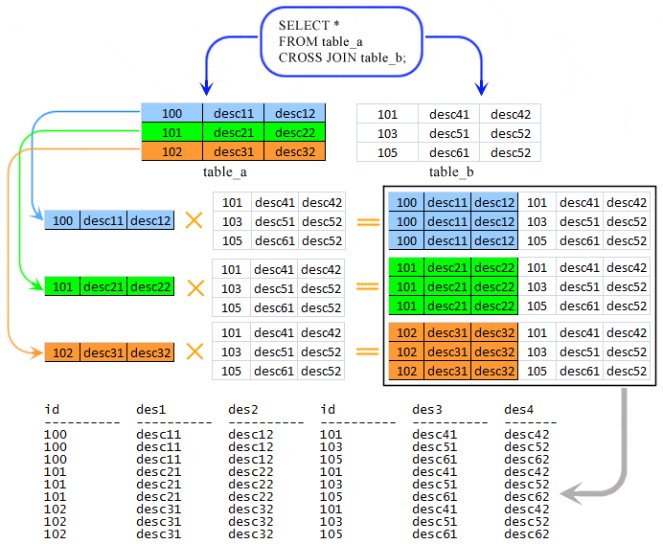
CROSS JOIN
SELECT
*
FROM
table1,
table2;
SELECT
*
FROM
table1
CROSS JOIN table2;

Slide 5
DELETE
table_d.*
FROM
table_a
<JOIN OPERATOR> table_b <JOIN CONDITION>
<JOIN OPERATOR> table_c <JOIN CONDITION>
<JOIN OPERATOR> table_d <JOIN CONDITION>
…

Slide 6
UPDATE
table_a
<JOIN OPERATOR> table_b <JOIN CONDITION>
<JOIN OPERATOR> table_c <JOIN CONDITION>
<JOIN OPERATOR> table_d <JOIN CONDITION>
SET
…

Slide 7
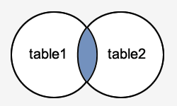
INNER JOIN
SELECT
columns
FROM
table1
INNER JOIN table2 ON table1.column = table2.column;
Возвращает все строки из множества, для которых выполняется JOIN CONDITION

Slide 8
order_id | supplier_id | order_date
500125 | 10000 | 2003/05/12
500126 | 10001 | 2003/05/13
500127 | 10004 | 2003/05/14
500128 | 10001 | 2003/05/15
supplier_id | supplier_name
10000 | IBM
10001 | Hewlett Packard
10002 | Microsoft
10003 | NVIDIA
SELECT
supplier.supplier_id,
supplier.supplier_name,
tech_order.order_date
FROM
tech_order
INNER JOIN supplier ON supplier.supplier_id = tech_order.supplier_id;
supplier_id | supplier_name | order_date
10000 | IBM | 2003/05/12
10001 | Hewlett Packard | 2003/05/13
10001 | Hewlett Packard | 2003/05/15
Notes:
would return all rows from the suppliers and orders tables where there is a matching supplier_id value in both the suppliers and orders tables
The rows for Microsoft and NVIDIA from the supplier table would be omitted, since the supplier_id's 10002 and 10003 do not exist in both tables. The row for 500127 (order_id) from the orders table would be omitted, since the supplier_id 10004 does not exist in the suppliers table.

Slide 9
SELECT
*
FROM
tech_order
INNER JOIN supplier USING(supplier_id);

Slide 10
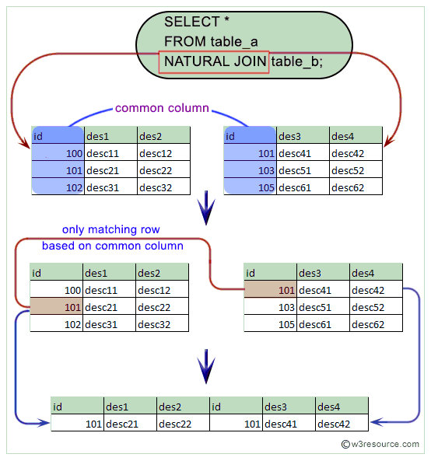
Natural JOIN
SELECT
*
FROM
table1
NATURAL JOIN table2;

Slide 11
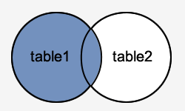
LEFT [OUTER] JOIN
SELECT
columns
FROM
table1
LEFT JOIN table2 ON table1.column = table2.column;
Вернет все записи из table1, соединив с теми записи из table2, для которых выполняется JOIN CONDITION

Slide 12
order_id | supplier_id | order_date
500125 | 10000 | 2003/05/12
500126 | 10001 | 2003/05/13
500127 | 10004 | 2003/05/14
500128 | 10001 | 2003/05/15
supplier_id | supplier_name
10000 | IBM
10001 | Hewlett Packard
10002 | Microsoft
10003 | NVIDIA
SELECT
tech_order.order_id,
supplier.supplier_id,
supplier.supplier_name,
tech_order.order_date
FROM
tech_order
LEFT JOIN supplier ON supplier.supplier_id = tech_order.supplier_id;
order_id | supplier_id | supplier_name | order_date
500125 | 10000 | IBM | 2003/05/12
500126 | 10001 | Hewlett Packard | 2003/05/13
500127 | NULL | NULL | 2003/05/14
500128 | 10001 | Hewlett Packard | 2003/05/15

Slide 13
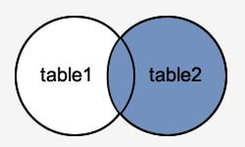
RIGHT [OUTER] JOIN
SELECT
columns
FROM
table1
RIGHT JOIN table2 ON table1.column = table2.column;
Вернет все записи из table2, соединив с теми записи из table1, для которых выполняется JOIN CONDITION

Slide 14
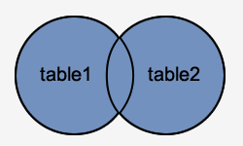
FULL [OUTER] JOIN
SELECT
columns
FROM
table1
FULL JOIN table2 ON table1.column = table2.column;
Вернет все записи из table1 и table2, для которых выполняется условие.
Там где JOIN CONDITION не выполняется, будет выставлено NULL
Отсутствует в MySQL

Slide 15
order_id | supplier_id | order_date
500125 | 10000 | 2003/05/12
500126 | 10001 | 2003/05/13
500127 | 10004 | 2003/05/14
500128 | 10001 | 2003/05/15
supplier_id | supplier_name
10000 | IBM
10001 | Hewlett Packard
10002 | Microsoft
10003 | NVIDIA
SELECT
tech_order.order_id,
supplier.supplier_id,
supplier.supplier_name,
tech_order.order_date
FROM
supplier
FULL JOIN order ON supplier.supplier_id = order.supplier_id;

Slide 16
SELECT
tech_order.order_id,
supplier.supplier_id,
supplier.supplier_name,
tech_order.order_date
FROM tech_order
LEFT JOIN supplier ON supplier.supplier_id = tech_order.supplier_id
UNION
SELECT
tech_order.order_id,
supplier.supplier_id,
supplier.supplier_name,
tech_order.order_date
FROM tech_order
RIGHT JOIN supplier ON supplier.supplier_id = tech_order.supplier_id;

Slide 17
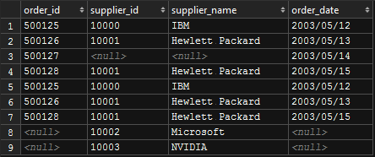

Slide 18
Классификация с точки зрения науки
Natural JOIN
SELECT * FROM table1 NATURAL JOIN table2
Theta JOIN
… ON table1.user_count >= table2.user_count
… ON CONCAT(table1.first_name, table1.last_name) = table2.full_name
EquiJOIN
… ON table1.id = table2.id
Cross JOIN
Notes:
The NATURAL JOIN of two tables is defined to be semantically equivalent to an INNER JOIN or a LEFT JOIN with a USING clause that names all columns that exist in both tables.

Slide 19
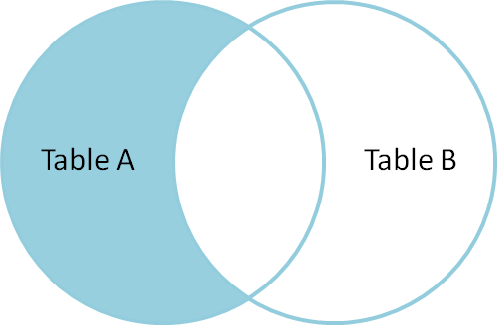
Подтипы: Left antijoin
order_id | supplier_id | order_date
500125 | 10000 | 2003/05/12
500126 | 10001 | 2003/05/13
500127 | 10004 | 2003/05/14
500128 | 10001 | 2003/05/15
supplier_id | supplier_name
10000 | IBM
10001 | Hewlett Packard
10002 | Microsoft
10003 | NVIDIA
SELECT
supplier.supplier_id,
supplier.supplier_name,
tech_order.order_date
FROM
supplier
LEFT JOIN order ON supplier.supplier_id = tech_order.supplier_id
WHERE
tech_order.supplier_id IS NULL
supplier_id | supplier_name | order_date
10002 | Microsoft | NULL
10003 | NVIDIA | NULL

Slide 20
Подтипы: Right antijoin
order_id | supplier_id | order_date
500125 | 10000 | 2003/05/12
500126 | 10001 | 2003/05/13
500127 | 10004 | 2003/05/14
500128 | 10001 | 2003/05/15
supplier_id | supplier_name
10000 | IBM
10001 | Hewlett Packard
10002 | Microsoft
10003 | NVIDIA
SELECT
supplier.supplier_name,
tech_order.order_date,
tech_order.order_id
FROM
supplier
RIGHT JOIN tech_order ON supplier.supplier_id = tech_order.supplier_id
WHERE
supplier.supplier_id IS NULL
order_id | order_date | supplier_name
500127 | 2003/05/14 | NULL

Slide 21
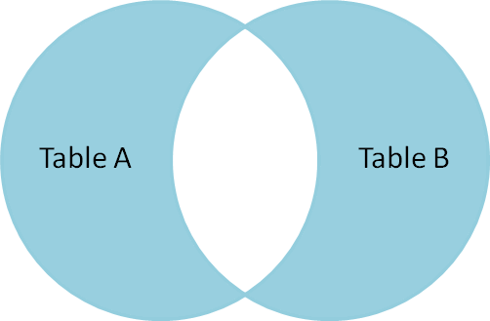
Подтипы: Full antijoin
order_id | supplier_id | order_date
500125 | 10000 | 2003/05/12
500126 | 10001 | 2003/05/13
500127 | 10004 | 2003/05/14
500128 | 10001 | 2003/05/15
supplier_id | supplier_name
10000 | IBM
10001 | Hewlett Packard
10002 | Microsoft
10003 | NVIDIA
SELECT
supplier.supplier_id,
supplier.supplier_name,
order.order_date,
order.order_id
FROM
supplier
FULL JOIN order ON supplier.supplier_id = order.supplier_id
WHERE
supplier.supplier_id IS NULL OR
order.supplier_id IS NULL

Slide 22

SELECT
tech_order.order_id,
supplier.supplier_id,
supplier.supplier_name,
tech_order.order_date
FROM tech_order
LEFT JOIN supplier ON supplier.supplier_id = tech_order.supplier_id
WHERE tech_order.order_id IS NULL OR supplier.supplier_id IS NULL
UNION
SELECT
tech_order.order_id,
supplier.supplier_id,
supplier.supplier_name,
tech_order.order_date
FROM tech_order
RIGHT JOIN supplier ON supplier.supplier_id = tech_order.supplier_id
WHERE tech_order.order_id IS NULL OR supplier.supplier_id IS NULL;

Slide 23


