Slide 1

CHATBOT ANALYTICS
NOOB ENTITY:
M Jaipal (9919004177)
H Nikhil Reddy (9919004106)
S Likhil Srinivas (9919004269)
S V Nagendra (9919004270)

Slide 2
INTRODUCTION
Chatbot analytics is the process of analyzing previous bot conversations to gain insights about chatbot performance and customer experience.
Due to increasing competition in every industry, customer experience became the key driver in gaining a competitive edge.
After a business deploys a chatbot, it is time to track how people are using it.
Based on chatbot analytics, organizations can identify patterns, trends, and correlations that might not get noticed using text-based data analysis methods.
Relying on chatbot analytics helps businesses avoid potential failures.

Slide 3
METHODOLOGY
Metric is a quantifiable measure that is used to track and assess the status of a specific business process
Many of the capabilities of the chatbot will be measured through those metrics
Through metrics we can expect efficiency enhancement, faster response, and greater conversion
USER METRICS
Total Users
Engaged Users
New Users
Avg conversation steps
Total Messages
CSAT Rating
This way, the performance of the bot can be monitored and improved efficiency

Slide 4
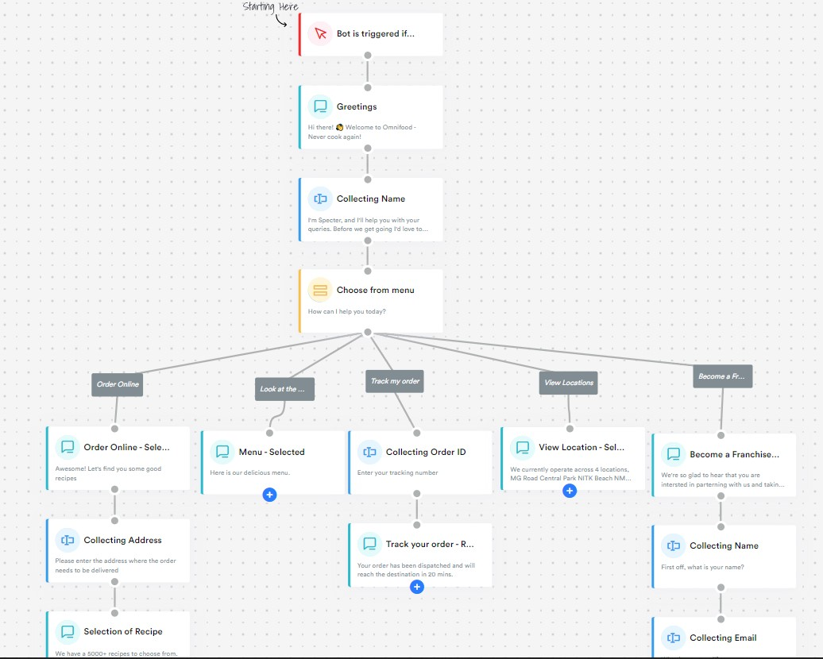
CHATBOT
ARCHITECTURE

Slide 5
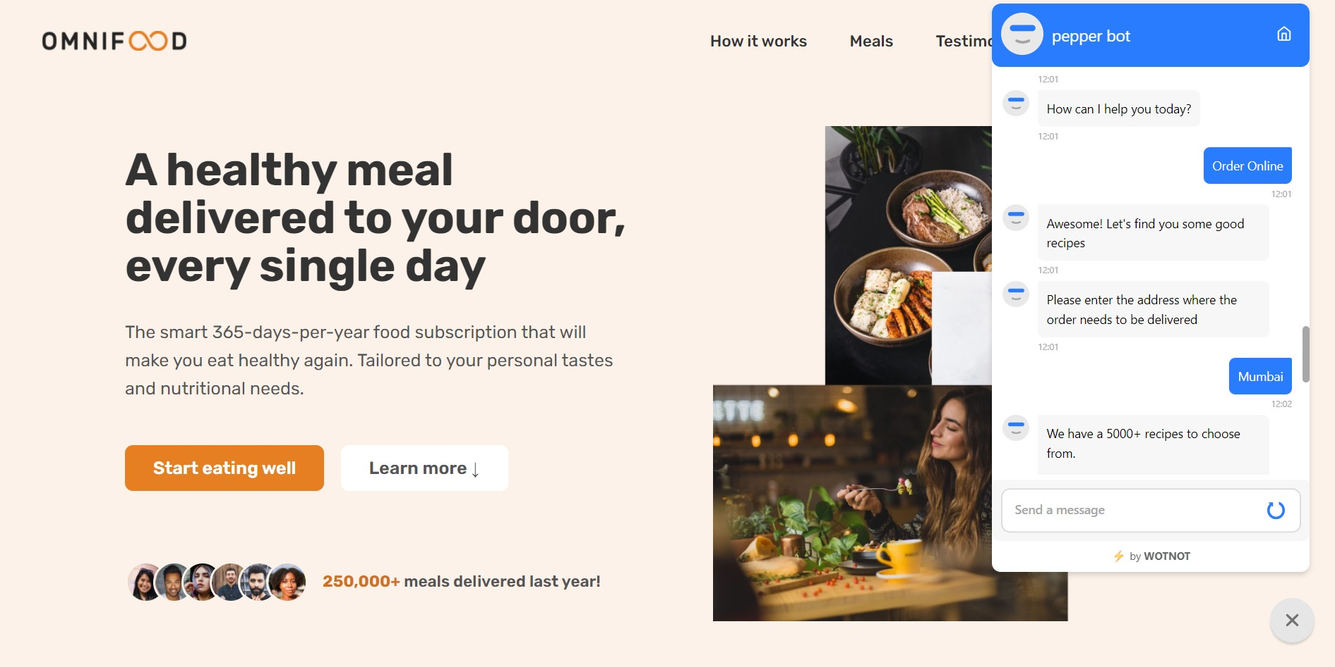
EXPERIMENTAL RESULTS

Slide 6
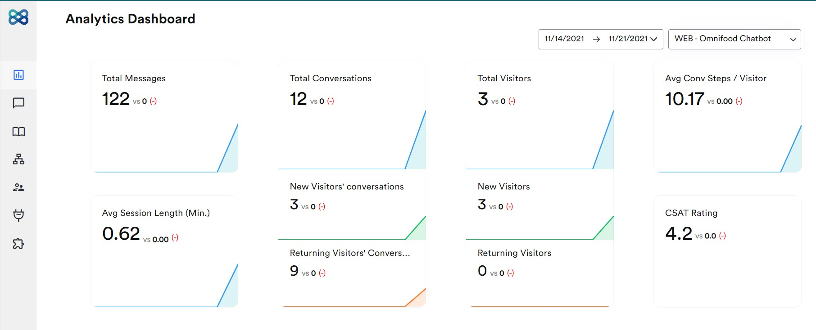
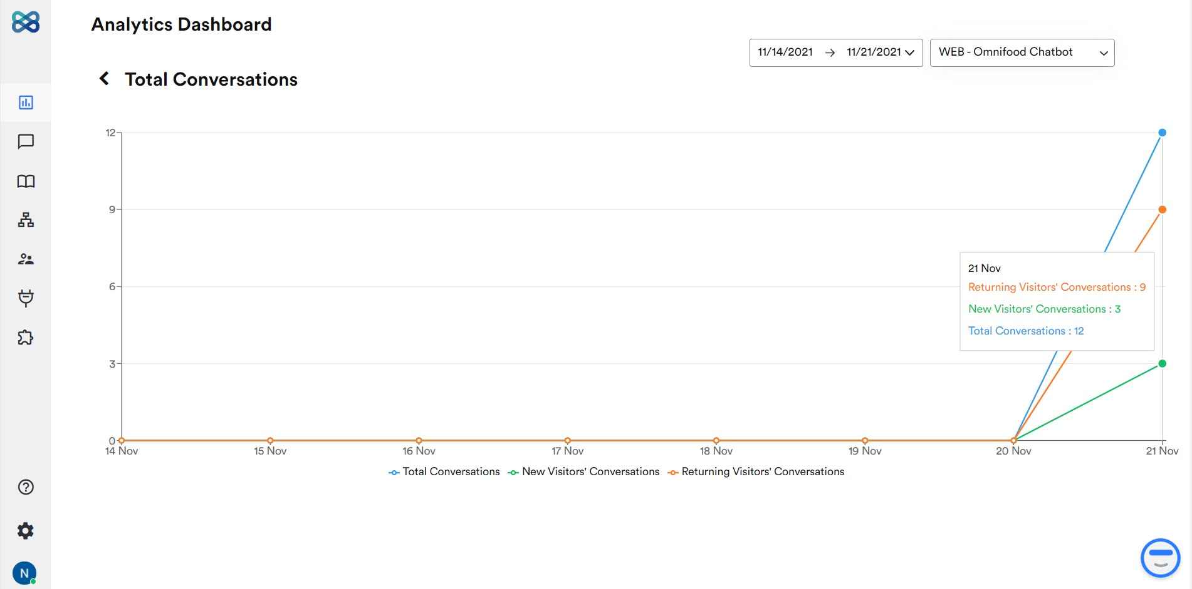
EXPERIMENTAL RESULTS

Slide 7
BENEFITS
cost savings
increased sales
increased customer interaction
reaching new customers
gaining a deeper understanding of customers

Slide 8
CONCLUSION
Bot analytics enable us to understand the customer behavior, what drives them in making relevant decisions, what disappoints them, what makes it easy to retain them and more.
Need to focus on optimizing our chatbot based on our goals in which we can drive your audience to your desired outcome.
From analytics we can measure the overall effectiveness of the chatbot and identify the loopholes.
Based on the flaws, you can iterate the bot flow to improve the communication process.

