Slide 1
UTILITY BILL ANALYSIS
Noob Entity :
M Jaipal (9919004177)
S Likhil Srinivas (9919004269)
H Nikhil Reddy (9919004106)
S V Nagendra (9919004270)

Slide 2
INTRODUCTION
Today the most information is available either on paper or in the form of photographs or videos.
Large information is stored in images.
Thus, there is a need for a system to extract text from general backgrounds.
Text Extraction and recognition in images has become a potential application in many fields like Image indexing, Robotics, Intelligent transport systems etc.
However, variations of text due to differences in size, style, orientation, and alignment, as well as low image contrast and complex background make the problem of automatic text extraction extremely challenging.

Slide 3
METHODOLGY
OCR
OCR stands for Optical Character Recognition. It is one such system that allows us to scan printed, typewritten or hand written text and convert scanned image into a computer process able format, either in the form of a plain text or a word document.
The converted text file take less space than the original image file and can be indexed.
Hence the use of OCR adds an advantage to the user who had to deal with conversation of great amount of paper works into electronic form

Slide 4
PIL | Image
PIL is a python Library which provides the python interpreter with image editing capabilities.
The module provides a number of factory functions, including functions to load images from files, and to create new images.

Slide 5
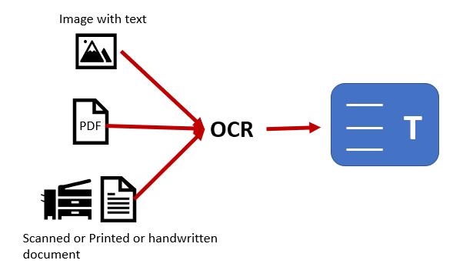
ARCHITECTURE

Slide 6
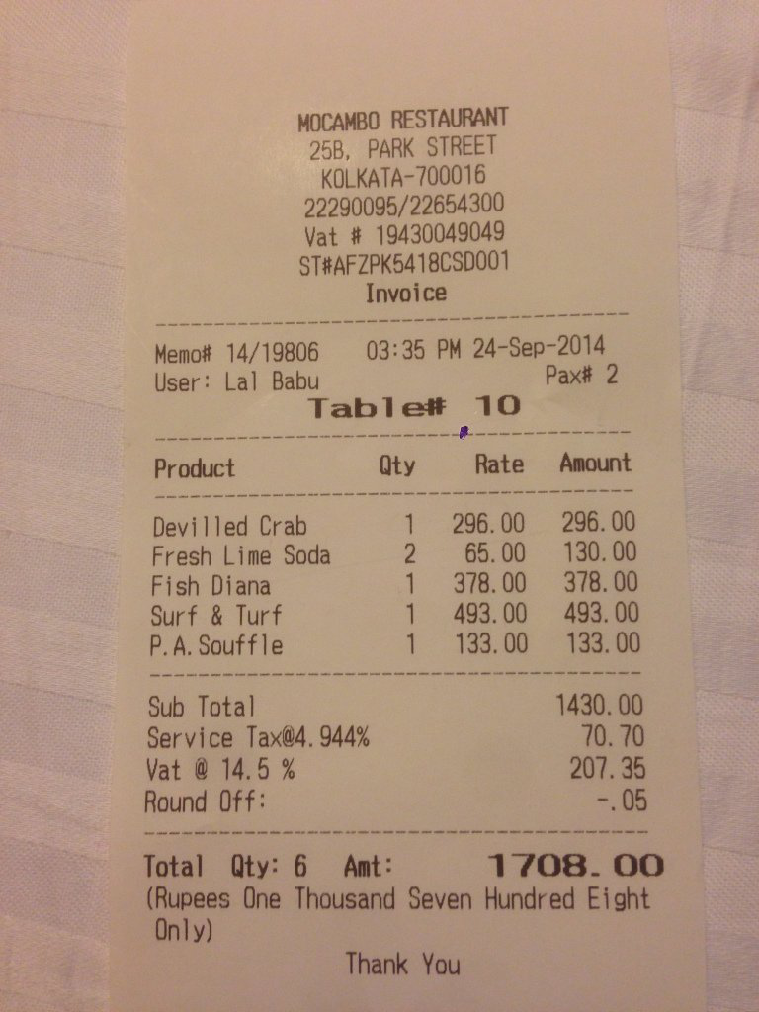
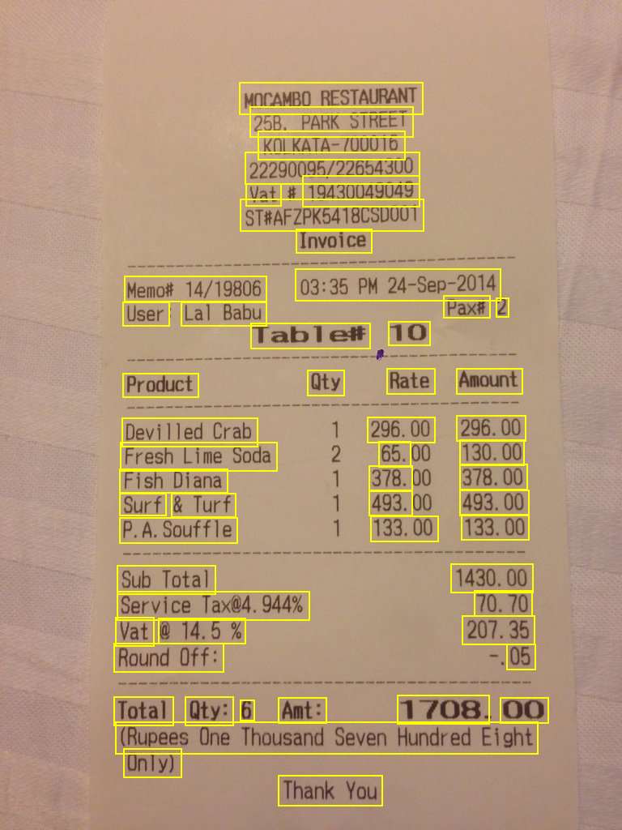
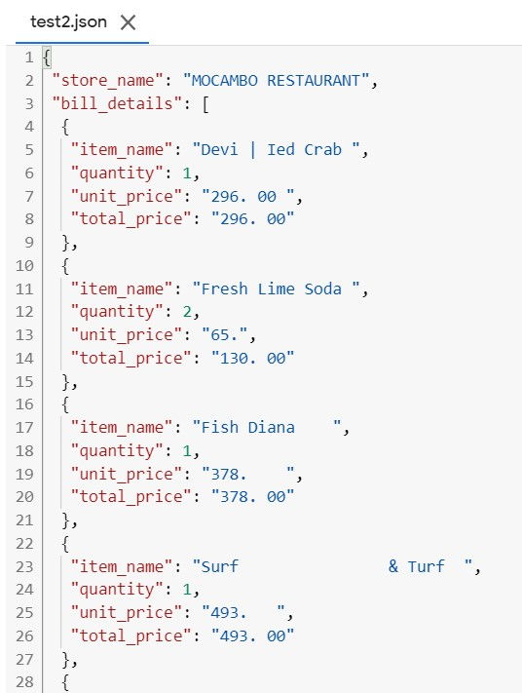
EXPERIMENTAL RESULTS

Slide 7
CONCLUSION
OCR technology provides fast, automated data capture which can save considerable time.
We have provided the text recognition in formatted bills using some methods and libraries.
The experiment proves that the high in accuracy and efficiency compared to other methods.
There is also possibility in finding solutions for extracting text from unformatted written text and updating automatically into the output and in the form of JSON format.

