Slide 1
S
19CSE314 – Software Engineering
Team Number: 23
Reg.No | Name of the Student
BL.EN.U4CSE22233 | Likhit Yammanuru
BL.EN.U4CSE22249 | R.Harsha

Slide 2
Abstract
This work aims to create an alumni portal named Alumination, with distinct student and alumni interfaces, employing full-stack web development concepts to facilitate interactive discovery of alumni. The system has a Tinder-like swipe interface with ease-of-use navigation buttons, enabling students to browse alumni profiles according to hobbies, profession, and academic background. Through the use of scalable architecture with React.js, Node.js, and minimal usage of PostgreSQL, the portal is made modular, high-performance, and clean data-handling. Authenticated access provides secure interactions, and features such as search, messaging, inboxes, and announcements provide two-way communication and active alumni participation.

Slide 3
INTRODUCTION
INTRODUCTION
Academic campuses usually do not have efficient platforms for impactful student-alumni interaction, particularly in areas such as mentorship, career research, and networking. Conventional systems are generally old, inflexible, and have minimal interactivity, limiting students' exposure to valuable alumni advice. This emphasizes the necessity for an up-to-date, easy-to-use, and feature-packed networking system. To bridge this gap, Alumination is proposed—a full-stack web application engineered for personalized, interactive alumni-student interaction. Students can browse alumni profiles through a Tinder-style swipe interface, look up important information such as names, registration numbers, and employment status, and send direct messages. Alumni, through a separate portal, can search students by name, look up academic profiles, and administer assignments via an inbox-style user interface. Students can also send broadcasts, which are received by alumni through a formalised feed to foster community participation.

Slide 4
LITERATURE SURVEY
S.No | Title of the Paper | Author | Inference | Research Gaps
1. | Tracking student progress through graduate programs | Young et al | Graduate education is milestone-centered and decentralized, and therefore needs customized tracking instruments. A milestones dashboard increases transparency, visualizes, and compares programs. The article focuses on difficulties in consistency and trust in data and underscores the importance of dashboards in enhancing decision-making and results. | Does not have quantitative data, comparisons of the model with other student support models, long-term impact evaluations, and understanding of technology-based interventions or policy reforms.

Slide 5
LITERATURE SURVEY
S.No | Title of the Paper | Author | Inference | Research Gaps
2 | Development and integration of a clinical dashboard within a dental school setting | Afshari et al | : The research created a computer-based student dashboard for patient management within dental education based on electronic health records. Post- implementation outcomes included decreased overdue patients and better compliance. The dashboard increases student involvement and patient care, with applications extending to dental education. | Does not have quantitative longitudinal data, representative demographic sample, detailed critical thinking skill examination, multi- institutional comparison, student and faculty views, incorporation with other key skills, and direct effect on patient outcomes.

Slide 6
LITERATURE SURVEY
S.No | Title of the Paper | Author | Inference | Research Gaps
3. | Exploring Strategies for Promoting Overseas Alumni Giving Activities in colleges and Universities Based on Coupled Models | Wang | The paper explores strategies to boost overseas alumni donations using a coupled model, finding that tax incentives, networking resources, and reputational gains influence donations, with tax benefits being the most effective. | However, it lacks real-world validation, ignores psychological and cultural donation drivers, and assumes static alumni behaviors without considering regional differences or digital fundraising trends. Future research should incorporate empirical data, dynamic modeling, and modern fundraising methods for a more comprehensive understanding.

Slide 7
LITERATURE SURVEY
S.No | Title of the Paper | Author | Inference | Research Gaps
4. | Visualization as a Tool to Understand the Experience of College Students with Autism | McCulloch et.al | The study explores visualization techniques to understand challenges faced by college students with autism, emphasizing their role in improving support systems and accessibility. | However, it lacks student input, long-term impact analysis, scalability insights, and real- world implementation details, limiting its generalizability and practical application.

Slide 8
OVERALL RESEARCH GAPS
There is no centralized, interactive platform for students to engage with alumni for career advice, mentorship, and professional networking. Existing systems are static, outdated, and not scalable. There is no centralized, interactive platform for students to engage with alumni for career advice, mentorship, and professional networking. Existing systems are static, outdated, and not scalable.

Slide 9
SOLVING THESE RESEARCH GAPS
Our Alumni-User Interaction System fills in the gaps that have been identified in the existing body of research by providing a centralized, interactive environment through which students and alumni can meaningfully interact for career guidance, mentorship, and professional connections. In contrast to static, outmoded, and unscalable systems that currently exist, our system is dynamic, flexible, and deployed within real-world settings. By collecting information over time and collating feedback from alumni and students through different backgrounds, we can examine what actually aids learning, career advancement, and engagement. The system adapts with improvements in technology and local requirements, so it is feasible to undertake long-term research, academic enhancement, and greater alumni assistance.

Slide 10
NOVELTY Till now there is no such interface/portals made in other colleges to connect Alumni’s with the current students and teachers. This in turn is a quite new idea that can boost the growth of both the current students, the college and the Alumni’s in their respective lives as mentioned above. It can bridge a gap between the Alumni’s and current students thereby helping the current students to express their issues pertaining to academics, placements and other student issues freely to the Alumni’s for help.

Slide 11
METHODOLOGY
Agile:
We have chosen the Agile methodology (Kanban) for the development of this project.
Justification:
1. Visual Workflow Management: Helps in tracking progress through different task stages.
2. Continuous Delivery: Supports iterative development with real-time updates.
3. Flexible & Adaptable: Easy to incorporate feedback and evolving requirements.
4. Less Restrictive: No fixed sprints, making it suitable for ongoing project improvements.

Slide 12
User Story:
METHODOLOGY
The alumni networking site allows students, faculty, and alumni to connect, collaborate, and expand their professional networks. Users register with their college email or LinkedIn, build comprehensive profiles, and establish event and mentorship preferences. Students and faculty can find and connect with alumni through a swipe-based matching system based on common backgrounds, career aspirations, or geographic locations. Alumni create availability for networking and mentoring, while administrators mediate connections and control privacy settings. Users are allowed to exchange direct messages, send out connection requests, and view recommendations for events based on their interest in their professional fields. Students and club owners can also browse through alumni in their respective clubs and invite them for a speech or mentoring. College administrators can monitor alumni information for placement, networking, and institutional partnerships, providing a complete and efficient career development platform for all stakeholders.

Slide 13
METHODOLOGY
System Requirements:
Functional:
1. User Authentication & Registration
a. Users and alumni can register using email and password.
b. Passwords must be encrypted.
c. Role-based access control (Users vs. Alumni).
2. Profile Management
a. Users can edit their profile details (name, college info, interests).
b. Alumni can update job title, hobbies, and professional details.
3. Alumni Discovery (Tinder-Style Swiping & Search)
a. Users can swipe left/right to explore alumni profiles.
b. Swiping right allows users to view detailed profiles and send messages.
c. Search functionality enables users to find alumni by name.

Slide 14
4. Messaging & Inbox System a. Users can send and receive real-time messages. b. Messages are stored securely and accessible in an inbox. c. Alumni can reply only to matched users. 5. Event Announcements & Help Page a. Users can create event announcements that appear on alumni dashboards. b. Alumni can access a help page with special contacts for assistance. 6. Security Features a. Unauthorized access to profiles is restricted. b. Data encryption ensures security.
METHODOLOGY
METHODOLOGY

Slide 15
METHODOLOGY
Non Functional Requirements:
(Describe how the system should perform)
Performance
The portal should load within 2 seconds on average.
Scalability
The system should handle high traffic efficiently during peak usage.
Usability & User Experience
Swiping and search features should be intuitive and responsive.
Availability & Reliability
The system should be available 24/7 with minimal downtime.
Security & Compliance
Data encryption and secure authentication must be implemented.
Maintainability & Extensibility
The system should allow easy updates and future feature additions.

Slide 16
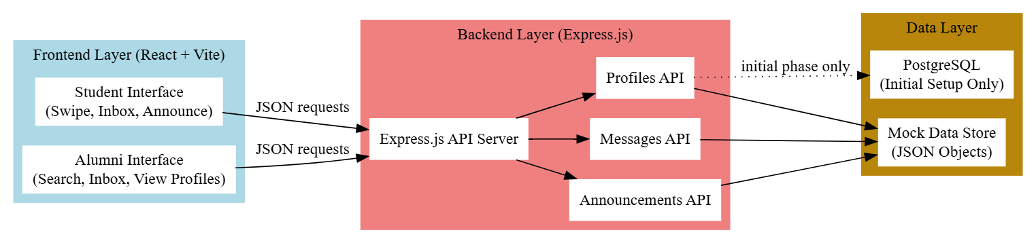
METHODOLOGY
System Architecture:

Slide 17
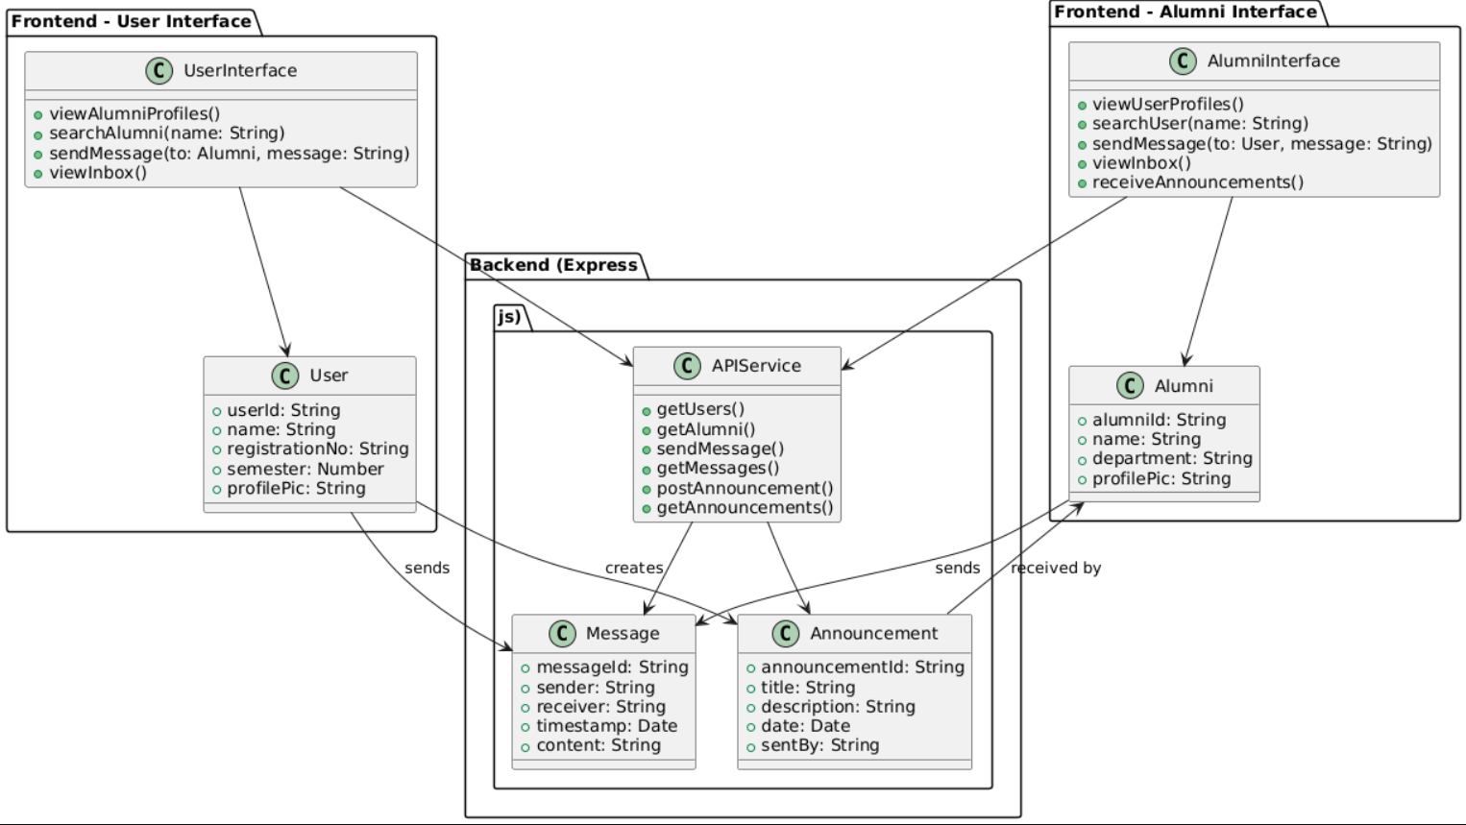
METHODOLOGY
UML Diagram:

Slide 18
METHODOLOGY
Test Plan:
Workflow Division: a) Division of tasks: 1) Kanban Master 2) Team member 3) Stakeholders 4) Product owner b) Modules:
1) Collection of Requirements, Creation and initial usage of PostgreSQL User Story, Identifying Stakeholders etc and Collection and Analysis of Literature Survey
2) Backend development (Node.js, API testing)
3) Frontend development of both user and alumni interface (React.js + Vite)
4) Integration and testing and Deployment and final review

Slide 19
METHODOLOGY
Test Plan:
Justification: There will be a constant switch of roles of Kanban Master and Team member between Likhit and Harsha. But for the first 2-3 weeks of creation of database, Likhit is going to be the Kanban Master while Harsha will be the Team member. In general, Likhit is competent in Database and Backend creation while Harsha is good in Frontend and Kanban Board creation. Hence via this we are going to segregate the roles amongst ourselves.
Product Owners: 1) Pooja Madam 2) Rashmi Madam Stakeholders: 1) Students of the college, 2) Faculty members of the college, 3) Club owners, 4) Alumni’s of the college, 5) Higher authorities (4 of the authorities have special access to view the contact number of Alumni’s which others don’t have access to).

Slide 20
RESULT
Bug Report:
Common Types of Bugs in our Project:
UI Bugs: Profile images not appearing, images too large.
Data Bugs: Messages failing to display due to missing or malformed data.
Routing Bugs: Navigating a profile doesn't work properly
State Bugs: Messages failing to be stored across page reloads (since there's no backend DB)
UX Bugs: "Loading." text gets stuck even when data silently fails.
6. User-interface gets affected when we work on Alumni-interface

Slide 21
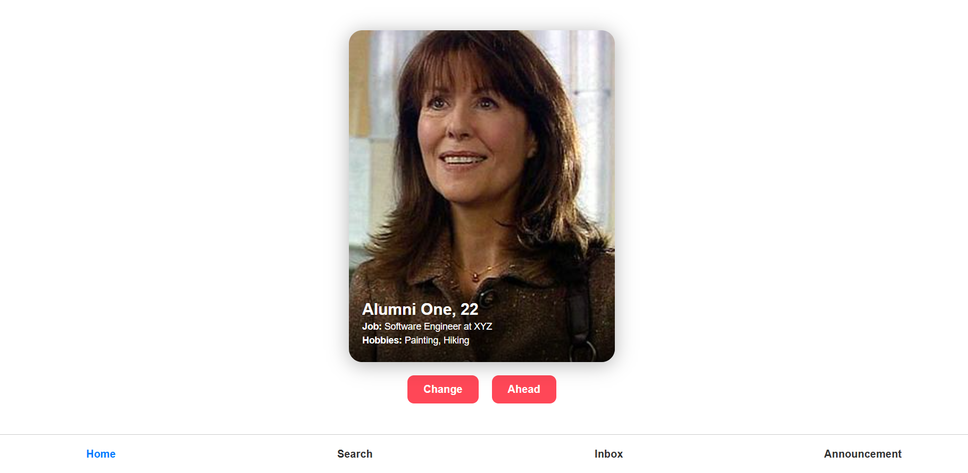
RESULT
SAMPLE DEMO:
User-interface:
Demo-1:

Slide 22
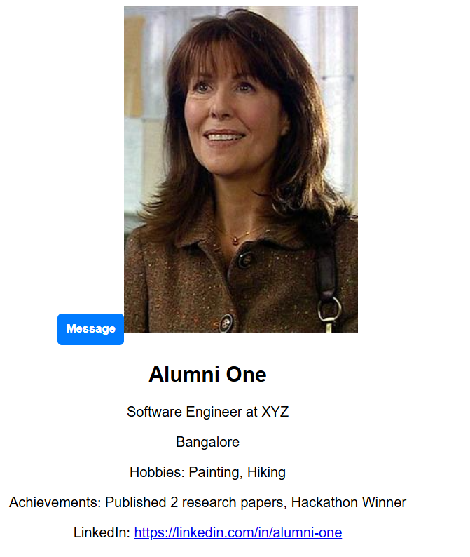
RESULTS
Demo-2:

Slide 23
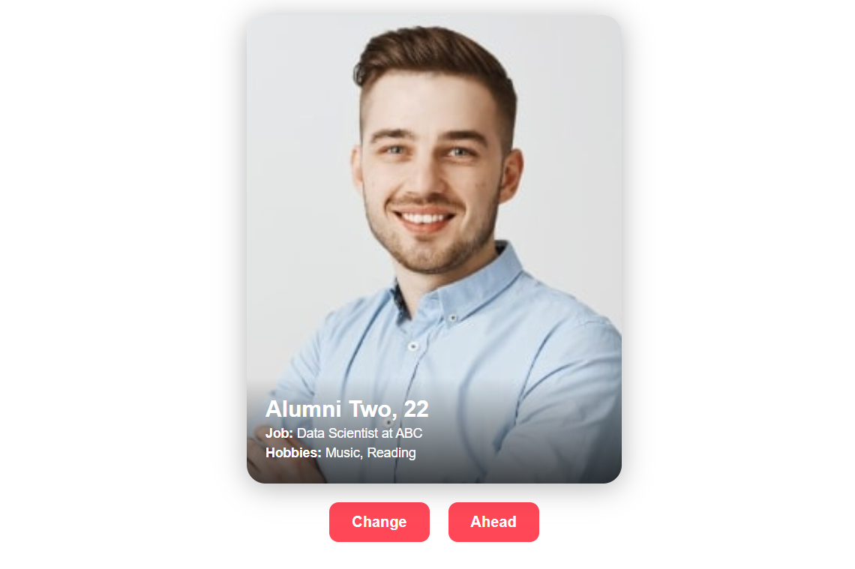
RESULTS
Demo-3:
Else:

Slide 24
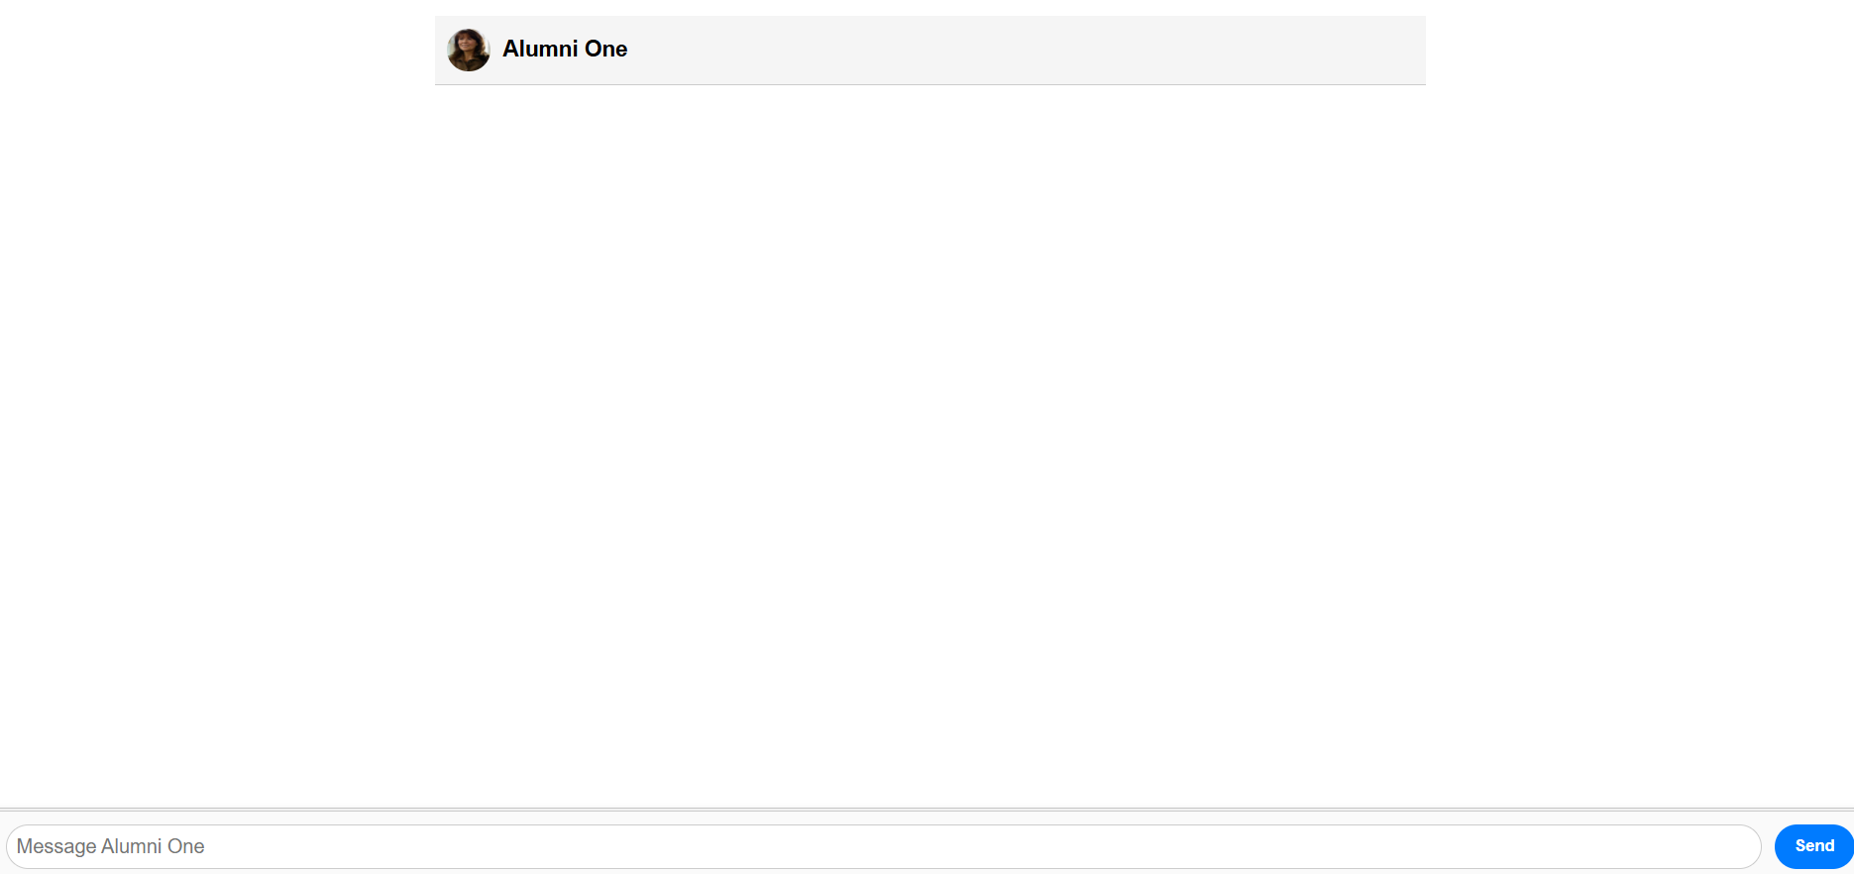
RESULTS
Demo 4:

Slide 25
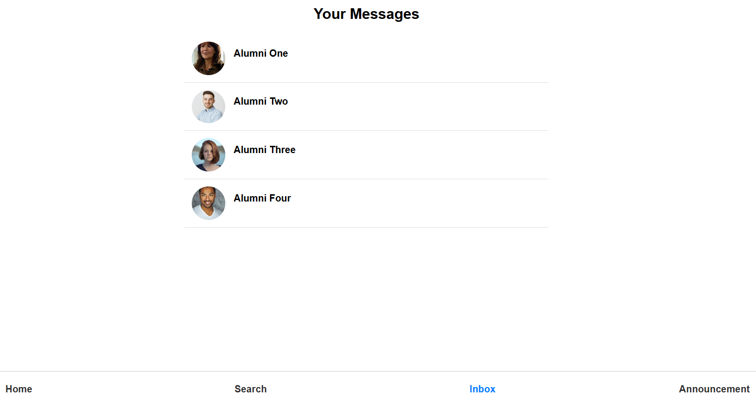
RESULTS
Demo 5:

Slide 26
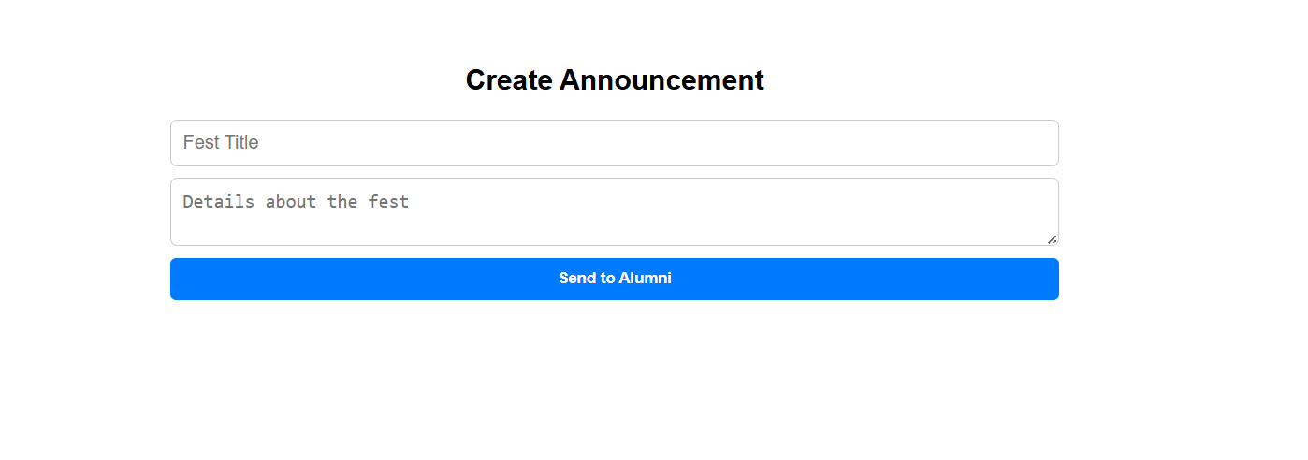
RESULTS
Demo 6:

Slide 27
RESULTS
Sprint Planning:
Sprint 1: Collection of Requirements, Creation and initial usage of PostgreSQL User Story, Identifying Stakeholders etc and Collection and Analysis of Literature Survey
Sprint 2: Backend development (Node.js, API testing)
Sprint 3: Frontend development of both user and alumni interface (React.js + Vite)
Sprint 4: Integration and testing and Deployment and final review
Definition of Done:
User Story, Initial usage of PostgreSQL and Functional and Non Functional Requirements
Backend development
Frontend development

Slide 28
CONCLUSION & FUTURE SCOPE
Alumination is a dynamic platform that allows students to have meaningful interactions with alumni in terms of mentorship, networking, and career advice. The student interface is React.js-powered with a PostgreSQL database as the backend, providing a structured data handling and responsiveness. Coupled with the shared Node.js backend, the platform provides a seamless, swipe-based discovery, clean profile display, and two-way messaging, which renders engagement easy and convenient. By making alumni-student relations simpler, Alumination enhances institutional ties and school spirit. Future plans will add real-time messaging, push notifications, OTP-based login, and deeper integration with institutional systems—improving security, scalability, and long-term user adoption.

Slide 29
THANK YOU

