Slide 1
S
19CSE314 – Software Engineering
Team Number: 23
Reg.No | Name of the Student
BL.EN.U4CSE22233 | Likhit Yammanuru
BL.EN.U4CSE22249 | R.Harsha

Slide 2
INTRODUCTION
INTRODUCTION
In the contemporary learning environ, students lack opportunities to interact directly with former graduates to get guidance and networking opportunities. There are various outdated, unengaging and clunky alumni connect platforms available. The resultant gap closes off access by students to real-world wisdom and advice in making career choices from previous students. The initiative of “Alumination” is to fill this void with a state-of-the-art , engaging alumni portal. Through an easy-to-use intuitive Tinder-style swipe interface, students can easily explore profiles. Connecting their fields of interest, the studying activity, and spheres of professional practice users can identify suitable alumni. Using its React.js, Node.js, and PostgreSQL, the system ensures seamless performance, scalability, as well as, active user interactions. What is aimed at is the development of sustainable academic and professional relations between students and alumni.

Slide 3
LITERATURE SURVEY
S.No | Title of the Paper | Author | Inference | Research Gaps
1. | Tracking student progress through graduate programs | Young et al | Graduate education is milestone-centered and decentralized, and therefore needs customized tracking instruments. A milestones dashboard increases transparency, visualizes, and compares programs. The article focuses on difficulties in consistency and trust in data and underscores the importance of dashboards in enhancing decision-making and results. | Does not have quantitative data, comparisons of the model with other student support models, long-term impact evaluations, and understanding of technology-based interventions or policy reforms.

Slide 4
LITERATURE SURVEY
S.No | Title of the Paper | Author | Inference | Research Gaps
2 | Development and integration of a clinical dashboard within a dental school setting | Afshari et al | : The research created a computer-based student dashboard for patient management within dental education based on electronic health records. Post- implementation outcomes included decreased overdue patients and better compliance. The dashboard increases student involvement and patient care, with applications extending to dental education. | Does not have quantitative longitudinal data, representative demographic sample, detailed critical thinking skill examination, multi- institutional comparison, student and faculty views, incorporation with other key skills, and direct effect on patient outcomes.

Slide 5
LITERATURE SURVEY
S.No | Title of the Paper | Author | Inference | Research Gaps
3. | Exploring Strategies for Promoting Overseas Alumni Giving Activities in colleges and Universities Based on Coupled Models | Wang | The paper explores strategies to boost overseas alumni donations using a coupled model, finding that tax incentives, networking resources, and reputational gains influence donations, with tax benefits being the most effective. | However, it lacks real-world validation, ignores psychological and cultural donation drivers, and assumes static alumni behaviors without considering regional differences or digital fundraising trends. Future research should incorporate empirical data, dynamic modeling, and modern fundraising methods for a more comprehensive understanding.

Slide 6
LITERATURE SURVEY
S.No | Title of the Paper | Author | Inference | Research Gaps
4. | Visualization as a Tool to Understand the Experience of College Students with Autism | McCulloch et.al | The study explores visualization techniques to understand challenges faced by college students with autism, emphasizing their role in improving support systems and accessibility. | However, it lacks student input, long-term impact analysis, scalability insights, and real- world implementation details, limiting its generalizability and practical application.

Slide 7
PROBLEM STATEMENT
There is no centralized, interactive platform for students to engage with alumni for career advice, mentorship, and professional networking. Existing systems are static, outdated, and not scalable.There is no centralized, interactive platform for students to engage with alumni for career advice, mentorship, and professional networking. Existing systems are static, outdated, and not scalable.

Slide 8
METHODOLOGY
Agile:
We have chosen the Agile methodology (Kanban) for the development of this project.
Justification:
1. Visual Workflow Management: Helps in tracking progress through different task stages.
2. Continuous Delivery: Supports iterative development with real-time updates.
3. Flexible & Adaptable: Easy to incorporate feedback and evolving requirements.
4. Less Restrictive: No fixed sprints, making it suitable for ongoing project improvements.

Slide 9
User Story:
METHODOLOGY
The alumni networking site allows students, faculty, and alumni to connect, collaborate, and expand their professional networks. Users register with their college email or LinkedIn, build comprehensive profiles, and establish event and mentorship preferences. Students and faculty can find and connect with alumni through a swipe-based matching system based on common backgrounds, career aspirations, or geographic locations. Alumni create availability for networking and mentoring, while administrators mediate connections and control privacy settings. Users are allowed to exchange direct messages, send out connection requests, and view recommendations for events based on their interest in their professional fields. Students and club owners can also browse through alumni in their respective clubs and invite them for a speech or mentoring. College administrators can monitor alumni information for placement, networking, and institutional partnerships, providing a complete and efficient career development platform for all stakeholders.

Slide 10
METHODOLOGY
System Requirements:
Functional:
1. User Authentication & Registration
a. Users and alumni can register using email and password.
b. Passwords must be encrypted.
c. Role-based access control (Users vs. Alumni).
2. Profile Management
a. Users can edit their profile details (name, college info, interests).
b. Alumni can update job title, hobbies, and professional details.
3. Alumni Discovery (Tinder-Style Swiping & Search)
a. Users can swipe left/right to explore alumni profiles.
b. Swiping right allows users to view detailed profiles and send messages.
c. Search functionality enables users to find alumni by name.

Slide 11
4. Messaging & Inbox System a. Users can send and receive real-time messages. b. Messages are stored securely and accessible in an inbox. c. Alumni can reply only to matched users. 5. Event Announcements & Help Page a. Users can create event announcements that appear on alumni dashboards. b. Alumni can access a help page with special contacts for assistance. 6. Security Features a. Unauthorized access to profiles is restricted. b. Data encryption ensures security.
METHODOLOGY
METHODOLOGY

Slide 12
METHODOLOGY
Non Functional Requirements:
(Describe how the system should perform)
Performance
The portal should load within 2 seconds on average.
Scalability
The system should handle high traffic efficiently during peak usage.
Usability & User Experience
Swiping and search features should be intuitive and responsive.
Availability & Reliability
The system should be available 24/7 with minimal downtime.
Security & Compliance
Data encryption and secure authentication must be implemented.
Maintainability & Extensibility
The system should allow easy updates and future feature additions.

Slide 13
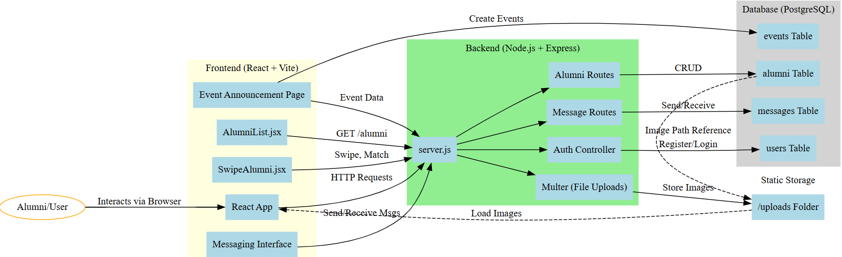
METHODOLOGY
System Architecture:

Slide 14
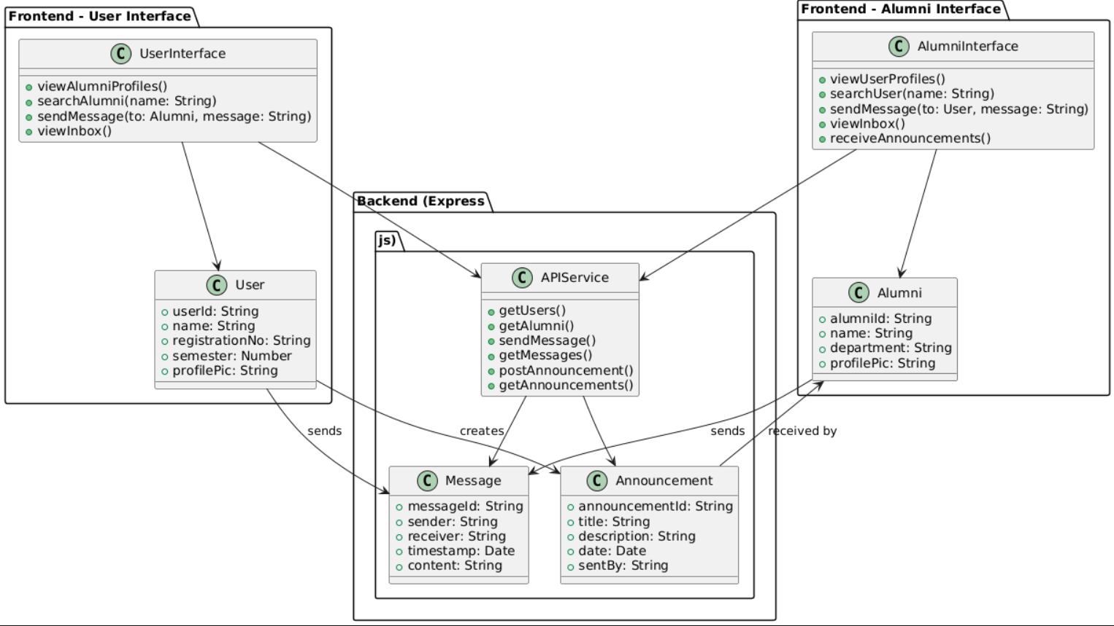
METHODOLOGY
UML Diagram:

Slide 15
METHODOLOGY
Test Plan:
Workflow Division: a) Division of tasks: 1) Kanban Master 2) Team member 3) Stakeholders 4) Product owner b) Modules: 1) Creation of Database (in 1st 2-3 weeks) 2) Backend creation (in third and fourth week) 3) Frontend creation (in fifth week) 4) Creation of Kanban Board (in fifth-sixth week)

Slide 16
METHODOLOGY
Test Plan:
Justification: There will be a constant switch of roles of Kanban Master and Team member between Likhit and Harsha. But for the first 2-3 weeks of creation of database, Likhit is going to be the Kanban Master while Harsha will be the Team member. In general, Likhit is competent in Database and Backend creation while Harsha is good in Frontend and Kanban Board creation. Hence via this we are going to segregate the roles amongst ourselves.
Product Owners: 1) Pooja Madam 2) Rashmi Madam Stakeholders: 1) Students of the college, 2) Faculty members of the college, 3) Club owners, 4) Alumni’s of the college, 5) Higher authorities (4 of the authorities have special access to view the contact number of Alumni’s which others don’t have access to).

Slide 17
RESULT
Bug Report:
Common Bug Types in Your Project:
UI Bugs: Profile pics not showing, too big images
Data Bugs: Messages failing to display due to absent or malformed data
Routing Bugs: Navigating a profile doesn't work properly
State Bugs: Messages failing to be stored across page reloads (since there's no backend DB)
UX Bugs: "Loading." text is stuck even when data silently fails.
Such bug reports are critical to Agile development in order to follow regressions and problems throughout sprints. Let me know if you'd like a formal bug report document or template.

Slide 18
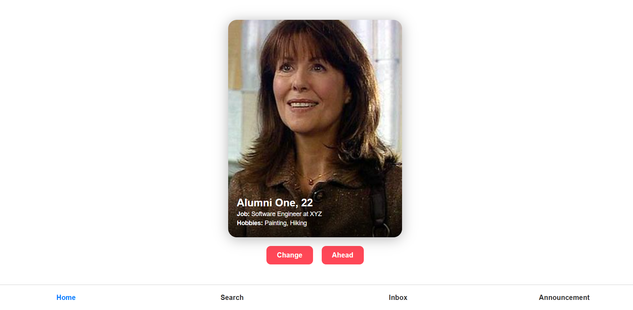
RESULT
SAMPLE DEMO:
User-interface:
Demo-1:

Slide 19
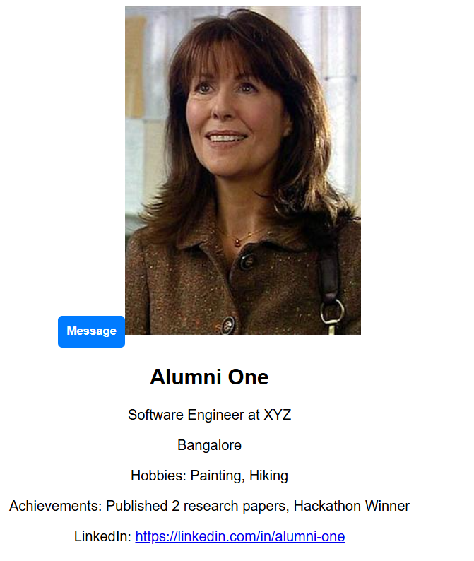
RESULTS
Demo-2:

Slide 20
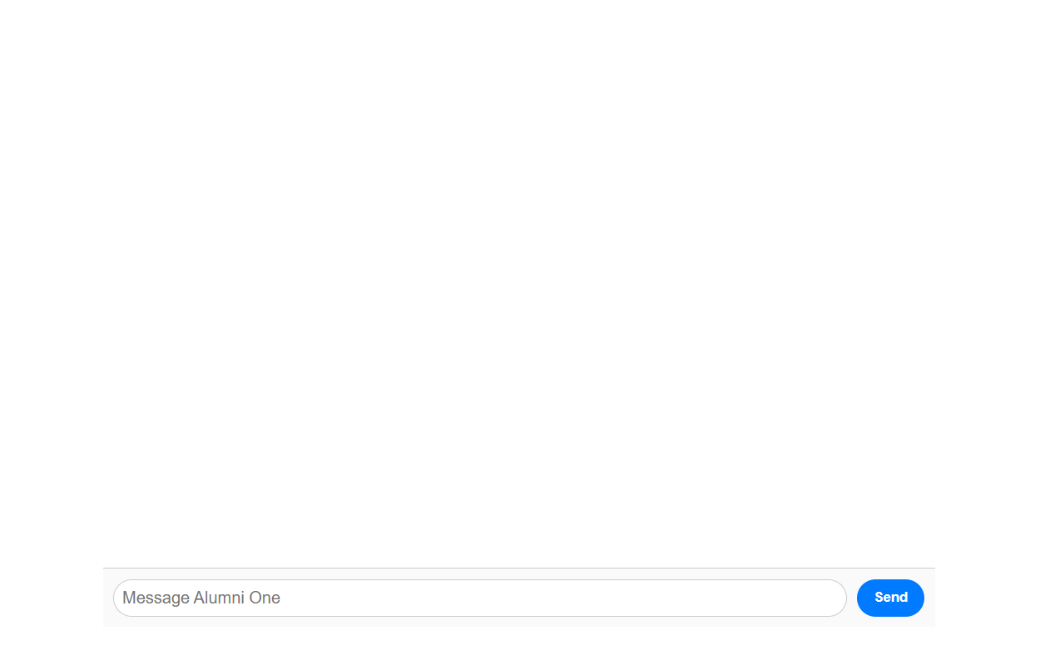
RESULTS
Demo 3:

Slide 21
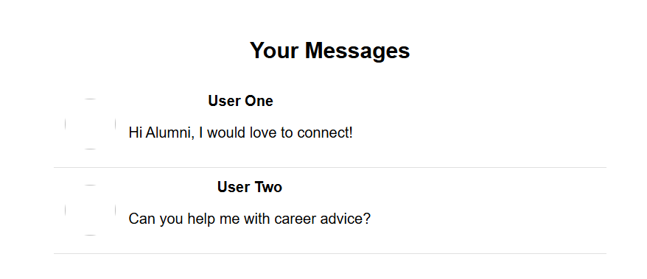
RESULTS
Demo 4:

Slide 22
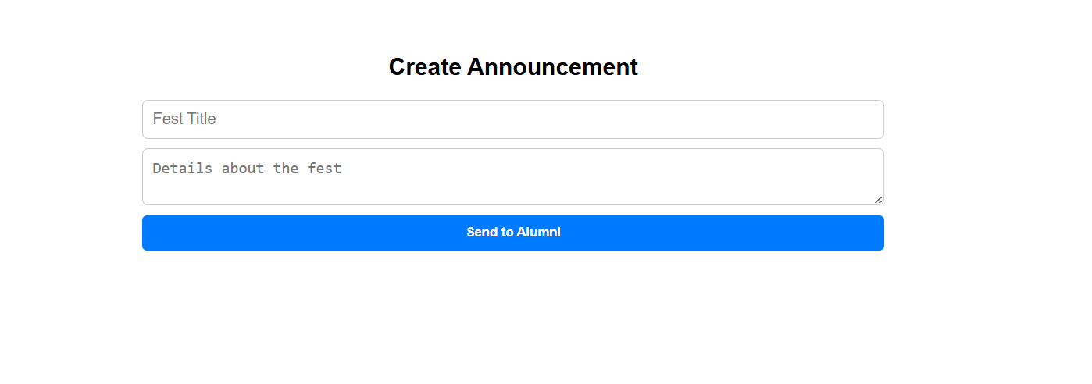
RESULTS
Demo 5:

Slide 23
RESULTS
Demo 6:

Slide 24
RESULTS
Demo 7:

Slide 25
RESULTS
Sprint Planning:
Sprint 1: Collection of Requirements, User Story, Identifying Stakeholders etc and Collection and Analysis of Literature Survey
Sprint 2: Backend development (Node.js, API testing)
Sprint 3: Frontend development (React.js)
Sprint 4: Integration and testing and Deployment and final review
Definition of Done:
User Story and Functional and Non Functional Requirements
Backend development
Frontend development

Slide 26
CONCLUSION & FUTURE SCOPE
Alumination gives students a dynamic platform to engage with the alumni; engage in mentorship; network; and seek job opportunities on alumni circles. A trustworthy scalable easy platform powered by React.js, Node.js and PostgreSQL serves both students and alumni. The swiped-based system is structured to make simple connections between the students and alumni enabling to tighten bonds that may reach outside other college networks. When scaled appropriately and drawing in features, the platform is set for continuous growth. An upgrade oven is expected to include real-time communication, instantaneous notification of events, the use of OTP authentication, and the ability to maintain consistent interaction with institutional systems. With the use of these features, the platform will help increase the interaction of the users and strengthen Alumination’s standing as a strong network of students at schools.

Slide 27
THANK YOU

