Slide 1

SQLIFY : A COMPLETE SQL AGENT
Under the Guidance of
Dr. Disha Sushant Wankhede
Assistant Professor
Department of Computer Engineering
VIT Pune
Presented By :
Sahil Ashok Khaire : 1252070013
Likhit Abhay Chirmade : 1252070023
Rohan Rajendra Langar : 1252070025
Pranil Pramod Jatkar : 1252070026
Vishwakarma Institute of Technology, Pune-48
(An Autonomous Institute affiliated to Savitribai Phule Pune University)
(NBA and NAAC accredited, ISO 9001:2015 certified)

Slide 2
Problem statement and solution
Problem Statement :
Beginners struggle to write correct SQL queries
No single platform for query writing, execution, and data generation
Manual database practice is time-consuming
Lack of real-time feedback and explanation
Solution :
One platform for learning, practicing, and executing SQL
Auto SQL query generation
Integrated SQL editor
Database connectivity
Sample data generation
Department of Computer Engineering, VIT, Pune-48

Slide 3
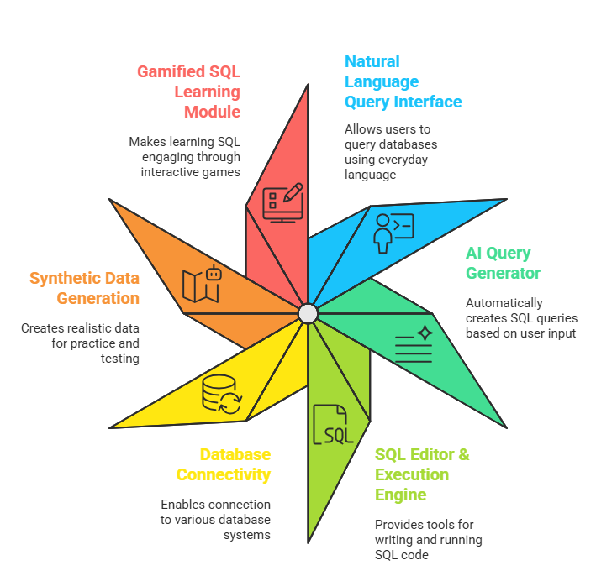
System Overview
Modules in SQLFIY
Natural Language Query Interface
AI Query Generator
SQL Editor & Execution Engine
Database Connectivity
Synthetic data generation
Gamified SQL Learning Module
Department of Computer Engineering, VIT, Pune-48

Slide 4




Tech Stack
Frontend: React
Styling: Tailwind CSS
Database : Supabase
Backend : flask
Department of Computer Engineering, VIT, Pune-48

Slide 5
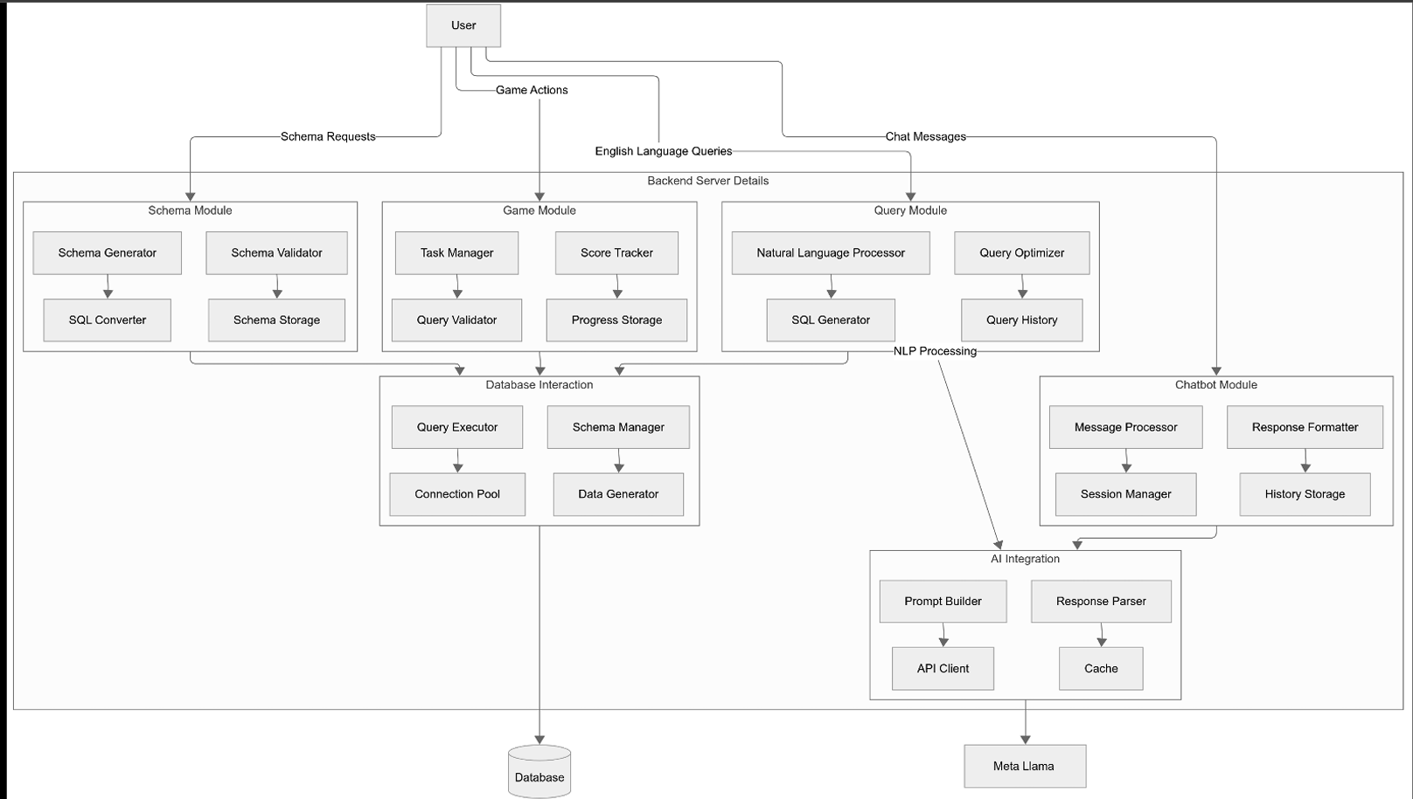
System Architecture
Department of Computer Engineering, VIT, Pune-48

Slide 6
Advantages And Application
Saves learning time
Reduces syntax errors
Improves SQL understanding
Hands-on practical learning
Useful for students and trainers
SQL Learning Platform
College Labs
Interview Preparation
Training Institutes
Self-Practice Tool
Department of Computer Engineering, VIT, Pune-48

Slide 7
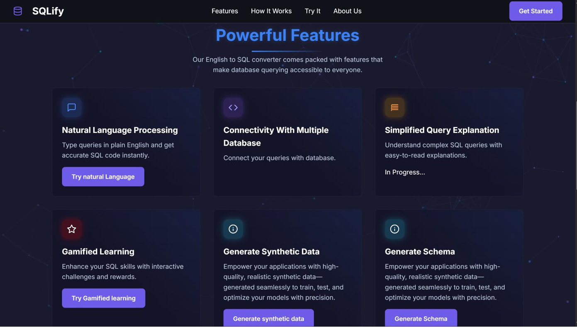
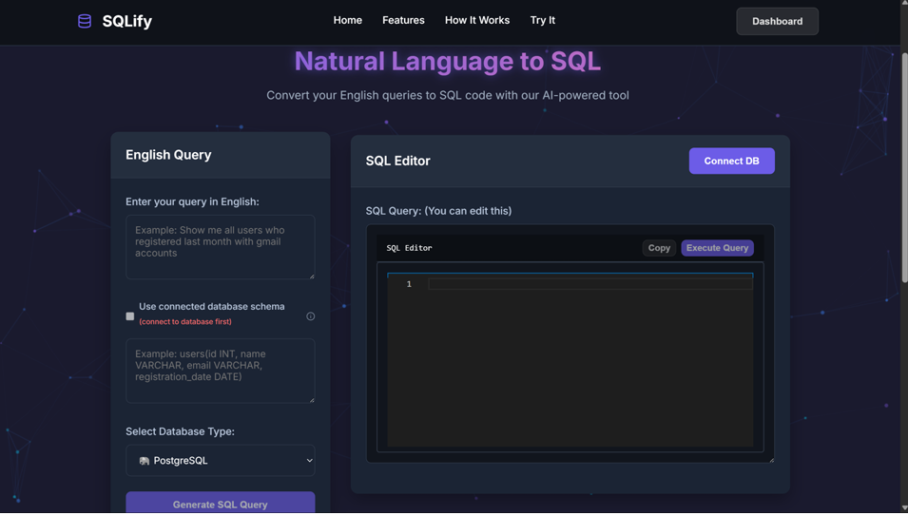
Conclusion and Future Scope
Support for more databases
Advanced query optimization
AI-based query explanation
User progress tracking and analytics
Enterprise-level integrations
Conclusion: SQLify simplifies database interaction using AI-powered natural language processing. It bridges the gap between theory and practical SQL usage by providing an intelligent, scalable, and user-friendly platform for learners and professionals.
Department of Computer Engineering, VIT, Pune-48

