Slide 1

Decentralized Peer-to-Peer File sharing system
Under the Guidance of
Prof. Vidya Gaikwad
Assistant Professor
Department of Computer Engineering
VIT Pune
Presented By :
Sahil Ashok Khaire : 1252070013
Likhit Abhay Chirmade : 1252070023
Rohan Rajendra Langar : 1252070025
Pranil Pramod Jatkar : 1252070026
Vishwakarma Institute of Technology, Pune-48
(An Autonomous Institute affiliated to Savitribai Phule Pune University)
(NBA and NAAC accredited, ISO 9001:2015 certified)

Slide 2
Problem statement and solution
Problem Statement
Traditional file sharing methods present several critical limitations:
Cloud Dependency: Reliance on external services causes privacy concerns and requires internet connectivity.
Security Risks: Sensitive data is exposed to third-party servers.
Performance Issues: Physical media like USBs are impractical for multi-user scenarios, while cloud services suffer from bandwidth limits and file size restrictions.
Technical Barriers: Existing local network solutions (SMB, FTP) require complex setup and lack intuitive interfaces.
Proposed Solution
The system is a production-ready P2P File Sharing System designed for secure, direct transfers within local networks:
Hybrid Architecture: Combines a high-performance C++ backend for data handling with an Electron desktop wrapper and a Web Dashboard for ease of use.
Custom P2P Protocol: Implements a custom TCP-based protocol for direct peer connections without intermediary servers or internet.
Efficient Transfer: Uses parallel chunk-based transfers (1MB default) to maximize local network bandwidth.
Security & Integrity: Ensures data reliability using SHA-256 checksums for integrity verification and keeps all traffic isolated to the local network.
Automation: Features automatic peer discovery and the ability to resume interrupted transfers.
Department of Computer Engineering, VIT, Pune-48

Slide 3
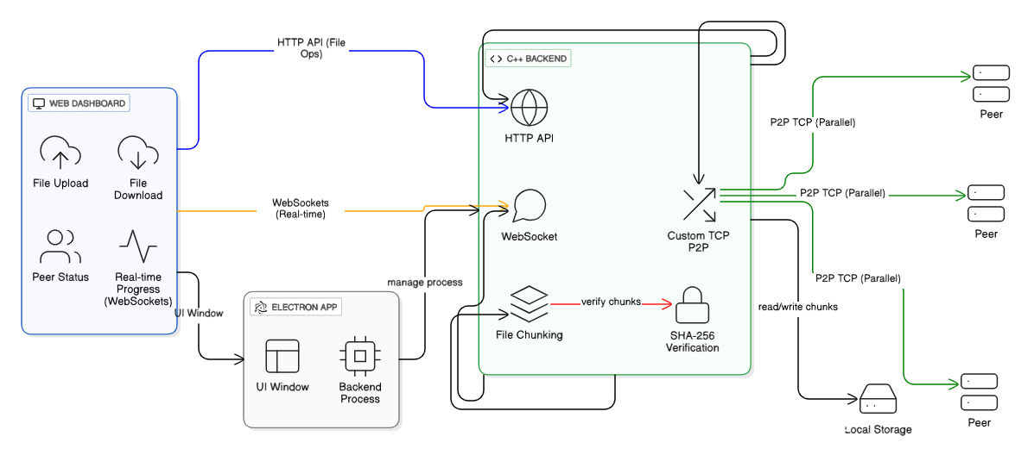
System Overview
System Architecture :
Department of Computer Engineering, VIT, Pune-48

Slide 4
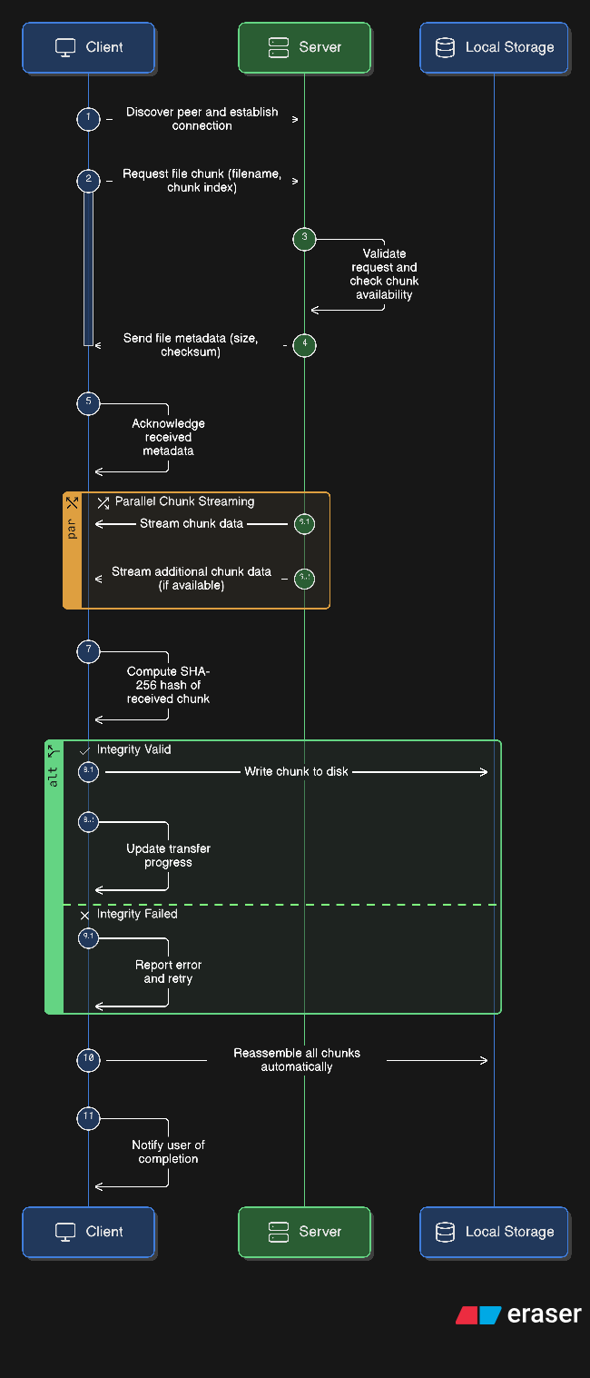
Features :
Offline Local Sharing: Direct transfers via local network without internet or cloud dependency.
High Performance: Parallel chunk-based transfers that maximize local bandwidth.
SHA-256 Integrity: Automatic verification of every file chunk to ensure zero data corruption.
Smart Discovery: Automatic peer detection and network-aware load balancing.
Transfer Resilience: Supports resuming interrupted transfers with automatic error recovery.
Security: Isolation within the local network with comprehensive input validation.
Department of Computer Engineering, VIT, Pune-48

Slide 5
Metrics and Feasibility
Feasibility :
Feasibility Category | Assessment | Supporting Evidence from Report
Technical | High | Uses a high-performance C++ backend for parallel chunking and SHA-256 verification. Integrated with Electron and modern web technologies.
Operational | Excellent | Automatic peer discovery and a user-friendly web dashboard remove technical barriers for non-expert users.
Economic | High | Zero dependency on internet or third-party cloud subscriptions. Infrastructure relies solely on existing local network hardware.
Security | Robust | Data remains strictly within the local network, preventing external exposure. SHA-256 ensures zero data corruption.
Scalability | High | Successfully tested with files up to 10GB and 20+ concurrent users with minimal CPU/Memory impact.
Reliability | Proven | Achieved a 99.8% transfer success rate and 98% success rate in resuming interrupted transfers.
Metrics
File Size | P2P System | Cloud Storage | USB 3.0
100 MB | 2.1s | 45s | 10s
1 GB | 21s | 450s | 100s
5 GB | 105s | 2250s | 500s
10 GB | 210s | 4500s | 1000s
Department of Computer Engineering, VIT, Pune-48

Slide 6
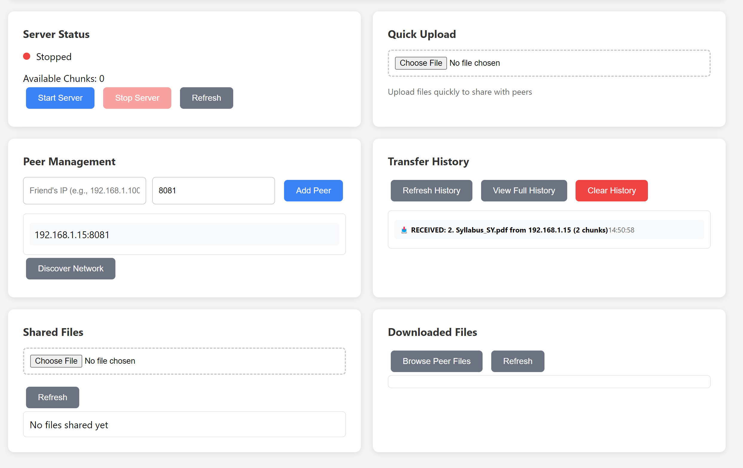
Conclusion
The P2P File Sharing System provides a high-performance, secure alternative to cloud-based services by keeping data strictly within local networks. By combining a robust C++ backend with an Electron desktop wrapper, the system achieves transfer speeds limited only by local bandwidth, outperforming traditional cloud storage by up to 21x for large files.
Department of Computer Engineering, VIT, Pune-48

Slide 7
Thank you
Department of Computer Engineering, VIT, Pune-48

